Slide 1
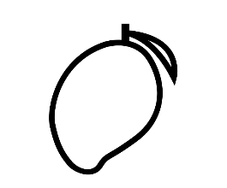
Celeste RIGHI RICCO
CHARACTERIZATION OF COGSHALL MANGO QUALITY IN PRE AND POST HARVEST STAGES
Isabelle GRECHI, Rob SCHOUTEN, Antoine DROUILLARD
CIRAD UPR Hortsys

Slide 2
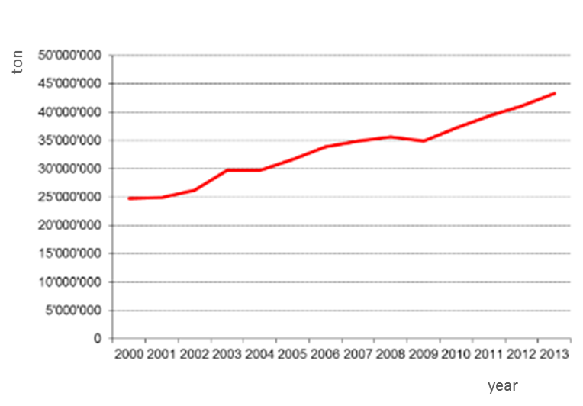


INTRODUCTION AND RESEARCH OBJECTIVES
Mango is commonly produced all around the world
Increasing countries producing mango, due to climate changes
Increasing exportation
In developing countries: low yields and low quality

Slide 3
INTRODUCTION AND RESEARCH OBJECTIVES
Mango quality depends on several factors:
Pre- Harvest factors:
Light
Temperature
Water availability
Carbon assimilation
At harvest factor:
Maturity stage
Post-harvest factor:
Storage conditions (temperature, relative humidity)
Notes:
By words, explain their influence on final quality !

Slide 4
INTRODUCTION AND RESEARCH OBJECTIVES
Research Problem: Need to optimize mango quality and reduce its variability
General objectives of project:
Understand effect on mango quality of :
growing conditions
maturity stage at harvest
conservation conditions
Develop a model for enhancing integrated approach on mango optimization
Specific objectives of my study:
Test and compare 2 different leaf/fruit ratios (100 and 25)
Test three different maturity stages at harvest (V, VM, PJ)
Test 2 conservation conditions (T10 and T20)
Notes:
ADD THAT ALL DATA OBTAINED WILL CONTRIBUTE TO THE MODEL OF ANTOINE, mainly kinetics
We have done both pre harvest and post harvest analysis;, but in my research I focused on post harvest analysis

Slide 5
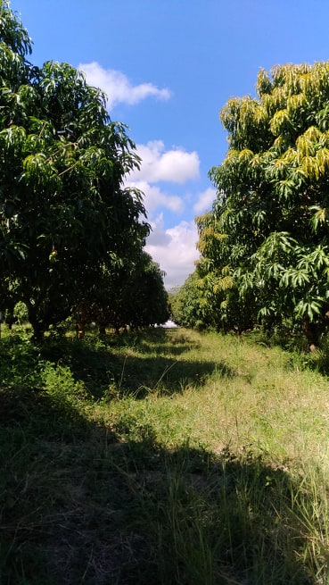
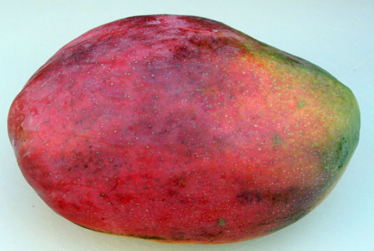
MATERIAL AND METHODS
Experimental orchard
Cogshall variety
Planted in 2004
Located in Bassin Plat,
Saint-Pierre, Réunion Island
Notes:
ADD picture cogshall fruit

Slide 6
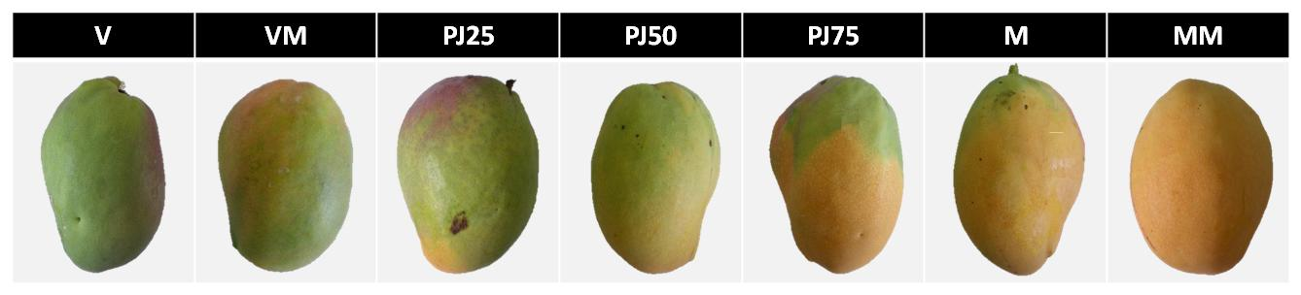
MATERIAL AND METHODS
Experimental design: studied factors
Leaf fruit ratio
Fruit maturity stages at harvest
Conservation treatmements
25
100
Leaf/fruit ratio: number of leaves per fruit --> way to control the amount of carbon available per fruit Carbon allocation
Leaf/Fruit ratios adjusted before and during the experiment
Girdling of branches around 59 DAB to stop phloem flow
T10
T20
Notes:
3 studied factors: pre harvest- at harvest and post harvest
PRE HARVEST = Growing condition factor : to control Carbon assimilation: lef fruit ratio: number of leaves per fruit. Decided to do two different treatments: 100 and 25.
Leaf has been adjusted both before and during the experiment to adjust for eventual fallen fruit
Branches were selected for dimension. Grindled 59 days after bloom to control phloem flow and stop it. (DO ANIMATION WITH THESE INFO)
At harvest factor: fruit maturity. Harvested in 3 different moments. G GM PY, stages defined by fluorescence measurement ( explain what)
Additional method, observe % of yellow color of the skin
Post Harvest: Cons treatment: two different cons conditions in cold chamber to study different storage environment. T10 mainly for export while T20 for local consumtion. T 10 not for PY, already too mautre, no sense for export

Slide 7
MATERIAL AND METHODS
 |  | T20 | T10
25 | V | 25 – V – T20 | 25 – V – T10
 | VM | 25 – VM – T20 | 25 – VM – T10
 | PJ | 25 – PJ – T20 | /
100 | V | 100 – V - 20 | 100 – V - 10
 | VM | 100 – V - 20 | 100 – VM - 10
 | PJ | 100 – PJ - 20 | /
Notes:
Table of FACTORS COMBINATION: 10 diff combo

Slide 8
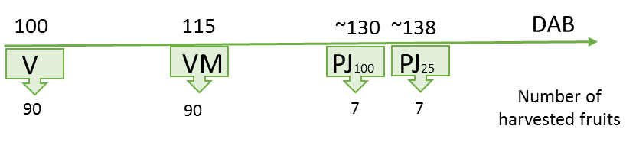
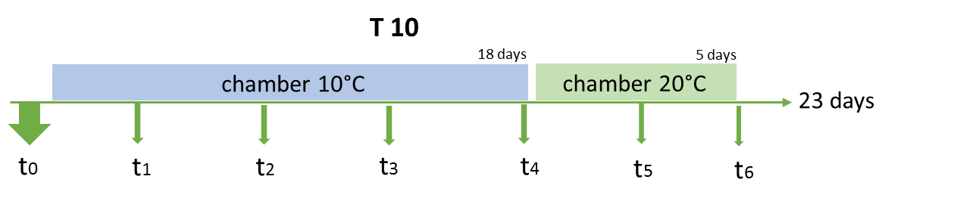
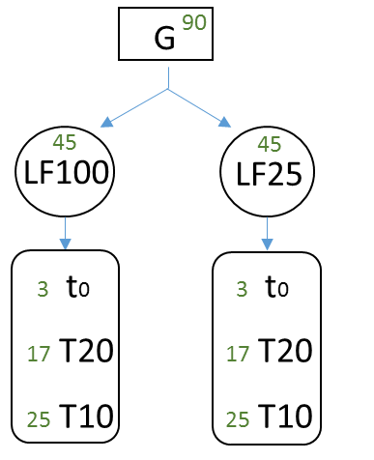
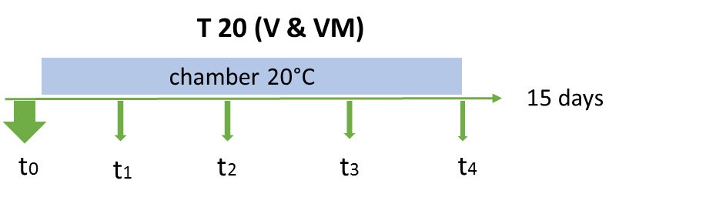
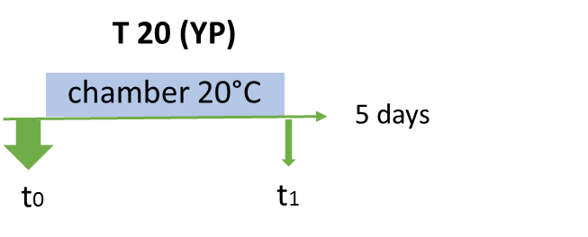
MATERIAL AND METHODS
Experimental design: Sampling and monitoring
Harvest plan
Conservation plan & analysis time points
Notes:
DAB: started from 1 September 2018
Number of Days after full bloom. PJ 25 and 100 got at that maturation stage in two different moments
Second graph, to appear afterwords : How harvested fruits have been devided.
Explain the three different conservation modes. Fruits taken out of conservation when mature.

Slide 9
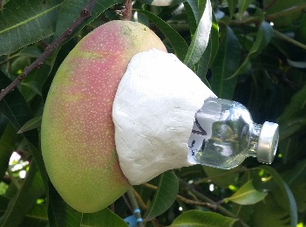
MATERIAL AND METHODS
MEASURED VARIABLES | INDICATORS OF | PART OF FRUIT ANALYSED | MEASUREMENT
Fresh mass (g) | Growth | Whole fruit | Precision balance
Transpiration (g/h) | Transpiration | Whole fruit | Precision balance (4times in 1 hour)
Dimensions: length, width, depth(cm) | Growth | Whole fruit
Dry mass rate (%) | Organoleptic quality | Pulp | Weight dry mass of a 2g sample 72 h of drying at 70°C
Titrable acidy | Acidity | Pulp | Automated tetrameter with NaOH solution
pH | Acidity | Pulp | pH-meter
Osmotic and water potentials | Hydric status | Pulp | Osmometer & Potential-Meter WP4
Soluble compounds: °Brix(% ESS) | Soluble sugars content | Pulp | Refractometer Atago Pocket PAL-1
Chroma-meter( L, a, b) | Color | Pulp | Chroma-meter Minolta CR300
Fluorescence (Fv) | Maturity | Skin | Fluorimeter
CO₂ & C₂H₄ (ppm) | Maturity | Skin/ Whole fruit | Gas chromatographer
Notes:
Explain more about them by words

Slide 10
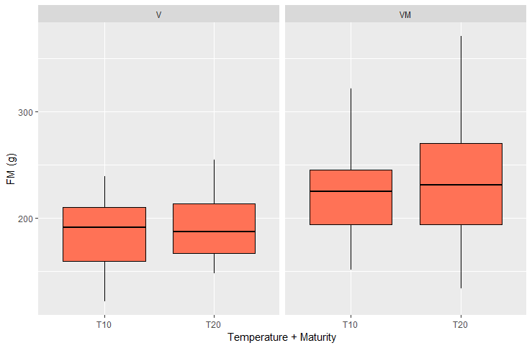
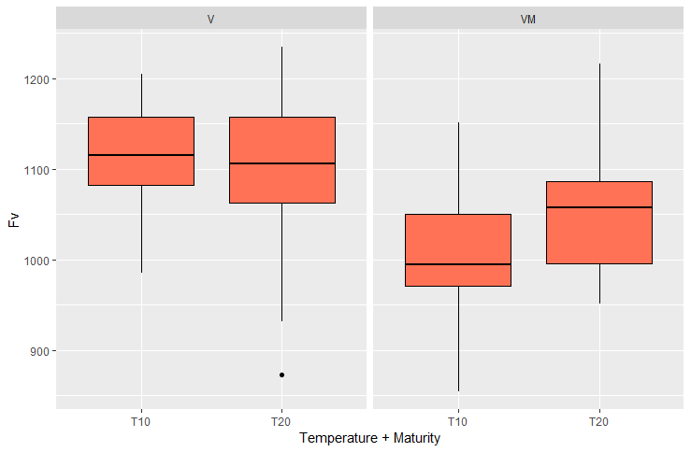
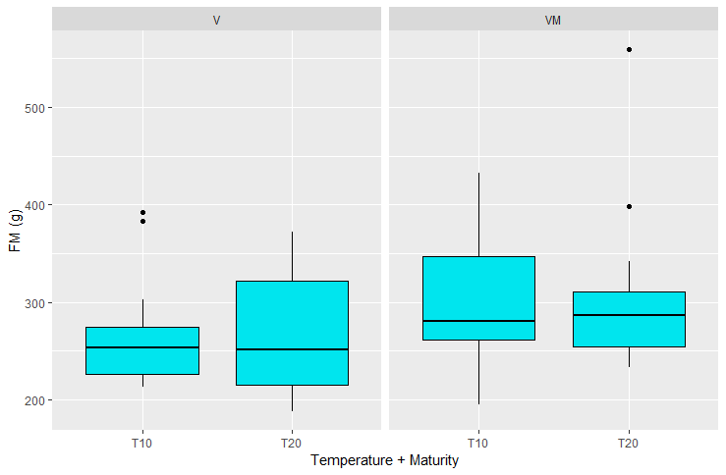
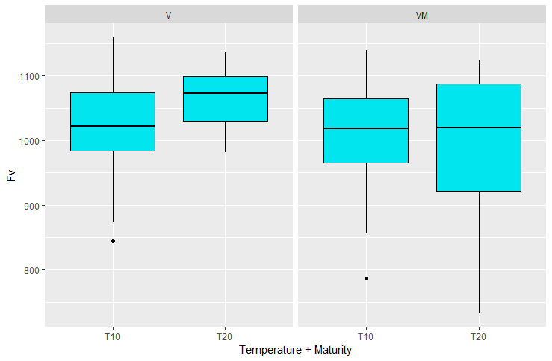
MATERIAL AND METHODS
Experimental design: Initial evaluation of sampled fruits
Homogeneity
LF25
LF100
Notes:
ALL HOMOGENEITY PROOVED.

Slide 11
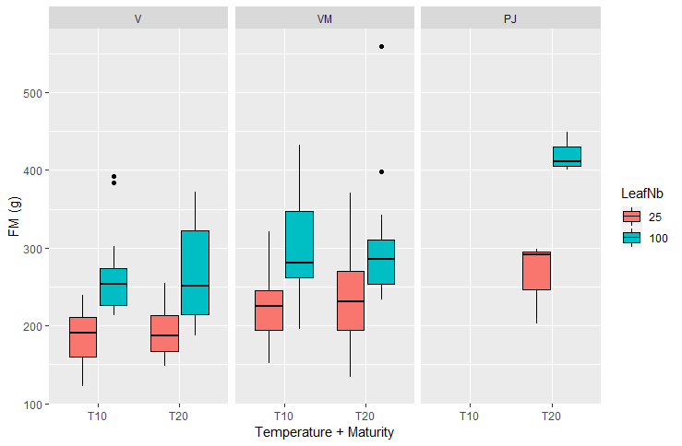
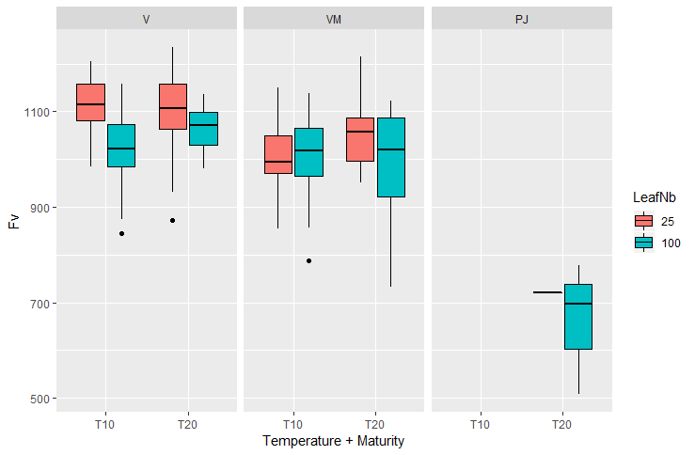
MATERIAL AND METHODS
Experimental design: Initial evaluation of sampled fruits
Heterogeneity
Notes:
ALL HETEROGENEOUS for individual factors. Interactions only for Fv

Slide 12
MATERIAL AND METHODS
Statistical Analysis
Test of normality for interaction model with all factors
Conversion of variables in logs, if not normally distributed
Test model with random effects of trees
ANOVA test to check for general interactions
ANOVA tests to check for indipendent effect of each factor
LF ratio, for each time point
Conservation conditions for final points
Maturity stages for starting and final points

Slide 13
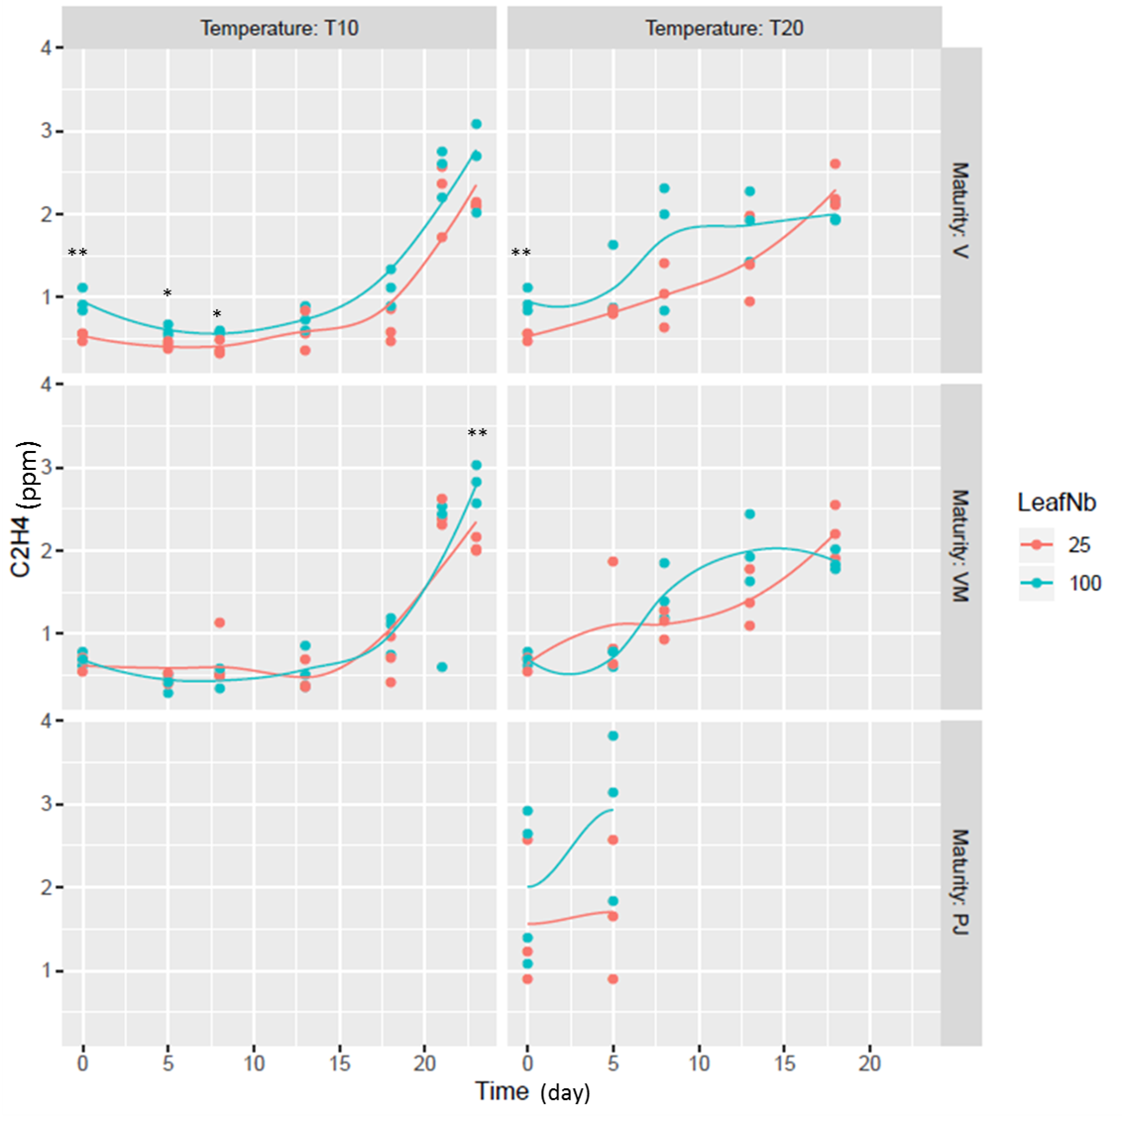
RESULTS
C2H4
Model: no normal distribution
Applyed log of variable to the model
No random effect of tree
Interactions between Leaf/Fruit ratio and Maturity stage
Individual factors ANOVAs
LFratios significant for combinations in the image
Conservation treatments:
V: no
VM100: yes
Maturity stages:
t0-T20-both LF: yes
(25: PJ vs V, 100: PJ vs VM)
tf-both T-bothLF: no
Notes:
Explain that * are explaining for sign only for LF treatments

Slide 14
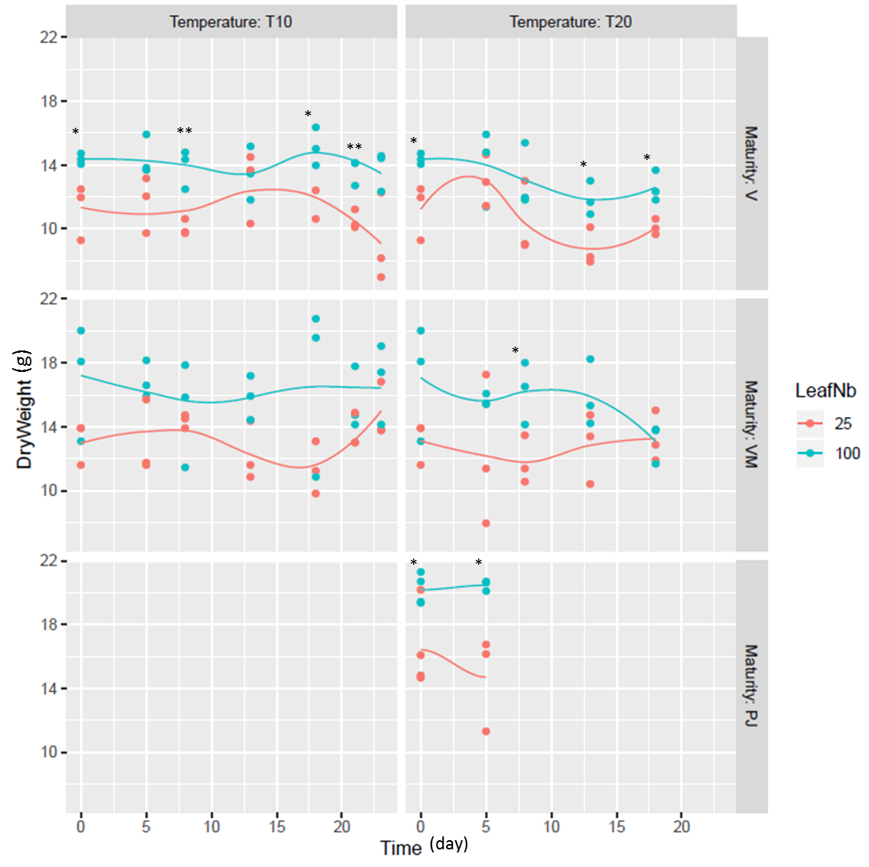
RESULTS
Dry Weight
Model: yes normal distribution
Not Applyed log of variable
No random effect of tree
No Interactions
Individual factors ANOVAs
LFratios significant for combinations in the image
Conservation treatments:
V: no
VM: no
Maturity stages:
t0-T20-both LF: yes
(25 and 100: PJ vs V)
tf-both T-LF25: yes

Slide 15
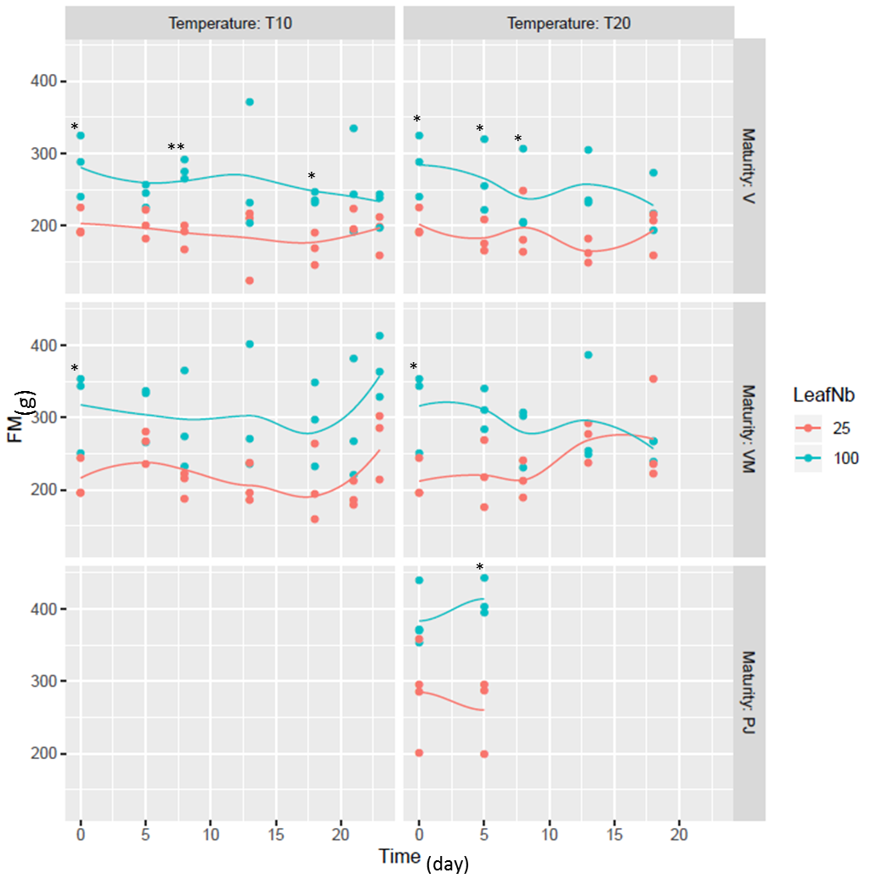
RESULTS
Fresh Mass
Model: no normal distribution
Applyed log of variable
No random effect of tree
No Interactions
Individual factors ANOVAs
LFratios significant for combinations in the image
Conservation treatments:
V: no
VM: no
Maturity stages:
t0: no
tf-T10-LF25: yes

Slide 16
RESULTS
Brix

Slide 17
RESULTS
Titratable Acidity

Slide 18
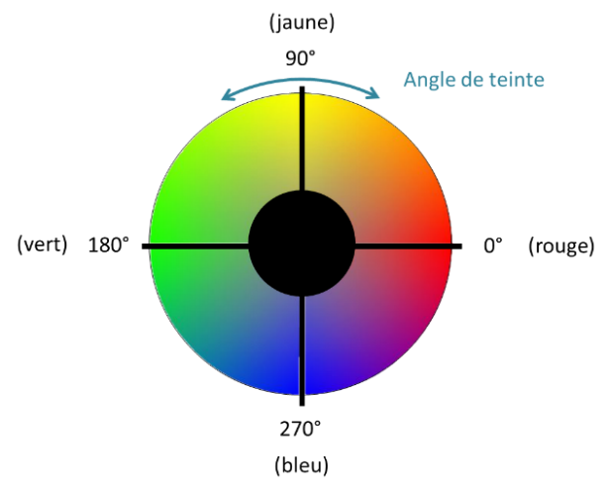
RESULTS
Hue Angle

Slide 19
CONCLUSIONS

Slide 20
THANK YOU
Isabelle Grechi
Rob Schoulz
Antoine Drouillard
Anna Doizy
All CIRAD friends and collegues

