Slide 1

Proposal for New Cloud Platform for MoVid Inc.
BASTIN BAJIYO JOB
IST659 Cloud Management

Slide 2
Agenda
Introduction
Current On-Premise Architecture
Proposed Cloud Solution
Storage Strategy
Backup/Restore Solution
Total Cost of Ownership
Advanced Cloud Feature
Drawbacks
Conclusion

Slide 3
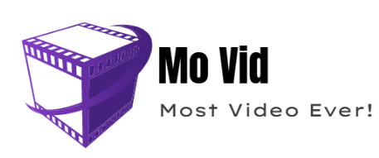
Introduction
MoVid Inc.is a company that is focused on developing video technologies.
Needs to create a new “Cloud-Hosted” MoVid deployment.
4 virtual machines in the on-premise virtualization platform for each customer.

Slide 4
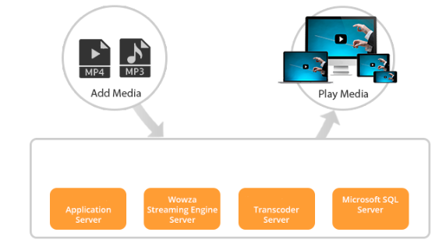
Current architectural design of Saas solution

Slide 5
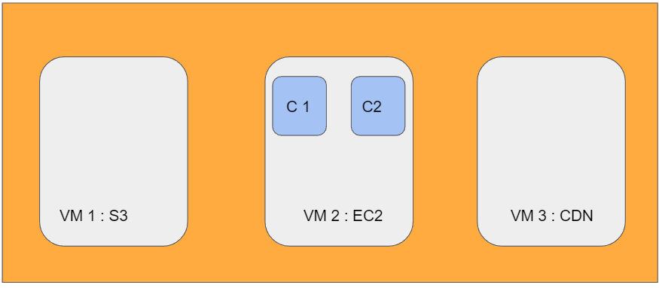
Proposed Cloud Architecture

Slide 6
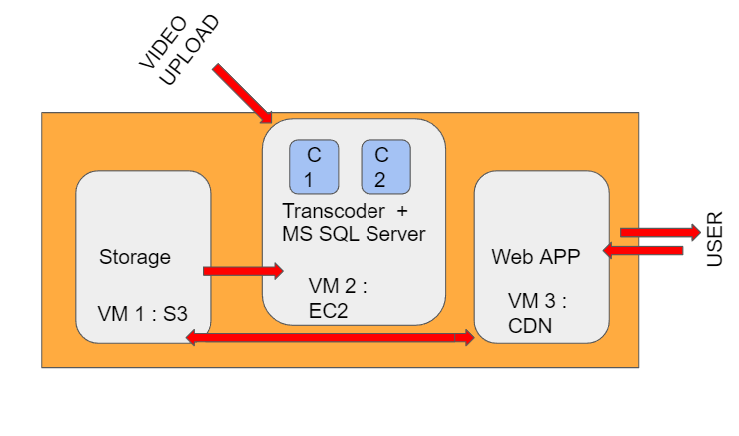
Proposed Cloud Architecture

Slide 7
Amazon Web Services – Pros and Cons : Why AWS ?
Advantages:
Broad and deep service offering.
Minimal loss of information during video hosting and start and storage transfer.
Strong support for BI, analytics and Devops.
High transfer stability.
Disadvantages:
General cloud computing issues
Technical support fees
Sum up : A WS2 faces the general problems faced by any cloud computing platform having said that the benefits of AWS are pretty great – enough for our use case.

Slide 8
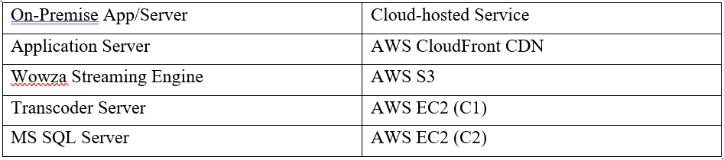
Specific Cloud Services chosen from AWS
For our use case we will be using three main cloud services offered by AWS :
Amazon Elastic Cloud Compute (EC2)
Amazon Simple Storage Service (S3)
Amazon cloudfront Content Delivery Network (CDN)

Slide 9
Proposed Cloud Architecture

Slide 10
VM specifications and guarantees by vendor
VM Specifications :
Windows Based VM’s
VM2 will have 8 core CPU, 16 GB RAM , 150+ GB 15k RPM Hard drive
VM1 Will have 8 core CPU, 12 GB RAM, 1TB+ GB 7500 RPM Hard drive
VM 3 will have 4 core CPU, 8 GB RAM, 500 GB 15k RPM Hard drive
Guarantees by the Vendor :
SLA 99.99%
98% reduction in unplanned downtime
71% faster deployment
26% higher developer productivity

Slide 11
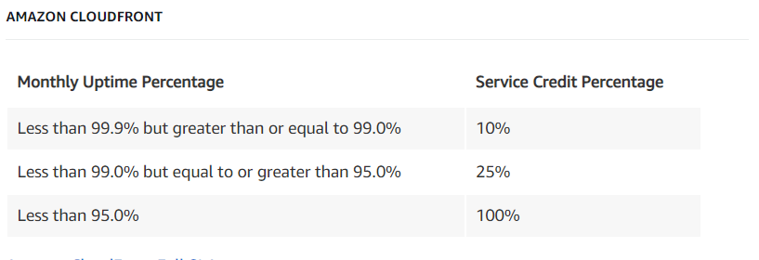
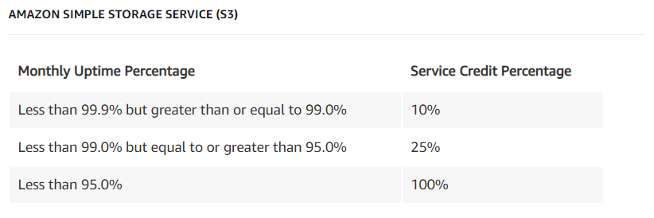
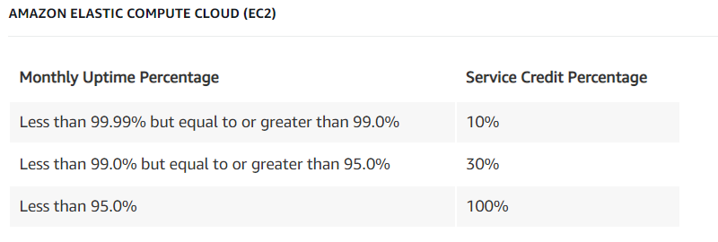
Compensation promised by the vendor in case of excess down-time:

Slide 12
Storage Strategy
Videos after transcoding are stored in the streaming engine. Outbound streaming also happens here. So, the S3 instance should be able to accommodate both outbound streaming and video storage.
The two EC2 instances – Transcoder and SQL Server can use the same Amazon S3 bucket storage.
Application Server uses CDN which has its own storage specifications and plans.
CDN’s can have an on demand availability of storage, S3 buckets have storage in the range 0-5TB
Thus, in this architecture, we will use S3 instances as storage for outbound video streaming, video storage, inbound traffic to the video transcoder and Web app Database.
CDN will store the inbound traffic to the web application alone.

Slide 13
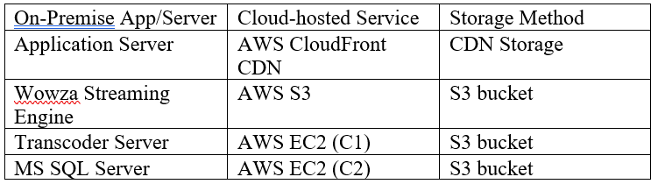
Storage Strategy

Slide 14
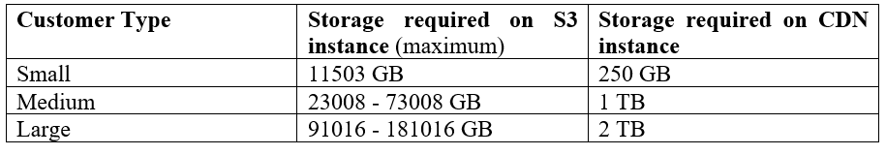
Storage requirement for different customer types

Slide 15
Backup/Recovery Solution
We have chosen AWS backup to provide backup and restore functionality to the video storage and SQL data.
Pricing is based on the amount of storage space your backup/restoration consumes.

Slide 16
Backup/Restore Pricing Details
Backup and Recovery for Video Storage (S3) :
Backup and Recovery for SQL data (EC2) :

Slide 17
Total Cost of Ownership
Calculation of TCO for a year with 250 GB per customer :
No: of customers : 10
Storage available to each customer : 250 GB
Cost of back up per month per GB : $0.05
No: of months : 12
Total cost of ownership (TCO) of backup (videos): 0.05*12*250*10 = $1500 per year
The cost of recovery depends on the amount of data recovered per month, and since it is on a usage basis, recovery cost has not been included in the total TCO.

Slide 18
Total Cost of Ownership
TCO Calculation of a hypothetical case : 25 small, 10 medium and 3 large customers :
No: of small customers : 25
Storage available to small customer : 11503 + 250 = 11753 GB
No: of medium customers : 10
Storage available to small customer : 73008+ 1000 = 74008 GB
No: of small customers : 3
Storage available to small customer : 181016 + 2000 = 183016 GB
Cost of back up per month per GB : $0.05 (same for both S3 and CDN)
No: of months : 12
Maximum total cost of ownership (TCO) of backup (videos): 0.05*(25*11753 +10*74008+3*183016) = $79147.65 per year
The cost of recovery depends on the amount of data recovered per month, and since it is on a usage basis, recovery cost has not been included in the total TCO.

Slide 19
Advanced Cloud Feature
MoVid is a streaming platform. As is the case with any content-on-request platform, a major constraint is Latency. A good video streaming platform should:
Stream videos real time, without interruptions.
Have buffering time as low as possible.
Minimize compromise in streaming quality due to slow network.
This is where we use AWS Wavelength.
AWS Wavelength boosts AWS services to nearly 5G network speeds.
Latency will be minimized when accessing the cloud through any kind of device.
Application traffic can reach application servers running in Wavelength Zones without leaving the mobile provider’s network.
Introducing AWS Wavelength can set the quality standard of MoVid apart from the competition. Seamless connectivity and nearly zero latency will be a business game changer.

Slide 20
Drawback of this model and a solution
Drawback :
Effective sharing of resources on VM2 where the transcoder and SQL server run in separate containers.
Transcoder being computationally heavy, can saturate the CPU cores unless a deliberate usage limit is set.
This can effectively slow down the website.
Solution :
Amazon Elastic Transcoder.
Using amazon’s transcoding service which is better optimised to run on AWS instances would reduce/optimize the CPU demand.
This would mean letting go of the native transcoder.

Slide 21
Conclusion
A viable cloud migration model has been proposed.
Drawbacks have been investigated and rectified.
Further development by using advanced cloud features were also investigated.

Slide 22
THANK YOU !

