Slide 1
CREDIT CARD FRAUD DETECTION AND DATAWRANGLING FOR DUPLICATE TRANSACTIONS
PROJECT TOPIC PRESENTATION
BASTINN BAJIYO JOB
CHINMAY ASHOK MAGANUR
KANISHK GUPTA

Slide 2
INTRODUCTION
Fraud is a problem for any bank. Fraud can take many forms, whether it is someone stealing a single credit card, to large batches of stolen credit card numbers being used on the web, or even a mass compromise of credit card numbers stolen from a merchant via tools like credit card skimming devices.
We try to build a predictive model to determine whether a given transaction will be fraudulent or not.

Slide 3
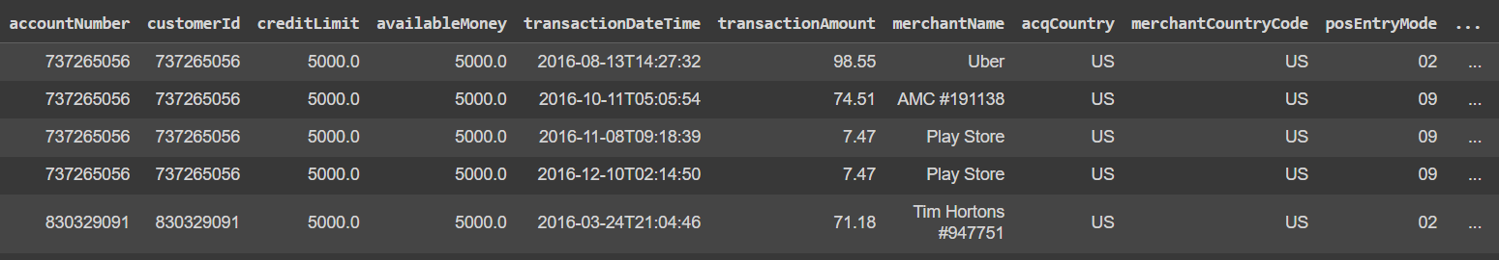
Dataset
We will use credit card transactions data provided by Capital One. This dataset closely resembles real transactional data from Capital One credit card customers, but the entities and relations within are purely fictional. No persons, places, or things lost their identity in the making of this dataset.
786363 records and 29 fields
Target Variable for Credit Card Fraud Classification : ‘isFraud’

Slide 4
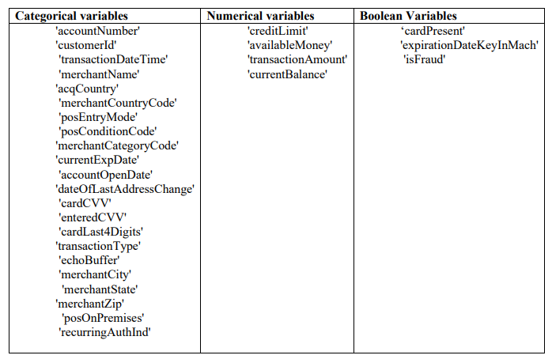
Dataset

Slide 5
Dataset
account Number: The account number associated with the credit card used for the transaction.
customerId: The customer ID associated with the account.
creditLimit: The credit limit for the account.
availableMoney: The amount of money available for the account after the transaction.
transactionDateTime: The date and time when the transaction occurred.
transactionAmount: The amount of money involved in the transaction.
merchantName: The name of the merchant where the transaction took place.
acqCountry: The country where the transaction was acquired (i.e., the country where the card was used).

Slide 6
Approach
Study and analyse the distribution and statistics of each variable and find correlations.
Do feature engineering to select viable features for Credit Card Fraud classification.
Use different models like SVM, decision tree, Naïve Bayes, Random Forest and neural networks for classification and compared the efficiency using metrics like accuracy, precision, recall and F1-score.
Find out specific characteristics of anomalous and duplicate transactions to perfrom data wrangling.

Slide 7
Challenges
Data imbalance. Proportion of fraudulent transactions is lower than normal ones. Tuning the model to overcome this aspect may be challenging.
Techniques like weighted classes may be useful.

