Slide 1
KERAS
IST 652 Advanced Topic Presentation
GROUP 8 Bastin| Anish Kumar | Sri Venkata Namana

Slide 2

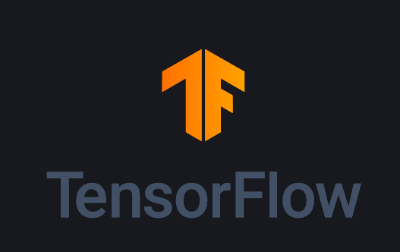

Introduction
This presentation will cover:
Fundamentals of Keras
Image classification using Keras
Advantages and Disadvantages

Slide 3
What is Keras ?
“Keras is a high-level neural networks API, designed to enable fast experimentation with deep neural networks”
Background : Originally developed by François Chollet, Keras was created with the goal of providing a user-friendly interface for building and training neural networks.
It is not a Python Standard Library
Keras offers compatibility with various backend engines: Keras can run on top of TensorFlow, Theano, or Microsoft Cognitive Toolkit (CNTK), offering flexibility and compatibility with different computational backends.

Slide 4
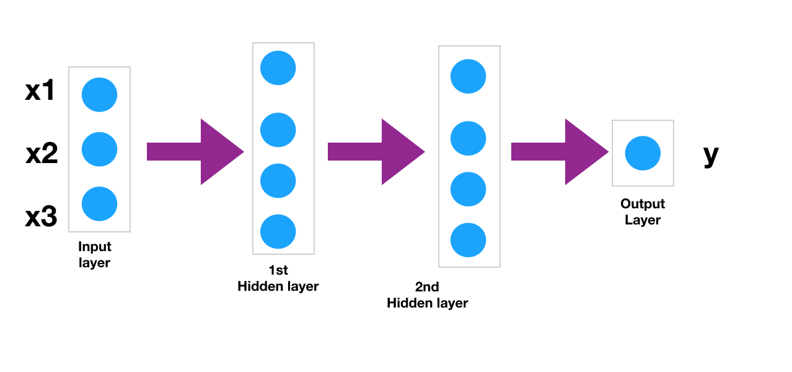
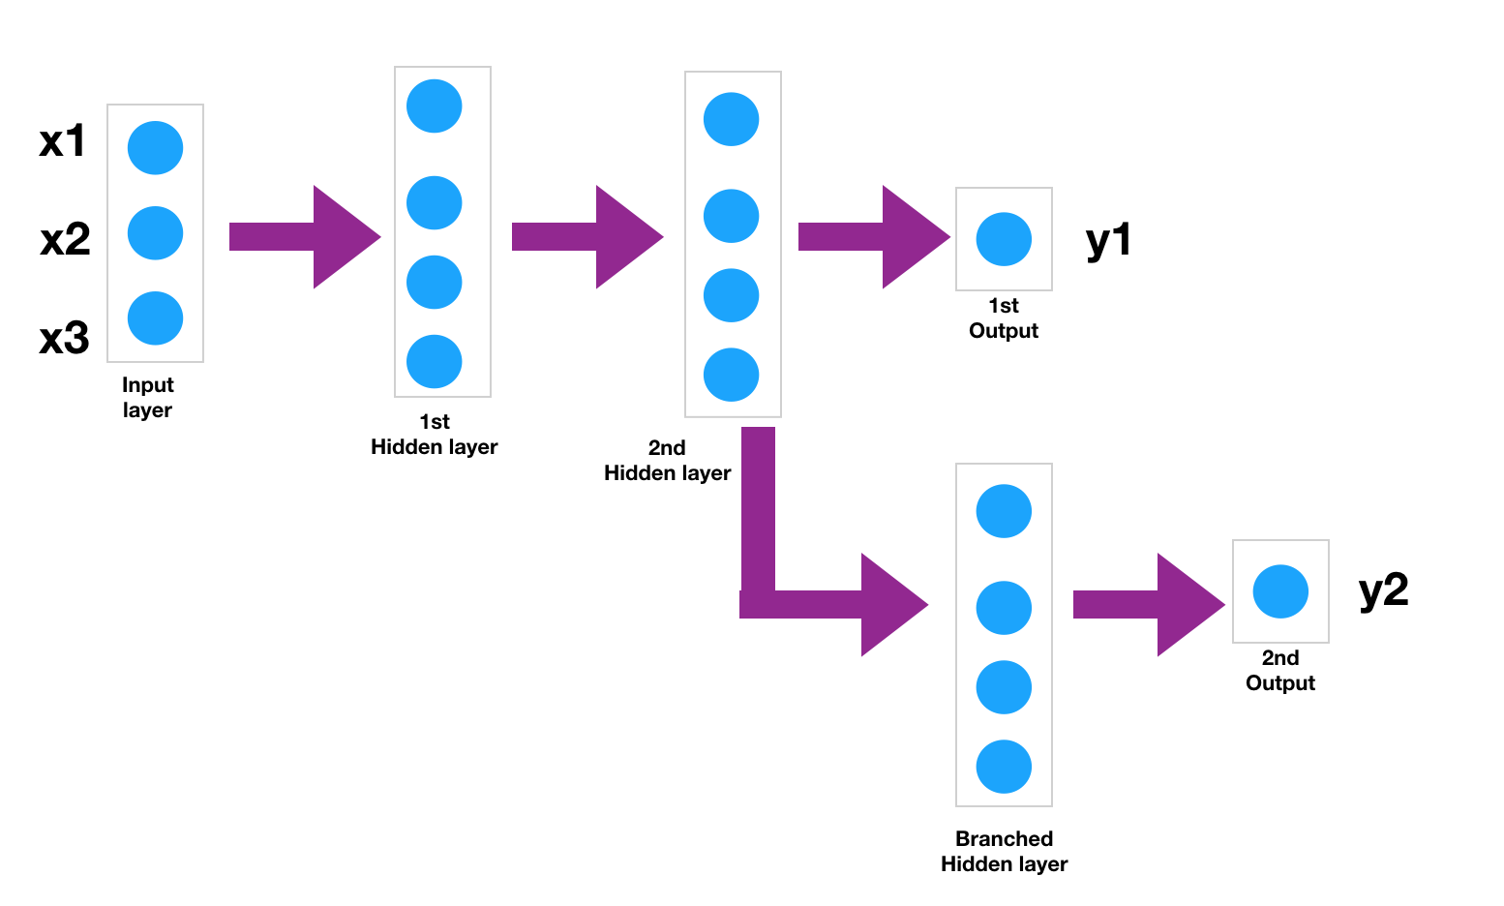
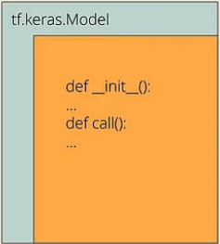
Keras API’s
Sequential API: Allows users to create models layer-by-layer in a linear stack. Ideal for building simple models where each layer has exactly one input tensor and one output tensor. (Single input, single output models)
Functional API: Allows for the creation of complex models with multiple inputs, multiple outputs, shared layers, and branching architectures.
Subclassing API: Enables dynamic architecture creation and modification at runtime, making it suitable for research and experimentation.

Slide 5
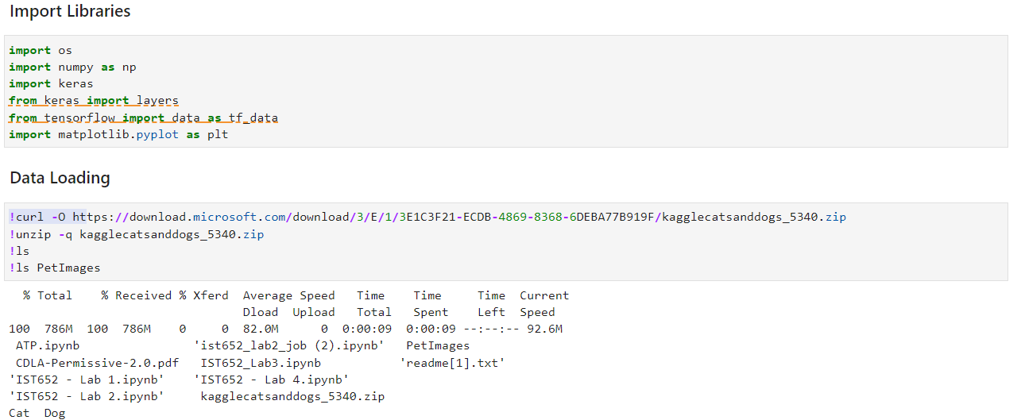
Image Classification Using Keras

Slide 6
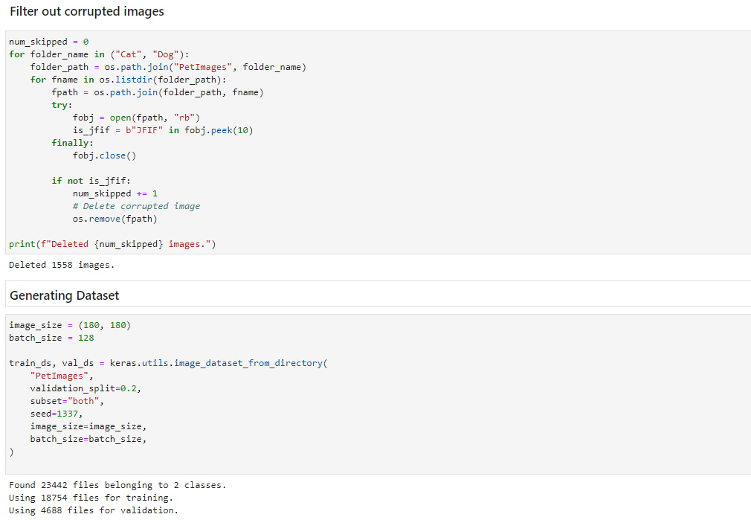

Slide 7
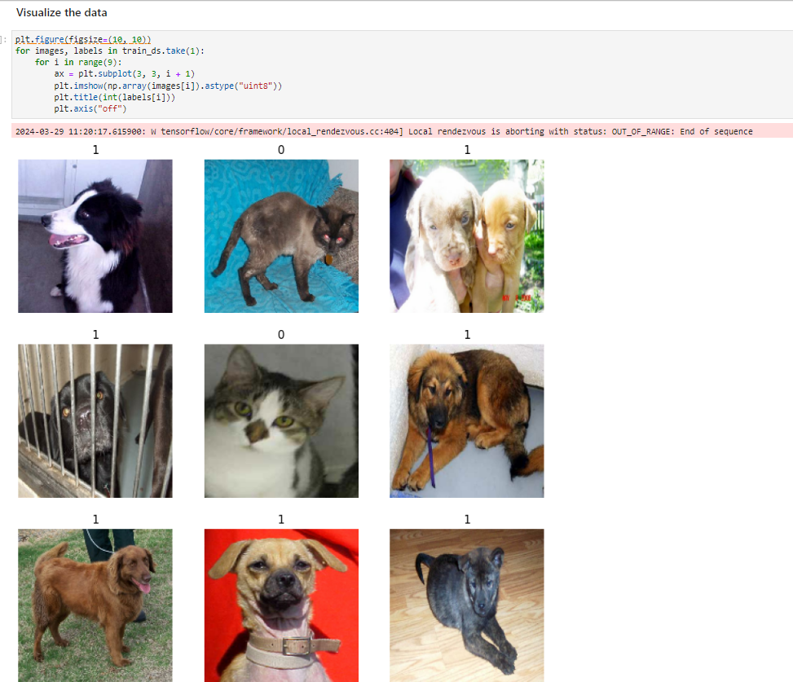

Slide 8
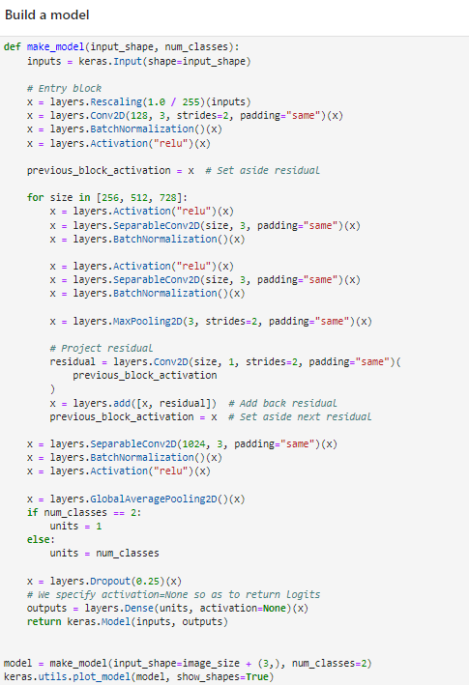
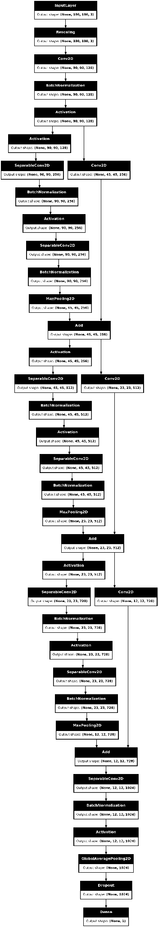
Scaled down version of Xception CNN network
Fully convolutional
Parallel convolutional branches
Depthwise separable convolution

Slide 9
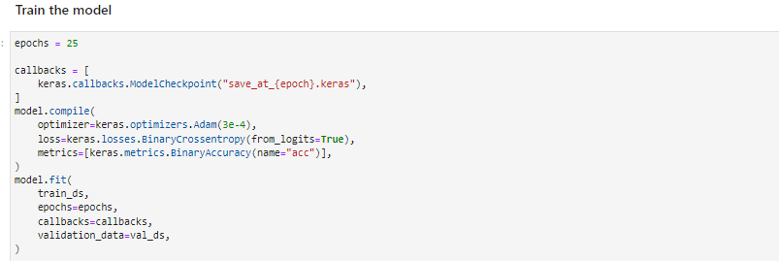
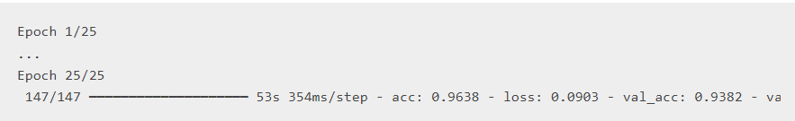

Slide 10
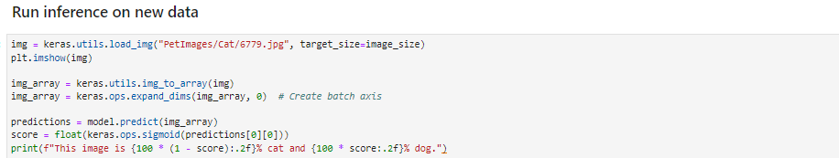
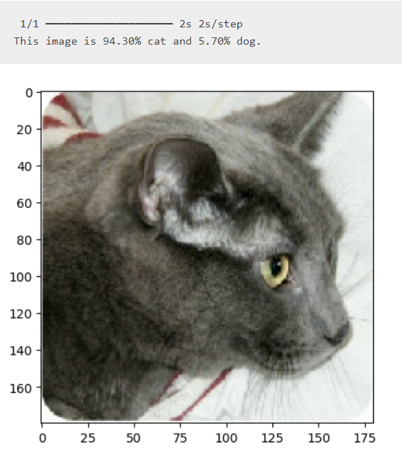

Slide 11
Advantages of Keras
Simplicity: Keras provides a simple and intuitive interface, making it easy to design, build, and train deep learning models.
Modularity: Keras offers a modular approach to building neural networks, allowing users to easily create complex architectures by stacking layers and defining connections between them.
Flexibility: Keras supports multiple backend engines, including TensorFlow, Theano, and Microsoft Cognitive Toolkit (CNTK), providing users with flexibility in choosing the backend that best suits their needs.
Extensibility: Keras allows for easy customization and extension through subclassing and functional API, enabling users to define custom layers, loss functions, and metrics.
Community Support: Keras benefits from a large and active community of users, researchers, and developers who contribute to its development, documentation, and ecosystem.

Slide 12
Disadvantages of Keras
Abstraction Overhead: While Keras' high-level API simplifies model development, it also abstracts away some low-level details, which may limit fine-grained control and customization for advanced users.
Performance Overhead: Keras' abstraction layer may introduce some performance overhead compared to using the backend frameworks directly. While Keras strives to optimize performance, users may experience slightly slower execution times for certain operations or models compared to native implementations in TensorFlow or other backends.
Backend Dependency: Although Keras supports multiple backend engines, it's primarily developed and optimized for TensorFlow.
Limited Research Focus: While Keras excels in rapid prototyping and production-level deployment, it may not be the first choice for research-oriented projects that require extensive experimentation and customization.
Documentation Fragmentation: Keras' documentation is comprehensive and well-maintained, but it can be fragmented due to the integration with multiple backend engines.

Slide 13
Conclusion
Overall, Keras offers a powerful and user-friendly platform for deep learning development, with a balance of simplicity, flexibility, and community support. While it may not be the best fit for every use case, its ease of use and broad adoption make it a popular choice for beginners, practitioners, and production-level applications.

