Slide 1
BI694 Bioinformatics & Phylogenetics
Winter Semester 2017
WEEK 2

Slide 2
Today we will install Vmware virtual machines
Copy VMware installer and Ubuntu disk image to your computer

Slide 3
Why are we using Ubuntu?
Actively developed and supported
Based on Debian
Large amount of software packaged and readily available through repositories
I picked a lightweight version of it to limit resource usage

Slide 4
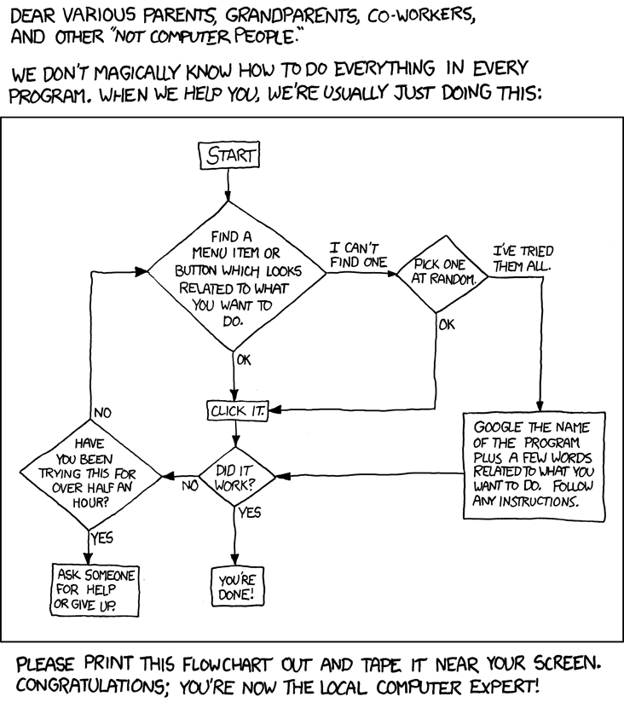
I’ll walk you through the installation, but…

Slide 5
Linux file system structure
Everything in Linux is a file – including harddrives
no C:, D:, etc drives…

Slide 6
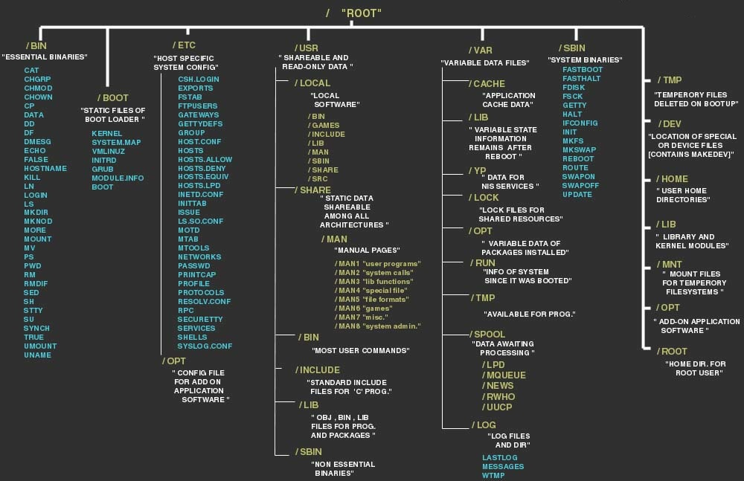

Slide 9
$ echo $PATH

Slide 10
compiling software
from source

Slide 11
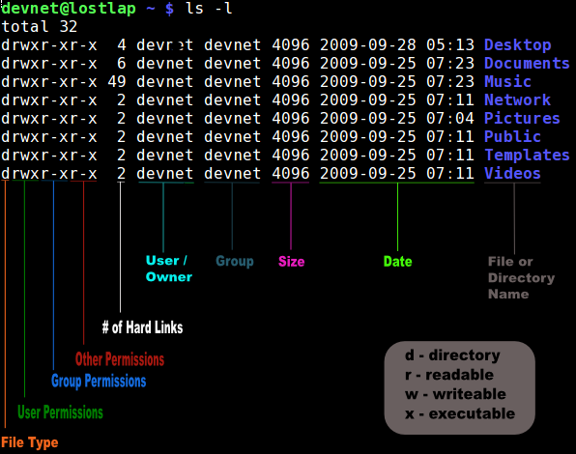
File permissions
High level of access control!
chown
chmod
r=4 w=2 x=1
Owner: rwx=4+2+1=7
Group: r-x=4+0+1=5
Other: r-x=4+0+1=5

Slide 12
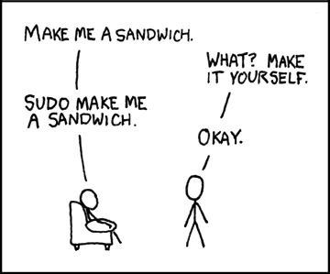
Regular versus super user
Users have limited power
→ you cannot mess up the system; only your own files!
Sometimes you need more authority:
→ sudo
→ su root

Slide 13
How to get around the system?
pwd
cd
ls
mkdir (-p)
rm
touch
man pages

Slide 14
No white spaces!
How do we deal with spaces in file names?
Escape them with \
We will come back to quotes later

Slide 15
Package manager
Package managers (keep track of dependencies)
apt-get update
apt-get upgrade
apt-cache search
install seaview

Slide 16
Text editors
less – text viewer
nano – intuitive and easy but limited
vi(m) – available everywhere and powerful
emacs – powerfull but too bloated for my taste
geany – ligt weight IDE

Slide 17
grep, sed, awk
grep – powerful pattern searches, including regex
sed – stream editor, search and replace (perl…)
awk – scanning and processing programming language

Slide 18
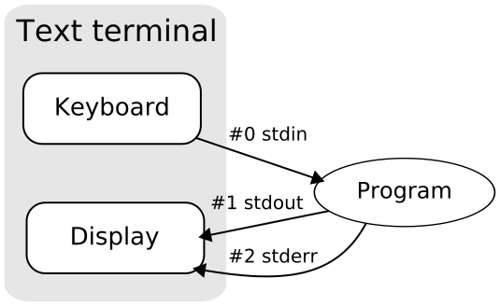
Keyboard to display
pipes – |
redirects - > < << >>
Separating streams – 1> 2>

Slide 19
System monitoring tools
Install htop
Memory and CPU usage
What is SWAP?
Killining process – ctrl-c, ps, htop

