Slide 1
BI694 Bioinformatics & Phylogenetics
Winter Semester 2017
WEEK 8
FastQ File Format, Quality Encoding, Genome/Transcriptome Assembly

Slide 2
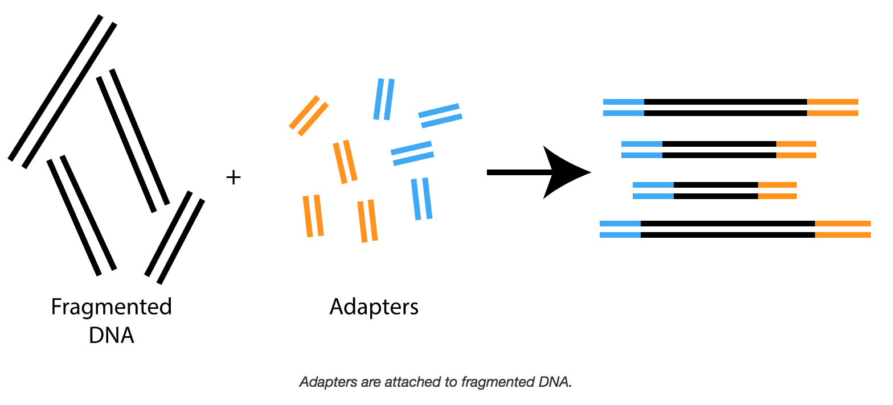
Sequencing

Slide 3
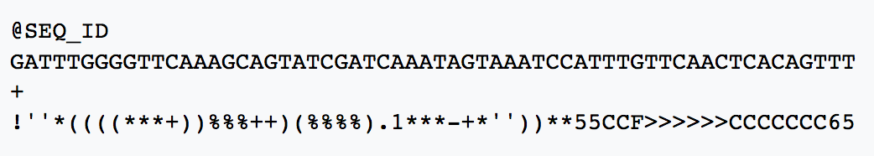
FastQ File Format…

Slide 4


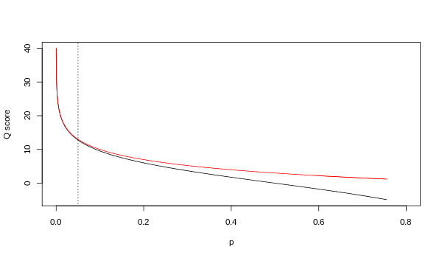
Phred Quality Scores
p corresponds to the probability of the basecall being incorrect; the old Solexa (Illumina)
encoding reports the odds that the basecall is incorrect.

Slide 5
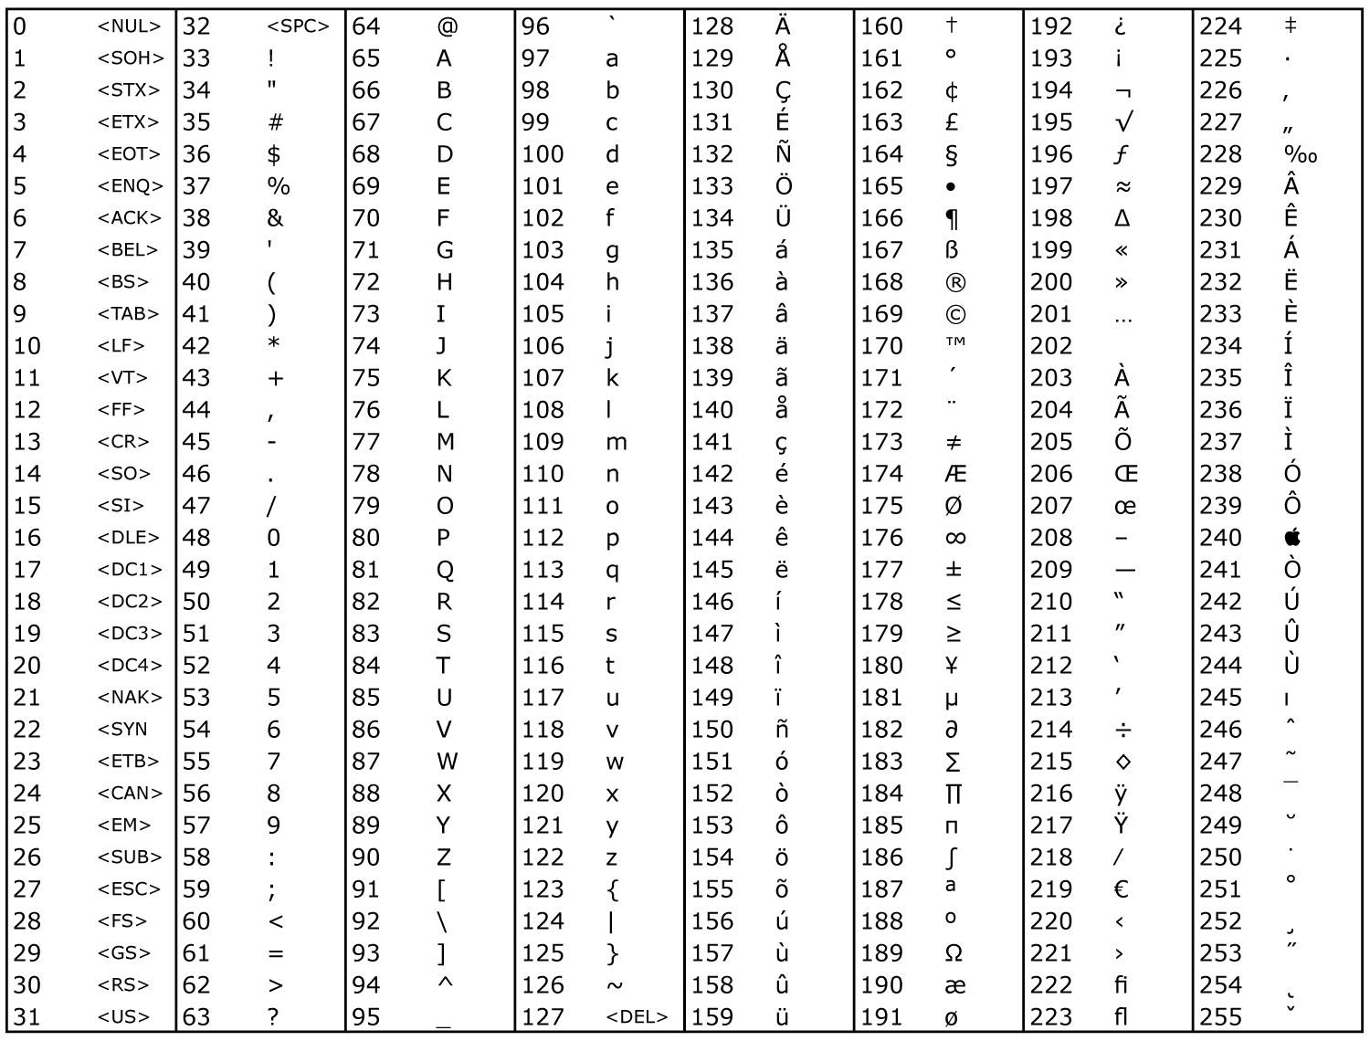
Phred Quality Scores – ASCII offset encoding
Phred score of 0 is encoded by ASCII
Character 33.
What is the phred score of *?

Slide 6
What to do with these sequences?

Slide 7
Assembly
GGCGTCTATATCTCGGCTCTAGGCCCTCATTTTTT
GGCGTCTATATCT
GGCGTCTATATCTCG
TATCTCGGCTCTAGG
TATCTCAGCTCTAGGCC
TATCTCAGCTCTAGGCCCTCA
CTCGGCTCTAGGCCCTCATTTT
GGCTCTAGGCCCTCATTTTTT
CTCTAGGCCCTCATTTTTT
CTAGGCCCTCATTTTTT

Slide 8
Assembly
GGCGTCTATATCTCGGCTCTAGGCCCTCATTTTTT
Genome
GGCGTCTATATCT
GGCGTCTATATCTCG
TATCTCGGCTCTAGG
TATCTCAGCTCTAGGCC
Reads
TATCTCAGCTCTAGGCCCTCA
CTCGGCTCTAGGCCCTCATTTT
GGCTCTAGGCCCTCATTTTTT
CTCTAGGCCCTCATTTTTT
CTAGGCCCTCATTTTTT

Slide 9
Assembly
GGCGTCTATATCTCGGCTCTAGGCCCTCATTTTTT
Reconstruct this…
GGCGTCTATATCT
GGCGTCTATATCTCG
TATCTCGGCTCTAGG
TATCTCAGCTCTAGGCC
…from this
TATCTCAGCTCTAGGCCCTCA
CTCGGCTCTAGGCCCTCATTTT
GGCTCTAGGCCCTCATTTTTT
CTCTAGGCCCTCATTTTTT
CTAGGCCCTCATTTTTT

Slide 10
Assembly
???????????????????????????????????
Reconstruct this…
GGCGTCTATATCT
GGCGTCTATATCTCG
TATCTCGGCTCTAGG
TATCTCAGCTCTAGGCC
…from this
TATCTCAGCTCTAGGCCCTCA
CTCGGCTCTAGGCCCTCATTTT
GGCTCTAGGCCCTCATTTTTT
CTCTAGGCCCTCATTTTTT
CTAGGCCCTCATTTTTT

Slide 11
Assembly
GGCGTCTATATCTCGGCTCTAGGCCCTCATTTTTT
GGCGTCTATATCT
GGCGTCTATATCTCG
TATCTCGGCTCTAGG
TATCTCAGCTCTAGGCC
TATCTCAGCTCTAGGCCCTCA
CTCGGCTCTAGGCCCTCATTTT
GGCTCTAGGCCCTCATTTTTT
CTCTAGGCCCTCATTTTTT
CTAGGCCCTCATTTTTT
Coverage = amount of redundant information

Slide 12
Assembly
GGCGTCTATATCTCGGCTCTAGGCCCTCATTTTTT
GGCGTCTATATCT
GGCGTCTATATCTCG
TATCTCGGCTCTAGG
TATCTCAGCTCTAGGCC
TATCTCAGCTCTAGGCCCTCA
CTCGGCTCTAGGCCCTCATTTT
GGCTCTAGGCCCTCATTTTTT
CTCTAGGCCCTCATTTTTT
CTAGGCCCTCATTTTTT
Coverage = 5

Slide 13
Assembly
GGCGTCTATATCTCGGCTCTAGGCCCTCATTTTTT
GGCGTCTATATCT
GGCGTCTATATCTCG
TATCTCGGCTCTAGG
TATCTCAGCTCTAGGCC
TATCTCAGCTCTAGGCCCTCA
CTCGGCTCTAGGCCCTCATTTT
GGCTCTAGGCCCTCATTTTTT
CTCTAGGCCCTCATTTTTT
CTAGGCCCTCATTTTTT
Coverage = 5

Slide 14
Assembly
GGCGTCTATATCTCGGCTCTAGGCCCTCATTTTTT
GGCGTCTATATCT
GGCGTCTATATCTCG
TATCTCGGCTCTAGG
TATCTCAGCTCTAGGCC
TATCTCAGCTCTAGGCCCTCA
CTCGGCTCTAGGCCCTCATTTT
GGCTCTAGGCCCTCATTTTTT
CTCTAGGCCCTCATTTTTT
CTAGGCCCTCATTTTTT
Average Coverage = Length of all reads / length of genome

Slide 15
Assembly
GGCGTCTATATCTCGGCTCTAGGCCCTCATTTTTT
35 bases
GGCGTCTATATCT
GGCGTCTATATCTCG
TATCTCGGCTCTAGG
TATCTCAGCTCTAGGCC
177 bases
TATCTCAGCTCTAGGCCCTCA
CTCGGCTCTAGGCCCTCATTTT
GGCTCTAGGCCCTCATTTTTT
CTCTAGGCCCTCATTTTTT
CTAGGCCCTCATTTTTT
Average Coverage = 177 / 35 = 5-fold

Slide 16
Assembly
TATCTCAGCTCTAGGCC
|
|
|
|
|
|
|
|
|
|
|
|
CTCGGCTCTAGGCCCTCATTTT
Suffix of one read is very similar to the prefix of another!

Slide 17
1st Law of Assembly
If suffix of read A is similar to prefix of read B…
TATCTCAGCTCTAGGCC
|
|
|
|
|
|
|
|
|
|
|
|
CTCGGCTCTAGGCCCTCATTTT
…then A and B might overlap in the genome
TATCTCAGCTCTAGGCC
GGCGTCTATATCTCGGCTCTAGGCCCTCATTTTTT
CTCGGCTCTAGGCCCTCATTTT

Slide 18
1st Law of Assembly
TATCTCAGCTCTAGGCC
|
|
|
|
|
|
|
|
|
|
|
|
CTCGGCTCTAGGCCCTCATTTT
Why do we observe differences/mismatches?

Slide 19
1st Law of Assembly
TATCTCAGCTCTAGGCC
|
|
|
|
|
|
|
|
|
|
|
|
CTCGGCTCTAGGCCCTCATTTT
Why do we observe differences/mismatches?
1. Sequencing errors

Slide 20
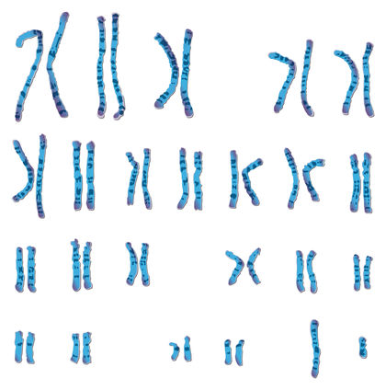
1st Law of Assembly
TATCTCAGCTCTAGGCC
|
|
|
|
|
|
|
|
|
|
|
|
CTCGGCTCTAGGCCCTCATTTT
Why do we observe differences/mismatches?
Sequencing errors
Polyploidy

Slide 21
2nd Law of Assembly
More coverage leads to more and longer overlaps
CTCTAGGCCCTCATTTTTT
TATCTCGGCTCTAGG
more coverage
GGCGTCTATATCTCG
GGCGTCTATATCTCGGCTCTAGGCCCTCATTTTTT
GGCGTCTATATCT
GGCGTCTATATCTCG
TATCTCGGCTCTAGG
TATCTCAGCTCTAGGCCCTCA
less coverage
CTCGGCTCTAGGCCCTCATTTT
GGCTCTAGGCCCTCATTTTTT
CTCTAGGCCCTCATTTTTT

Slide 22
Greedy Assembly
GGCGTCTATATCT
GGCGTCTATATCTCG
TATCTCGGCTCTAGG
TATCTCAGCTCTAGGCCCTCA
CTCGGCTCTAGGCCCTCATTTT
GGCTCTAGGCCCTCATTTTTT
CTCTAGGCCCTCATTTTTT

Slide 23
Greedy Assembly
GGCGTCTATATCT
GGCGTCTATATCTCG
TATCTCGGCTCTAGG
TATCTCAGCTCTAGGCCCTCA
CTCGGCTCTAGGCCCTCATTTT
GGCTCTAGGCCCTCATTTTTT
CTCTAGGCCCTCATTTTTT
Given any read: find match and extend

Slide 24
Greedy Assembly
TATCTCAGCTCTAGGCCCTCA
CTCGGCTCTAGGCCCTCATTTT
Given any read: find match and extend

Slide 25
Greedy Assembly
TATCTCAGCTCTAGGCCCTCA
CTCGGCTCTAGGCCCTCATTTT
GGCTCTAGGCCCTCATTTTTT
Given any read: find match and extend

Slide 26
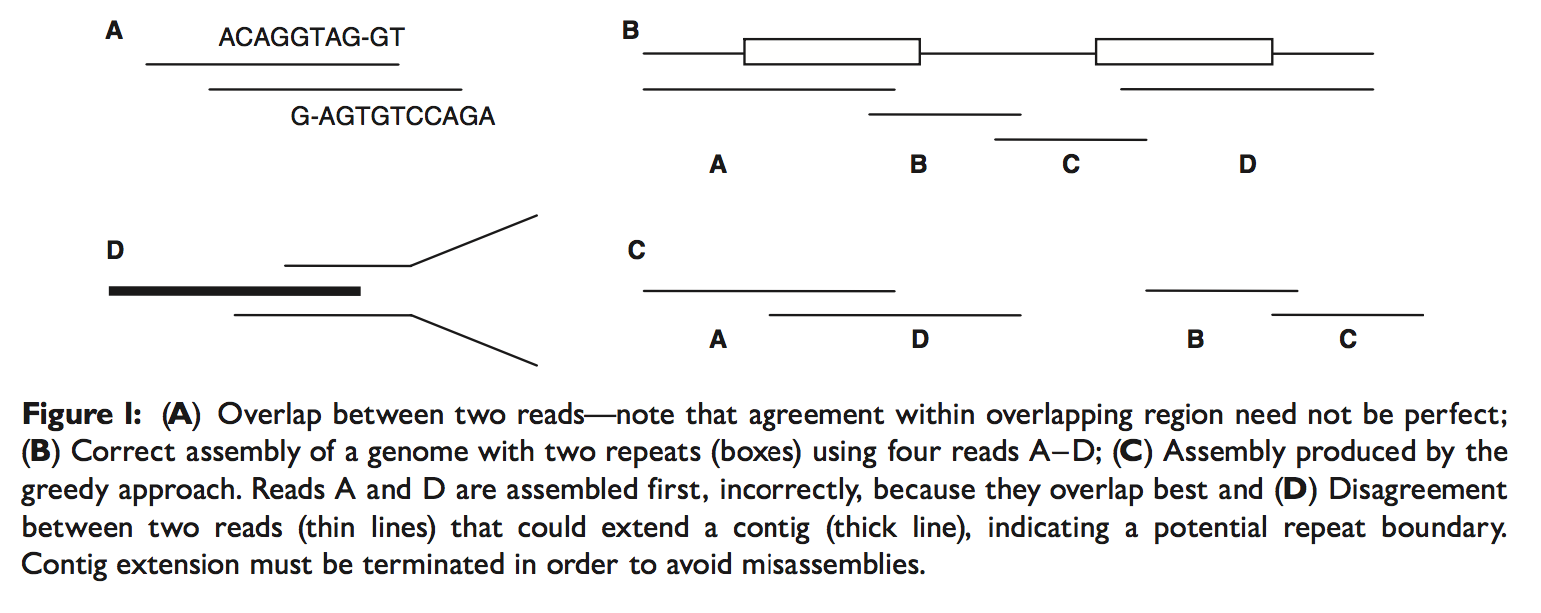
Greedy Assembly
Prone to get stuck in local optima!
Pop (2009) Briefings in Bioinformatics

Slide 27
Overlap Layout Consensus (OLC)
3 Phases:
Search for read overlaps using short seeds (k-mers); extend seeds (sounds a bit like BLAST…)
Construct a graph of overlapping reads
Perform a multiple sequence alignment and calculate consensus sequence

Slide 28
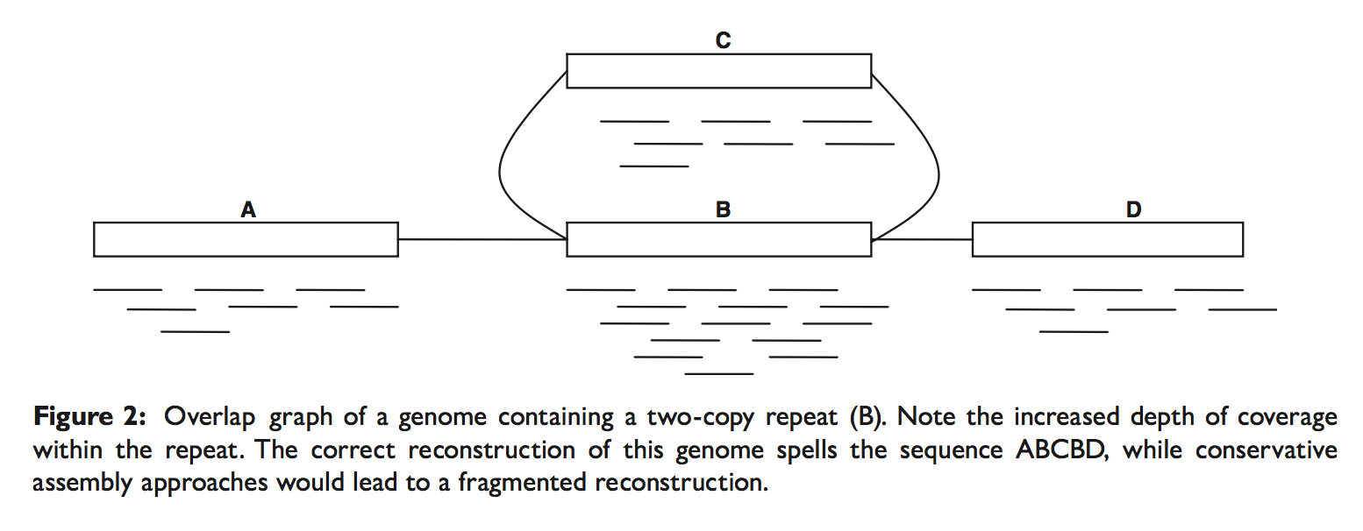
Overlap Layout Consensus (OLC)
Pop (2009) Briefings in Bioinformatics

Slide 29
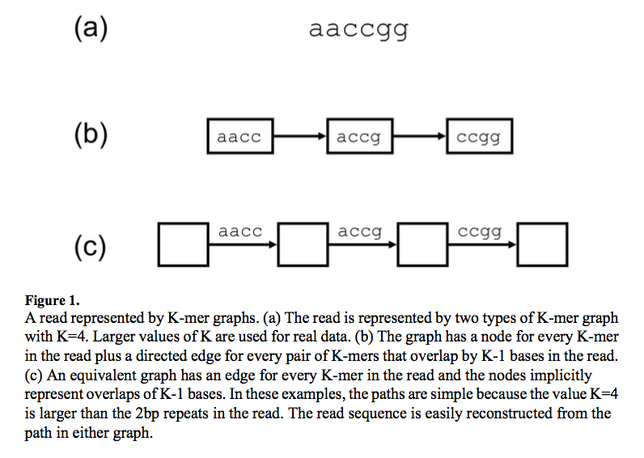
de Bruijn graph assemblers
Miller et al. (2010) Genomics

Slide 30
de Bruijn graph assemblers
Every k-mer becomes a node
Two nodes are connected if they share a k-1-mer
Miller et al. (2010) Genomics

Slide 31
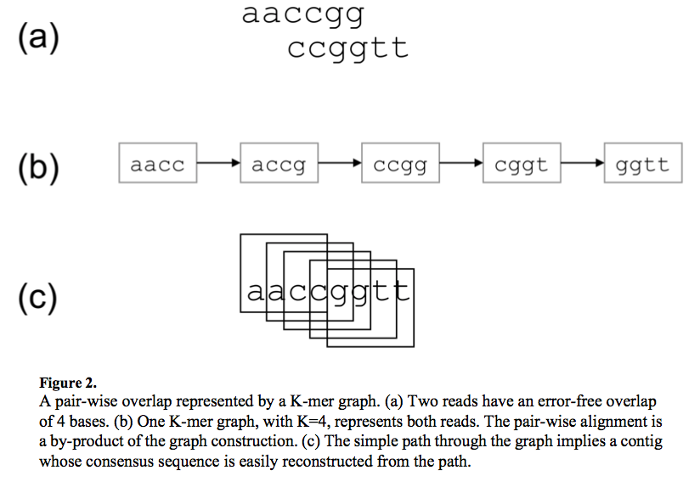
de Bruijn graph assemblers
Miller et al. (2010) Genomics

Slide 32
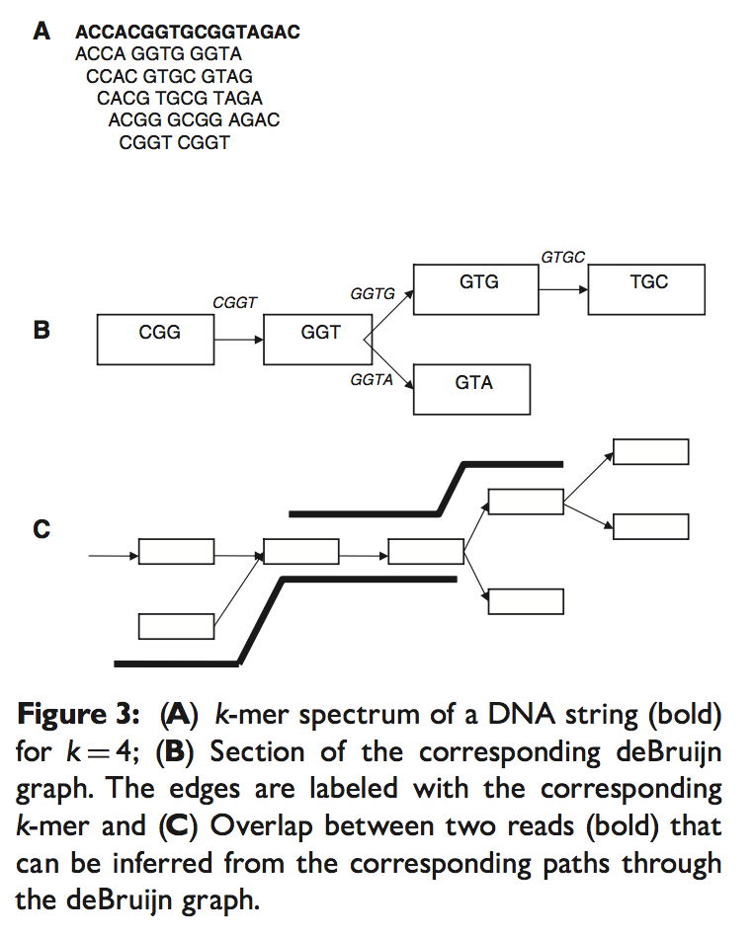
de Bruijn graph assemblers
Pop (2009) Briefings in Bioinformatics

Slide 33
de Bruijn graph assemblers
Why bother with a de Bruijn graph?

Slide 34
de Bruijn graph assemblers
Why bother with a de Bruijn graph?
This approach to assembly fits into small memory space by
creating a hash table (think Python dictionary) to store k-mer/read associations.
Given error free data with reads that span across repeats, the de Bruijn graph would equal the k-mer graph.

Slide 35
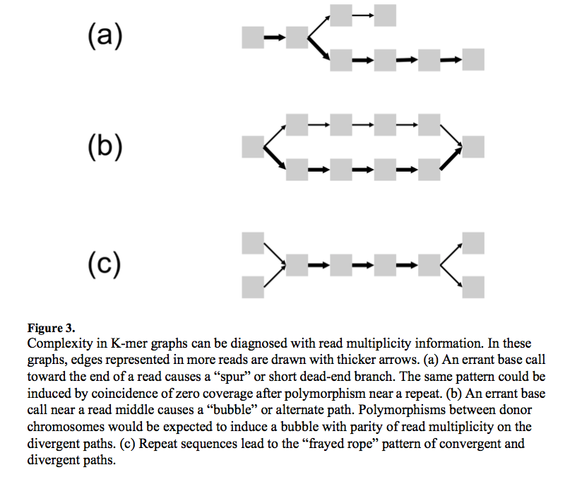
de Bruijn graph assemblers
Miller et al. (2010) Genomics

Slide 36
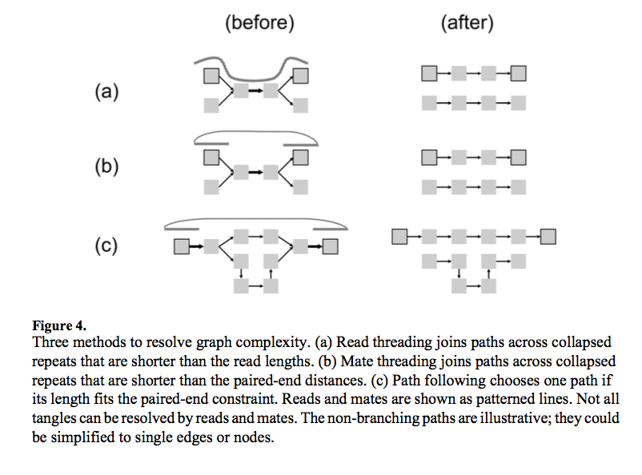
de Bruijn graph assemblers
The k-mer graph is validated against the actual reads!
Miller et al. (2010) Genomics

Slide 37
de Bruijn graph assemblers
Contigs, Scaffolds, and
Long Reads
Miller et al. (2010) Genomics

Slide 38
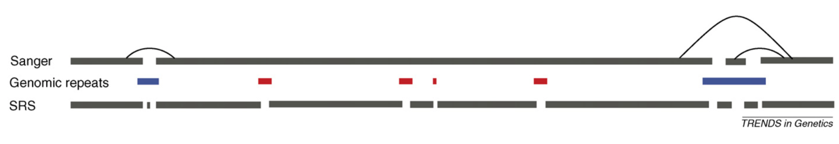
Short Reads and Their Drawbacks
Pop & Salzberg (2008) Trends in Genetics

