Slide 1
BI694 Bioinformatics & Phylogenetics
Winter Semester 2017
WEEK 4

Slide 2
Overview
BLAST: Basic Local Alignment Tool
Local alignment!
Used to compare sequences to database
Described by Altschul et al. 1990

Slide 3
Overview
BLAST: Basic Local Alignment Tool
Identify highest scoring pair (HSP) between sequences
Produces ungapped alignments
Newer versions allow for gaps in alignment

Slide 4
BLAST algorithm
 |  | Database (e.g., genome)
 |  | C | C | A | A | G | G | T | C | A | G | T

Slide 5
BLAST algorithm
 |  | Database (e.g., genome)
 |  | C | C | A | A | G | G | T | C | A | G | T
Query | A
 | C
 | C
 | G
 | G
 | G
 | T
 | T
 | T
 | T
How do we find the best subset of sequences that match between query and database?
We want to find the best ungapped local alignment…

Slide 6
BLAST algorithm
 |  | 1 | 2 | 3 | 4 | 5 | 6 | 7 | 8 | 9 | 10 | 11
 |  | C | C | A | A | G | G | T | C | A | G | T
1 | A
2 | C
3 | C
4 | G
5 | G
6 | G
7 | T
8 | T
9 | T
10 | T
Scoring matrix with:
Sii = +1
Sij = -1
i ≠ j
How do we find the best matching sub-sequences?

Slide 7
BLAST algorithm
 |  | 1 | 2 | 3 | 4 | 5 | 6 | 7 | 8 | 9 | 10 | 11
 |  | C | C | A | A | G | G | T | C | A | G | T
1 | A
2 | C
3 | C
4 | G
5 | G
6 | G
7 | T
8 | T
9 | T
10 | T
Scoring matrix with:
Sii = +1
Sij = -1
i ≠ j
2) Determine highest segment score →
Highest Scoring Pair (HSP)

Slide 8
BLAST algorithm
 |  | 1 | 2 | 3 | 4 | 5 | 6 | 7 | 8 | 9 | 10 | 11
 |  | C | C | A | A | G | G | T | C | A | G | T
1 | A
2 | C
3 | C
4 | G
5 | G
6 | G
7 | T
8 | T
9 | T
10 | T
Scoring matrix with:
Sii = +1
Sij = -1
i ≠ j
2) Determine highest segment score →
Highest Scoring Pair (HSP)
maximum
minimum

Slide 9
BLAST algorithm
 |  | 1 | 2 | 3 | 4 | 5 | 6 | 7 | 8 | 9 | 10 | 11
 |  | C | C | A | A | G | G | T | C | A | G | T
1 | A
2 | C
3 | C
4 | G
5 | G
6 | G
7 | T
8 | T
9 | T
10 | T
Scoring matrix with:
Sii = +1
Sij = -1
i ≠ j
2) Determine highest segment score →
Highest Scoring Pair (HSP)
maximum
Score = max - min
minimum

Slide 10
BLAST algorithm
 |  | 1 | 2 | 3 | 4 | 5 | 6 | 7 | 8 | 9 | 10 | 11
 |  | C | C | A | A | G | G | T | C | A | G | T
1 | A
2 | C
3 | C
4 | G
5 | G
6 | G
7 | T
8 | T
9 | T
10 | T
By chance ¾ of comparisons will be mismatches → negative trend.
Scoring matrix with:
Sii = +1
Sij = -1
i ≠ j
2) Determine highest segment score →
Highest Scoring Pair (HSP)

Slide 11
BLAST algorithm
 |  | 1 | 2 | 3 | 4 | 5 | 6 | 7 | 8 | 9 | 10 | 11
 |  | C | C | A | A | G | G | T | C | A | G | T
1 | A
2 | C
3 | C
4 | G
5 | G
6 | G
7 | T
8 | T
9 | T
10 | T
Without going into much detail: we can calculate our confidence in the HSP by comparing the best Score to the background.
Scoring matrix with:
Sii = +1
Sij = -1
i ≠ j
2) Determine highest segment score →
Highest Scoring Pair (HSP)

Slide 12
BLAST algorithm
 |  | 1 | 2 | 3 | 4 | 5 | 6 | 7 | 8 | 9 | 10 | 11
 |  | C | C | A | A | G | G | T | C | A | G | T
1 | A
2 | C
3 | C
4 | G
5 | G
6 | G
7 | T
8 | T
9 | T
10 | T
Without going into much detail: we can calculate our confidence in the HSP by comparing the best Score to the background.
Scoring matrix with:
Sii = +1
Sij = -1
i ≠ j
2) Determine highest segment score →
Highest Scoring Pair (HSP)
BLAST reports Score as bit score. Using the length of the query and size of database the e-value is calculated.

Slide 13
BLAST algorithm
 | M | E | N | G | G | P | A | P | E | S

Slide 14
BLAST algorithm
Create all Words of length 3 (kmers)
 | M | E | N | G | G | P | A | P | E | S
 | M | E | N
 |  | E | N | G
 |  |  | N | G | G
 |  |  |  | G | G | P
 |  |  |  |  | G | P | A
 |  |  |  |  |  | P | A | P
 |  |  |  |  |  |  | A | P | E
 |  |  |  |  |  |  |  | P | E | S

Slide 15
BLAST algorithm
Create all Words of length 3 (kmers)
Find exact matches for all W
 | I | P | A | G | G | P | A | P | E | S
 | M | E | N | G | G | P | A | P | E | S
 | M | E | N
 |  | E | N | G
 |  |  | N | G | G
 |  |  |  | G | G | P
 |  |  |  |  | G | P | A
 |  |  |  |  |  | P | A | P
 |  |  |  |  |  |  | A | P | E
 |  |  |  |  |  |  |  | P | E | S

Slide 16
BLAST algorithm
Create all Words of length 3 (kmers)
Find exact matches for all W
Score all hits
 | I | P | A | G | G | P | A | P | E | S
 | 1 | -2 | -2 | 6 | 6 | 7 | 4 | 7 | 5 | 4
 | M | E | N | G | G | P | A | P | E | S
 | M | E | N
 |  | E | N | G
 |  |  | N | G | G
19 |  |  |  | G | G | P
17 |  |  |  |  | G | P | A
18 |  |  |  |  |  | P | A | P
18 |  |  |  |  |  |  | A | P | E
16 |  |  |  |  |  |  |  | P | E | S

Slide 17
BLAST algorithm
Create all Words of length 3 (kmers)
Find exact matches for all W
Score all hits
Keep hits above Threshold (19)
 | I | P | A | G | G | P | A | P | E | S
 | 1 | -2 | -2 | 6 | 6 | 7 | 4 | 7 | 5 | 4
 | M | E | N | G | G | P | A | P | E | S
 | M | E | N
 |  | E | N | G
 |  |  | N | G | G
19 |  |  |  | G | G | P
17 |  |  |  |  | G | P | A
18 |  |  |  |  |  | P | A | P
18 |  |  |  |  |  |  | A | P | E
16 |  |  |  |  |  |  |  | P | E | S

Slide 18
BLAST algorithm
Create all Words of length 3 (kmers)
Find exact matches for all W
Score all hits
Keep hits above Threshold (19)
Extend alignment until T drops
 | I | P | A | G | G | P | A | P | E | S
 | 1 | -2 | -2 | 6 | 6 | 7 | 4 | 7 | 5 | 4
 | M | E | N | G | G | P | A | P | E | S
21 |  |  | N | G | G | P | A

Slide 19
BLAST algorithm
Current versions produce gapped alignments
Multiple seeds of short kmer matches are kept during initial search
These matches are extended
Final alignment reported is a Smith-Waterman alignment
 | I | P | A | G | G | P | A | P | E | S
 | I | P | A | A | P | P | E | P | E | S
 | M | E | N
 |  |  |  |  |  |  |  | P | E | S

Slide 20
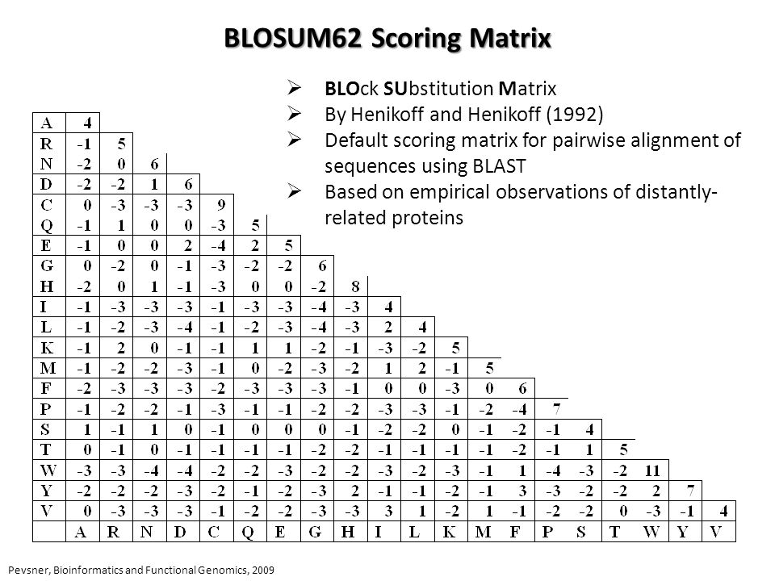
BLAST

Slide 21
BLAST
Query NLYENFVQATFNALTAEKV
NY ENF+Q+ + L +
Subject NYAENTIQSIISTVEPAQR
Centerline provides the following information:
Letter designates identity of high similarity
Plus indicates similarity but not very similar
No symbol equals low similarity

Slide 22
BLAST
Nucleotide scoring matrices for ungapped (left) and gapped alignments (right)
 | A | T | C | G |  |  | A | T | C | G
A | 5 |  |  |  |  | A | 1
T | -4 | 5 |  |  |  | T | -3 | 1
C | -4 | -4 | 5 |  |  | C | -3 | -3 | 1
G | -4 | -4 | -4 | 5 |  | G | -3 | -3 | -3 | 1
Gap opening score: -11
Gap extension: -1

Slide 23
BLAST statistics
Score (Bits)
a conversion of of summed substitution scores
Expect(e) value
Function of the score and database size
1 alignment using a query of this size will by chance produce a score of this value in a database of this size
e-value is specific to a database of a certain size

Slide 24
BLAST statistics
Rules of thumb
e value of =< e-5: often used for annotating genes
E value of =< e-30: strong evidence of homolgy
Length of hit is important when evaluating e values

Slide 25
BLAST programs
Search | Query | Database
blastn | nucleotide | nucleotide
blastx | translated nucleotide in all 6 frames | protein
tblastx | translated nucleotide in all 6 frames | translated nucelotide in all 6 frames
blastp | protein | protein

Slide 26
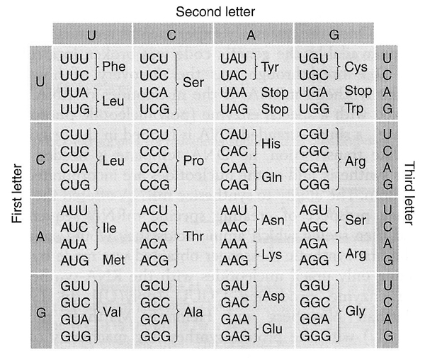
BLAST programs
Search | Query | Database
blastn | nucleotide | nucleotide
blastx | translated nucleotide in all 6 frames | protein
tblastx | translated nucleotide in all 6 frames | translated nucelotide in all 6 frames
blastp | protein | protein

