Slide 1


Slide 2
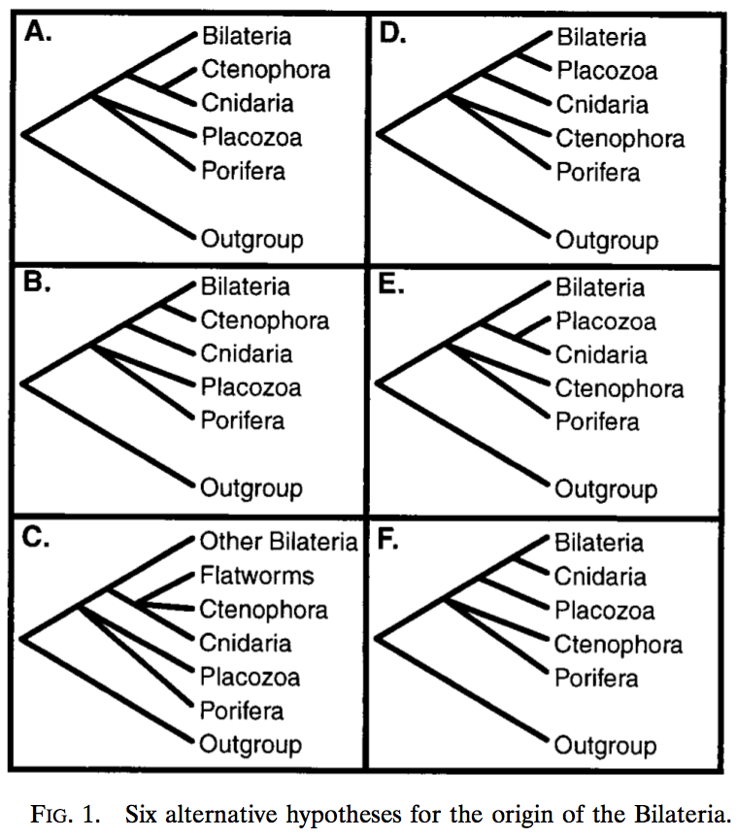
Collins (1998) PNAS

Slide 3
Maximum likelihood
Bootstrapping ML phylogenies: RAxML implements fast algorithm for ML search
$ raxmlHPC -f a \ # rapid bootstrap and search for best ML tree
-m GTRGAMMA \ # model of evolution
-p 12345 \ # random no seed for tree search
-x 12345 \ # random number seed for bootstrap
-# 100 \ # no of bootstrap replicates
-s RootOfBilateria_RAxML.phy \ # alignment file
-n Bilatria_RAxML # name of run

Slide 4
Bayesian
MrBayes:
lset nst=6 rates=gamma # set the model
prset statefreqpr=fixed(equal) # set the prior
mcmcp \
ngen=100000 \ # number of generations to run sampler for
printfreq=100 \ # How often will output be printed to screen
samplefreq=100 \ # set frequency for sampling trees and their likelihoods
nruns=2 nchains=4 \ # How many chains and runs are conducted?
savebrlens=yes \ # save the branch lengths of tree
mcmcdiagn=yes # save diagnostics of run
mcmc # start MCMC sampler
sump # calculate summary statistics
sumt # calculate consensus tree

Slide 5
Bayesian
R we there yet – basic run diagnostics recipe:
$ library(rwty)
# load trees and parameter estimates
$ mb <- load.multi('./', format='mb')
# Let's look at how we are sampling treespace...
$ mb.rwty.topology <- makeplot.topology(mb, burnin=0)
$ mb.rwty.param <- makeplot.param(mb, burnin=0)
$ stats.rwty.treespace <- makeplot.treespace(mb)

