Slide 1


Slide 2
Phylogenetic Analysis using PAUP
The Nexus file format and PAUP command block
→ example using a small dataset

Slide 3
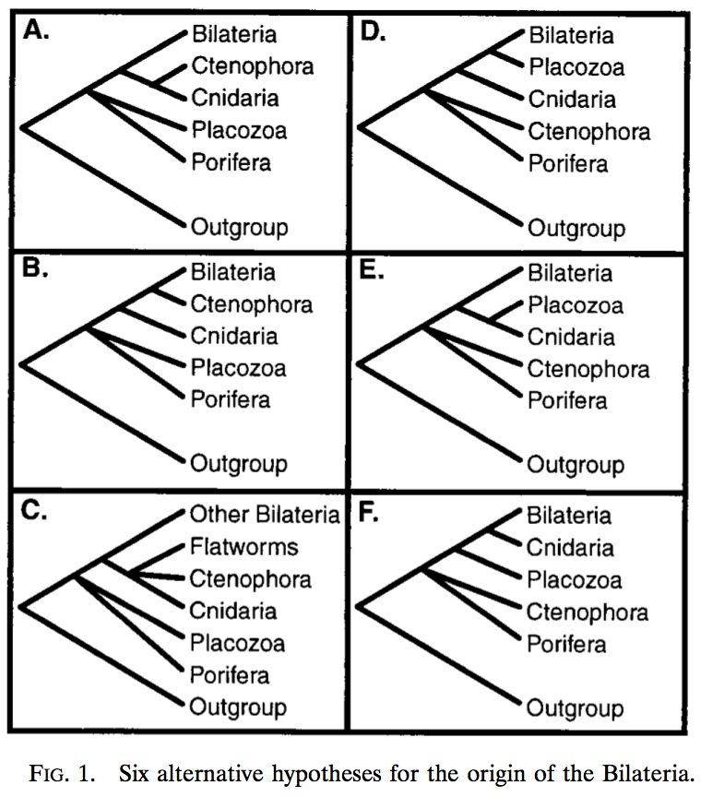
Phylogenetic Analysis using PAUP
Collins (1998) PNAS

Slide 4
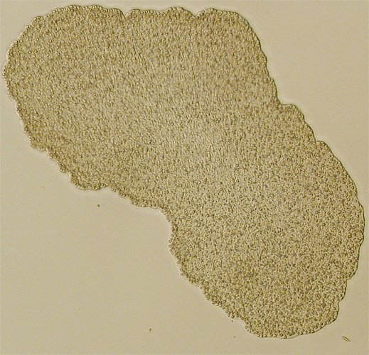
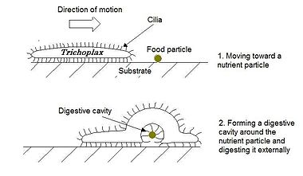
Phylogenetic Analysis using PAUP
Collins (1998) PNAS

Slide 5
Phylogenetic Analysis using PAUP
We have a best tree but how
confident are we in the results?
Collins (1998) PNAS

Slide 6
Evaluating a tree: the bootstrap
Data in hand are probably somewhat like the underlying universe of
possible data sets
We can simulate other possible data sets by drawing randomly from the
data already collected
This seems to get information from nothing, lifting yourself off the ground
by your bootstraps...

Slide 7
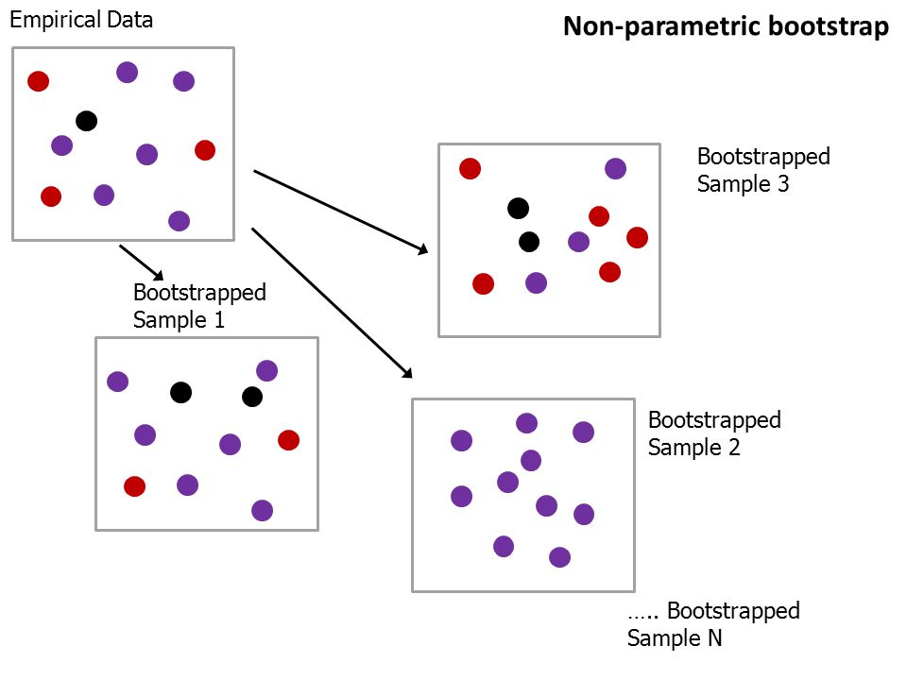
Evaluating a tree: the bootstrap

Slide 8
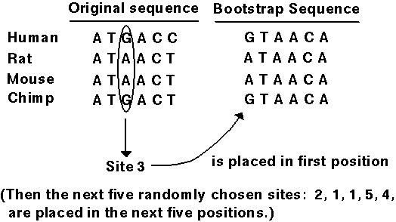
Evaluating a tree: the bootstrap

Slide 9
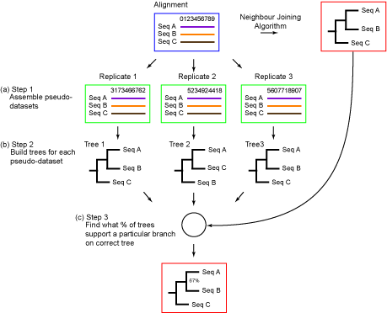
Evaluating a tree: the bootstrap

Slide 10
How about maximum likelihood?
Collins (1998) PNAS

Slide 11
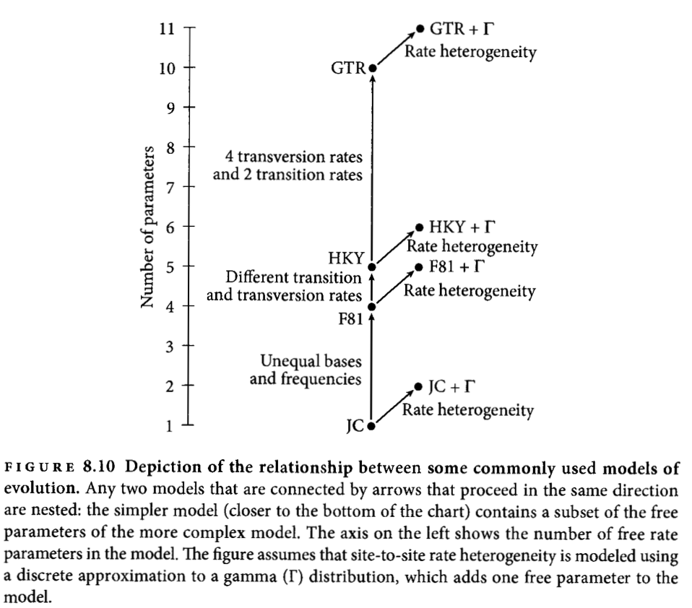
Testing Model Fit
Pick a more complex model only when the gain in likelihood is higher than expected if
the simpler model were true.

Slide 12
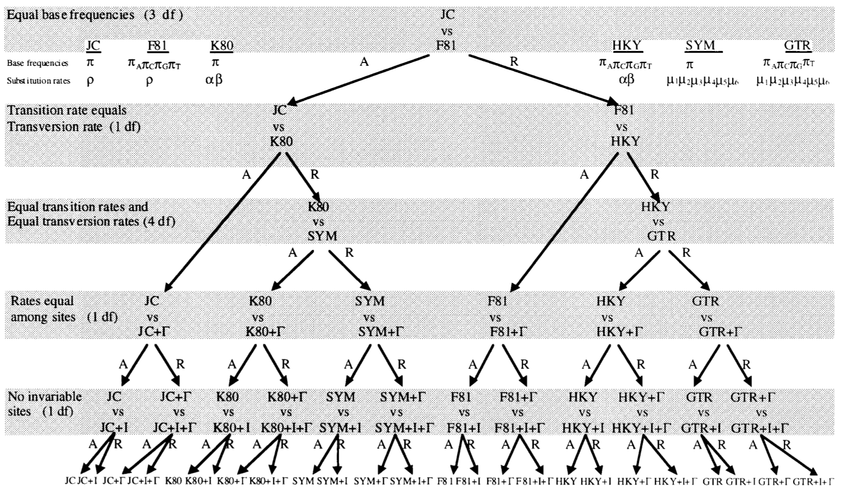
Testing Model Fit
Posada & Crandall (1998)

Slide 13
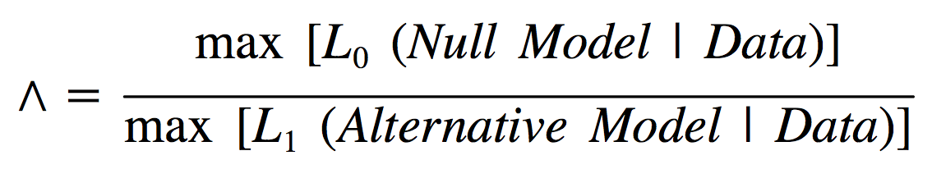
Testing Model Fit
Likelihood Ratio:
Chi-square can be used as approximation for likelihood ratio test

Slide 14
Testing Model Fit
Akaike Information Criterion (AIC)
Suppose data generated by some unknown process f. Two candidate models
represent f: g1 and g2.
If we knew f, then we could find the
information lost from using g1; similarly, the information lost from using g2 to
represent f could be found. We would then choose the candidate model that
minimized the information loss.
We do not know f. We can estimate how much more (or less) information is lost
by g1 than by g2; ie, which model fits the data better (Akaike 1974)
k is the number of estimated parameters; ln(L) the log likelihood
Smaller AIC indicates better fit of the model to the data

Slide 15
Testing Model Fit
MrModeltest:
Execute your data file in PAUP*.
Execute the file MrModelblock in PAUP*. A file called mrmodel.scores will
appear in the current directory.
This file is the input for mrmodeltest2.
mrmodeltest2 < mrmodel.scores > out

Slide 16
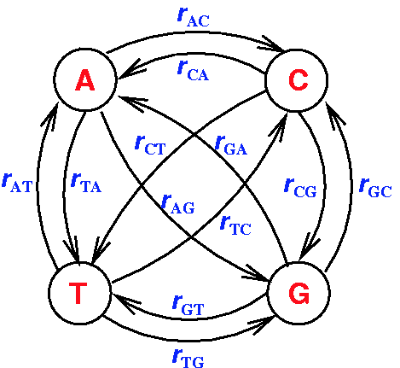
Testing Model Fit

