Slide 1
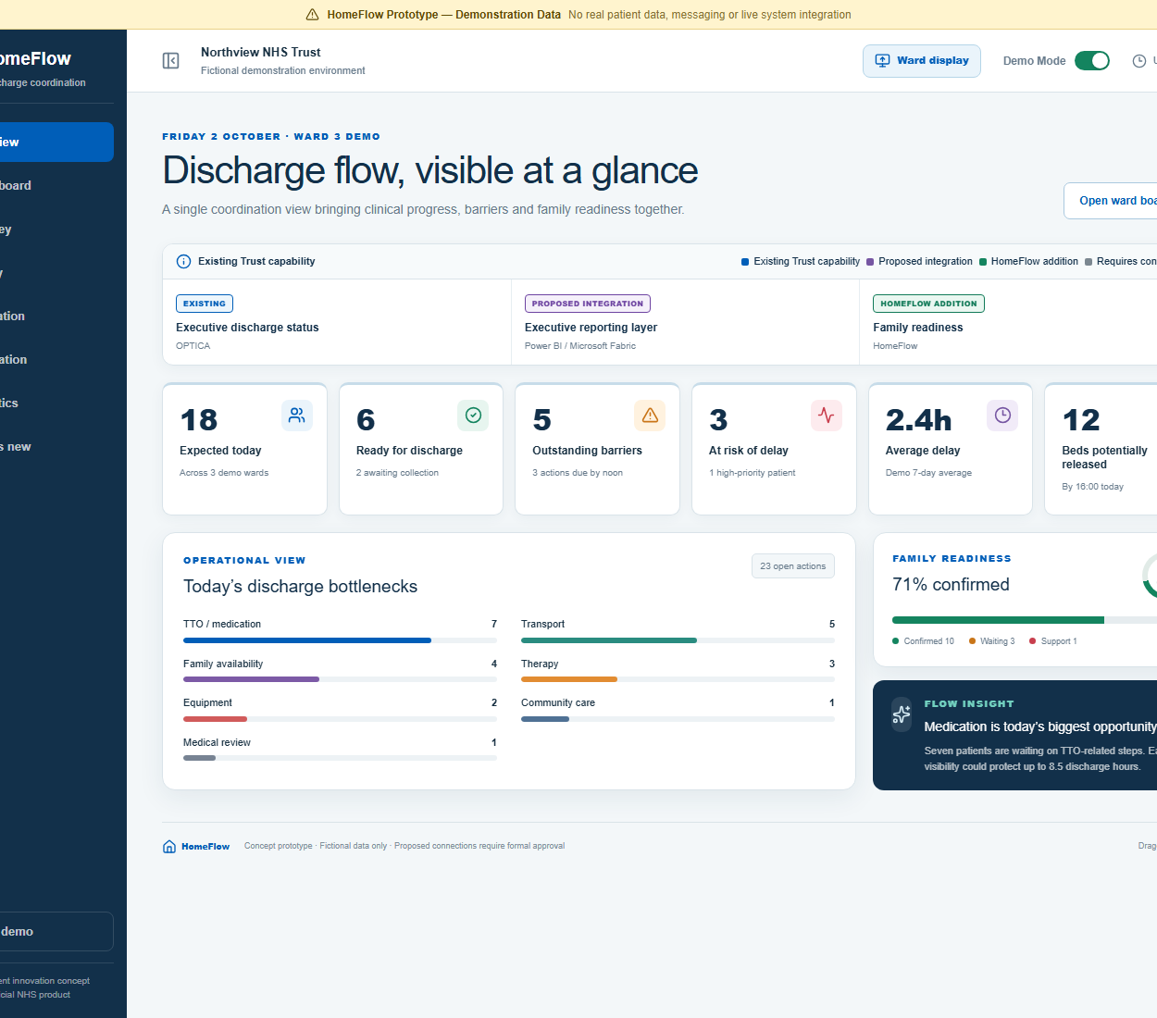
HOMEFLOW: REDUCING DISCHARGE DELAYS
HomeFlow
Preparing the patient, the ward and the family for discharge
A proposed coordination and family readiness layer
PROTOTYPE / DEMONSTRATION DATA ONLY
DRAGONS’ DEN 2026
Notes:
HomeFlow focuses on a simple discharge problem. A patient can be medically ready, but the ward may still be waiting for medication, transport, equipment, or a family collection plan. HomeFlow proposes one clear coordination view so the patient, ward team and family prepare together. Everything shown is a prototype using fictional demonstration data. I am not presenting HomeFlow as an existing Trust product or claiming that these integrations already operate.

Slide 2
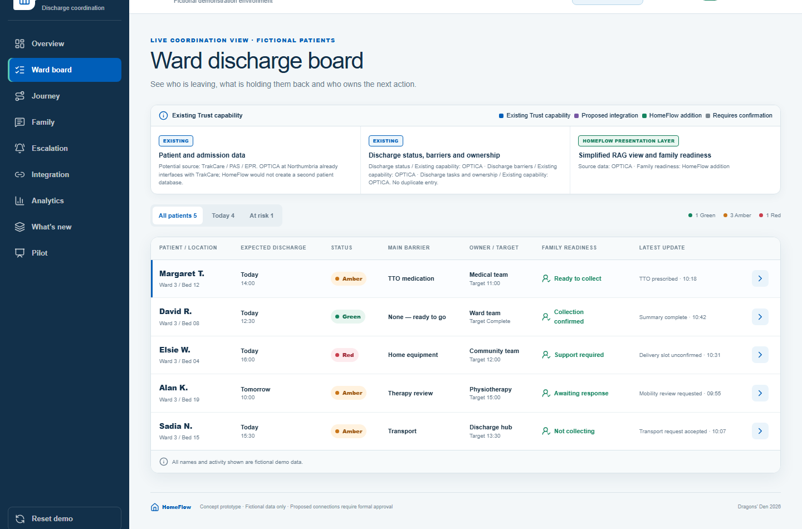
02
The discharge visibility gap
PROTOTYPE / DEMONSTRATION DATA ONLY
Clinical readiness can arrive before practical readiness
A patient can be ready for discharge and still wait.
The next barrier is not visible to everyone
Ownership and target times are easy to miss
Family readiness may only surface late
The result
avoidable waiting after the clinical decision
AMBER BARRIER
HomeFlow
Independent innovation concept
02
Notes:
The problem is not simply whether someone is medically fit. Discharge depends on several practical actions completing at the right time. A medication task can be overdue, transport may be booked for later, or the family may not know when to prepare. Teams already work hard to manage these details, but the information does not always appear together in one clear view. The Amber patient shown here illustrates the gap: we can see the barrier, owner, target time and family readiness together, rather than discovering each issue in sequence.

Slide 3
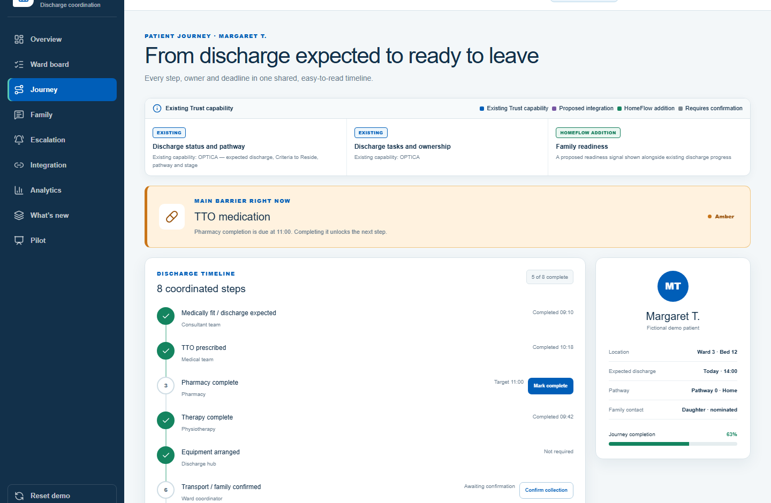
03
The HomeFlow idea
PROTOTYPE / DEMONSTRATION DATA ONLY
A shared view of the next action and what it depends on
One coordination view
Discharge status
Outstanding barrier
Named owner and deadline
Family readiness
HOMEFLOW ADDITION
Family readiness sits beside the existing discharge workflow.
HomeFlow
Independent innovation concept
03
Notes:
The idea is to create one shared coordination view around the discharge journey. Staff can see the current status, the main barrier, who owns the action, the deadline and whether the family can collect or needs support. HomeFlow should not ask teams to re-enter information that already exists in OPTICA or the patient record. Its genuinely new contribution is the family readiness signal and a simplified presentation that makes dependencies easier to act on. In the prototype, updating an action also changes the ward board and the separate ward display.

Slide 4
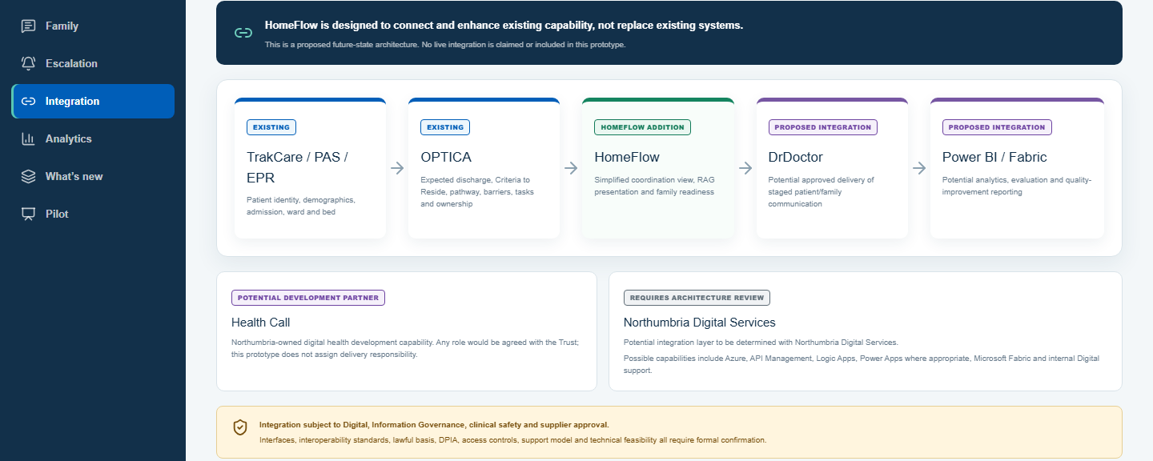
04
We are not starting from scratch
PROTOTYPE / DEMONSTRATION DATA ONLY
HomeFlow is designed around existing Trust capability
EXISTING CAPABILITY
PROPOSED INTEGRATION
HOMEFLOW ADDITION
REQUIRES CONFIRMATION
Health Call and Digital Services: potential development support subject to Trust review
HomeFlow
Independent innovation concept
04
Notes:
HomeFlow should build on capability already available to the Trust. TrakCare, PAS or the EPR can provide patient and ward information. OPTICA already supports discharge status, barriers, tasks and ownership. DrDoctor could potentially deliver approved patient or family messages, and Power BI or Microsoft Fabric could support evaluation. Those connections are proposals, not current HomeFlow integrations. Health Call and Northumbria Digital Services could advise on development and architecture, but their role would need formal agreement alongside Information Governance, clinical safety and supplier review.

Slide 5
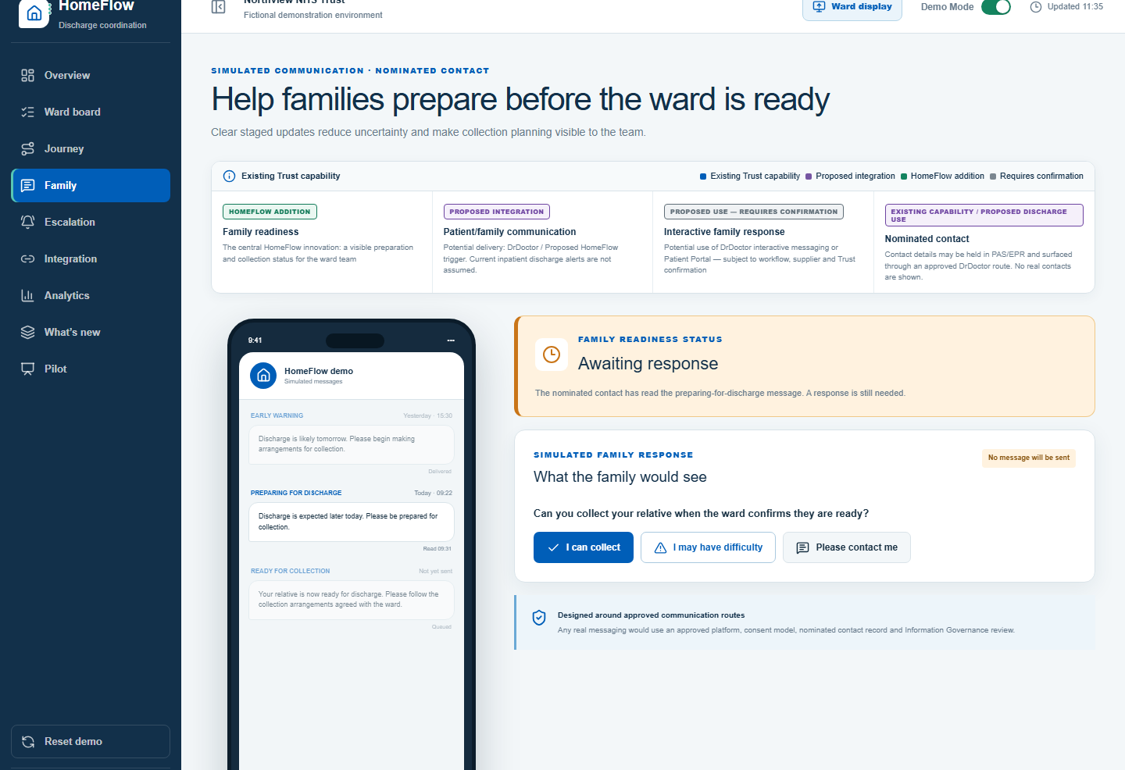
05
Family readiness alerts
PROTOTYPE / DEMONSTRATION DATA ONLY
Earlier notice gives families more time to prepare
A staged conversation
01
Likely discharge
Begin planning
02
Prepare for collection
Check availability
03
Ready for collection
Confirm arrangements
04
Family response
Confirm or request support
HOMEFLOW ADDITION
PROPOSED DRDOCTOR USE
HomeFlow
Independent innovation concept
05
Notes:
Families often receive certainty only when the ward is almost ready. The HomeFlow concept introduces staged communication. An early message says discharge is likely, a second asks the family to prepare, and a final message confirms that the patient is ready for collection. The family can confirm or say they may need help, so the ward sees readiness before it becomes a delay. DrDoctor is a potential delivery route because it offers established communication capability, but inpatient discharge alerts and interactive responses would need workflow, consent, supplier and Trust confirmation.

Slide 6
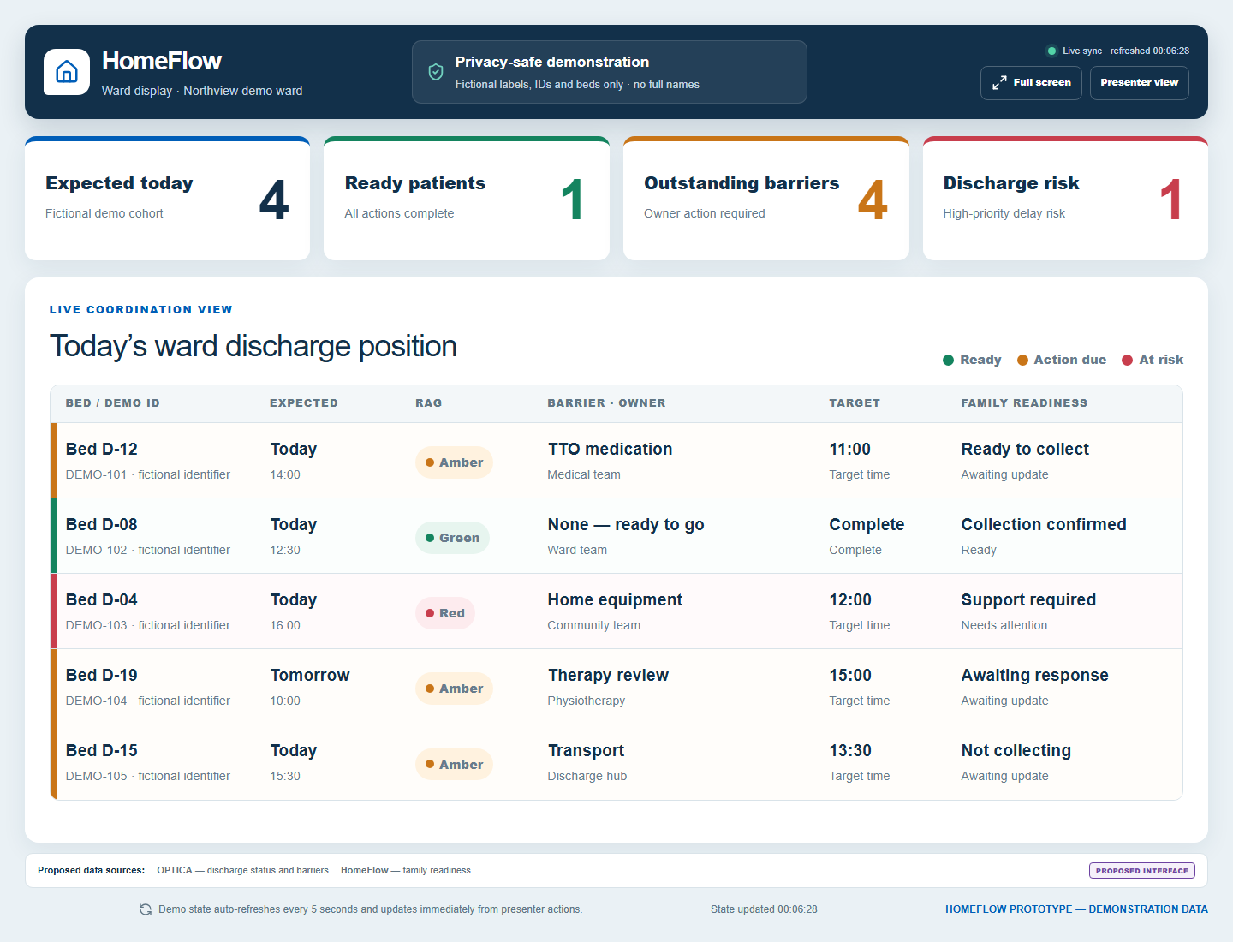
06
Ward display
PROTOTYPE / DEMONSTRATION DATA ONLY
Privacy-safe visibility for the whole team
At a glance
Expected discharges
Current barrier and owner
Target completion time
Family readiness
NO FULL PATIENT NAMES
Proposed sources: OPTICA and HomeFlow
HomeFlow
Independent innovation concept
06
Notes:
The ward display is a separate, privacy-safe interface for a large monitor. It shows expected discharges, the current barrier, who owns it, the target time and family readiness. It deliberately avoids full patient names and uses fictional bed numbers and demo identifiers in this prototype. The display updates when the presenter changes a patient in the main app, so the team sees the same information without refreshing manually. In a real pilot, OPTICA could provide discharge status and barriers while HomeFlow contributes the family readiness signal, subject to technical and governance approval.

Slide 7
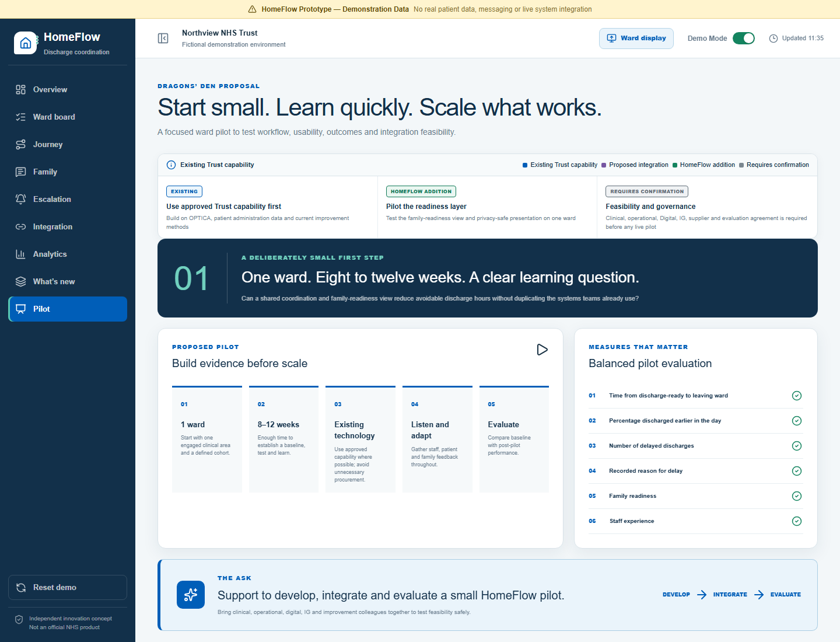
07
Pilot and ask
PROTOTYPE / DEMONSTRATION DATA ONLY
One ward, 8 to 12 weeks, with clear measures
What we would test
Discharge-ready to leaving time
Delayed discharges and common barriers
Discharge time of day
Family readiness
Staff feedback
THE ASK
Support a small HomeFlow pilot with Digital, discharge teams and ward staff
USE EXISTING TECHNOLOGY WHERE POSSIBLE
HomeFlow
Independent innovation concept
07
Notes:
The ask is deliberately modest. I am seeking support to work with Digital, discharge teams and ward staff on one ward for eight to twelve weeks. We would use existing technology wherever possible and evaluate whether the HomeFlow view changes day-to-day coordination. The measures include the time from discharge-ready to leaving, delayed discharges, time of day, common barriers, family readiness and staff feedback. The purpose is to learn safely before considering scale. I am asking for the clinical, operational, digital and improvement support needed to develop and evaluate that small pilot.

