Slide 1




No Show Prediction
By:
Ibrahim
Priyadarshi
Punit
Sheeba Patel

Slide 2
Agenda
Our Goals
Data Cleaning
Data Exploration
Feature Engineering
Predictive Modelling
Business Understanding
Data Visualization

Slide 3

“In God We Trust, all others must bring the Data.”
W. Edwards Deming

Slide 4
Lets know the Data first.
14 columns
Datatypes
Columns required
Columns Omitted

Slide 5

Background
Costs the U.S. healthcare system $150 billion a year
No-shows have a direct impact on individuals’ health
Data Source: https://www.ncbi.nlm.nih.gov/pmc/articles/PMC6243417/

Slide 6


How to Reduce no-shows
Patient reminders
Predict before they happen

Slide 7
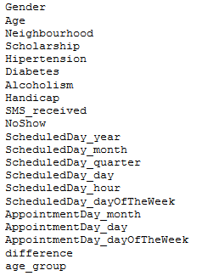

Data Background
107,419 and 14 columns

Slide 8

Python Packages used
Pandas
Seaborn
Numpy
matplotlib.pyplot
Matplotlib
Scipy
Missingno

Slide 9
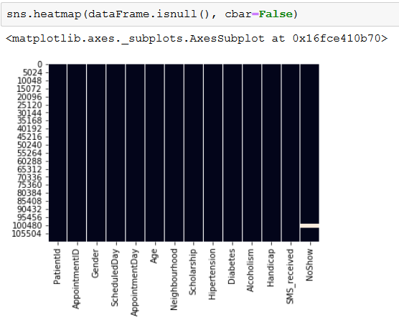
Check out the Nulls
Null values in NoShow column.

Slide 10
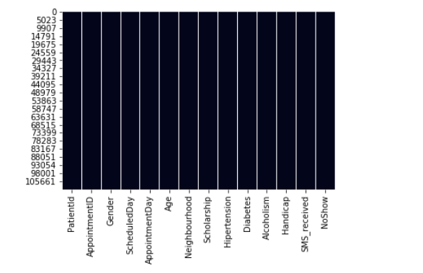
Check out the Nulls
No Nulls by dropping the Null values by using dropna() function.

Slide 11
Lets do the Cleansing
Renaming Columns
Identifying Distinct values for Handicap.
Dropping na values
Checking any residual null values.

Slide 12
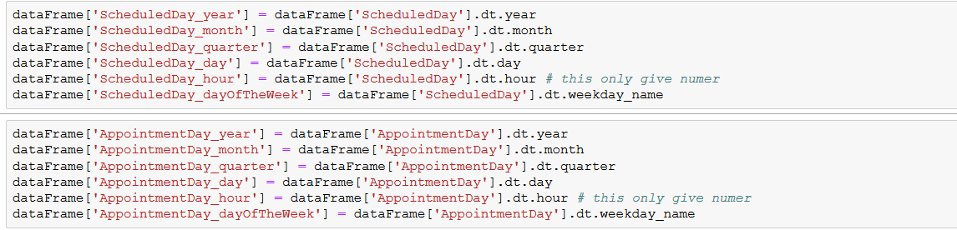
Changing Schedule/ Appointment day to date & time.
Calculating difference between Appointment day and Scheduled Day

Slide 13
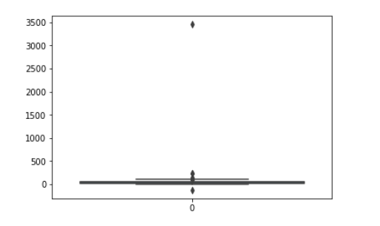

Data Exploration
Outlier inspection with the Age data
We have discarded any age in less than 0 and greater than 110
We have done outlier inspection for all the columns respectively and discarded the outliers.

Slide 14
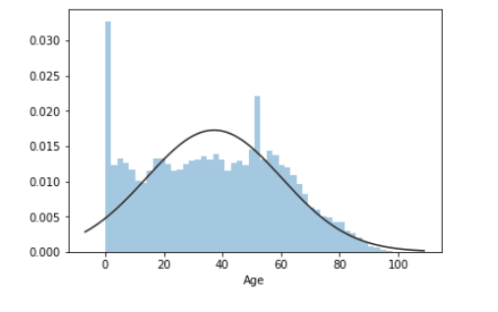
Distribution plot for Age

Slide 15
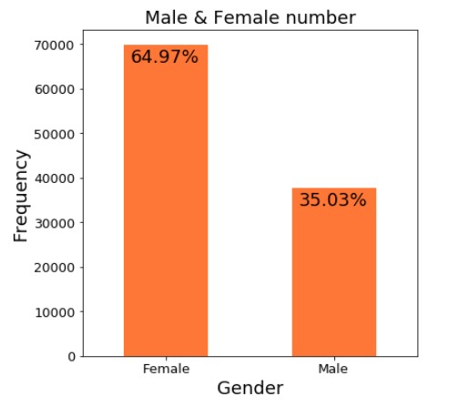
Gender count based on Frequency

Slide 16
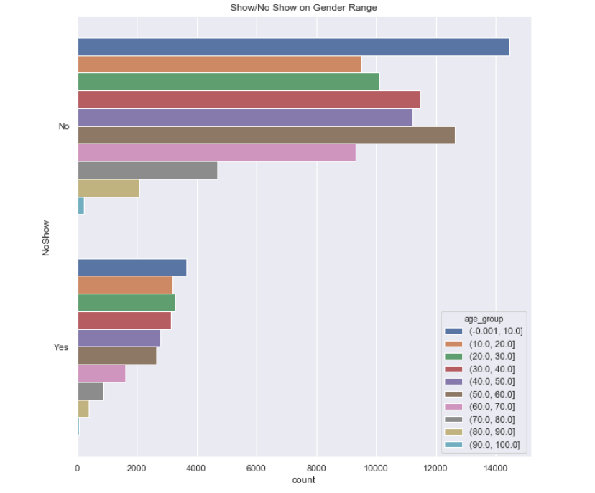
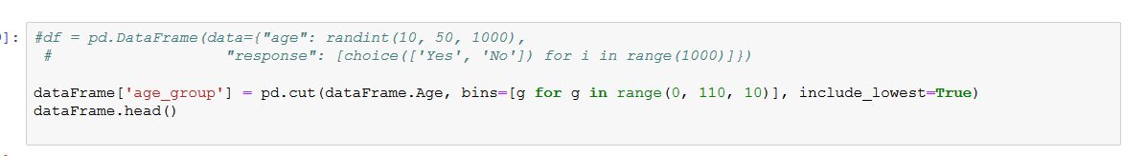
No Show based on Age range
We have created bin of 10 for the age variable to se which age range are not showing up to the appointment.

Slide 17
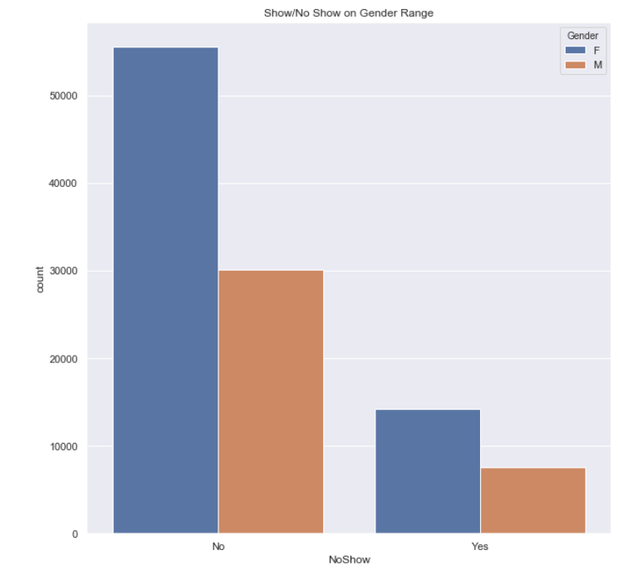
No Show based on Male and Female
As we can see Males are showing up more for there appointments.

Slide 18
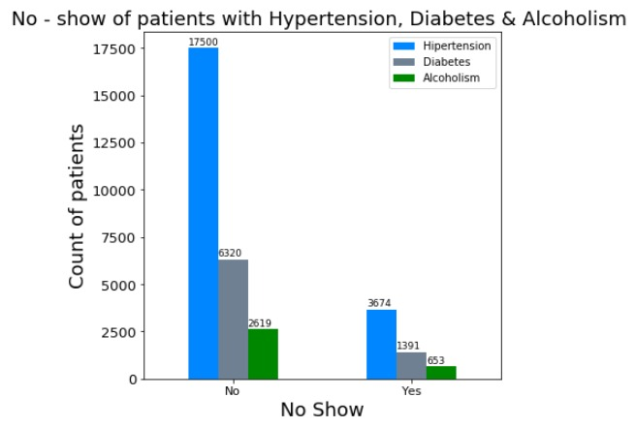
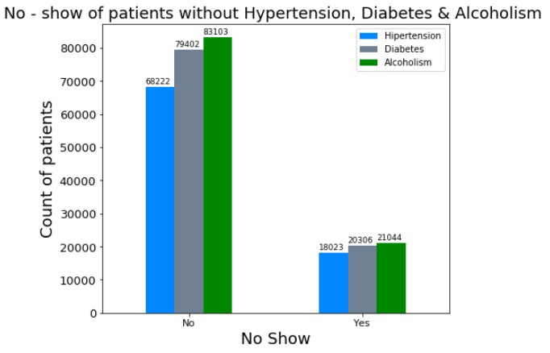
Conditions

Slide 19
Lets prep the Ingredients(Data)
Renaming Attributes
Replacing ‘M’ with ‘1’ in Gender Column.
Replacing ‘F’ with ‘0’ in Gender Column.
Applying Lambda function in order to get NoShow as 0 and 1.
Dropping columns.

Slide 20

Predictions

Slide 21
Model Prediction
Training and Testing in the ratio 70:30
Training data has 75193 observation and test has 32226 observations.
RandomForestClassifier() with 10,000 trees with depth of 10 each.
Fit() is used to training the model and we have predicted the feature using predict() .
We have calculated the accuracy using accuracy_score() which comes around 80%.

Slide 22
Conclusion
We know 80% accuracy is not a deployable solution, but while working on the project we learned that there are some columns which are imbalanced and which might affect the accuracy.
We will be working to make the dataset more balanced and again training the model.

Slide 23

Thank you & Happy Holidays

