Slide 1
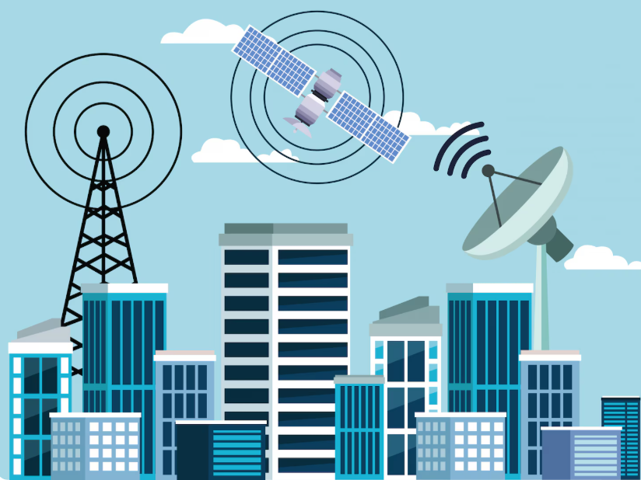
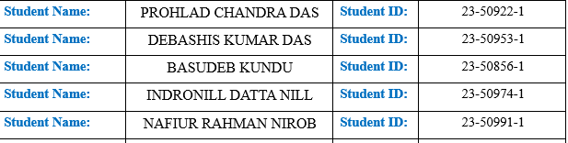
Welcome To Our Presentation
OEL Report, Section D, Group - 4
Group Members:
`

Slide 2
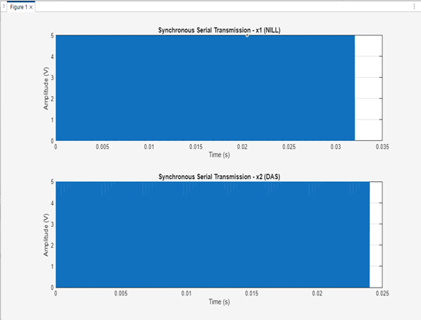
Task 1: Binary Conversion & NRZ Visualization
How we solved :
1. Convert Names to Binary: Converted group members’ surnames ('NILL' and 'DAS') to 8-bit ASCII binary.
2.Form Bitstream: Flattened the binary matrices column-wise to create a numeric bitstream for serial transmission.
3.Display Binary Vectors: Printed the binary vectors for verification.
4.NRZ Signal Generation: Generated Unipolar NRZ waveforms by mapping bit ‘1’ to high voltage and bit ‘0’ to low voltage.
5.Plotting: Visualized the NRZ signals using subplot with time on x-axis and voltage on y-axis.
Code Snippet:
% Convert names to binary
x1 = dec2bin('NILL',8)'; x1 = x1(:)-'0';
x2 = dec2bin('DAS',8)'; x2 = x2(:)-'0';
% Generate NRZ waveform
samples_per_bit = 100; bp = 1e-3;
generateNRZ = @(bitstream) reshape(repmat(bitstream*5, samples_per_bit, 1),1,[]);
nrz1 = generateNRZ(x1); nrz2 = generateNRZ(x2);
% Plot signals
t1 = linspace(0,length(x1)*bp,length(nrz1));
t2 = linspace(0,length(x2)*bp,length(nrz2));
plot(t1,nrz1); plot(t2,nrz2);
OUTPUT:

Slide 3
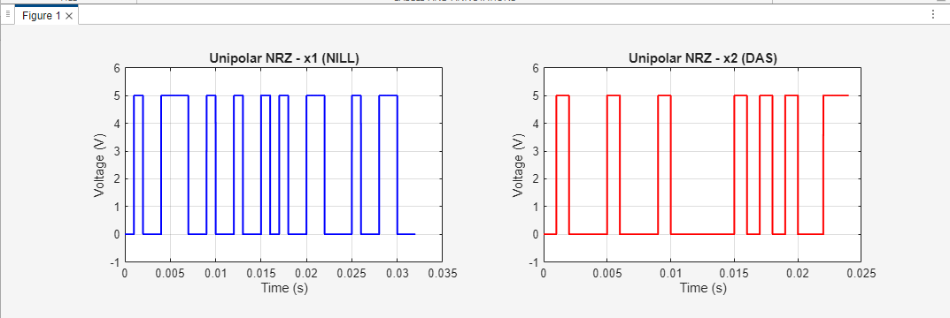
Task 2: Digital Waveform Generation (NRZ for Sample Names)
How we solved
.Define Group Members: Set the surnames of the two group members as strings.
Convert Names to Binary: Converted each character of the surnames into 8-bit ASCII binary to create bitstreams.
Generate Time Vector: Defined the time vector based on the number of bits and the number of samples per bit for smooth waveform plotting.
Create NRZ Waveform: Built unipolar NRZ signals by assigning high voltage for bit ‘1’ and low voltage for bit ‘0’.
Plot NRZ Signals: Visualized both signals using subplots, including labels, titles, and grid for clarity.
Code snippet:
surname1='NILL'; surname2='DAS';
x1=dec2bin(surname1,8)'-'0'; x1=x1(:);
x2=dec2bin(surname2,8)'-'0'; x2=x2(:);
samples_per_bit=500; max_v=5;
nrz1=reshape(repmat(x1'*max_v,samples_per_bit,1),1,[]);
nrz2=reshape(repmat(x2'*max_v,samples_per_bit,1),1,[]);
t1=linspace(0,length(x1)*1e-3,length(nrz1));
t2=linspace(0,length(x2)*1e-3,length(nrz2));
subplot(2,2,1); plot(t1,nrz1); title('x1 (NILL)');
subplot(2,2,2); plot(t2,nrz2); title('x2 (DAS)');
Output:

Slide 4
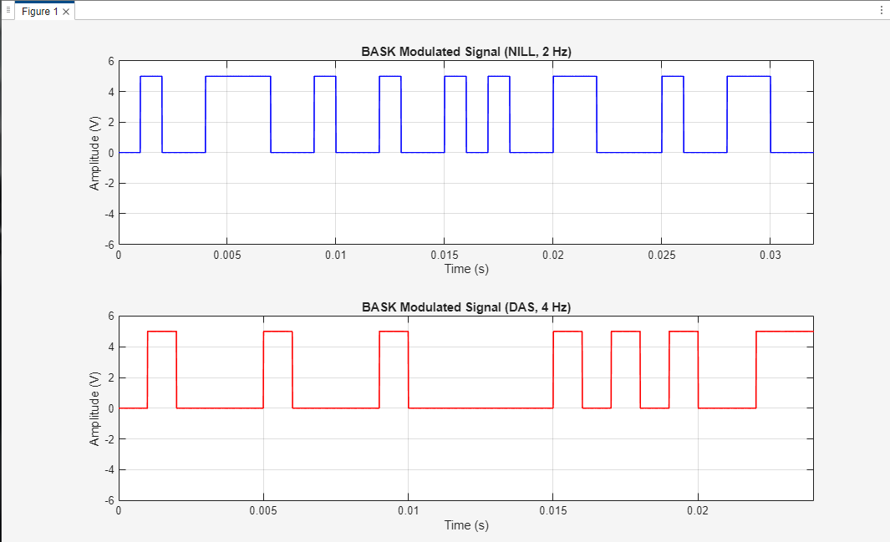
Task 3: BASK Modulation of Bitstreams
Code Snippet:
% Modulate each bit using BASK
bp = 0.001; A1 = 5; A0 = 0; f1 = 2; f2 = 4;
t_bit = linspace(0,bp,100);
m1=[]; m2=[];
for i=1:length(x1)
if x1(i)==1, y=A1*cos(2*pi*f1*t_bit); else y=A0*cos(2*pi*f1*t_bit); end
m1=[m1 y];
end
for i=1:length(x2)
if x2(i)==1, y=A1*cos(2*pi*f2*t_bit); else y=A0*cos(2*pi*f2*t_bit); end
m2=[m2 y];
end
Output:
How we solved:
1.Bitstream Preparation: Converted surnames to 8-bit binary vectors.
2.Define Modulation Parameters: Set bit period, amplitude for ‘1’ and ‘0’, and carrier frequencies.
3.BASK Modulation: For each bit, multiplied a cosine carrier by amplitude depending on bit value.
4.Plot Modulated Signal: Plotted modulated signals for visualization.

Slide 5
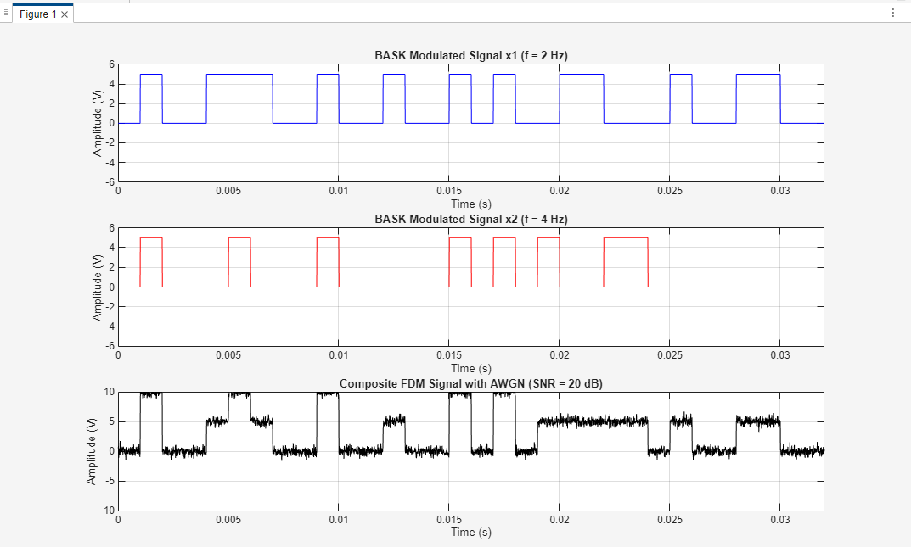
Task 4: Frequency Division Multiplexing (FDM) with Noise
How we solved:
Equalize Lengths: Padded shorter bitstream to match lengths.
BASK Modulation: Generated modulated signals for x1 and x2.
FDM Composite: Added the two modulated signals to create a composite FDM signal.
Add Noise: Applied Gaussian noise using awgn.
Plot Signals: Plotted individual BASK signals and the noisy FDM signal.
Code Snippet :
% Composite FDM signal
composite_signal = m1 + m2;
noisy_signal = awgn(composite_signal, 20, 'measured');
% Plot
subplot(3,1,1); plot(t,m1);
subplot(3,1,2); plot(t,m2);
subplot(3,1,3); plot(t,noisy_signal);
output

Slide 6
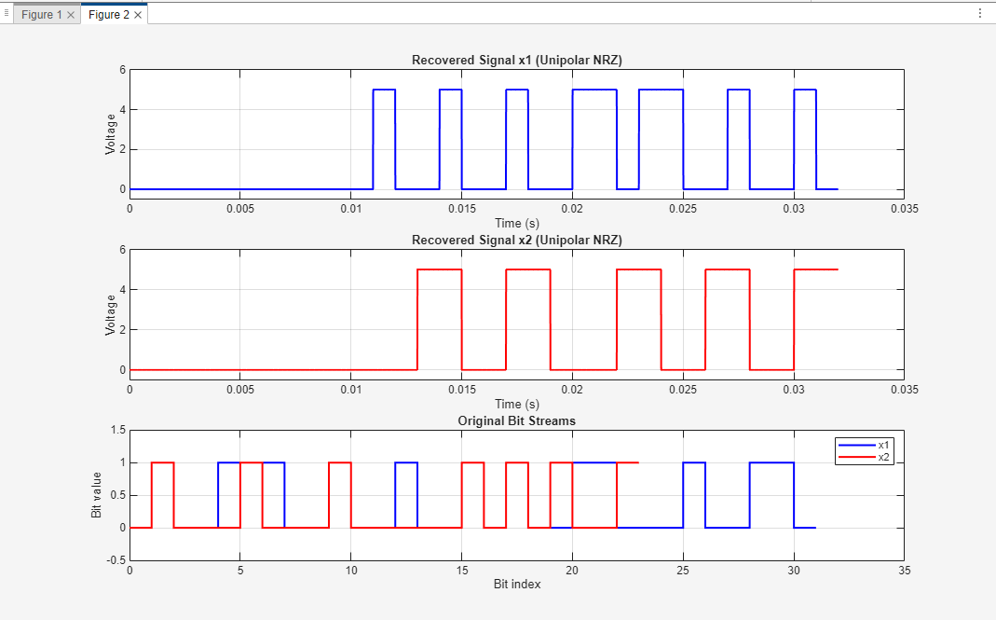
Task 5: Demultiplexing & Signal Recovery
How we solved:
Bandpass Filtering: Filtered noisy composite signal around carrier frequencies to separate channels.
Coherent Demodulation: Multiplied filtered signals by carrier to bring back baseband.
Lowpass Filter: Removed high-frequency components to recover baseband signals.
Bit Sampling & Decision: Sampled at center of each bit and decided 0/1 based on threshold.
Reconstruct NRZ: Converted recovered bits to NRZ waveform for plotting and verification.
Code Snippet:
% Bandpass filter
[b1,a1]=butter(6,[(f1-1.5)/(fs/2) (f1+1.5)/(fs/2)],'bandpass');
sep1=filter(b1,a1,noisy_signal);
% Coherent demodulation & lowpass
demod1 = sep1.*cos(2*pi*f1*t_demod);
baseband1 = filter(b_lp,a_lp,demod1);
% Sample & recover bits
rec_bits1 = baseband1(sample_points) > (A1/2);
OUTPUT

Slide 7
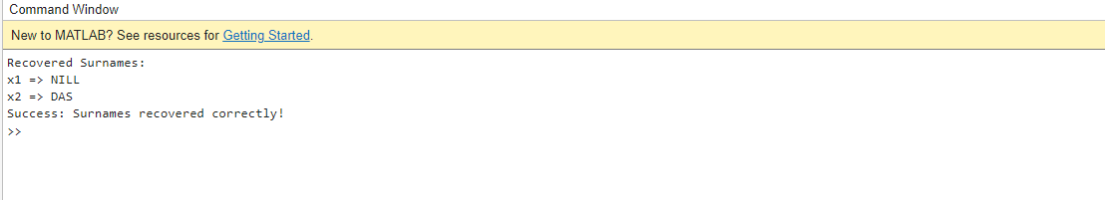
Task 6: Reconstruct ASCII from Bits
How we solved:
Group Bits into Bytes: Reshaped bitstream into 8-bit groups.
Binary-to-Decimal Conversion: Used bin2dec to convert each byte to decimal ASCII code.
Decimal-to-Character: Converted decimal values to characters to recover original surnames.
Verification: Compared recovered surnames with expected ones and displayed success/error.
Code Snippet:
% Convert bits to ASCII characters
bin_chars1 = reshape(char(x1+'0'),8,[])';
ascii_recovered1 = bin2dec(bin_chars1)';
recovered_surname1 = char(ascii_recovered1);
% Verification
if strcmp(recovered_surname1,'NILL')
disp('Success: Surname recovered correctly!');
end
OUTPUT:

Slide 8



