Slide 1
KMode

Slide 2
K-Means Assumes Numeric Data
Limitations of K-Means on Categorical Data
Concept | Why It Matters
K-Means uses Euclidean distance | Requires numerical vectors
Means are computed as centroids | Only valid for continuous values
Categorical values can't be averaged | What’s the “mean” of {Red, Blue, Blue}? 🤯
Distance between “Male” and “Female”? | Nonsensical under Euclidean metric

Slide 3
Real Example – It Fails with Strings
“K-Means Struggles with Categorical Attributes”
Data Point ID | Color | Shape
1 | Red | Circle
2 | Blue | Circle
3 | Blue | Square
Imagine these as categorical features:
How would you compute the mean of these?
How would you compute distance between “Red” and “Blue”?
K-Means will:
Try to cast them to integers (arbitrary!)
Or one-hot encode and distort distance space
Takeaway: You can’t meaningfully calculate means or Euclidean distance on nominal categories.

Slide 4
What is K-Modes? (Intuition + Role)
Introducing K-Modes – Clustering for Categorical Data
🔍 Concept | 💡 Explanation
K-Modes = K-Means for Categorical Data | Designed to handle non-numeric, nominal features
Replaces Mean with Mode | Uses most frequent category in each cluster (not average)
Uses Dissimilarity (not Euclidean) | Based on number of mismatches across categories
Output | Each record is assigned to a cluster based on categorical similarity
Core idea: Cluster using the mode (most common value) for each column.

Slide 5
K-Modes vs K-Means Comparison Table
Feature | K-Means | K-Modes
Data Type | Numeric | Categorical
Distance Metric | Euclidean | Hamming / Mismatch count
Centroid | Mean of features | Mode (most frequent value)
Cost Function | Squared Euclidean distance | Total dissimilarity
Use Case | Image data, sensors, embeddings | Survey responses, product types, locations
If your data is all non-numeric and can't be ordered, K-Modes is a better fit.

Slide 6
K-Modes Algorithm – Step-by-Step
K-Modes: How It Works
Step | Description
Step 1: Choose K | Decide the number of clusters K
Step 2: Initialize Modes | Randomly choose K data points as initial modes (prototypes)
Step 3: Assign Records | For each data point, assign to the cluster with minimum mismatches
Step 4: Update Modes | Recalculate the mode (most frequent value) in each cluster
Step 5: Repeat | Until no change in assignment or max iterations reached
This is similar to K-Means, but uses mode + categorical distance instead.

Slide 7

K-Modes in Action (Toy Example)
Record ID | Color | Shape | Size
A | Red | Circle | Small
B | Blue | Circle | Large
We compare Record A and B column by column (attribute-wise):
Attribute | A Value | B Value | Match? | δ(xᵢ, yᵢ)
Color | Red | Blue | ❌ | 1
Shape | Circle | Circle | ✅ | 0
Size | Small | Large | ❌ | 1
Interpretation:
K-Modes compares row-wise records by counting mismatches across columns (attributes).
Records A and B have 2 mismatched values, so their dissimilarity is 2.
During clustering, each record will be assigned to the mode (cluster center) that has the least mismatch.

Slide 8
Step-by-Step Mode Calculation from a Cluster
Record ID | Color | Shape | Size
A | Red | Circle | Small
B | Red | Circle | Large
C | Blue | Circle | Small
Compute the mode per column (majority value):
Attribute | Values in Cluster | Mode (most frequent)
Color | Red, Red, Blue | Red
Shape | Circle, Circle, Circle | Circle
Size | Small, Large, Small | Small
So, the new cluster center (mode) is:
Cluster Mode=(Red,Circle,Small
This becomes the updated centroid used in the next iteration.

Slide 9

Step-by-Step Mode Calculation from a Cluster
Cluster 1 Centroid from previous iteration =(Red, Circle, Small)
Now imagine we get a new data point
D = (Blue, Square, Small). We want to assign it to a cluster — let’s compute its dissimilarity with the updated centroid.
Attribute | Centroid Value | Record D Value | Match? | δ(xᵢ, yᵢ)
Color | Red | Blue | ❌ | 1
Shape | Circle | Square | ❌ | 1
Size | Small | Small | ✅ | 0
Lets compare with first cluster

Slide 10

Step-by-Step Mode Calculation from a Cluster
Let’s assume Cluster 2 centroid is:
(Blue, Square, Large)
Attribute | Cluster 2 Value | Record D Value | Match? | δ(xᵢ, yᵢ)
Color | Blue | Blue | ✅ | 0
Shape | Square | Square | ✅ | 0
Size | Large | Small | ❌ | 1
So in this iteration, Record D is closer to Cluster 2, and will be assigned there.

Slide 11
Choosing the Right K in K-Modes
Just like K-Means, K-Modes requires K to be specified upfront.
Why important?
Too small K → clusters are too broad
Too large K → overfitting, meaningless micro-groups
Optimal K = balance between compactness & separation
So we need a quantitative method to determine K.

Slide 12
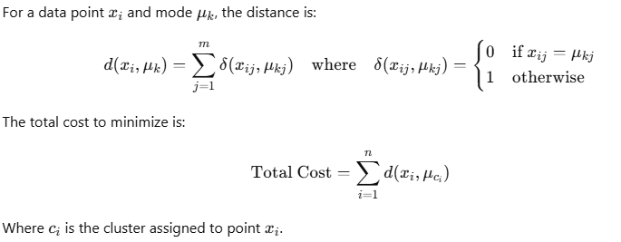
Cost Function in K-Modes
Conceptually Similar to Euclidean distance in Kmeans, But Not Mathematically the Same.x
Aspect | K-Means | K-Modes
What it minimizes | Sum of squared Euclidean distances | Sum of mismatches (dissimilarities)
Works on | Numerical data only | Categorical data only
Distance Function | ∥x_{i}−μ_{k}∥² | d(x_{i},μ_{k})=∑δ(x_{j},μ_{kj})
Centroid update logic | Use mean (average) | Use mode (most frequent category)
Where:
x_{i} is a data point
μ_{k} is the mode of the assigned cluster
d(x_{i},μ_{k}) is the number of mismatches between point and mode
Total cost is the sum of all dissimilarities from points to their cluster modes.

Slide 13
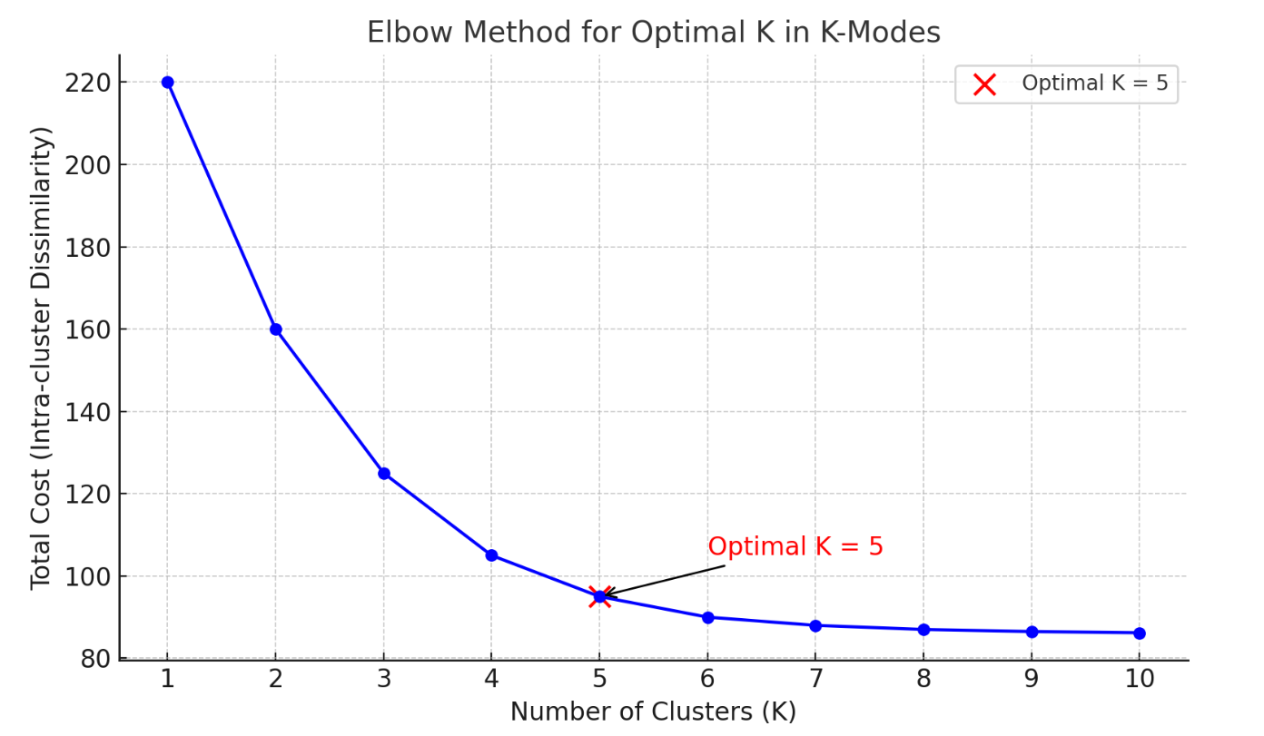
Elbow Method for K-Modes
Steps:
Run K-Modes for a range of K values (e.g., 1 to 10)
Record the total cost for each value of K
Plot K (x-axis) vs cost (y-axis)
Look for the “elbow point” — the point after which cost reduction slows down

Slide 14
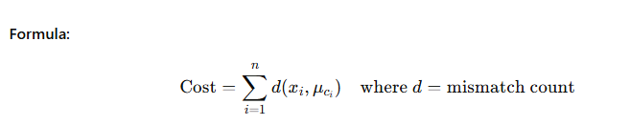
Evaluation Metrics for K-Modes
Primary Metric – Total Cost (Intra-cluster Dissimilarity)
Metric | Description
Total Cost | Sum of dissimilarities (mismatches) between each point and its cluster's mode
Used for: | Elbow Method, monitoring convergence
Lower is better? | ✅ Yes, it means more compact clusters

Slide 15
Evaluation Metrics for K-Modes
Another Metric – Silhouette Score for Categorical Data
Metric | Description
Silhouette Score | Measures how similar a point is to its cluster compared to other clusters
Adaptation | For categorical data, use Hamming distance
Range | -1 to 1 (higher = better clustering)

Slide 16
Evaluation Metrics for K-Modes
Another Metric – If Labels Are Known
Metric | Description
Purity Score | Fraction of cluster members that belong to the dominant class (if known)
Adjusted Rand Index (ARI) | Measures similarity between predicted clusters and true labels
Normalized Mutual Information (NMI) | Compares overlap between clusters and ground truth
Summary Table:
Metric | Type | Notes
Total Cost | Internal | Always available
Silhouette Score | Internal | Needs dissimilarity matrix
Purity, ARI, NMI | External | Only if ground truth is known

Slide 17
If we already have labels, why would we still use clustering instead of classification ?
1. Label Quality Check / Ground Truth Validation
Sometimes the "labels" available:
Are noisy, inconsistent, or human-generated
May have bias or human error
Were assigned long ago and might be outdated
Clustering helps us re-discover structure in the data:
If clusters match the labels, labels are good
If they don’t, it suggests:
Labeling errors
Hidden subgroups
Evolving patterns
Use Case: Label auditing, domain revalidation

Slide 18
If we already have labels, why would we still use clustering instead of classification ?
2. Find New Patterns the Labels Miss
Clustering might reveal sub-segments within a labeled class.
Helps identify fine-grained structure or new categories.
Example: Label = "Customer" K-Modes reveals → {Bargain Shoppers, Brand-Loyal, Occasional Buyers}
Classification wouldn’t find these — it’s locked into existing labels.

Slide 19
If we already have labels, why would we still use clustering instead of classification ?
3. Cold Start for Supervised Models
If:
You have a few labeled examples, but most data is unlabeled
Or you're building a new model from scratch
You can cluster the whole dataset to:
Understand class structure
Pre-label data for semi-supervised learning
Select representative samples for labeling
Use Case: Building a training set when labels are costly

Slide 20
If we already have labels, why would we still use clustering instead of classification ?
4. Dimensionality Reduction / Preprocessing for Classification
Clustering can be used as a feature:
Add cluster IDs as an additional feature
Improves classification by grouping semantically similar items
You’re combining unsupervised grouping with supervised learning.

Slide 21
If we already have labels, why would we still use clustering instead of classification ?
5. Model Debugging / Interpretability
Clustering results can help explain why a model is struggling:
E.g., Are misclassified samples grouped together?
Are labels being forced onto a naturally different cluster?
Summary:
Reason | Why It Matters
Validate or audit labels | Labels might be wrong
Discover new groups | Labels may hide substructure
Cold start or low labels | Bootstraps semi-supervised learning
Feature enrichment | Clusters can assist classification
Debugging | Helps interpret model behavior

