Slide 1
Reinforcement Learning

Slide 2
Introduction to Reinforcement Learning
Begin by introducing the core components of RL:
Agent: The decision-maker.
Environment: The system the agent interacts with.
State (s): A representation of the environment at a given time.
Action (a): A choice the agent can make.
Reward (r): Feedback signal for an action taken.
Goal: Maximize the cumulative reward over time (total return).

Slide 3
Self-Driving Car
Agent: The AI controlling the car.
Environment: The road network, including traffic signals, pedestrians, and other vehicles.
State (sss): Current information about the car and surroundings (e.g., position, speed, distance to other cars, traffic signal status).
Action (aaa): Choices such as accelerate, decelerate, turn left, turn right, or stop.
Reward (rrr): Positive reward for driving safely and reaching the destination quickly; negative reward for collisions, running red lights, or driving off-road.

Slide 4
Chess Game
Agent: The chess-playing AI.
Environment: The chessboard and its current configuration of pieces.
State (sss): The arrangement of pieces on the chessboard at a specific time.
Action (aaa): Moving a specific piece to a specific square.
Reward (rrr): Positive reward for capturing an opponent’s piece, achieving checkmate, or improving the position; negative reward for losing pieces or allowing checkmate.

Slide 5
Warehouse Robot
Agent: A robot moving goods in a warehouse.
Environment: The warehouse layout, including shelves, obstacles, and loading zones.
State (sss): Robot’s current position, orientation, and the location of goods to be picked or delivered.
Action (aaa): Move forward, turn, pick up an item, drop off an item.
Reward (rrr): Positive reward for successfully picking up and delivering goods; negative reward for collisions or delays.

Slide 6
Stock Trading
Agent: A trading bot.
Environment: The stock market, including stock prices, volumes, and historical data.
State (sss): Current stock prices, holdings, and market trends.
Action (aaa): Buy, sell, or hold stocks.
Reward (rrr): Positive reward for making profitable trades; negative reward for losses or high transaction costs.

Slide 7
Key Categories of RL Algorithms
Model-Free Algorithms:
Do not require a model of the environment.
Examples: Q-Learning, DQN, SARSA, Policy Gradient, PPO, A3C.
Model-Based Algorithms:
Build or use a model of the environment to plan and make decisions.
Examples: Dynamic Programming, Monte Carlo Tree Search (MCTS).
On-Policy vs Off-Policy:
On-Policy: Learns based on actions taken by the current policy (e.g., SARSA, PPO).
Off-Policy: Learns based on actions taken by another policy or behavior (e.g., Q-Learning, DQN).

Slide 8
Introduction to Q Learning
What is Q-Learning?
Q-Learning is a model-free, off-policy reinforcement learning algorithm.
It is used to learn the optimal policy for an agent to take actions in an environment to maximize cumulative rewards.
It uses a Q-table to store the expected rewards for each state-action pair.
Key Features:
Model-Free: Does not require knowledge of the environment's dynamics (transition probabilities).
Off-Policy: Learns the optimal policy while potentially exploring actions that are not part of the current policy.
Goal: Learn the optimal action-selection policy that maximizes the total reward over time.

Slide 9

Core Concepts in Q-Learning
Q-Table:
A table where rows represent states, columns represent actions, and the values represent the expected cumulative reward for a state-action pair.
Updated iteratively during learning.
Bellman Equation: The Q-values are updated using:
Where:
Q(s,a): Current Q-value for state s and action a.
α: Learning rate (0 < α < 1).
r : Immediate reward for taking action a in state s.
γ: Discount factor (0 ≤ γ ≤ 1), which determines the importance of future rewards.
max⁡_{a′}Q(s′,a′): Maximum Q-value of the next state s′.
Exploration vs Exploitation:
Exploration: Take random actions to explore the environment.
Exploitation: Use the learned Q-values to select the best-known action.

Slide 10
Example: Q-Learning to Solve a Maze
Problem Statement
An agent is navigating a simple 4x4 grid (maze) and must find the shortest path to the goal. The environment provides rewards and penalties:
Goal: +100 (reward).
Each step: -1 (penalty).
Hitting a wall: -10 (penalty).

Slide 11
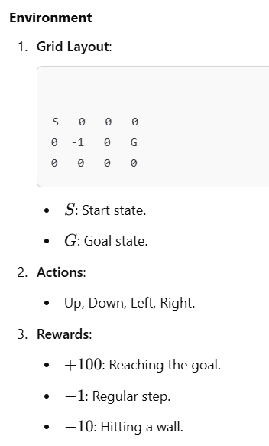
Problem Formulation

Slide 12
Solution
Steps to Solve Using Q-Learning
Initialize Q-Table:
Start with all Q-values set to 0.
Table size: [Number of States × Number of Actions]
Learning Process:
For each episode:
Start at the initial state.
Choose an action using an ε-greedy policy (exploration vs exploitation).
Take the action, observe the reward, and transition to the next state.
Update the Q-value using the Bellman equation.
Termination:
End the episode when the agent reaches the goal or exceeds a maximum number of steps.
Output:
After many episodes, the Q-table will represent the optimal policy.

Slide 13
Example: Teaching a Drone to Deliver Packages
Problem Statement
Imagine a drone that needs to deliver packages from a warehouse to multiple delivery points in a city. The drone must learn the optimal path to maximize efficiency (minimizing energy consumption and time), while avoiding obstacles like buildings and restricted airspaces.

Slide 14
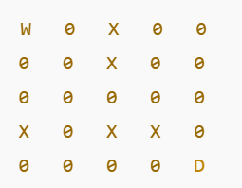
Environment Setup
Grid Layout:
The city is represented as a 5x5 grid.
The warehouse is at position (0,0).
The delivery point is at position (4,4).
Certain cells represent restricted airspaces that the drone must avoid.
W: Warehouse.
D: Delivery point.
X: Restricted airspace.
0: Navigable cell.

Slide 15
Actions:
The drone can move up, down, left, or right.
Rewards:
+100: Reaching the delivery point.
−1: For each step taken (energy cost).
−10: Entering a restricted airspace (penalty).

Slide 16
Core Components
Agent:
The drone is the agent that learns to navigate the grid.
State (s):
Each grid cell represents a state, identified by its coordinates (e.g., (0,0), (4,4)).
Actions (a):
Possible moves: up, down, left, right.
Reward (r):
Feedback based on the action taken.
Goal:
Minimize the total cost (energy and penalties) while successfully reaching the delivery point.

Slide 17
Q-Learning for Drone Navigation
Steps
Initialize the Q-Table:
The Q-table has a row for each state (grid cell) and a column for each action (up, down, left, right).
Initially, all Q-values are set to 0.
Learning Process:
For each episode:
Start at the warehouse ((0,0)).
Choose an action using the ε-greedy policy (exploration vs exploitation).
Take the action, observe the reward, and transition to the next state.
Update the Q-value using the Bellman equation.
Repeat until the delivery point ((4,4)) is reached or a maximum number of steps is exceeded.
Termination:
Stop the episode when the drone reaches the delivery point or crashes into restricted airspace.

