Slide 2
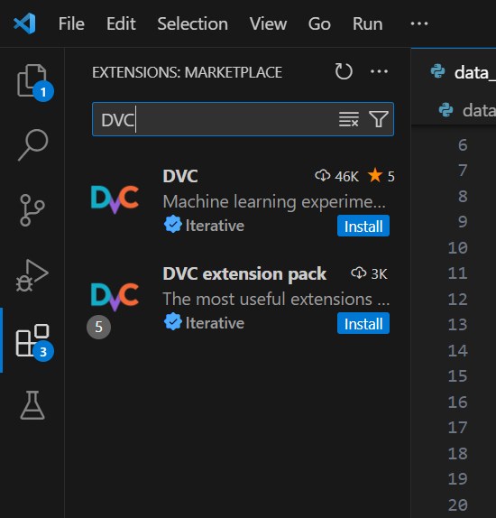

DVC
https://dvc.org/doc/user-guide/how-to/run-dvc-on-windows

