Slide 1
Accuracy Matrices

Slide 2
Categories of Matrices
In the world of Large Language Models (LLMs), the evaluation metrics are broadly categorized into
text similarity metrics,
task-specific metrics,
human evaluation metrics,
efficiency-based metrics.
Fairness and Bias Metrics
Safety and Security Metrics
Ethical Considerations
Beyond Text-Based Evaluation
User Experience

Slide 3
Text similarity metrics
Used to evaluate how closely the generated text matches a reference text, often in tasks like machine translation, summarization, and text generation.
Lexical Similarity Metrics:
BLEU (Bilingual Evaluation Understudy): Measures the overlap of n-grams between the generated and reference text.
ROUGE (Recall-Oriented Understudy for Gisting Evaluation): Focuses on recall, precision, and F1 of n-gram overlaps.
ROUGE-1: Unigram overlap.
ROUGE-2: Bigram overlap.
ROUGE-L: Longest Common Subsequence (LCS)-based overlap.
METEOR: Considers synonymy and stemming for unigram matches.
TER (Translation Edit Rate): Measures the amount of editing required to match the reference.
Embedding-Based Similarity Metrics:
BERTScore: Computes cosine similarity of BERT embeddings of tokens.
MoverScore: Embedding-based metric using Earth Mover’s Distance.

Slide 4
BLEU-1
BLEU-1 (Unigram Precision)
Focus: Measures single-word (unigram) precision.
Calculation: Fraction of unigrams in the candidate that are in the reference.
Purpose: Captures the basic overlap of words between the candidate and reference.
Example:
Reference: "The cat is on the mat"
Candidate: "The cat sat on the mat"
Unigrams in reference: {"The", "cat", "is", "on", "the", "mat"}
Unigrams in candidate: {"The", "cat", "sat", "on", "the", "mat"}
Common unigrams: {"The", "cat", "on", "the", "mat"}
BLEU-1 Precision = 5/6 ≈ 0.833

Slide 5
BLEU-2
BLEU-2 (Bigram Precision)
Focus: Measures two-word sequence (bigram) precision.
Calculation: Fraction of bigrams in the candidate that are in the reference.
Purpose: Captures some fluency by considering sequential word relationships.
Example:
Reference: "The cat is on the mat"
Candidate: "The cat sat on the mat"
Bigrams in reference: {"The cat", "cat is", "is on", "on the", "the mat"}
Bigrams in candidate: {"The cat", "cat sat", "sat on", "on the", "the mat"}
Common bigrams: {"The cat", "on the", "the mat"}
BLEU-2 Precision = 3/5 = 0.6

Slide 6
Higher-Order BLEU (e.g., BLEU-3, BLEU-4)
Focus: Measures precision for trigrams (3-word sequences) or 4-grams.
Purpose: Useful for evaluating grammatical structure and coherence in longer outputs.
Observation: Higher-order BLEU scores tend to decrease with longer n-grams because exact matches are harder to achieve.

Slide 7
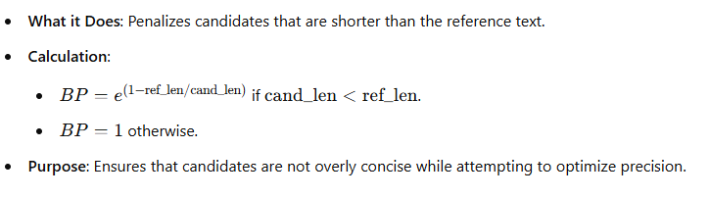
Brevity Penalty

Slide 8
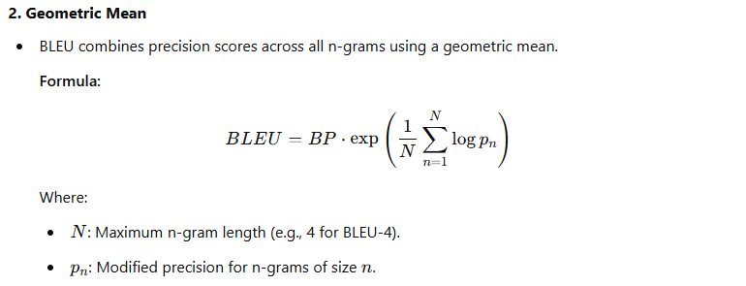
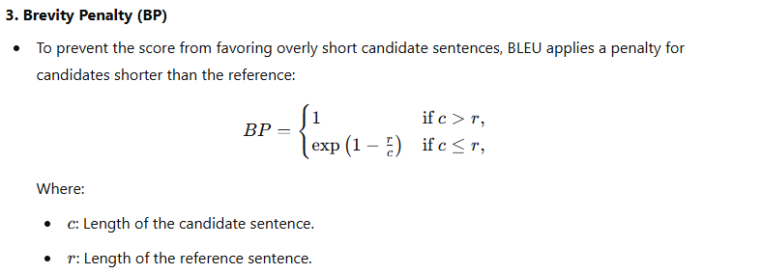
How BLEU Scores are Calculated
1. Modified Precision
BLEU counts n-grams in the candidate sentence that also appear in the reference sentence(s).
The count is clipped to the maximum number of times the n-gram appears in the reference sentence(s). This avoids overestimating precision by repeated occurrences in the candidate sentence.
Example: Reference: "the cat is on the mat" Candidate: "the the the mat" For the unigram "the," BLEU would count it only as 1 (matching the reference), not 3 (in the candidate).
Key Steps
Count n-grams in both candidate and reference sentences.
Clip counts of n-grams in the candidate to their maximum in the reference.
Calculate modified precision for each n-gram size.
Compute the geometric mean of the precisions across n-grams.
Apply the brevity penalty.

Slide 9
ROUGE
ROUGE-1: Measures unigram (single word) overlap.
Precision: Fraction of unigrams in the candidate that are in the reference.
Recall: Fraction of unigrams in the reference that are in the candidate.
ROUGE-2: Measures bigram (two consecutive words) overlap.
Precision: Fraction of bigrams in the candidate that are in the reference.
Recall: Fraction of bigrams in the reference that are in the candidate.
ROUGE-L: Measures the longest common subsequence (LCS) overlap.
Precision: LCS length divided by the number of words in the candidate.
Recall: LCS length divided by the number of words in the reference.
F1: Harmonic mean of Precision and Recall.
How to Use These Metrics
ROUGE-1 is useful for simple word overlap.
ROUGE-2 helps capture fluency by considering sequential relationships.
ROUGE-L is robust for longer texts since it considers the LCS.

Slide 10
Key Differences Between BLEU and ROUGE
Feature | BLEU | ROUGE
Focus | Measures precision of n-grams (focuses on exact matches in the candidate). | Measures recall (focuses on matching n-grams in the reference).
Strengths | Good for evaluating short, well-structured outputs like machine translation. | Better for summarization tasks and longer, more flexible text.
Handling Paraphrasing | Poor: Penalizes even valid paraphrasing due to lack of overlap. | Handles paraphrasing better by prioritizing recall and the LCS.
Penalty for Brevity | Penalizes short candidates with a brevity penalty. | Recall-based metric naturally favors longer candidates.

Slide 11
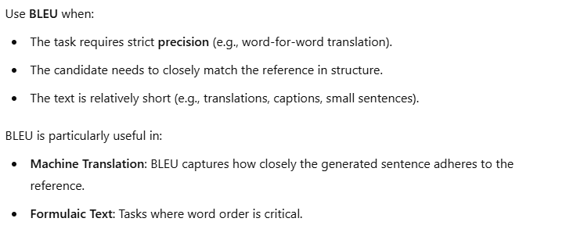
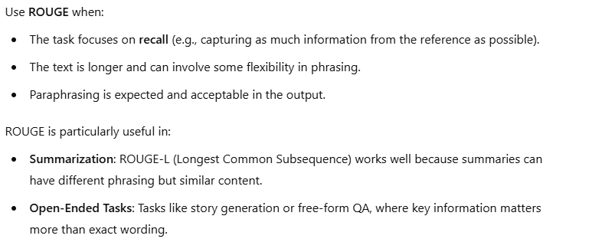
When to Use BLEU or ROUGE or Both
When to Use Both
In many cases, it is helpful to use both BLEU and ROUGE:
BLEU evaluates precision (are generated words accurate?).
ROUGE evaluates recall (does the generated text capture the reference's meaning?).
For example:
In machine translation, BLEU ensures precision while ROUGE ensures fluency and flexibility.
In summarization, BLEU ensures accuracy in capturing key details, and ROUGE measures overall coverage.

Slide 12
If BLEU and ROUGE gives different signal
Other Complementary Metrics
If BLEU and ROUGE give different signals, you can include other metrics to gain a holistic understanding:
METEOR: Focuses on semantic similarity and accounts for synonyms.
CIDEr: Optimized for image captioning tasks.
BERTScore: Uses embeddings from BERT to measure semantic similarity (better for capturing paraphrasing and nuance).

Slide 13
Choosing Metrics Based on Task
Scenario 1: Machine Translation
Main Metric: BLEU (precision-heavy metric is preferred).
Supplementary Metric: ROUGE-1 or BERTScore (to check recall and semantic similarity).
Scenario 2: Summarization
Main Metric: ROUGE (recall-focused for evaluating overall coverage).
Supplementary Metric: METEOR or BERTScore (to evaluate paraphrasing and nuance).
Scenario 3: Open-Ended Text Generation
Main Metric: BERTScore (semantic similarity matters most).

Slide 14
Finally
The choice of metrics depends heavily on the task requirements:
If precision and structure are critical: Focus on BLEU.
If recall and flexibility are key: Focus on ROUGE.
If semantics or meaning matters most: Use BERTScore or METEOR alongside BLEU/ROUGE.

Slide 15
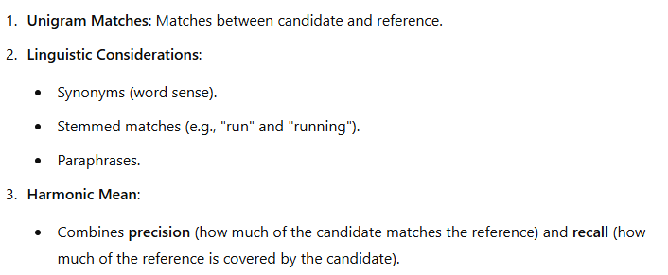
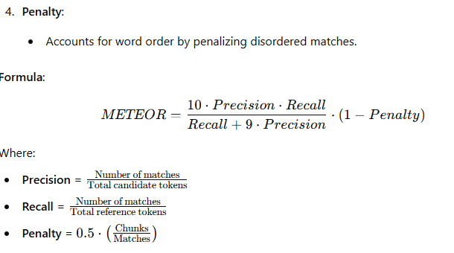
METEOR
The METEOR (Metric for Evaluation of Translation with Explicit ORdering) metric evaluates machine translation quality with greater sensitivity to linguistic phenomena compared to BLEU.

Slide 16
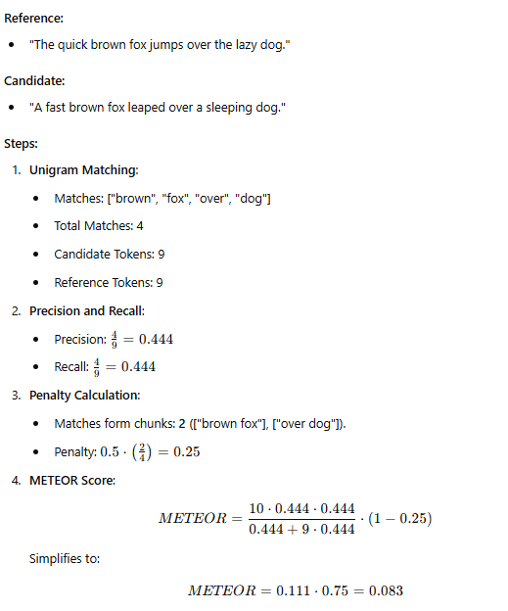
Example

Slide 17
CIDEr
CIDEr (Consensus-based Image Description Evaluation) is a metric used for evaluating the quality of generated sentences, typically in tasks like image captioning or text generation. It belongs to the category of text similarity metrics, as it evaluates the similarity between a candidate text (e.g., a generated caption) and reference texts (e.g., human-written captions).

Slide 18
How CIDEr Works and use
n-gram Similarity: CIDEr computes the cosine similarity between n-grams of the candidate text and the reference texts.
Uses unigrams, bigrams, and up to 4-grams.
TF-IDF Weighting: Each n-gram is weighted based on Term Frequency-Inverse Document Frequency (TF-IDF) to emphasize rare but meaningful phrases and discount frequent but less meaningful ones.
Normalization: CIDEr normalizes the similarity scores to make them robust to different lengths of the candidate and reference texts.
Usage:-
Primarily in image captioning tasks to compare generated captions against reference captions.
Also used in other natural language generation tasks where the goal is to align generated text with human expectations.
Comparison with BLEU and ROUGE:-
BLEU: Focuses on exact n-gram overlap without considering semantic or importance weighting.
ROUGE: Emphasizes recall, suitable for summarization tasks.
CIDEr: Uses TF-IDF weighting, making it more suitable for descriptive tasks like captioning where rare terms are important.

Slide 19
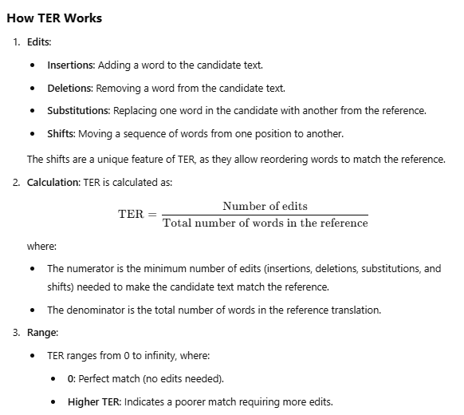
TER
TER (Translation Edit Rate) is a metric used to evaluate the quality of machine translation (MT) by measuring the number of edits required to transform a machine-generated translation (candidate) into a reference translation (human-written). The goal is to quantify the effort a human translator would need to post-edit the candidate translation to match the reference translation.

Slide 20
Key Characteristics and Advantages, Limitation
Key Characteristics
Focus on Edit Distance:
It evaluates how much effort (in terms of text edits) is needed to transform the candidate into the reference, making it highly interpretable.
Unlike metrics such as BLEU or ROUGE, TER is not based on n-gram overlaps but directly evaluates the similarity through edits.
Shift Handling:
TER is unique because it accounts for word reordering (shifts), making it suitable for languages with different syntactic structures.
Interpretability:
TER provides a clear and actionable measure: the lower the TER, the less effort is needed to post-edit the translation.
Advantages:
Easy to interpret for human translators and post-editing tasks.
Considers reordering of words, which is crucial for translating between languages with different syntactic structures.
Useful for real-world applications where the translation quality is evaluated based on human effort.
Limitations:
Penalizes creative or semantically equivalent translations if they deviate too much from the reference wording.
Relies heavily on a single reference translation, which may not capture all valid ways of expressing the same meaning.
Does not explicitly measure fluency or grammatical correctness, focusing only on edit distance.

Slide 21
Task-specific metrics
1. Machine Translation
BLEU (Bilingual Evaluation Understudy)
ROUGE (Recall-Oriented Understudy for Gisting Evaluation)
METEOR (Metric for Evaluation of Translation with Explicit ORdering)
TER (Translation Edit Rate)
ChrF (Character F-score)
2. Text Summarization
ROUGE-1: Unigram overlap.
ROUGE-2: Bigram overlap.
ROUGE-L: Longest common subsequence.
BLEU (less common compared to ROUGE).
METEOR
3. Text Classification
Accuracy: Correct predictions / Total predictions.
Precision: True positives / (True positives + False positives).
Recall (Sensitivity): True positives / (True positives + False negatives).
F1-Score: Harmonic mean of Precision and Recall.
AUC-ROC (Area Under Curve - Receiver Operating Characteristic)
4. Question Answering
Exact Match (EM): Fraction of predictions that exactly match the ground truth.
F1-Score: Overlap of predicted answer tokens with the reference answer tokens.
BLEU: For sentence-level comparison.
METEOR
5. Sentiment Analysis
Accuracy
Precision/Recall/F1
AUC-ROC
Confusion Matrix Analysis: To understand class-specific performance.
6. Natural Language Generation (General)
BLEU
ROUGE
METEOR
CIDEr (Consensus-based Image Description Evaluation): Focused on visual captioning tasks but applicable to general NLG.
Perplexity: Evaluates the fluency of text by computing the inverse probability of the test set.

Slide 22
Task-specific metrics
7. Dialogue Systems
BLEU: For response overlap.
METEOR: For semantic overlap.
Perplexity: For fluency of generated responses.
Conversational Success Rate: Task-specific success criteria (e.g., slot filling in goal-oriented chatbots).
Turn-Level Appropriateness: Human evaluation or automated scoring for coherence.
8. Named Entity Recognition (NER)
Precision/Recall/F1: Evaluated at entity-level or token-level.
Entity-Level Exact Match: Fraction of entities correctly identified with exact boundaries.
Slot Error Rate (SER): Common in spoken language understanding.
9. Image Captioning
BLEU: Measures n-gram overlap between predicted and reference captions.
ROUGE
CIDEr
SPICE (Semantic Propositional Image Captioning Evaluation): Evaluates the semantic content of image captions.
10. Text-to-Speech (TTS)
Mean Opinion Score (MOS): Subjective human evaluation of audio quality.
WER (Word Error Rate): Measures accuracy of generated speech transcription.
Pitch Accuracy and Variability: Evaluates naturalness in speech generation.
11. Speech Recognition
WER (Word Error Rate): Percentage of word errors in the transcription.
CER (Character Error Rate): Percentage of character errors in the transcription.
TER: Translation edit rate adapted for speech-to-text.

Slide 23
Task-specific metrics
12. Coreference Resolution
MUC (Mention-Pair Recall)
B3 (Bag of Mentions)
CEAF (Constrained Entity Alignment F-Measure)
13. Paraphrase Detection
BLEU
ROUGE
METEOR
Pearson/Spearman Correlation: Evaluates similarity scores.
14. Text Simplification
SARI (System Output Against References and Input): Evaluates text simplification by comparing against reference simplifications.
15. Adversarial Robustness (for all tasks)
Error Rate on Adversarial Examples: Fraction of predictions changed by adversarial inputs.
Robustness Score: Average perturbation required to fool the model.

Slide 24
Human evaluation metrics,
1. Fluency
Definition: Evaluates the grammatical correctness and naturalness of generated text.
Example: Assessing whether the sentence reads smoothly without errors or awkward phrasing.
Use Cases: Text summarization, machine translation, text generation.
2. Coherence
Definition: Measures the logical flow and consistency of ideas or sentences in a generated text.
Example: Evaluating if the output makes sense contextually.
Use Cases: Dialogue systems, story generation, text summarization.
3. Relevance
Definition: Assesses the alignment of the generated text with the input or task.
Example: Checking whether a response directly answers the input query.
Use Cases: Question answering, summarization, chatbot evaluation.
4. Adequacy
Definition: Measures how much of the information in the reference text is retained in the generated text.
Example: Comparing the coverage of key points in a machine-translated sentence.
Use Cases: Machine translation, text summarization.
5. Readability
Definition: Focuses on the ease with which a human reader can understand the text.
Example: Simplified text should be easier to read for a target audience.
Use Cases: Text simplification, educational content.
6. Engagement
Definition: Evaluates how engaging or captivating the generated text is for the user.
Example: Checking if a chatbot's responses encourage further interaction.
Use Cases: Dialogue systems, conversational AI.

Slide 25
Human evaluation metrics,
7. Diversity
Definition: Measures the variety and richness of responses or text generated by the model.
Example: Avoiding repetitive sentences in a conversation or creative content.
Use Cases: Creative writing, storytelling, dialogue generation.
8. Trustworthiness
Definition: Ensures that the content generated is accurate and not misleading.
Example: Evaluating the factual correctness of a summary or generated statement.
Use Cases: Fact-checking, information retrieval.
9. Sentiment Alignment
Definition: Evaluates if the generated text aligns with the intended sentiment or tone.
Example: Ensuring a positive review sounds positive.
Use Cases: Sentiment-controlled text generation.
10. Emotive Quality
Definition: Assesses whether the generated text appropriately conveys emotions.
Example: Checking if a condolence message conveys empathy.
Use Cases: Emotional chatbots, empathetic dialogue generation.
11. Human Likeness
Definition: Measures how similar the generated text is to human-written content.
Example: Checking if a chatbot's responses appear human-like.
Use Cases: Dialogue systems, conversational AI.

Slide 26
How Human Evaluation is Conducted & Challenges
Pairwise Comparison:
Humans compare two outputs and choose the better one based on a specific metric (e.g., fluency or relevance).
Likert Scale Rating:
Humans rate the text on a scale (e.g., 1 to 5) for specific attributes like fluency or relevance.
A/B Testing:
Evaluators interact with two systems without knowing which is which, then provide preferences.
Open Feedback:
Humans provide qualitative feedback on what works and what needs improvement.
Challenges in Human Evaluation
Subjectivity: Human opinions vary based on cultural, personal, and contextual factors.
Cost and Time: Requires significant resources compared to automated metrics.
Scalability: Difficult to scale for large datasets.
HUMAN EVALUATION IS CRUCIAL FOR UNDERSTANDING NUANCES THAT AUTOMATED METRICS MIGHT MISS. COMBINING HUMAN AND AUTOMATED EVALUATIONS PROVIDES A COMPREHENSIVE UNDERSTANDING OF AN LLM SYSTEM'S PERFORMANCE.

Slide 27
Efficiency-based metrics
1. Latency
Definition: The time it takes for the model to generate a response after receiving an input.
Use Case: Evaluates response time critical for real-time applications like chatbots or virtual assistants.
Example: A lower latency model is preferred for customer service chatbots.
2. Throughput
Definition: Number of responses or tokens generated per second.
Use Case: Measures the model's ability to handle large-scale workloads efficiently.
3. Memory Usage
Definition: Amount of memory (RAM or GPU) required during model inference or training.
Use Case: Helps in determining hardware requirements and scaling feasibility.
Example: Models with lower memory footprints are preferred for deployment on edge devices.
4. Model Size
Definition: The number of parameters or the disk space required to store the model.
Use Case: Determines storage efficiency and impacts deployment on devices with limited capacity.
Example: Smaller models are ideal for mobile or IoT applications.
5. Energy Consumption
Definition: Amount of power used during model training or inference.
Use Case: Important for sustainability and cost management.
Example: Evaluates the carbon footprint of deploying a model in cloud data centers.

Slide 28
Efficiency-based metrics
6. Scalability
Definition: The ability of the model to maintain performance while handling increasing workloads or larger datasets.
Use Case: Key for enterprise applications requiring consistent performance under heavy traffic.
Example: A scalable model can efficiently process queries during peak usage.
7. Optimization Efficiency
Definition: The model's ability to converge to optimal performance with minimal training iterations or compute resources.
Use Case: Reduces training costs and time.
Example: Fine-tuning LLMs with efficient optimizers can save computational resources.
8. Inference Cost
Definition: The financial cost of running the model in production, considering compute, memory, and energy usage.
Use Case: Useful for budgeting and resource allocation.
Example: Lower inference costs make models more attractive for startups and SMEs.
9. Bandwidth Usage
Definition: Data transfer requirements during training or deployment, especially for distributed systems.
Use Case: Optimizing bandwidth ensures smooth operation in multi-node environments.
Example: Models that require less bandwidth are better for remote deployment scenarios.
10. Token Efficiency
Definition: The average number of tokens processed per unit time.
Use Case: Helps in evaluating token processing speed for LLMs.
Example: Useful for models used in token-intensive tasks like document summarization.
11. Robustness to Compression
Definition: Evaluates the model's ability to maintain performance after compression techniques like pruning or quantization.
Use Case: Essential for deploying LLMs in resource-constrained environments.
Example: A robust model delivers consistent accuracy even after quantization.

Slide 29
How These Metrics Are Measured & Applications
Latency: Measured in milliseconds using profiling tools like TensorFlow Profiler or PyTorch Profiler.
Throughput: Number of tokens generated per second, tested using batch inference.
Memory Usage: Tracked using tools like NVIDIA’s Nsight Systems for GPU or system monitors for CPU.
Energy Consumption: Measured using hardware-specific tools like Power Profiler or external wattmeters.
Inference Cost: Calculated based on cloud provider billing for resources utilized.
Applications
Resource-Constrained Environments: Efficiency metrics help optimize models for mobile or edge devices.
Cost Optimization: Balancing model performance with financial and computational resources.
Sustainability: Reducing energy consumption to minimize environmental impact.
BY MONITORING AND OPTIMIZING THESE METRICS, DEVELOPERS CAN MAKE LLMS MORE PRACTICAL, AFFORDABLE, AND ENVIRONMENTALLY FRIENDLY FOR DIVERSE USE CASES.

Slide 30
Fairness and Bias Metrics
1. Demographic Parity
Definition: Measures if the model’s predictions are independent of sensitive attributes like race, gender, or age.
Formula: P(prediction=positive∣group=A) = P(prediction=positive∣group=B)
Use Case: Evaluates whether all demographic groups are equally likely to receive a positive outcome.
3. Disparate Impact
Definition: Evaluates whether the selection rate for a particular group is significantly different from another.
Formula: P(positive outcome∣group=A) \ P(positive outcome∣group=B)
Threshold: Less than 80% indicates potential bias (commonly called the "80% rule").
Use Case: Detects biases in selection systems, like automated resume screening.
2. Equalized Odds
Definition: Measures if a model performs equally well across different demographic groups for both true positives and false negatives.
Formula: P(prediction=positive∣group=A,actual=positive) = P(prediction=positive∣group=B,actual=positive)
Use Case: Checks for fairness in high-stakes applications like hiring or loan approvals.
4. Bias Amplification
Definition: Measures if the model increases bias present in the training data.
Approach: Compare bias in the outputs with the bias in the input dataset.
Use Case: Useful in identifying if LLMs exacerbate biases when generating text or summarizing.

Slide 31
Fairness and Bias Metrics
5. Stereotype Detection
Definition: Evaluates whether the model generates text that reinforces harmful stereotypes.
Approach: Use prompts targeting specific groups and analyze the generated responses.
Example: "Women are good at ___."
Use Case: Ensures models do not propagate societal stereotypes.
6. Subgroup Fairness
Definition: Ensures fairness not just at the group level but for subgroups within the population.
Use Case: Identifies biases affecting intersectional groups (e.g., young women of a specific ethnicity).
8. Toxicity and Offensive Content
Definition: Evaluates if the model generates harmful, offensive, or toxic language when prompted.
Tools: Perspective API, Hate Speech Detection models.
Use Case: Important for ensuring safe use in public-facing applications.
7. Representational Fairness
Definition: Measures if the model equally represents all groups in its outputs.
Use Case: Checks for overrepresentation or underrepresentation in generated content.
9. Fairness through Unawareness
Definition: Ensures that sensitive attributes are excluded from the training process to mitigate bias.
Limitation: May not fully address proxy biases where other features correlate with sensitive attributes.
10. Counterfactual Fairness
Definition: Ensures predictions remain consistent even if sensitive attributes are altered.
Example: Changing "gender" in a resume should not affect the prediction.
Use Case: Prevents decisions based on sensitive attributes.

Slide 32
Fairness and Bias Metrics
Tools for Evaluating Bias in LLMs
Fairlearn: Python library for assessing and mitigating bias.
Aequitas: Bias and fairness audit toolkit.
Perspective API: Detects toxicity and harmful language.
Hugging Face Evaluate: Includes tools to analyze fairness in text generation.
Challenges
Subjectivity in Fairness: Definitions of fairness can vary across applications and stakeholders.
Proxy Bias: Indirect correlations between features and sensitive attributes.
Trade-offs: Improving fairness may reduce overall model accuracy.
Applications
Hiring Systems: Ensuring fair evaluation across diverse candidates.
Content Moderation: Detecting and reducing toxic outputs.
Healthcare: Avoiding biases in medical diagnosis recommendations.

Slide 33
Beyond Text-Based Evaluation
"Beyond Text-Based Evaluation in Large Language Models (LLMs)" focuses on extending the evaluation metrics beyond traditional text generation and understanding tasks, incorporating diverse capabilities and real-world applications. Here's a detailed exploration:
Beyond Text-Based Evaluation in LLMs
1. Multimodal Capabilities
Definition: Evaluating an LLM's ability to process and integrate multiple data modalities such as text, images, audio, or video.
Key Metrics:
Accuracy and Recall: For tasks like image captioning or video summarization.
Modal Fusion Coherence: Checks how well information from different modalities is combined (e.g., text and images in a chatbot).
Use Cases:
Generating textual descriptions from images (e.g., alt text for accessibility).
Conversational agents with voice and visual understanding.
2. Real-World Applications
Customer Service: Evaluating response accuracy, sentiment alignment, and relevance in practical scenarios.
Content Creation:
Scoring the originality and coherence of auto-generated articles or creative content.
Medical Diagnosis:
Verifying accuracy and adherence to medical guidelines when generating summaries or suggestions.
Key Metrics:
Task-Specific Accuracy: Precision tailored to specific application needs.
Human Feedback Scores: User ratings for practical usability.

Slide 34
Beyond Text-Based Evaluation
3. Data-to-Text Generation
Definition: Assessing how well LLMs convert structured data (e.g., tables, graphs) into meaningful text.
Metrics:
Content Fidelity: Ensures the generated text aligns accurately with the data.
Fluency and Readability: Measures linguistic quality.
Applications:
Automated report generation for business intelligence.
Weather updates and financial summaries.
4. Responsiveness and Adaptability
Definition: Evaluating the LLM's ability to handle dynamic and evolving scenarios.
Metrics:
Latency: Time taken to generate responses.
Context Awareness: Ability to maintain coherence across sessions.
Use Cases:
Real-time support systems.
Multi-turn conversations.

Slide 35
Beyond Text-Based Evaluation
5. Integration with External APIs
Definition: Assessing LLM's ability to fetch, process, and incorporate data from external APIs or systems.
Metrics:
API Call Accuracy: Whether external data is integrated correctly.
Response Adaptation: Ensuring smooth interaction between API results and generated content.
Applications:
Chatbots integrated with calendars, maps, or databases.
6. Ethical and Societal Impact
Bias in Multimodal Outputs: Evaluating the fairness and inclusiveness of outputs when processing visual or auditory inputs.
Toxicity Detection: Ensuring multimodal generations (e.g., image captions) avoid harmful or offensive content.
7. Explain ability and Interpretability
Definition: Assessing whether LLM outputs can be traced back to their data sources and logic.
Metrics:
Attribution Accuracy: Measures how well the generated response cites sources.
Explanation Clarity: Evaluates the understandability of explanations provided by the LLM.
Applications:
Educational tools requiring rationale for answers.
Legal or compliance settings needing traceable outputs.
8. User Experience
Ease of Interaction: Assessing the intuitiveness and user-friendliness of LLM-powered systems.
Customization: Measuring how well an LLM adapts to specific user needs and preferences.
Applications:
Personalized tutoring systems.
Digital assistants for specialized tasks.

Slide 36
Beyond Text-Based Evaluation
9. Cognitive Load Evaluation
Definition: Measuring how much effort users need to understand or use the LLM’s outputs.
Metrics:
Processing Time: Time users spend comprehending responses.
Effort Scores: Human feedback on cognitive ease.
BY EVALUATING BEYOND TEXT, THESE METRICS HELP ASSESS HOW LLMS FUNCTION IN DIVERSE, PRACTICAL, AND MULTIMODAL ENVIRONMENTS, ENSURING THEY MEET REAL-WORLD EXPECTATIONS EFFECTIVELY.

Slide 37
User Experience matrices
User experience (UX) metrics focus on evaluating how users perceive and interact with LLM-powered systems. These metrics provide insights into usability, satisfaction, and efficiency from a user's perspective.
1. Ease of Use
Definition: Measures the intuitiveness and simplicity of interacting with the LLM.
Metrics:
Completion Time: Time taken for users to accomplish tasks with the LLM.
Error Rate: Frequency of user mistakes due to confusing or unclear responses.
User Feedback Scores: Ratings on how easy the system is to navigate.
Applications:
Onboarding new users to AI-powered tools.
Measuring the simplicity of chatbot interactions.
2. Accessibility
Definition: Evaluates how well the LLM supports diverse user needs, including those with disabilities.
Metrics:
Screen Reader Compatibility: Usability with assistive devices.
Language Support: Coverage of multiple languages and dialects.
Adaptability to Input Modalities: Effectiveness with voice, text, or visual inputs.
Applications:
Ensuring inclusivity in digital assistants.
Building globally accessible systems.

Slide 38
User Experience matrices
3. Responsiveness
Definition: Measures the speed and relevance of the LLM's responses.
Metrics:
Response Time: Time taken to generate an output.
Latency: Total delay in communication cycles.
Dynamic Adaptability: How quickly the system adjusts to evolving contexts or user preferences.
Applications:
Real-time customer support systems.
Voice assistants requiring minimal delays.
4. Satisfaction
Definition: Evaluates user contentment with the overall performance and outputs.
Metrics:
Net Promoter Score (NPS): Measures user willingness to recommend the system.
Satisfaction Ratings: User-assigned scores based on task completion.
Survey Feedback: Qualitative insights from direct user feedback.
Applications:
Enhancing personalized learning platforms.
Improving customer service interactions.
5. Coherence and Clarity
Definition: Assesses the quality, organization, and comprehensibility of the LLM's outputs.
Metrics:
Clarity Index: Rates how well users can understand the response.
Logical Consistency: Evaluates whether the output aligns with prior statements.
Relevance Scores: Measures how pertinent the answers are to user queries.
Applications:
Writing assistants generating structured content.
AI tutors explaining complex concepts.

Slide 39
User Experience matrices
6. Engagement
Definition: Measures user interaction levels and interest in engaging with the system.
Metrics:
Session Duration: Average time spent interacting with the system.
Return Rates: Frequency of users returning to use the LLM.
Interaction Depth: Number of follow-up queries or conversations.
Applications:
Chatbots designed for conversational interfaces.
Content recommendation systems.
7. Emotional Impact
Definition: Evaluates how the LLM's responses affect users emotionally.
Metrics:
Sentiment Analysis: Measures user sentiment after interactions.
Tone Alignment: Assesses whether the system’s tone matches user expectations (e.g., empathetic in support scenarios).
Stress/Frustration Metrics: Tracks indicators like user dropout rates or complaints.
Applications:
Mental health chatbots.
Customer service bots requiring empathetic responses.
8. Customization and Personalization
Definition: Assesses the LLM's ability to adapt to individual user needs and preferences.
Metrics:
Preference Matching Score: How well the system aligns with user settings.
Adaptability Index: Speed and accuracy of learning user habits.
Retention Rates: Long-term usage trends among personalized users.
Applications:
Personalized content generation.
Adaptive learning platforms.

Slide 40
User Experience matrices
9. Trustworthiness
Definition: Evaluates user trust in the accuracy, fairness, and reliability of the LLM.
Metrics:
Transparency Ratings: How well the system explains its reasoning.
Error Recovery Rates: Measures the ability to rectify incorrect responses.
Bias Perception Scores: Tracks user perception of fairness and impartiality.
Applications:
Healthcare assistants providing critical advice.
Financial advisors generating investment recommendations.
BY FOCUSING ON THESE METRICS, DEVELOPERS CAN ENSURE THAT LLM-POWERED SYSTEMS DELIVER A USER-CENTRIC EXPERIENCE THAT IS INTUITIVE, ENGAGING, AND SATISFYING. THESE INSIGHTS CAN GUIDE IMPROVEMENTS IN DESIGN, FUNCTIONALITY, AND ADAPTABILITY FOR DIVERSE USER NEEDS.

