Slide 1
LangChain

Slide 2
What is LangChain
LangChain is a framework that helps developers build applications that combine large language models (LLMs) with other sources of data. It provides a modular and flexible way to integrate LLMs into your applications, making it easier to leverage their capabilities for tasks like summarization, translation, question answering, and more.
Here are some key features of LangChain:
Modularity: LangChain breaks down the process of building LLM-powered applications into smaller, reusable components. This makes it easier to customize and extend your applications.
Flexibility: LangChain supports a variety of LLMs and data sources, allowing you to choose the best tools for your specific needs.
Efficiency: LangChain can help you optimize the performance of your LLM applications by caching results and using other techniques to reduce processing time.
Ease of use: LangChain provides a simple and intuitive API that makes it easy to get started with building LLM-powered applications.
If you are looking for a powerful and flexible framework for building LLM-powered applications, LangChain is a great option.

Slide 3
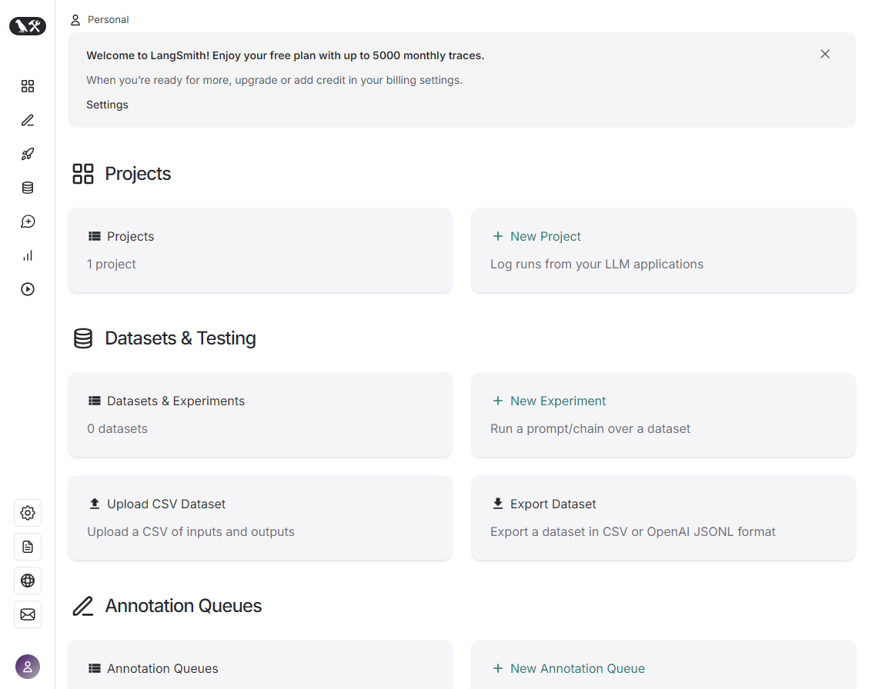
Signup
https://www.langchain.com/
Create account in Langchain (Signup Process)

Slide 4
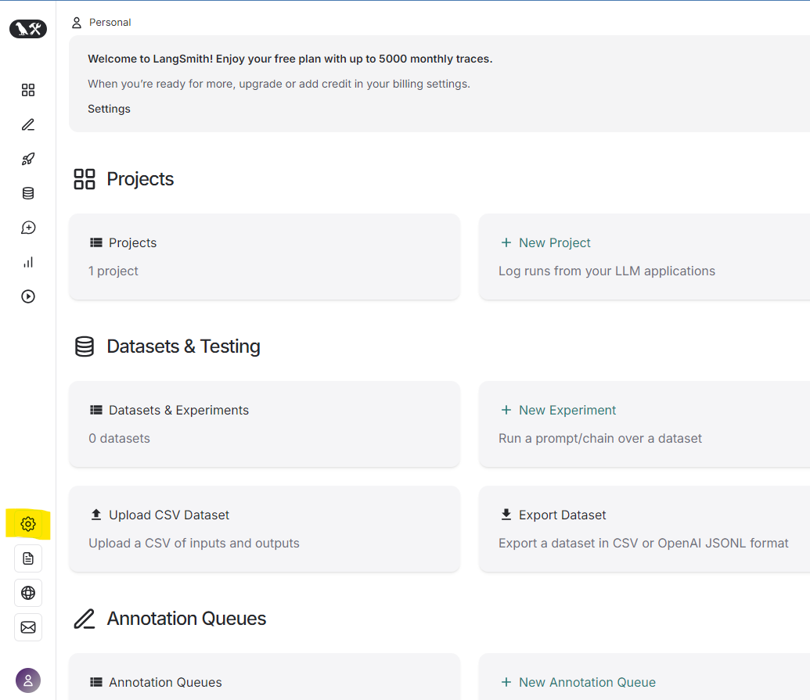
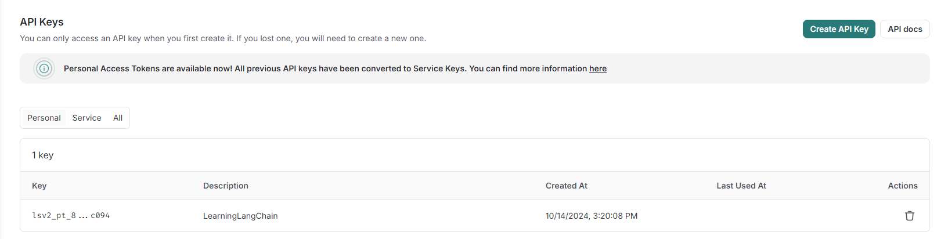
Get LanChain API Key

Slide 5
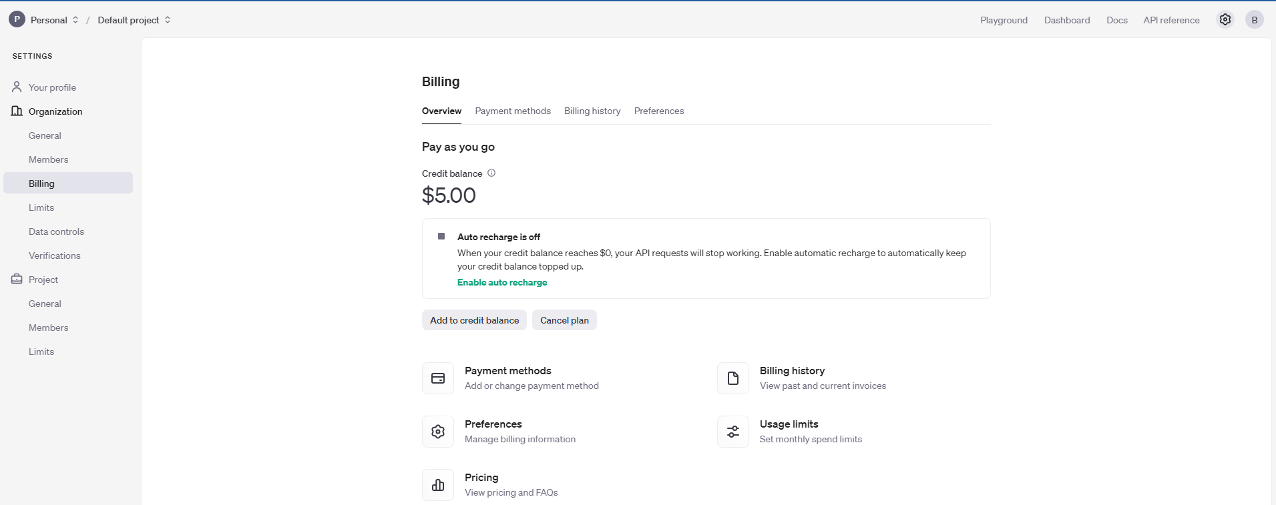
OpenAI API Key
https://platform.openai.com/settings/organization/billing/overview

Slide 6
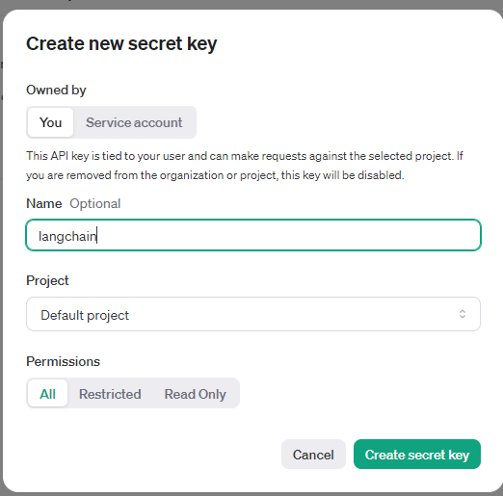
Create a new Key

Slide 7
LangChain Components
Langchain
Langsmith
Langgraph
Langserve

Slide 8
Components
LangChain is a framework that helps developers build applications that combine large language models (LLMs) with other sources of data. It provides a modular and flexible way to integrate LLMs into your applications, making it easier to leverage their capabilities for tasks like summarization, translation, question answering, and more.
LangSmith is a tool that helps developers build and manage LLM applications. It provides features such as version control, experimentation tracking, and deployment.
LangGraph is a tool that helps developers visualize the architecture of their LLM applications. It can be used to identify bottlenecks and improve performance.
LangServe is a powerful language server that provides intelligent code completion, real-time error checking, refactoring suggestions, and documentation for various programming languages. It integrates seamlessly with popular IDEs to enhance code editing experiences.

Slide 9
Langchain methods
Retrieval: The process of finding relevant information from a large dataset based on a given query or input.
Agents: Autonomous entities that can perform tasks or interact with their environment.
Evaluation: The process of assessing the performance of a system or model based on predefined metrics or criteria.

Slide 10
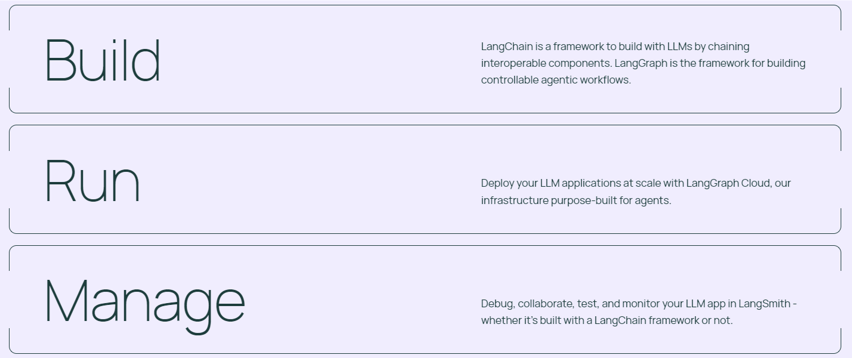
Langchain usage

Slide 11
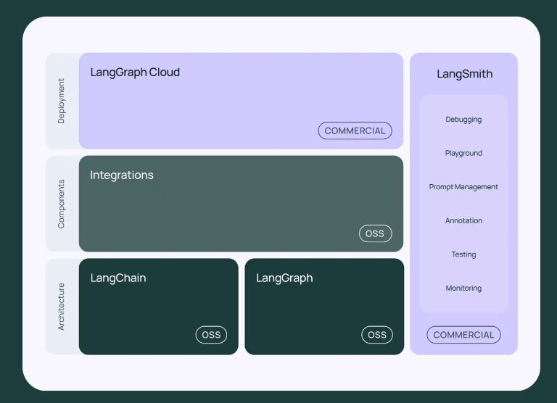
Architecture

Slide 12
Understanding the architecture
LangGraph Cloud: A hosted version of LangGraph for easier deployment and management.
LangSmith: A tool for building and managing LLM applications, including debugging, prompt management, annotation, testing, and monitoring.
Integrations: Connects LangChain with other tools and services for enhanced functionality.
Components: Building blocks of LangChain, such as LLM chains, prompts, and indexes.
Architecture: The underlying structure and design of LangChain.
Deployment: Options for deploying LangChain applications, including cloud-based and on-premise.
LangChain: A framework for building LLM applications.
LangGraph: A tool for visualizing and understanding the architecture of LLM applications.

Slide 13
LangSmith
LangSmith is a comprehensive toolset designed to assist developers in building and managing large language model (LLM) applications. It offers a variety of features to streamline the development process and ensure efficient operation. Here's a breakdown of the key components listed under LangSmith:
Debugging: Provides tools to identify and resolve issues within LLM applications, helping developers pinpoint errors and improve performance.
Playground: A sandbox environment where developers can experiment with different LLM configurations, prompts, and data to fine-tune their applications.
Prompt Management: Manages and organizes prompts used in LLM applications, making it easier to reuse and modify them.
Annotation: Facilitates the process of labeling and annotating data used to train or fine-tune LLMs, improving their accuracy and performance.
Testing: Offers tools for testing and evaluating LLM applications to ensure they meet desired quality standards and perform as expected.
Monitoring: Provides insights into the performance and behavior of LLM applications, helping developers identify potential bottlenecks or issues.
In essence, LangSmith empowers developers with a suite of tools to effectively build, manage, and optimize LLM applications, streamlining the development process and ensuring high-quality results.

Slide 14
LangSmith
LangSmith is the enterprise DevOps platform built for LLMs.
Gain visibility to make trade offs between cost, latency, and quality.
Increase developer productivity.
Eliminate manual, error-prone testing.
Reduce hallucinations and improve reliability.
Enterprise deployment options to keep data secure.
LangSmith is an all-in-one developer platform for every step of the LLM-powered application lifecycle, whether you’re building with LangChain or not. Debug, collaborate, test, and monitor your LLM applications.

Slide 15
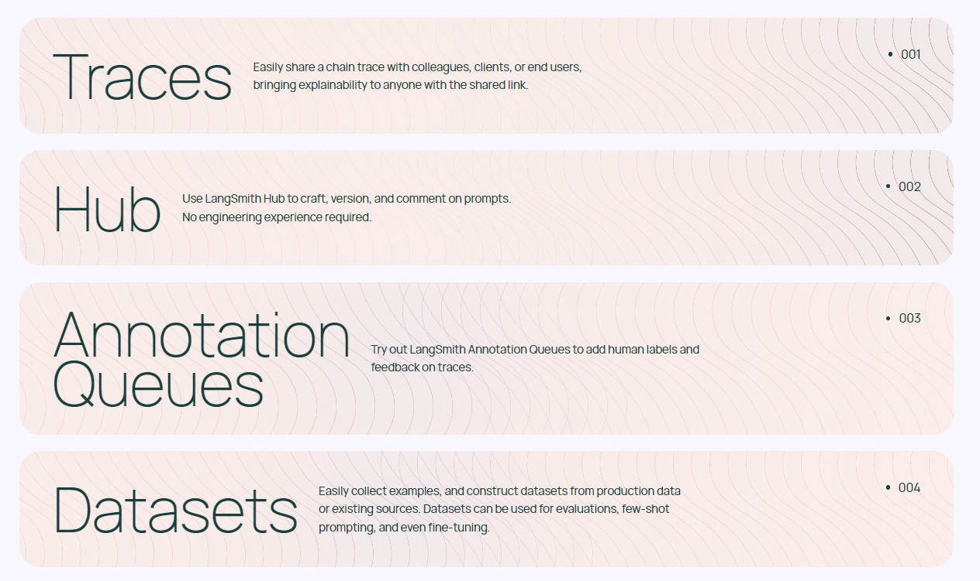
LangSmith

Slide 16
RAG

Slide 17
Limitations of LLMs
Language Models are great up to the data they are trained with.
Stale Information
No source data attribution / references
Hallucinations

Slide 18
Why RAG
Access to update / Current information along with external information.
LLM can trace back to source of information
Customizability and flexibility for domains
Mitigate Hallucination

Slide 19
RAG Vs Fine Tuning
Aspect | RAG | Fine Tuning
Knowledge Source | External Knowledge base or Documents | Internalized during training
Adaptability | Dynamic, fetches real-time information | Static, requires retraining to update
Training Requirements | No need of retraining the model | Requires retraining for specific datasets
Efficiency | Efficient for large or frequently updated datasets (Data that changes frequently) | Computationally very intensive
Best Use Cases | Domain task with sufficiently large body of knowledge | Domain specific tasks

Slide 20
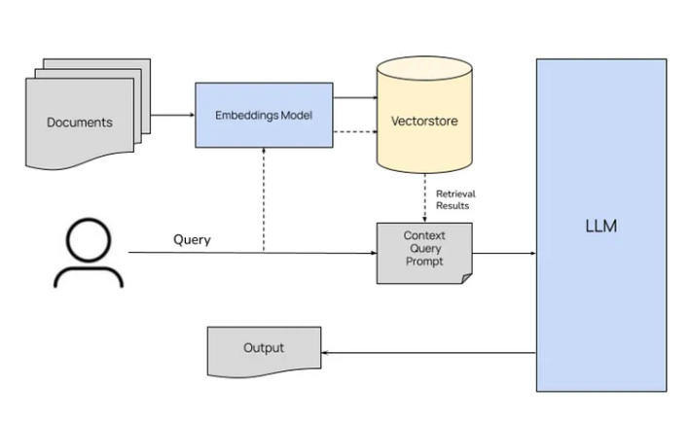
RAG Architecture
https://blog.stackademic.com/mastering-retrieval-augmented-generation-rag-architecture-unleash-the-power-of-large-language-a1d2be5f348c

Slide 21
Components:
Knowledge Base: A repository of relevant information, such as documents, articles, or databases.
Query Embedding: Converts the user's query into a numerical representation (embedding) that can be compared to the embeddings of the knowledge base.
Document Retrieval: Searches the knowledge base for documents whose embeddings are most similar to the query embedding.
Prompt Engineering: Constructs a prompt that combines the original query with the retrieved documents, providing context for the LLM.
Language Model (LLM): Generates a response based on the prompt and its understanding of the retrieved documents.

Slide 22
Process Flow:
User Query: The user submits a query.
Query Embedding: The query is converted into an embedding.
Document Retrieval: The most relevant documents from the knowledge base are retrieved based on their embeddings.
Prompt Engineering: A prompt is created using the query and the retrieved documents.
LLM Generation: The LLM processes the prompt and generates a response.

Slide 23
Retrieval
Vector Databases: Tools like Faiss, Annoy, or Pinecone for efficient similarity search.
Indexing Techniques: Methods like TF-IDF, BM25, or semantic search for representing and comparing documents.
Query Understanding: Techniques to parse and understand user queries effectively.

Slide 24
Chunking
Document Segmentation: Methods to break large documents into smaller, more manageable chunks.
Contextual Awareness: Ensuring that chunks maintain context and meaning.
Chunk Length Optimization: Determining the optimal chunk size for efficient retrieval and generation.

Slide 25
Semantic Search
Embedding Models: Techniques like BERT, RoBERTa, or Sentence Transformers for creating semantic embeddings.
Similarity Metrics: Cosine similarity, Euclidean distance, or other metrics for comparing embeddings.
Semantic Understanding: Capturing the underlying meaning and relationships between words and concepts.

Slide 26
Prompt Engineering
Prompt Templates: Designing effective prompts that guide the LLM's response.
Few-Shot Learning: Providing examples or demonstrations to help the LLM understand the task.
Prompt Optimization: Iterative refinement of prompts to improve response quality.

Slide 27
LLM Integration
API Integration: Connecting to LLM providers like OpenAI, Hugging Face, or Google AI.
Model Selection: Choosing the appropriate LLM based on task requirements and performance.
Parameter Tuning: Adjusting LLM parameters (e.g., temperature, top_p) to control the output.

Slide 28
Evaluation
Metrics: Using metrics like BLEU, ROUGE, or METEOR to assess the quality of generated responses.
Human Evaluation: Gathering feedback from human experts to evaluate subjective aspects like relevance and coherence.
Bias and Fairness: Ensuring the LLM's outputs are unbiased and fair.

Slide 29
Advanced RAGs
Hybrid Retrieval Models
Multi-Modal RAG
Knowledge Graph Integration
Reinforcement Learning for RAG
Explainable RAG
Large-Scale RAG

Slide 30
Hybrid Retrieval Models
Combining Different Retrieval Methods: Integrating semantic search with keyword-based retrieval for a more comprehensive approach.
Hierarchical Retrieval: Organizing knowledge bases into hierarchies for more efficient retrieval.
Contextual Retrieval: Considering the context of the query and retrieved documents for more relevant results.

Slide 31
Multi-Modal RAG
Image and Text Integration: Incorporating visual information to enhance understanding and response generation.
Audio and Text Integration: Combining textual and auditory data for more nuanced responses.

Slide 32
Knowledge Graph Integration
Semantic Relationships: Leveraging knowledge graphs to capture relationships between entities and concepts.
Reasoning and Inference: Using knowledge graphs to perform logical reasoning and draw inferences.

Slide 33
Reinforcement Learning for RAG
Reinforcement Learning for RAG
Reward Functions: Designing reward functions to train RAG systems to generate more relevant and informative responses.
Policy Optimization: Using reinforcement learning algorithms to optimize the system's behavior.

Slide 34
Explainable RAG
Interpretability: Developing techniques to understand how RAG systems arrive at their conclusions.
Bias Mitigation: Identifying and addressing biases in the knowledge base or LLM.

Slide 35
Large-Scale RAG
Distributed Systems: Scaling RAG systems to handle massive datasets and complex queries.
Cloud-Based Solutions: Utilizing cloud platforms for efficient deployment and management.

