Slide 1
Representation Learning

Slide 2
Representation Learning
Representation learning, also known as feature learning, is a type of machine learning technique where the system automatically discovers the representations needed for a task. Instead of relying on manually engineered features, representation learning algorithms learn to transform raw data into the representations that make it easier to perform the desired task, such as classification, regression, clustering, etc.
Basic Concepts
Raw Data: The initial form of data that hasn't been transformed or processed, such as pixels in an image or words in a sentence.
Features: A feature is an individual measurable property or characteristic of a phenomenon being observed. In representation learning, the features are learned automatically from the data.

Slide 3
Latent Space
Representation learning is a field within machine learning that focuses on learning efficient, meaningful, and often lower-dimensional representations of data, which can then be used for various tasks such as classification, clustering, or generation. These representationns often reside in what we refer to as a "latent space."
Feature Space vs. Latent Space
Feature Space: The feature space refers to the original space where the raw data is represented by its features or attributes. For instance, in image data, each pixel is a feature, so an image is represented by a vector of pixel values. This space can be very high-dimensional, especially for complex data like images, text, or audio.
Latent Space: Latent space, on the other hand, is the transformed version of this feature space, typically lower-dimensional, where the model encodes the essential information needed to describe the data. It captures the underlying patterns or structures in the data, often in a way that is more efficient or more interpretable than the original feature space.

Slide 4
How Latent Space Facilitates Representation Learning
Dimensionality Reduction:
During the process of representation learning, a model (like an autoencoder, PCA, or a neural network) reduces the dimensionality of the feature space and maps it into the latent space.
This latent space is typically of lower dimensionality but captures the most salient features of the data. For instance, in images, this might mean focusing on features like edges, textures, or shapes rather than individual pixel values.
Learning Meaningful Representations:
The representations in the latent space are often more abstract and meaningful than those in the original feature space. For instance, in a deep neural network, different layers learn different levels of abstraction, with higher layers (closer to the output) often representing the data in a latent space that encodes high-level concepts (like the presence of certain objects in an image).
These representations are what the model "understands" as the essence of the input data.

Slide 5
Smooth Interpolations and Generative Capabilities:
The latent space is often structured in a way that allows for smooth interpolations between points, meaning that small changes in the latent variables result in gradual changes in the generated data.
For generative models like GANs or VAEs, this means you can smoothly transition between different generated outputs by interpolating between points in the latent space.
Transfer Learning:
In transfer learning, the representations learned by a model on one task are used as features for a different, related task. These representations typically reside in a latent space learned by the model.
For example, a model trained on a large dataset of images can learn a latent space that captures general features like shapes and textures, which can then be fine-tuned for a specific task, such as identifying specific objects in images.

Slide 6
Steps in creating a Generative Model
Data Preparation: Clean, tokenize, and preprocess raw text data.
Pretraining (Self-Supervised Learning): Train the model using unsupervised tasks like MLM and NSP to understand language patterns.
Supervised Fine-Tuning: Fine-tune the model on curated human-labeled data for specific tasks.
Reward Modeling: Train a model to rank responses based on human feedback.
Reinforcement Learning (RLHF): Use reinforcement learning to optimize the model further using the reward model.
Deployment: Deploy the model and monitor its performance for continuous improvements.

Slide 7
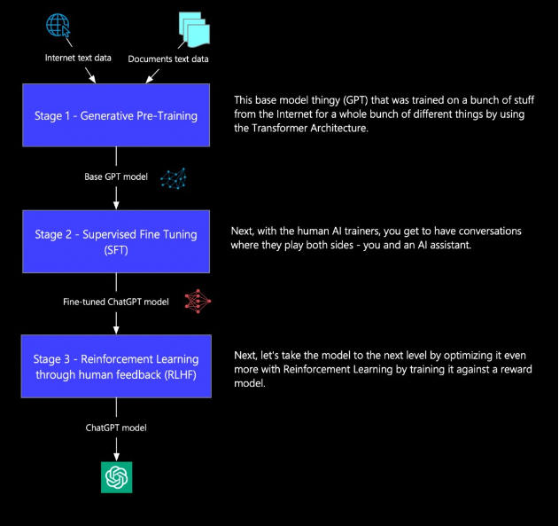
How Chat GPT is Trained

Slide 8
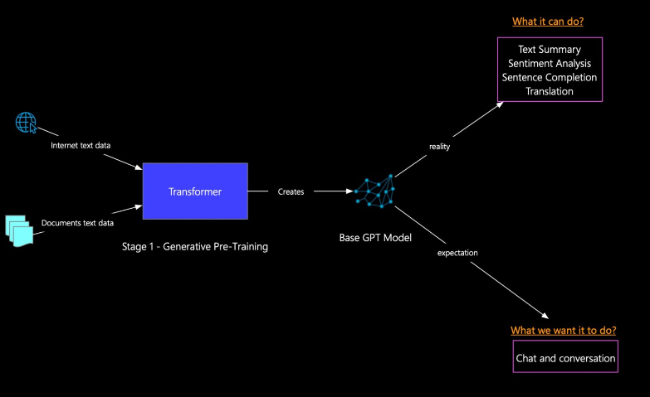
Stage 1 Generative Pre-training

Slide 9
Stage -1
Data Preparation
Objective: Collect and clean raw data for pretraining the model.
Key Components:
Data Collection: Gather large-scale datasets from various sources like books, websites, or text documents.
Data Cleaning: Clean the data by removing noise (e.g., special characters, incomplete sentences) and handling missing data or outliers. Preprocessing is crucial to ensure the model doesn't learn from noisy data.
Tokenization: Convert the cleaned text into tokens (small units like words or subwords). This is done using tokenizers like Byte Pair Encoding (BPE) or WordPiece. The tokenization process breaks the text into manageable chunks and assigns each token a unique index.
Outcome: The raw text is converted into numerical data (tokens) that the model can understand and use for training.

Slide 10
Stage -1
Pretraining (Self-Supervised Learning)
Objective: Train the model in a self-supervised manner to predict tokens in text, learning general language patterns.
Key Components:
Masked Language Modeling (MLM): The model is trained by masking certain tokens in the input text and predicting the masked tokens. This helps the model understand context and relationships between words.
Next Sentence Prediction (NSP): The model learns to predict whether two sentences are consecutive. This helps in understanding text flow and relationships between sentences.
Self-Supervised Learning: The model learns without explicit labels, using patterns within the data to make predictions. This includes tasks like token prediction, sentence ordering, etc.
Outcome: The model gains a general understanding of language syntax, semantics, and context. It can generate fluent text but might not be perfectly aligned with specific goals or safety concerns.

Slide 11
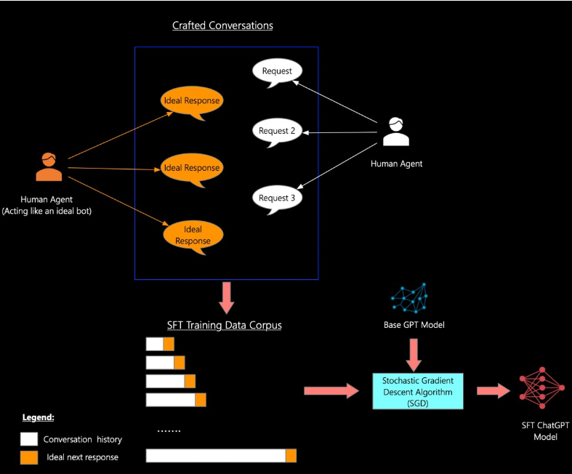
Stage 2 Supervised Fine Tuning

Slide 12
Stage 2 Supervised Fine Tuning

Slide 13
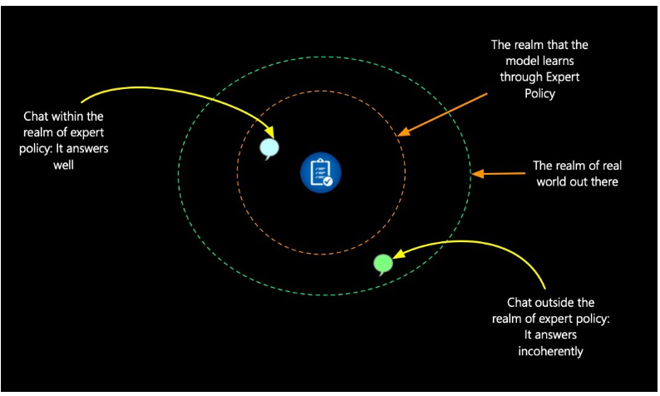
Stage 2 Supervised Fine Tuning

Slide 14
Stage -2 Supervised Fine-Tuning (SFT)
In Stage 2, the primary goal is to fine-tune the pretrained model using Supervised Fine-Tuning (SFT). This involves human annotators carefully crafting responses that align with how a model should ideally respond to specific requests or prompts. The purpose is to align the pretrained model more closely with specific tasks and scenarios, making its responses more structured, coherent, and contextually appropriate.
Components of Stage 2:
Crafted Conversations:
The process begins with human agents engaging in conversations where one human acts like a chatbot. This human provides responses as if they were an "ideal bot," offering the perfect next response to each request
Request-Response Pairing: The human annotator provides responses to multiple requests, which help generate the ideal response for the training data. These conversations form the SFT Training Data Corpus, where each request has its ideal answer.
Supervised Learning:
The conversation data is fed into the Base GPT model, and an optimization algorithm like Stochastic Gradient Descent (SGD) is used to fine-tune the model.
During training, the model is adjusted to learn the correct responses for given conversation histories, matching them with the ideal next response. This supervised process helps the model learn to mimic high-quality, human-like responses.
SFT Model Output:
After SFT, the model produces a SFT ChatGPT model. This version of the model can respond more accurately and coherently to specific queries. It’s tailored for better task-specific performance, such as handling questions on policies, employee benefits, or other business-related tasks.

Slide 15
Stage -2

Slide 16
Stage -2

Slide 17
Stage -2

Slide 18
Stage-3

Slide 19
Appendix

Slide 20
SGD
SGD (Stochastic Gradient Descent) is an optimizer. It's a fundamental algorithm used in machine learning and deep learning to optimize (or "train") models by adjusting their parameters (weights) to minimize the loss function.
How SGD Works:
Initialize Weights:
When training a neural network, the model's weights (parameters) are typically initialized randomly.
Forward Pass (Prediction):
The model makes predictions by passing the input through its layers. This is called the forward pass.
Calculate Loss:
The difference between the predicted output and the true output (label) is calculated using a loss function (e.g. Categorical Cross Entropy / Softmax Cross Entropy).
Backward Pass (Gradient Calculation):
After calculating the loss, backpropagation is used to compute the gradients (partial derivatives of the loss function with respect to each model parameter).

Slide 21
SGD
Weight Update (Optimization):
The SGD optimizer updates the model's parameters by subtracting the product of the gradient and a learning rate from the current weights:
W_{new} = W_{old} − η⋅∇L
Where:
W_{new} are the updated weights.
W_{old} are the current weights.
η is the learning rate (a hyperparameter that controls how much the weights are adjusted).
∇L ∇L is the gradient of the loss with respect to the weights.
Repeat:
This process is repeated across many iterations (epochs), gradually improving the model's performance.

Slide 22
Categorical Cross Entropy / Softmax Cross Entropy
In Stage 2: Supervised Fine-Tuning (SFT), the model is trained on human-labeled examples of conversations. Specifically, the model learns to predict the next response based on an input (a question, for example). The loss function used in this stage is typically categorical cross-entropy (also referred to as softmax cross-entropy).
How does this work?
Task in SFT:
In SFT, the task is essentially a sequence generation task. The model is provided with a prompt (e.g., a question) and is trained to predict the next correct response as provided by a human annotator.
The process is similar to multi-class classification where each possible token in the vocabulary is considered a class.

Slide 23
Why Categorical Cross-Entropy:
The model outputs a probability distribution over the entire vocabulary for the next word (token) in the response.
Categorical cross-entropy is the standard loss function for multi-class classification tasks, and in this case, each token (word) in the vocabulary is treated as a class.
The model’s goal is to minimize the difference between its predicted probability for the correct token and the actual token as given in the human-labeled example.

Slide 24
Example of Categorical Cross-Entropy in ChatGPT’s SFT:
Let’s break it down with an example:
Input (conversation history):
Human: "What is the capital of France?"
Model: "The capital of France is ___"
True label (ideal response from the human-labeled dataset):
"Paris"
Predicted output (probability distribution over the vocabulary):
The model predicts the next word (token) in the sequence with a probability distribution over the entire vocabulary. Let’s say it predicts:
{'London': 0.2, 'Paris': 0.7, 'Berlin': 0.05, 'Rome': 0.05}
In this case, the model predicted "Paris" with a probability of 0.7, but its goal is to predict it with a probability close to 1.

Slide 25
Categorical Cross-Entropy Loss Calculation:
The loss is calculated as the negative log likelihood of the correct word (in this case, "Paris").
The formula for categorical cross-entropy is:
Loss = −∑(true probability × log(predicted probability))
For this example, the true probability for "Paris" is 1, so the loss will be:
Loss= - log(0.7) = 0.155
This loss is backpropagated, and the model is updated to maximize the probability of predicting the correct tokens for future responses.

