Slide 1
NLP Basics

Slide 2
Tokenization

Slide 3
Tokenization
Tokenization is the process of breaking down text into smaller units, or "tokens," which can then be processed by machine learning or natural language processing (NLP) models. There are various levels of tokenization, depending on how granular you want the analysis to be, including character-level, word-level, sentence-level, and paragraph-level tokenization.
Character-Level Tokenization
Word-Level Tokenization
Sentence-Level Tokenization
Paragraph-Level Tokenization
Subword Tokenization
Morphological Tokenization
N-Gram Tokenization
Syllable-Level Tokenization
Entity-Level Tokenization
Regex-Based Tokenization

Slide 4
Character-Level Tokenization
Definition: Each individual character in the text becomes a token.
Example:
For the word "Hello", character-level tokens would be ['H', 'e', 'l', 'l', 'o’].
Use Cases: Useful for languages with complex character structures, such as Chinese or Arabic, where characters carry semantic meaning. It’s also helpful in text generation, spelling correction, and applications where minor textual variations (e.g., typos) need to be considered.
Pros: Captures details at the finest level, making it adaptable to handling unknown words or spelling variations.
Cons: Results in a large number of tokens, which can increase computational complexity and lead to issues like long sequence lengths in deep learning models.

Slide 5
Word-Level Tokenization
Definition: The text is split into tokens based on words. Typically, words are separated by whitespace or punctuation.
Example:
For the sentence "The quick brown fox," word-level tokens would be ['The', 'quick', 'brown', 'fox’].
Use Cases: Commonly used in NLP tasks like sentiment analysis, machine translation, and text classification. Most word embeddings (like Word2Vec and GloVe) are designed for word-level tokens.
Pros: Captures semantic meaning more effectively than character-level tokenization, making it efficient and interpretable.
Cons: Cannot handle out-of-vocabulary (OOV) words, misspellings, or variations effectively. Models trained on word-level tokens may struggle with unseen words in new text.

Slide 6
Sentence-Level Tokenization
Definition: The text is split into individual sentences, which are treated as tokens.
Example:
For the text "Hello world! How are you?", sentence-level tokens would be ['Hello world!', 'How are you?’].
Use Cases: Useful for tasks requiring context within a sentence, such as summarization, sentence classification, or text segmentation. Sentence-level tokenization can help retain contextual information that spans multiple words.
Pros: Preserves sentence structure, which is beneficial for tasks requiring an understanding of complete thoughts or ideas.
Cons: Sentence boundaries can be challenging to identify in certain languages or informal writing styles. Additionally, it may overlook finer details within each sentence.

Slide 7
Paragraph-Level Tokenization
Definition: The text is divided into paragraphs, often separated by newlines or indentation.
Example:
For a text with two paragraphs, "Hello world! This is the first paragraph.\nAnd here’s the second paragraph," the tokens would be:
['Hello world! This is the first paragraph.', 'And here’s the second paragraph.’]
Use Cases: Used in applications like document summarization, topic modeling, and legal or medical text analysis, where entire paragraphs may hold unique, contextually complete thoughts.
Pros: Retains the highest level of context, making it suitable for analyses that rely on larger portions of text or where paragraph structure has meaning.
Cons: This approach is less granular, so it may overlook important details within sentences or words. Additionally, it’s less suitable for tasks that require detailed text analysis at a finer level.

Slide 8
Subword Tokenization
Definition: Divides text into subword units, which are smaller than words but larger than characters. Subword tokenization is often used in modern NLP models to balance between handling unknown words and retaining meaning.
Common Methods:
Byte-Pair Encoding (BPE): A compression algorithm that merges the most frequent pairs of characters iteratively, resulting in subword units.
WordPiece: Used in models like BERT, it builds a vocabulary of subword tokens based on frequency while handling out-of-vocabulary issues effectively.
SentencePiece: Used in models like T5, it segments text into subwords without relying on whitespace.
Example:
For the word "unhappiness," BPE might tokenize it as ['un', 'happi', 'ness’].
Use Cases: Frequently used in transformers and other deep learning models to handle rare or unknown words. Ideal for languages with complex morphology or many compound words.
Pros: Reduces the vocabulary size and addresses OOV issues by breaking words into known subword units.
Cons: Requires training a tokenizer on the corpus, and subwords can sometimes lack standalone meaning.

Slide 9
Morphological Tokenization
Definition: Breaks down words based on morphological structure, such as prefixes, suffixes, roots, or stems.
Example:
For "unhappiness," morphological tokenization might separate it as ['un', 'happy', 'ness’]
Use Cases: Useful for languages with rich morphology, like Finnish, Turkish, or Arabic. It’s also valuable in text generation and understanding word semantics.
Pros: Captures the grammatical and semantic structure within words, which is helpful for languages with complex morphology.
Cons: Requires language-specific knowledge and tools, and can be computationally intensive.

Slide 10
N-Gram Tokenization
Definition: Breaks text into continuous sequences of n words or characters, known as n-grams. Common values are bigrams (2 words), trigrams (3 words), etc.
Example:
For the sentence "I love NLP," bigram tokenization produces ['I love', 'love NLP’].
Use Cases: Useful in text classification, sentiment analysis, and language modeling, as it captures context within neighboring tokens.
Pros: Captures local context and word associations, making it effective for analyzing phrases or short sequences.
Cons: Large n-grams can lead to very large feature spaces, which increases computational cost.

Slide 11
Syllable-Level Tokenization
Definition: Divides words into syllables, which are intermediate units smaller than words but larger than characters.
Example:
For the word "tokenization," syllable tokenization might produce ['to', 'ken', 'i', 'za', 'tion’].
Use Cases: Primarily used in speech processing, text-to-speech (TTS), and poetry analysis.
Pros: Useful in languages where syllables have meaning or in tasks where pronunciation is important.
Cons: Language-dependent and challenging for languages with complex syllable rules.

Slide 12
Entity-Level Tokenization
Definition: Segments text based on meaningful entities like names, locations, dates, or organizations, often used in Named Entity Recognition (NER).
Example:
For the sentence "John lives in New York," entity tokenization might produce tokens like ['John', 'New York’].
Use Cases: Common in NLP tasks like information retrieval, question answering, and NER.
Pros: Captures meaningful entities that are semantically important, reducing irrelevant information.
Cons: Requires entity recognition models or tagging, which may vary across contexts.

Slide 13
Regex-Based Tokenization
Definition: Uses regular expressions to define custom patterns for tokenization, often for domain-specific applications.
Example:
Splitting text based on dates or URLs, like turning "See more at https://example.com on 12/12/2023" into ['https://example.com', '12/12/2023’].
Use Cases: Useful in text preprocessing for cleaning or splitting based on specific patterns.
Pros: Highly customizable for specific tokenization needs, especially in preprocessing.
Cons: Requires expertise in regular expressions and can be error-prone if patterns are not defined carefully.

Slide 14
Vectorization

Slide 15
Vectorization
Vectorization is the process of converting textual data into numerical vectors so that machine learning models can process and learn from it. Different vectorization methods are used depending on the complexity, context requirements, and applications.
Count Vectorization (Term Frequency)
Term Frequency-Inverse Document Frequency (TF-IDF)
Word Embeddings (e.g., Word2Vec, GloVe)
FastText
Contextualized Embeddings (ELMo, BERT)
Transformer-Based Models and Beyond (GPT, T5)
Sentence Embeddings (Sentence-BERT, Universal Sentence Encoder)

Slide 16
Method | Level | Contextual? | Handles Polysemy | Common Use Cases
Common Use Cases | Word-level | No | No | Simple text classification
 | Word-level | No | No | Text classification, relevance ranking
Word2Vec / GloVe | Word embeddings | No | No | Sentiment analysis, word similarity
FastText | Subword embeddings | No | Partial | Text classification, languages with complex morphology
ELMo | Contextual word embeddings | Yes | Yes | Named entity recognition, part-of-speech tagging
BERT | Contextual word embeddings | Yes | Yes | QA systems, language inference, translation
Sentence-BERT / USE | Sentence embeddings | Yes | Yes | Semantic similarity, document clustering

Slide 17
Count Vectorization (Term Frequency)
Count Vectorization converts text to vectors by counting the occurrences of each word in a document. Each unique word becomes a feature, and its value is the number of times it appears in the document.
Example: For two documents, "I love NLP" and "NLP is great," the count vector might look like:
Limitations: High dimensionality and inability to capture semantic relationships. It only tells you if a word appears and how often, not its importance.
I | love | NLP | is | great
1 | 1 | 1 | 0 | 0
0 | 0 | 1 | 1 | 1

Slide 18
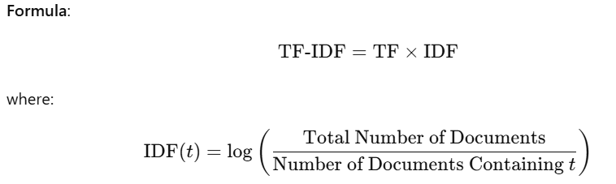
TF-IDF
TF-IDF improves on raw counts by weighing words according to their importance. It combines two metrics:
Term Frequency (TF): How frequently a word appears in a document.
Inverse Document Frequency (IDF): The inverse frequency of the word across all documents, reducing the weight of commonly occurring words (e.g., "the," "and").
Advantages: Highlights important words and reduces the influence of commonly used words.
Limitations: Still treats each word independently, losing the context of word sequences.

Slide 19
Word2Vec / GloVe
Word embeddings capture semantic relationships by mapping words into a continuous vector space. Word2Vec and GloVe are two popular word embedding techniques that use context to understand word relationships.
Word2Vec: Uses neural networks to learn word representations based on neighboring words. It has two approaches:
CBOW (Continuous Bag of Words): Predicts a word given its surrounding words.
Skip-gram: Predicts the surrounding words given a specific word.
Word2Vec learns word relationships like king - man + woman ≈ queen.
GloVe (Global Vectors for Word Representation): Learns embeddings by factorizing word co-occurrence matrices, capturing both global and local contexts.
Advantages: Captures semantic and syntactic relationships, e.g., similar words are closer in the vector space.
Limitations: Fixed embeddings, so it can't handle polysemy (words with multiple meanings).

Slide 20
FastText
FastText, developed by Facebook, is an extension of Word2Vec that breaks words into character n-grams and then generates word embeddings by aggregating these n-grams. This allows subword information to be included, which is particularly useful for morphologically rich languages and for handling out-of-vocabulary words.
Example: The word "playing" might be broken down into subword tokens like "pla," "lay," "ayi," etc., and then represented as the sum of these subword embeddings.
Advantages: Improves on Word2Vec by handling rare words and morphologically complex languages better.

Slide 21
Contextualized Embeddings (ELMo, BERT)
Contextualized embeddings consider the surrounding words dynamically, providing different embeddings for the same word based on its context. These embeddings are generated by large language models (LLMs).
ELMo (Embeddings from Language Models):
ELMo embeddings are generated using a two-layer bi-directional LSTM trained on a language modeling task.
Each word’s embedding is generated based on the entire sentence, allowing different embeddings for the same word depending on its context.
Example: The word "bank" will have different embeddings in "river bank" and "money bank."
BERT (Bidirectional Encoder Representations from Transformers):
BERT is based on the Transformer architecture, using self-attention to capture context from both left and right sides of each word.
BERT embeddings are contextualized at a deeper level, as it’s trained on a masked language model objective, where some words are randomly masked and predicted from the context.
Advantage: BERT embeddings capture deeper context and handle polysemy better than ELMo and Word2Vec.
Limitation: BERT embeddings are computationally expensive and require fine-tuning for specific tasks.

Slide 22
Transformer-Based Models and Beyond (GPT, T5)
Advanced transformer-based models like GPT and T5 generate embeddings for both words and entire sentences by understanding context bidirectionally (BERT-style) or autoregressively (GPT-style). These models create embeddings not only for individual words but also for sentences and even documents.
GPT (Generative Pre-trained Transformer):
GPT is an autoregressive model, generating text by predicting the next word based on prior context.
Use case: Mainly used for generating coherent and contextually relevant text.
T5 (Text-To-Text Transfer Transformer):
T5 is designed as a text-to-text framework, meaning that it reformulates NLP tasks as text generation.
This allows T5 to learn generalized embeddings across tasks like summarization, translation, and question answering.

Slide 23
Sentence Embeddings (Sentence-BERT, Universal Sentence Encoder)
Sentence embeddings provide fixed-size vector representations for entire sentences rather than individual words. These embeddings are useful for sentence-level tasks such as semantic similarity and text classification.
Sentence-BERT: A variant of BERT fine-tuned on sentence pairs to create embeddings that capture semantic similarity.
Universal Sentence Encoder: Developed by Google, it generates sentence embeddings that are easy to use in various applications, especially in semantic search and clustering.

Slide 24
Vector Database

Slide 25
VectorDB
A vector database is a specialized type of database designed to handle high-dimensional data in the form of vectors. Vectors are mathematical representations of data points in a multidimensional space, commonly used in machine learning, natural language processing, and computer vision. In these applications, vector databases are essential for efficiently storing, retrieving, and searching for vectors, enabling tasks like similarity search and recommendation.

Slide 26
Key Concepts in Vector Databases
Vectors:
Vectors represent features or embeddings derived from raw data like text, images, audio, or any structured or unstructured data. For example, words in a document can be converted into vectors using models like Word2Vec, BERT, or GPT. Similarly, images can be represented as vectors by passing them through a convolutional neural network (CNN).
Each vector is a list of numerical values representing the data in a high-dimensional space.
Similarity Search:
One of the main applications of vector databases is similarity search, where the goal is to find vectors (data points) that are similar to a given query vector.
Similarity is often measured using metrics like cosine similarity, Euclidean distance, or Manhattan distance. Vector databases are optimized to perform these calculations quickly on large datasets.
Indexing:
Vector databases use specialized indexing methods, such as Approximate Nearest Neighbor (ANN) techniques, to efficiently search through vast amounts of high-dimensional data.
Popular indexing algorithms include FAISS (Facebook AI Similarity Search), HNSW (Hierarchical Navigable Small World), and ANNOY (Approximate Nearest Neighbors Oh Yeah).
Scalability and Speed:
Vector databases are built to handle large volumes of data with low latency. This makes them suitable for real-time applications, such as recommendation systems, chatbots, image search, and voice recognition.
Traditional relational databases are not efficient for high-dimensional vector data due to their inability to perform rapid vector similarity searches.

Slide 27
Why Use a Vector Database?
Efficient Similarity Search:
Vector databases are optimized to retrieve the most similar data points (nearest neighbors) for a given vector, making them ideal for recommendation systems, search engines, and personalized content delivery.
Real-time Recommendations:
E-commerce platforms, social media sites, and streaming services use vector databases to recommend items based on user behavior, preferences, and past interactions.
Handling Unstructured Data:
Unstructured data like text, images, and audio can be transformed into vector representations, which vector databases can store and retrieve. This makes vector databases suitable for tasks involving natural language processing, image recognition, and more.
Flexibility with Machine Learning Models:
With pre-trained models available for tasks like NLP and computer vision, developers can quickly generate embeddings for their data, store them in a vector database, and start performing similarity searches without additional model training.

Slide 28
Popular Vector Databases
Pinecone:
A fully managed vector database that integrates with machine learning models and provides API-based access for similarity search.
Weaviate:
An open-source, schema-based vector database with built-in support for various machine learning models, including text and image embeddings.
Milvus:
Another open-source vector database, optimized for scalability, and frequently used in large-scale AI and data analytics projects.
FAISS (Facebook AI Similarity Search):
Not strictly a database, FAISS is a library for efficient similarity search and clustering of dense vectors, often integrated into vector databases.

Slide 29
How Vector Databases Work with Machine Learning Pipelines
Embedding Generation:
First, data (e.g., text, images) is converted into embeddings using a machine learning model. The embeddings are vectors that capture the essential features of the data.
Storage:
The embeddings are stored in the vector database, along with any associated metadata (e.g., item ID, description) to help with contextual information retrieval.
Querying:
When a query (e.g., a user’s text input or image) is converted into a vector, the vector database performs a similarity search, returning the most similar vectors stored in the database.
Application:
The retrieved results are then used in applications like recommendation systems, content-based filtering, or clustering for analysis.

Slide 30
Example: Basic Workflow of Using a Vector Database for Semantic Search
Data Preparation:
Text data (e.g., articles, product descriptions) is transformed into embeddings using a language model like BERT.
Storage in Vector Database:
The embeddings are saved in a vector database like Pinecone or Milvus.
Query Processing:
A user inputs a search query, which is also converted into an embedding.
Similarity Search:
The vector database performs a similarity search to find the top N closest embeddings to the query vector.
Result Presentation:
The results are returned to the user, showing the most relevant documents or products based on semantic similarity.

Slide 31
Why NOT regular Databases
Regular databases, like relational databases (e.g., MySQL, PostgreSQL) and NoSQL databases (e.g., MongoDB), are not optimized for handling vector data due to the following reasons:
1. Lack of Support for High-Dimensional Data Operations
Vector Representation: Vectors, especially embeddings from machine learning models, are high-dimensional numeric arrays (often hundreds or thousands of dimensions). Regular databases are not optimized for storing and manipulating these high-dimensional vectors.
Complexity of Operations: Operations on vectors, such as similarity search, require complex mathematical calculations like cosine similarity, Euclidean distance, or dot product, which are computationally intensive in high-dimensional spaces.

Slide 32
Why NOT regular Databases
2. Inefficient Similarity Search
Nearest Neighbor Search: In many AI/ML applications, the goal is to find the "nearest neighbors" of a query vector, which involves comparing the query vector with each vector in the database. Traditional databases perform poorly on this type of search due to the lack of optimized indexing for high-dimensional data.
Indexing Limitations: Traditional databases use indexes (like B-trees or hash indexes) for efficient lookup, but these indexing methods are ineffective for nearest neighbor search in high-dimensional space. Vector databases use specialized indexing techniques (e.g., Approximate Nearest Neighbor or ANN algorithms) that allow for faster, approximate similarity search.
3. Scalability and Performance Issues
High-Dimensionality and Curse of Dimensionality: As the number of dimensions increases, the volume of the space increases exponentially. This phenomenon, known as the curse of dimensionality, makes traditional databases extremely slow for high-dimensional vector data, as they end up having to perform a brute-force search over all data points.
Memory and CPU Usage: Performing similarity calculations on high-dimensional vectors requires substantial CPU and memory resources. Regular databases are not designed to efficiently allocate resources for such operations, which leads to performance bottlenecks.

Slide 33
Why NOT regular Databases
4. Lack of Specialized Indexing for Approximate Search
Exact vs. Approximate Search: Regular databases typically perform exact search operations. However, in many vector-based applications (like recommendation systems or semantic search), exact matches are unnecessary; approximate nearest neighbor (ANN) search is sufficient and much faster. Vector databases use ANN algorithms (such as HNSW, FAISS, or ANNOY), which trade off a small degree of accuracy for significant performance gains.
High Query Latency: Without specialized indexes for ANN, traditional databases suffer from high query latency when working with vectors, making them unsuitable for real-time applications like image search or voice recognition.
5. Inefficiency in Handling Unstructured Data
Embedding Metadata: Each vector often has associated metadata (like item IDs, labels, or tags) that provides context to the embedding. While regular databases can store this metadata, they cannot effectively combine it with high-dimensional vector data in a way that enables efficient similarity search and retrieval.
Data Transformation and Preprocessing: In applications like image or text search, unstructured data (e.g., images, text) is converted into vector representations (embeddings). Regular databases are not designed to natively support this type of data transformation, requiring additional systems to preprocess and store these embeddings.

Slide 34
Why NOT regular Databases
6. Real-Time Similarity and Ranking
Ranked Retrieval: In many applications, results need to be ranked based on their similarity to the query. Traditional databases lack efficient mechanisms for ranking results based on vector similarity, especially in high dimensions.
Dynamic Embedding Updates: Applications that frequently update embeddings (e.g., real-time recommendation engines) require efficient storage and retrieval. Regular databases are not designed for frequent high-dimensional updates and can become slow and inefficient over time as the data changes.

Slide 35
Transfer Learning

Slide 36
Transfer learning
Transfer learning is a machine learning technique where a model developed for a specific task is reused as the starting point for a model on a second, related task. Instead of training a model from scratch on a large dataset, transfer learning allows the use of a pre-trained model as a foundation, which is then fine-tuned for the specific requirements of a new task.

Slide 37
Benefits of transfer Learning
Reduced Training Time: By leveraging pre-trained models, you can significantly reduce the time required to train a new model from scratch. This is particularly beneficial for complex models like deep neural networks.
Improved Performance: Pre-trained models often achieve better performance than models trained from scratch, especially when dealing with limited data. The knowledge captured in the pre-trained model can help the new model generalize better to unseen data.
Lower Data Requirements: Transfer learning can be effective even with small datasets. The pre-trained model provides a strong foundation, allowing the new model to learn from a smaller amount of data.
Increased Accessibility: Transfer learning makes advanced machine learning techniques more accessible to researchers and developers with limited resources. By using pre-trained models, you can build complex models without the need for extensive data or computational power.
Enhanced Generalization: Pre-trained models often have a broader understanding of the underlying features and patterns in the data. This can help the new model generalize better to unseen data, leading to improved performance on new tasks.

Slide 38
Representation Learning

Slide 39
Representation Learning
Representation learning, also known as feature learning, is a type of machine learning technique where the system automatically discovers the representations needed for a task. Instead of relying on manually engineered features, representation learning algorithms learn to transform raw data into the representations that make it easier to perform the desired task, such as classification, regression, clustering, etc.
Basic Concepts
Raw Data: The initial form of data that hasn't been transformed or processed, such as pixels in an image or words in a sentence.
Features: A feature is an individual measurable property or characteristic of a phenomenon being observed. In representation learning, the features are learned automatically from the data.

Slide 40
Latent Space
Representation learning is a field within machine learning that focuses on learning efficient, meaningful, and often lower-dimensional representations of data, which can then be used for various tasks such as classification, clustering, or generation. These representationns often reside in what we refer to as a "latent space."
Feature Space vs. Latent Space
Feature Space: The feature space refers to the original space where the raw data is represented by its features or attributes. For instance, in image data, each pixel is a feature, so an image is represented by a vector of pixel values. This space can be very high-dimensional, especially for complex data like images, text, or audio.
Latent Space: Latent space, on the other hand, is the transformed version of this feature space, typically lower-dimensional, where the model encodes the essential information needed to describe the data. It captures the underlying patterns or structures in the data, often in a way that is more efficient or more interpretable than the original feature space.

Slide 41
How Latent Space Facilitates Representation Learning
Dimensionality Reduction:
During the process of representation learning, a model (like an autoencoder, PCA, or a neural network) reduces the dimensionality of the feature space and maps it into the latent space.
This latent space is typically of lower dimensionality but captures the most salient features of the data. For instance, in images, this might mean focusing on features like edges, textures, or shapes rather than individual pixel values.
Learning Meaningful Representations:
The representations in the latent space are often more abstract and meaningful than those in the original feature space. For instance, in a deep neural network, different layers learn different levels of abstraction, with higher layers (closer to the output) often representing the data in a latent space that encodes high-level concepts (like the presence of certain objects in an image).
These representations are what the model "understands" as the essence of the input data.

Slide 42
Smooth Interpolations and Generative Capabilities:
The latent space is often structured in a way that allows for smooth interpolations between points, meaning that small changes in the latent variables result in gradual changes in the generated data.
For generative models like GANs or VAEs, this means you can smoothly transition between different generated outputs by interpolating between points in the latent space.
Transfer Learning:
In transfer learning, the representations learned by a model on one task are used as features for a different, related task. These representations typically reside in a latent space learned by the model.
For example, a model trained on a large dataset of images can learn a latent space that captures general features like shapes and textures, which can then be fine-tuned for a specific task, such as identifying specific objects in images.

Slide 43
Steps in creating a Generative Model
Data Preparation: Clean, tokenize, and preprocess raw text data.
Pretraining (Self-Supervised Learning): Train the model using unsupervised tasks like MLM and NSP to understand language patterns.
Supervised Fine-Tuning: Fine-tune the model on curated human-labeled data for specific tasks.
Reward Modeling: Train a model to rank responses based on human feedback.
Reinforcement Learning (RLHF): Use reinforcement learning to optimize the model further using the reward model.
Deployment: Deploy the model and monitor its performance for continuous improvements.

Slide 44
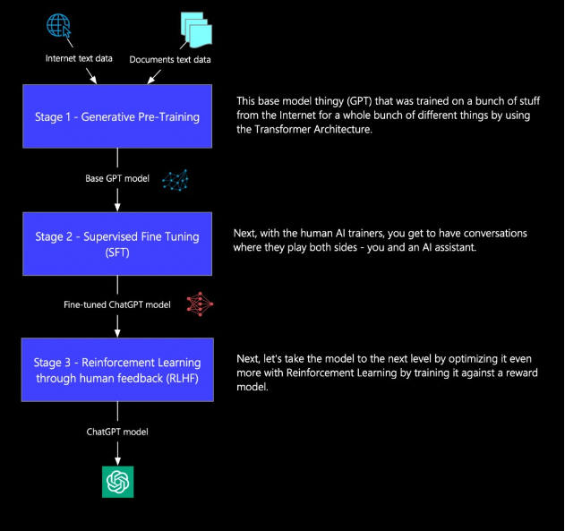
How Chat GPT is Trained

Slide 45
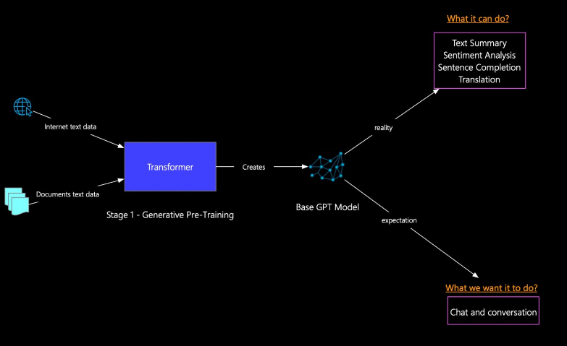
Stage 1 Generative Pre-training

Slide 46
Stage -1
Data Preparation
Objective: Collect and clean raw data for pretraining the model.
Key Components:
Data Collection: Gather large-scale datasets from various sources like books, websites, or text documents.
Data Cleaning: Clean the data by removing noise (e.g., special characters, incomplete sentences) and handling missing data or outliers. Preprocessing is crucial to ensure the model doesn't learn from noisy data.
Tokenization: Convert the cleaned text into tokens (small units like words or subwords). This is done using tokenizers like Byte Pair Encoding (BPE) or WordPiece. The tokenization process breaks the text into manageable chunks and assigns each token a unique index.
Outcome: The raw text is converted into numerical data (tokens) that the model can understand and use for training.

Slide 47
Stage -1
Pretraining (Self-Supervised Learning)
Objective: Train the model in a self-supervised manner to predict tokens in text, learning general language patterns.
Key Components:
Masked Language Modeling (MLM): The model is trained by masking certain tokens in the input text and predicting the masked tokens. This helps the model understand context and relationships between words.
Next Sentence Prediction (NSP): The model learns to predict whether two sentences are consecutive. This helps in understanding text flow and relationships between sentences.
Self-Supervised Learning: The model learns without explicit labels, using patterns within the data to make predictions. This includes tasks like token prediction, sentence ordering, etc.
Outcome: The model gains a general understanding of language syntax, semantics, and context. It can generate fluent text but might not be perfectly aligned with specific goals or safety concerns.

Slide 48
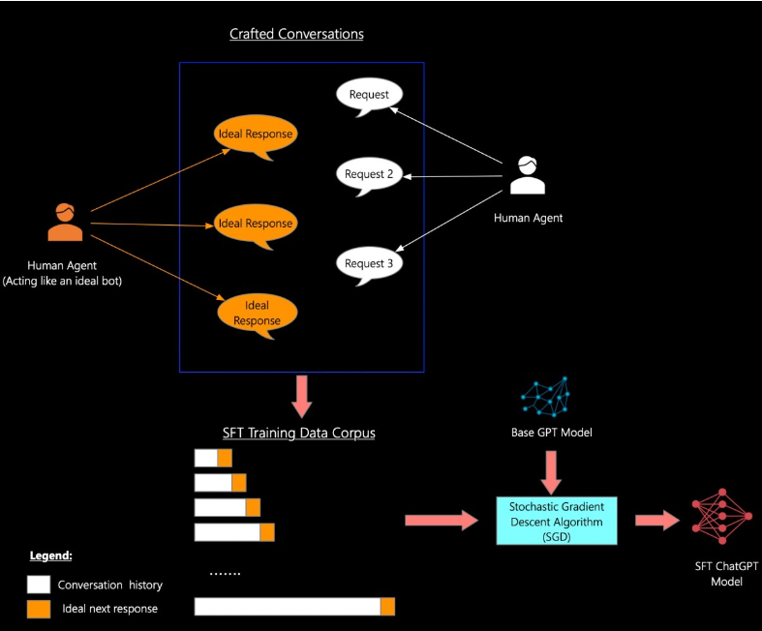
Stage 2 Supervised Fine Tuning

Slide 49
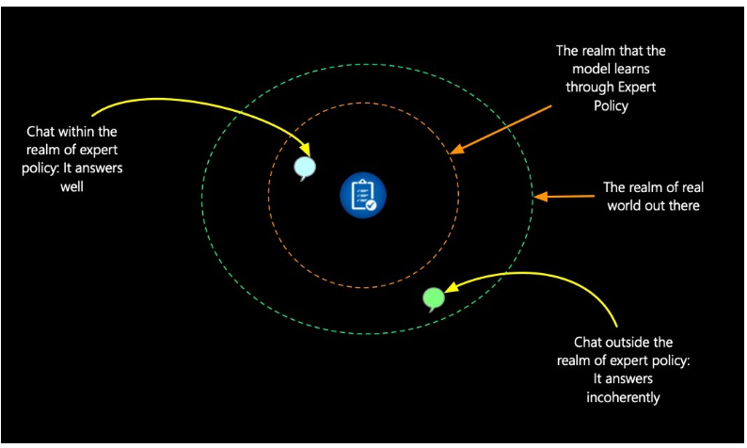
Stage 2 Supervised Fine Tuning

Slide 50
Stage -2 Supervised Fine-Tuning (SFT)
In Stage 2, the primary goal is to fine-tune the pretrained model using Supervised Fine-Tuning (SFT). This involves human annotators carefully crafting responses that align with how a model should ideally respond to specific requests or prompts. The purpose is to align the pretrained model more closely with specific tasks and scenarios, making its responses more structured, coherent, and contextually appropriate.
Components of Stage 2:
Crafted Conversations:
The process begins with human agents engaging in conversations where one human acts like a chatbot. This human provides responses as if they were an "ideal bot," offering the perfect next response to each request
Request-Response Pairing: The human annotator provides responses to multiple requests, which help generate the ideal response for the training data. These conversations form the SFT Training Data Corpus, where each request has its ideal answer.
Supervised Learning:
The conversation data is fed into the Base GPT model, and an optimization algorithm like Stochastic Gradient Descent (SGD) is used to fine-tune the model.
During training, the model is adjusted to learn the correct responses for given conversation histories, matching them with the ideal next response. This supervised process helps the model learn to mimic high-quality, human-like responses.
SFT Model Output:
After SFT, the model produces a SFT ChatGPT model. This version of the model can respond more accurately and coherently to specific queries. It’s tailored for better task-specific performance, such as handling questions on policies, employee benefits, or other business-related tasks.

Slide 51
ADD Stage-3 RLHF

Slide 52
SGD
SGD (Stochastic Gradient Descent) is an optimizer. It's a fundamental algorithm used in machine learning and deep learning to optimize (or "train") models by adjusting their parameters (weights) to minimize the loss function.
How SGD Works:
Initialize Weights:
When training a neural network, the model's weights (parameters) are typically initialized randomly.
Forward Pass (Prediction):
The model makes predictions by passing the input through its layers. This is called the forward pass.
Calculate Loss:
The difference between the predicted output and the true output (label) is calculated using a loss function (e.g. Categorical Cross Entropy / Softmax Cross Entropy).
Backward Pass (Gradient Calculation):
After calculating the loss, backpropagation is used to compute the gradients (partial derivatives of the loss function with respect to each model parameter).

Slide 53
SGD
Weight Update (Optimization):
The SGD optimizer updates the model's parameters by subtracting the product of the gradient and a learning rate from the current weights:
W_{new} = W_{old} − η⋅∇L
Where:
W_{new} are the updated weights.
W_{old} are the current weights.
η is the learning rate (a hyperparameter that controls how much the weights are adjusted).
∇L ∇L is the gradient of the loss with respect to the weights.
Repeat:
This process is repeated across many iterations (epochs), gradually improving the model's performance.

Slide 54
Categorical Cross Entropy / Softmax Cross Entropy
In Stage 2: Supervised Fine-Tuning (SFT), the model is trained on human-labeled examples of conversations. Specifically, the model learns to predict the next response based on an input (a question, for example). The loss function used in this stage is typically categorical cross-entropy (also referred to as softmax cross-entropy).
How does this work?
Task in SFT:
In SFT, the task is essentially a sequence generation task. The model is provided with a prompt (e.g., a question) and is trained to predict the next correct response as provided by a human annotator.
The process is similar to multi-class classification where each possible token in the vocabulary is considered a class.

Slide 55
Why Categorical Cross-Entropy:
The model outputs a probability distribution over the entire vocabulary for the next word (token) in the response.
Categorical cross-entropy is the standard loss function for multi-class classification tasks, and in this case, each token (word) in the vocabulary is treated as a class.
The model’s goal is to minimize the difference between its predicted probability for the correct token and the actual token as given in the human-labeled example.

Slide 56
Example of Categorical Cross-Entropy in ChatGPT’s SFT:
Let’s break it down with an example:
Input (conversation history):
Human: "What is the capital of France?"
Model: "The capital of France is ___"
True label (ideal response from the human-labeled dataset):
"Paris"
Predicted output (probability distribution over the vocabulary):
The model predicts the next word (token) in the sequence with a probability distribution over the entire vocabulary. Let’s say it predicts:
{'London': 0.2, 'Paris': 0.7, 'Berlin': 0.05, 'Rome': 0.05}
In this case, the model predicted "Paris" with a probability of 0.7, but its goal is to predict it with a probability close to 1.

Slide 57
Categorical Cross-Entropy Loss Calculation:
The loss is calculated as the negative log likelihood of the correct word (in this case, "Paris").
The formula for categorical cross-entropy is:
Loss = −∑(true probability × log(predicted probability))
For this example, the true probability for "Paris" is 1, so the loss will be:
Loss= - log(0.7) = 0.155
This loss is backpropagated, and the model is updated to maximize the probability of predicting the correct tokens for future responses.

