Slide 2
Seq2Seq Modeling
1. One-to-One
Definition: Each input corresponds to a single output.
Example: Traditional classification tasks like image classification.
Input: A single image.
Output: A single label (e.g., "cat" or "dog").
2. One-to-Many
Definition: A single input generates multiple outputs.
Example: Text generation or image captioning.
Input: A single image.
Output: A sequence of words describing the image (e.g., "A cat sitting on the mat").

Slide 3
Seq2Seq Modeling
3. Many-to-One
Definition: Multiple inputs result in a single output.
Example: Sentiment analysis or sequence classification.
Input: A sequence of words (e.g., "This movie is fantastic").
Output: A single label (e.g., "Positive sentiment").
4. Many-to-Many
Definition: A sequence of inputs maps to a sequence of outputs. Can be synchronous (input and output have the same length) or asynchronous (different lengths).
Example 1: Machine Translation (asynchronous).Input: A sequence of words in one language (e.g., "How are you?").
Output: A sequence of words in another language (e.g., "Comment ça va?").
Example 2: Video frame labeling (synchronous).Input: Frames of a video.
Output: Labels for each frame.

Slide 4
Encoder Decoder Architecture
The Encoder-Decoder architecture is a neural network design commonly used in sequence-to-sequence (Seq2Seq) tasks, where the input and output are sequences of variable lengths. This architecture is a key component in tasks like machine translation, text summarization, and speech-to-text systems.

Slide 5
Key Components of Encoder Decoder
Encoder:
The encoder processes the input sequence and compresses its information into a fixed-size context vector (also called the latent representation or hidden state).
It typically uses Recurrent Neural Networks (RNNs) like LSTMs or GRUs, or Transformers.
The encoder's job is to summarize the input sequence into a meaningful representation that the decoder can understand.
Steps in the Encoder:
Input sequence → RNN/Transformer layers → Context vector
Decoder:
The decoder takes the context vector from the encoder and generates the output sequence, one step at a time.
It uses its own hidden states and previously generated tokens to predict the next token.
The decoder is also usually implemented using RNNs, LSTMs, GRUs, or Transformers.
Steps in the Decoder:
Context vector + previous outputs → RNN/Transformer layers → Output sequence

Slide 6
How it works
Let’s consider an example of English-to-French translation (e.g., "I am happy" → "Je suis heureux").
Encoder:
The input sentence "I am happy" is tokenized and passed through the encoder.
The encoder processes the input step-by-step and generates a context vector summarizing the sentence.
Decoder:
The decoder takes the context vector as input and generates the output sequence, one word at a time.
For example:
At time step 1: Generate "Je."
At time step 2: Use "Je" and the context vector to generate "suis."
At time step 3: Use "Je suis" and the context vector to generate "heureux."

Slide 7
Application of Encoder Decoder
The Encoder-Decoder architecture is used in:
Machine Translation: Translating text from one language to another.
Text Summarization: Generating concise summaries from long texts.
Speech-to-Text: Converting speech audio into written text.
Image Captioning: Describing the content of an image in natural language.
Dialogue Systems: Generating responses in conversational agents or chatbots.

Slide 8
Strengths and Limitations of Encoder Decoder
Strengths :-
Handles variable-length input and output sequences.
Encapsulates the input sequence into a meaningful latent representation.
Works well with complex sequence-related tasks when combined with attention mechanisms.
Limitations:
Fixed Context Vector (Without Attention):
Compressing all input sequence information into a fixed-size vector can lead to loss of information, especially for long sequences.
Sequential Nature:
The decoder generates tokens step-by-step, making the process slower than parallelizable architectures (e.g., Transformers).
Training Challenges:
Training encoder-decoder models can be computationally expensive, especially for long sequences.

Slide 9
Encoder-Decoder with Attention:
A significant improvement to this architecture was the introduction of attention mechanisms, where the decoder dynamically focuses on relevant parts of the input sequence. This overcomes the limitation of relying on a single context vector.
For example, in machine translation, attention allows the model to focus on specific words in the input sentence while generating each word in the output.

Slide 10
Why Use Attention?
Problem with Fixed-Size Context Vector:
In the vanilla Encoder-Decoder architecture, the encoder encodes the entire input sequence into a single context vector.
For long sequences, this can lead to loss of important details because the fixed-size context vector cannot store all the necessary information.
Solution:
Attention enables the decoder to look at different parts of the input sequence (produced by the encoder) at each decoding step.
Instead of relying solely on a fixed-size vector, the decoder assigns weights to the encoder's hidden states, indicating their relevance to the current decoding step.

Slide 11
How Attention Works:
Let’s break it down step-by-step using an English-to-French translation example:
1. Encoder:
The input sequence (e.g., "I am happy") is tokenized and processed by the encoder.
The encoder outputs:
Hidden states: One for each token in the input sequence. These represent the contextualized information for each token.
Example: For "I am happy", the encoder might produce hidden states: h₁,h₂,h₃​.
2. Attention Mechanism in the Decoder:
At each decoding step, the decoder:
Calculates Attention Weights:
For each input token, a score is computed to determine how relevant it is to the current decoding step.
These scores are typically computed using a function of the encoder hidden states (h₁,h₂,h₃​) and the decoder's current state (s_{t}​):
score(h_{i} , s_{t}) = f(h_{i} , s_{t})
Common scoring functions:
Dot product: score(h_{i} , s_{t})=h_{i}⋅s_{t}
Additive (Bahdanau attention): A learned neural network combines h_{i} and s_{t}
Scaled dot product (used in Transformers): Scales the dot product for numerical stability.
Contd…

Slide 12
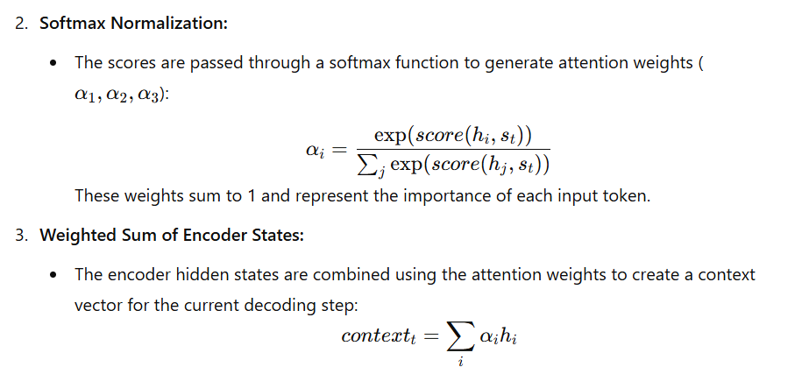
How Attention Works:
Contd…

Slide 13
How Attention Works:
3. Decoder:
The decoder uses the context vector (context_{t}​) and its own hidden state (s_{t}​) to predict the next word in the output sequence.
For example:
At step 1, the decoder predicts "Je" using context1context_1context1​.
At step 2, the decoder predicts "suis" using context2context_2context2​.
This process continues until the entire output sequence is generated.

Slide 14
Visualization of Attention
Imagine translating "I am happy" to "Je suis heureux". At each decoding step:
While generating "Je", the decoder assigns higher weights to "I".
While generating "suis", the decoder focuses on "am".
While generating "heureux", the decoder focuses on "happy".
The attention mechanism helps the model dynamically focus on the most relevant words, improving the quality of translations, especially for longer sentences.

Slide 15
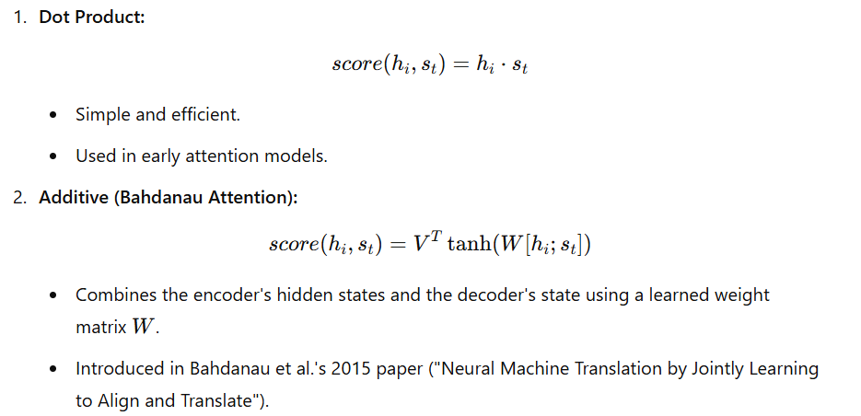
Attention Score Functions
Some commonly used Score functions
Contd…

Slide 16
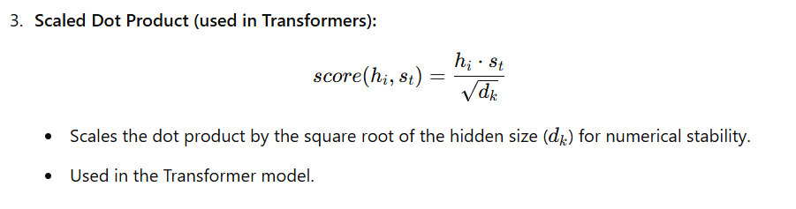
Attention Score Functions

Slide 17
Benefits of Attention
Handles Long Sequences Better:
Avoids the limitations of a fixed-size context vector by dynamically attending to relevant parts of the input.
Improves Interpretability:
Attention weights can be visualized to understand which input tokens the model focused on while generating each output token.
Boosts Performance:
Especially effective for tasks like machine translation, text summarization, and speech recognition.

Slide 18
Applications of Encoder-Decoder with Attention
Machine Translation:
Translate sentences from one language to another.
Text Summarization:
Generate a concise summary of a long article.
Image Captioning:
Use an image encoder (like a CNN) to extract features and a decoder with attention to generate captions.
Speech Recognition:
Convert audio sequences into text.
Dialogue Systems:
Generate contextually relevant responses in chatbots.

Slide 19
Transformers: The Core Idea
Transformers are a type of neural network architecture introduced in the groundbreaking paper "Attention Is All You Need" (Vaswani et al., 2017). They have revolutionized Natural Language Processing (NLP) and other sequence-related tasks by replacing traditional recurrent or convolutional neural networks with a mechanism called Self-Attention.

Slide 20
Key Features of Transformers
Parallel Processing:
Unlike RNNs or LSTMs, which process tokens sequentially, Transformers process all tokens simultaneously, enabling faster training and inference.
Self-Attention Mechanism:
The core of Transformers, self-attention allows the model to weigh the importance of different words (or tokens) in a sequence relative to each other.
Scalability:
Transformers scale efficiently to large datasets and sequences, making them ideal for training massive models like BERT, GPT, and T5.

Slide 21
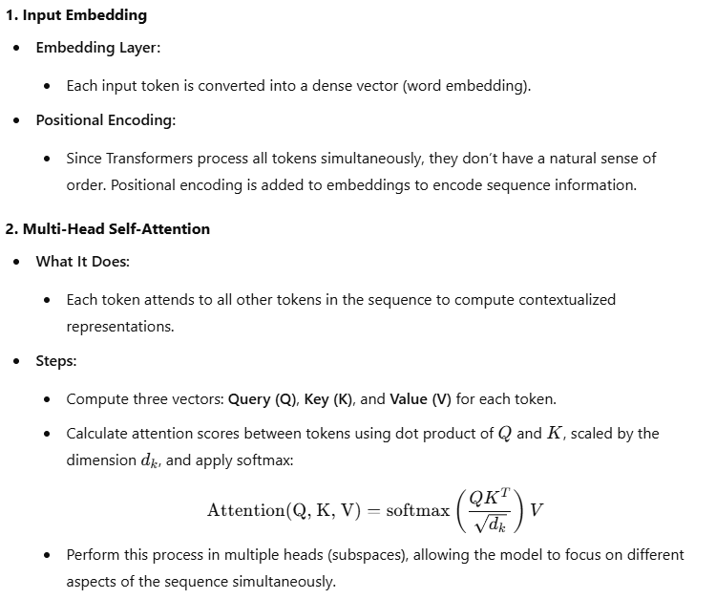
Components of Transformers
Contd…

Slide 22
Components of Transformers
3. Feed-Forward Neural Network
After self-attention, each token’s representation is passed through a feed-forward neural network (applied independently to each token).
4. Add & Normalize
Residual connections and layer normalization are applied to stabilize training and improve gradient flow.
5. Stacking Layers
The Transformer consists of stacked layers (e.g., 6, 12, or more) of attention and feed-forward networks, enabling deep learning of complex relationships.
6. Output Layer
For tasks like text generation, classification, or translation, a task-specific head is added to the output.

Slide 23
Architecture Overview
Transformers consist of two main parts:
A. Encoder
Encodes the input sequence into a contextualized representation.
Used for tasks like sentence classification or BERT (Bidirectional Encoder Representations from Transformers).
B. Decoder
Decodes the encoder’s output into a target sequence.
Used for tasks like machine translation or GPT (Generative Pre-trained Transformer).
For sequence-to-sequence tasks like translation, both encoder and decoder are used.

Slide 24
Key Innovations in Transformers
Self-Attention:
Models relationships between tokens regardless of their distance in the sequence.
Positional Encoding:
Adds information about token positions in the sequence.
Multi-Head Attention:
Enables the model to attend to different parts of the sequence in parallel.
Parallelization:
Removes sequential dependencies, making training faster and more efficient on GPUs.

Slide 25
Advantages of Transformers
Scalability: Efficiently scales to large datasets and sequences.
Parallelization: Faster training compared to RNNs/LSTMs.
Global Context: Self-attention enables long-range dependencies to be captured.
State-of-the-Art Results: Backbone of modern NLP models like BERT, GPT, T5, and more.

Slide 26
Applications
NLP Tasks:
Text classification, sentiment analysis, translation, summarization, and question-answering.
Vision:
Vision Transformers (ViT) for image classification and other computer vision tasks.
Audio and Speech:
Transformers are used for speech recognition and audio generation.
Code Understanding:
Models like Codex use Transformers to generate and interpret code.

Slide 27
Transformer-Based Models
BERT (Bidirectional Encoder Representations from Transformers):
Focuses on understanding (NLP tasks like classification, QA).
GPT (Generative Pre-trained Transformer):
Focuses on generating coherent text.
T5 (Text-to-Text Transfer Transformer):
A unified framework for NLP tasks where everything is treated as a text-to-text problem.

Slide 28
How Generative AI Models use transformer-based architecture.
Generative AI models, such as GPT (Generative Pre-trained Transformer), BERT, T5, DALL-E, and others, leverage the Transformer architecture to generate text, images, code, and more. The key innovation of Transformers is their attention mechanism, which enables models to handle long-range dependencies and generate coherent, context-aware outputs.

Slide 29
Core Components of Generative AI Models Using Transformers
1. Self-Attention Mechanism
Enables the model to focus on different parts of the input sequence.
Helps the model learn relationships between tokens in the sequence, even when they are far apart.
2. Positional Encoding
Adds sequence-order information to embeddings, ensuring the model understands the structure of input data.
3. Decoder-Only vs. Encoder-Decoder Architecture
Decoder-Only (e.g., GPT):
Generates outputs token by token.
Uses causal (masked) self-attention to prevent attending to future tokens during generation.
Ideal for tasks like text generation, code generation, and conversational AI.
Encoder-Decoder (e.g., T5, DALL-E):
Encodes an input sequence into a context vector and uses the decoder to generate outputs.
Suitable for tasks like translation, summarization, and image generation from text.

Slide 30
Steps in Generative AI Using Transformers
1. Pre-Training
Models are trained on massive datasets using self-supervised learning.
Example tasks:
Causal Language Modeling (CLM): Predict the next token in a sequence. Used in GPT.
Masked Language Modeling (MLM): Predict masked tokens in a sequence. Used in BERT.
2. Fine-Tuning
Pre-trained models are fine-tuned on task-specific datasets for applications like:
Text summarization.
Dialogue generation.
Code generation (e.g., Codex).
Image generation (e.g., DALL-E).
3. Generation
Models generate outputs using techniques like:
Greedy Decoding: Choose the token with the highest probability at each step.
Beam Search: Explore multiple output sequences simultaneously for the best result.
Temperature Sampling: Introduce randomness to the output by sampling from the probability distribution.

Slide 31
Popular Generative AI Models Using Transformers
1. GPT (Generative Pre-trained Transformer)
Architecture: Decoder-only Transformer.
Functionality: Text generation, conversation, story writing, and code generation.
Mechanism:
Generates one token at a time using causal self-attention.
Example: Autocomplete for a sentence like "The weather is" to "The weather is sunny today."
2. BERT (Bidirectional Encoder Representations from Transformers)
Architecture: Encoder-only Transformer.
Functionality: Focuses on understanding input sequences rather than generation.
Generative Use:
Combined with decoders to enable text generation (e.g., T5, BART).
3. T5 (Text-to-Text Transfer Transformer)
Architecture: Encoder-Decoder Transformer.
Functionality: Treats every NLP task as a text-to-text problem.
Example:
Input: "Summarize: The cat sat on the mat. It was a sunny day."
Output: "The cat sat on the mat on a sunny day."
4. DALL-E
Architecture: Transformer adapted for image generation.
Functionality: Generates images from text descriptions.
Mechanism:
Combines text embeddings with an autoregressive Transformer to create images pixel by pixel or patch by patch.

Slide 32
Generative AI Workflow Using Transformers
Input Representation:
Tokenize and embed the input sequence (e.g., text or image).
Add positional encoding.
Attention-Based Learning:
Use multi-head self-attention to understand relationships between tokens.
Decoding:
For text generation, decode the output one token at a time, attending to the input and previously generated tokens.
Output Generation:
Use a softmax layer to generate probabilities for the next token.
Convert the token IDs back to human-readable text or pixels.

Slide 33
Advantages of Transformers in Generative AI
Parallel Processing:
Allows for faster training and inference compared to sequential models like RNNs.
Handling Long Sequences:
Self-attention efficiently captures dependencies between distant tokens.
Scalability:
Scales well with increased data and model size (e.g., GPT-3 has 175 billion parameters).
Flexibility:
Applicable to text, images, audio, and other modalities.

Slide 34
Challenges
High Computational Costs:
Requires significant computational resources for training and inference.
Memory Limitations:
Self-attention has quadratic complexity with respect to sequence length.
Bias and Ethics:
Can generate biased or harmful content if the training data is biased.

Slide 35
Real-World Examples of Generative AI with Transformers
ChatGPT:
Builds conversational AI for interactive question-answering.
Google Bard:
AI assistant for language-based tasks.
DALL-E 2:
Generates high-quality images from text prompts.
GitHub Copilot:
Assists developers by generating code snippets from comments.

Slide 36
Thank You…
Welcome to the world of Generative AI

