Slide 1
Text Representation

Slide 2
Bag of Words (BoW)
What is Bag of Words (BoW)?
Represents text as a collection of words (ignores grammar and word order).
Each document becomes a vector of word counts.
Simple, effective method for classical ML.
Document | Text
Doc1 | "I love NLP"
Doc2 | "NLP is fun"
✅ Good for: Text classification, spam detection, sentiment analysis.
✅ Limitation: Doesn't capture word meaning or order.
→ Vocabulary = ['I', 'love', 'NLP', 'is', 'fun']
 | I | love | NLP | is | fun
D1 | 1 | 1 | 1 | 0 | 0
D2 | 0 | 0 | 1 | 1 | 1
→ BoW Matrix:

Slide 3
Term Frequency (TF) and TF-IDF
🔵 Term Frequency (TF)
How frequently a term appears in a document.
Normalized to avoid bias towards longer documents.
🔵 TF-IDF (Term Frequency-Inverse Document Frequency)
Penalizes words that are common across documents.
TF-IDF = TF × IDF
Highlights important and rare words in each document.
✅ Good for:
Document retrieval
Keyword extraction
Duplicate detection

Slide 4
TF Calculation
Doc ID | Text
Doc 1 | "Machine learning is fascinating"
Doc 2 | "Deep learning drives machine intelligence"
Word | Doc 1 ("Machine learning is fascinating") | Doc 2 ("Deep learning drives machine intelligence")
machine | 1/4 = 0.25 | 1/5 = 0.2
learning | 1/4 = 0.25 | 1/5 = 0.2
fascinating | 1/4 = 0.25 | 0/5 = 0.0
deep | 0/4 = 0.0 | 1/5 = 0.2
drives | 0/4 = 0.0 | 1/5 = 0.2
intelligence | 0/4 = 0.0 | 1/5 = 0.2

Slide 5
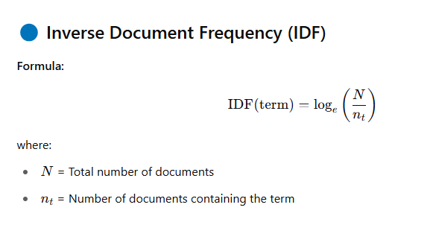
IDF Calculation
Word | #Docs Containing Word | IDF Calculation | IDF Value
machine | 2 | log(2/2) = log(1) = 0.0 | 0.0
learning | 2 | log(2/2) = log(1) = 0.0 | 0.0
fascinating | 1 | log(2/1) ≈ 0.693 | 0.693
deep | 1 | log(2/1) ≈ 0.693 | 0.693
drives | 1 | log(2/1) ≈ 0.693 | 0.693
intelligence | 1 | log(2/1) ≈ 0.693 | 0.693

Slide 6
TF IDF Calculation
TF-IDF(term, document) = TF(term, document) × IDF(term)
Word | Doc 1 TF-IDF | Doc 2 TF-IDF
machine | 0.25 × 0.0 = 0.0 | 0.2 × 0.0 = 0.0
learning | 0.25 × 0.0 = 0.0 | 0.2 × 0.0 = 0.0
fascinating | 0.25 × 0.693 ≈ 0.173 | 0.0 × 0.693 = 0.0
deep | 0.0 × 0.693 = 0.0 | 0.2 × 0.693 ≈ 0.139
drives | 0.0 × 0.693 = 0.0 | 0.2 × 0.693 ≈ 0.139
intelligence | 0.0 × 0.693 = 0.0 | 0.2 × 0.693 ≈ 0.139

Slide 7
DTM and TDM Matrix Creation
🔵 Document-Term Matrix (DTM)
Rows = Documents
Columns = Terms (words)
Cells = Word counts (or TF-IDF scores)
🔵 Term-Document Matrix (TDM)
Transpose of DTM:
Rows = Terms
Columns = Documents
Doc/Word | NLP | Love | Fun
Doc1 | 1 | 1 | 0
Doc2 | 1 | 0 | 1
Word | Doc1 | Doc2 | Doc3 | Doc4 | Doc5
apple | 1 | 0 | 1 | 0 | 0
banana | 0 | 1 | 0 | 0 | 1
orange | 0 | 1 | 0 | 1 | 0
mango | 1 | 0 | 0 | 0 | 1
✅ Good for:
ML models (DTM)
Topic modeling and word analysis (TDM)
✅ DTM → Documents × Words ✅ TDM → Words × Documents

Slide 8
Sparse Matrix Visualization
🔵 Why Sparse Matrices?
Most documents do not use most words.
Matrices have lots of 0s and few nonzero values.
🔵 Visualization
Use spy plots to show sparsity pattern.
Dots = non-zero entries (word present in document).
Doc/Word | Apple | Banana | Orange
Doc1 | 1 | 0 | 0
Doc2 | 0 | 0 | 1
✅ Majority = zeros ➔ sparse matrix
✅ Sparse Matrix = Efficient for Memory & Speed

