Slide 1
Text Analytics
Basudev

Slide 2
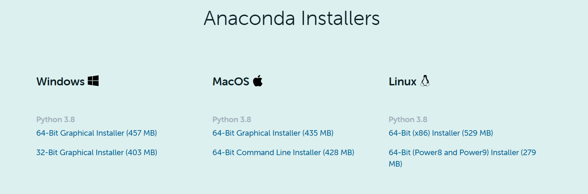
Anaconda distribution
https://www.anaconda.com/products/individual
Notes:
Win 64-bit version takes around 2-3 Minutes to download.

Slide 3
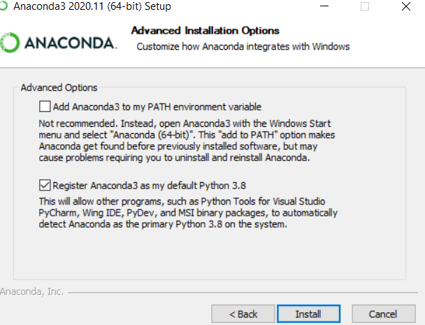
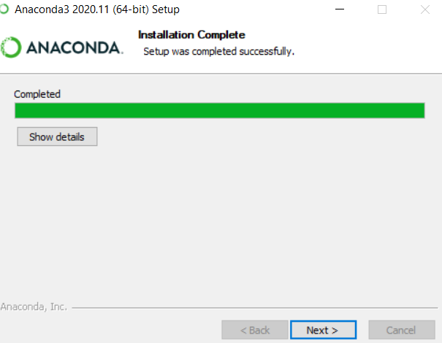
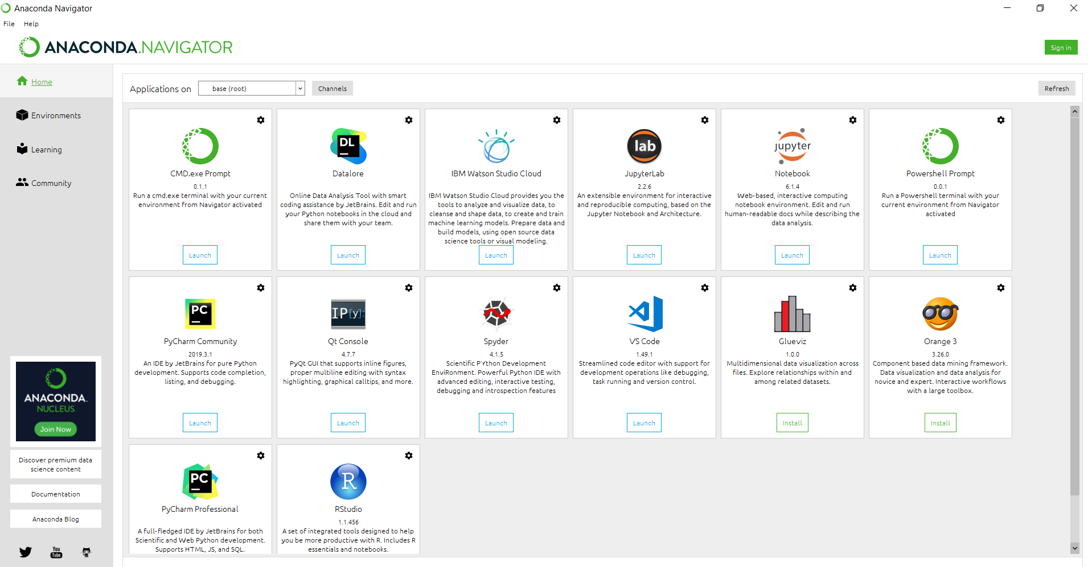
Notes:
Installation should take around 2-3 Minutes

Slide 4
Create Virtual Environment for Text Analytics
conda –V (To check the current version of Anaconda)
conda update conda ( To update conda)
Python version is different from Anaconda version, to check the list of available python versions we can use (conda search "^python$“)
To list the available virtual environments (conda env list)
Now to create the virtual environment with a particular version of the Python use ( conda create --name textanalyticsenv python=3.8)
Activate the virtual environment (conda activate textanalyticsenv)
To deactivate and return to the base environment (conda deactivate)
Install all the relevant packages in the virtual environment using pip

Slide 5
Installing packages in the virtual environment
pip install pandas
pip install numpy
pip install sklearn
pip install os
Notes:
Os.chdir

Slide 6
Python IDEs
Jupyter notebook
Spider
Pycharm
Notepad
Visual studio
Sublime text
Atom
IDLE
And the list goes on…

Slide 7
Importing packages
Import pandas
Import pandas as pd
from sklearn import datasets
From sklearn.model_selection import train_test_split

Slide 8
Python Built in Data Types
Text Type : str
Numeric Type: int, float, complex
Sequence type : list , tupple, range
Mapping type: dict
Set types: set, frozenset
Boolean type: bool
Binary types: bytes, bytearray, memoryview
Print(type(x))

Slide 9
Lets write a simple function
def multipy_num ( x, y):
z = x * y
return print(“The answer is : “,z)
multipy_num(5,7)

Slide 10
Introducing Machine Learning
Tom M Mitchel :- A computer program is said to learn from experience E with respect to some class of task T and a performance measure P, if the performance P at task T improves with experience E
The primary aim is to allow the computers learn automatically (from data)
Suppose an email program watches which mail you do or do not mark as spam and based on that it automatically filters your spam then
Classifying emails as spam or not is
Watching you which mail you flag as spam or not is
The number of mails it classifies correctly is

Slide 11
Classification of ML (14 Types)
Learning Problems
Supervised Learning:-
Unsupervised Learning:-
Reinforcement Learning:-
Statistical Inferences
Inductive Learning:-
Deductive Learning:-
Transductive Learning :-
Learning Techniques
Multi-task Learning:-
Active Learning:-
Online Learning:-
Transfer Learning:-
Ensemble Learning:-
Hybrid-Learning Environment
Semi-supervised Learning:-
Self-supervised Learning:-
Multi-Instance Learning:-

Slide 12
Supervised Learning
Supervised learning describes a class of problem that involves using a model to learn a mapping between input examples and the target variable.
The term supervised learning originates from the view of the target y being provided by an instructor or teacher who shows the machine learning system what to do.
Our goal is to find a useful approximation f(x) to the function f(x) that underlies the predictive relationship between the inputs and outputs
There are two main types of supervised learning problems: they are classification that involves predicting a class label and regression that involves predicting a numerical value.
Classification: Supervised learning problem that involves predicting a class label.
Regression: Supervised learning problem that involves predicting a numerical label.
Ex:- Linear Regression, Random Forest etc.

Slide 13
Un-Supervised Learning
Unsupervised learning describes a class of problems that involves using a model to describe or extract relationships in data.
In unsupervised learning, there is no instructor or teacher, and the algorithm must learn to make sense of the data without this guide.
Clustering: Unsupervised learning problem that involves finding groups in data.
Association Mining: Unsupervised learning problem that involves finding the associations exists among data
Ex:- K-means clustering, A-priori association mining

Slide 14
Reinforcement Learning
Reinforcement learning describes a class of problems where an agent operates in an environment and must learn to operate using feedback.
Reinforcement learning is learning what to do — how to map situations to actions—so as to maximize a numerical reward signal. The learner is not told which actions to take, but instead must discover which actions yield the most reward by trying them.
Some machine learning algorithms do not just experience a fixed dataset. For example, reinforcement learning algorithms interact with an environment, so there is a feedback loop between the learning system and its experiences.
Ex:- Q-Learning, temporal-difference learning, Google Alpha Go

Slide 15
Text Analytics
Text Mining, Natural Language Processing
Text analytics is the automated process of translating large volumes of unstructured text into quantitative data to uncover insights, trends, and patterns.
Why Text Analytics ?
Around 60-70% of the total data an organization have are unstructured
Harvard Business Review

Slide 16
Applications…

Slide 17

Survey Response
Survey Response | Category
I feel the product is moderately expensive | Price
wish it could have been cheaper | Price
right price for the right product | Price
Easy to clean after use | Ease of use
the set-up was quick | Ease of use

Slide 18
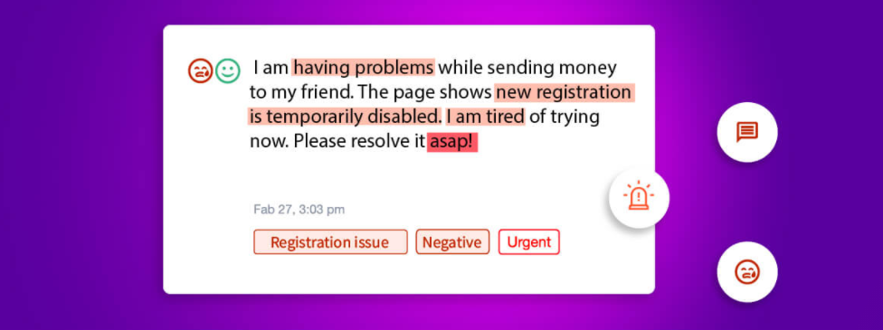
Thematic Analysis

Slide 19
Some More…
Spam Filtering
Social Media Analysis ( extracting opinion, emotion, sentiment and other feedback for a brand)
Business Intelligence (supporting decision making)
Contextual Advertising ( rather than conventional cookie-based approach)
Fraud detection ( text data + organized data)
Customer care Services

Slide 20


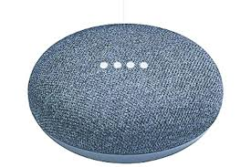


And More…
Conversional Agents
Chat Bots

Slide 21
And the list continues…

Slide 22
Excited ?

Slide 23
Lets install the required packages…
Pip install spacy
python -m spacy download en_core_web_sm
Pip install nltk
nltk.download()
Pip install textblob
Restart python
import spacy
nlp = spacy.load("en_core_web_sm")
doc = nlp("Apple is looking at buying U.K. startup for $1 billion")
for token in doc:
print(token.text, token.lemma_, token.pos_)
from textblob import TextBlob
sentence = ‘‘’Life is awesome'''
analysis = TextBlob(sentence).sentiment
print(analysis)
from nltk.tokenize import word_tokenize
text = “Life is good"
print(word_tokenize(text))

Slide 24
Text data Sources
Library database
Social media
Open sources
Web scaping
Language corpora
Transcription of audio/video etc…

Slide 25
My Github link
https://github.com/basudev2016/textanalytics

Slide 26
Thing to self study
Language Semantics and Lexical semantics…

