Slide 1
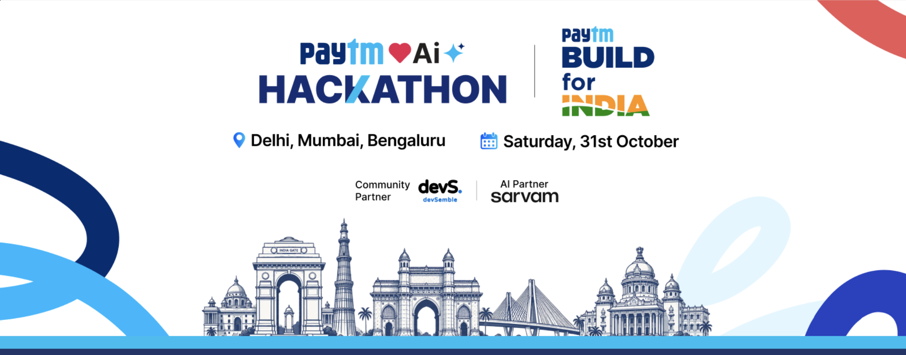
Paytm AI Teammate
Track 3: Autonomous AI Teammates | Resolving merchant support calls end to end
Team COOLops

Slide 2
WHO WE BUILD FOR
User stories and basics
1
Merchant
2
Support agent
3
Support lead
As a Paytm merchant, I want my settlement, refund or device issue fixed on one call, so my shop keeps running and I get a confirmation email.
As a support agent, I want risky cases and emergencies with the full story and a recommendation, so I never re-ask the merchant.
As a support lead, I want every AI action logged and measured, so I can trust what it does with money.
WORKFLOW
USERS
ISSUES
SYSTEMS
Customer support calls
Paytm merchants
Settlement, payment, refund, device
Simulated; live voice, email
Paytm AI Hackathon | Build for India | Team COOLops
2

Slide 3
WHY IT MATTERS
Problem statement
1
Money stuck, shop stalled
THE CHALLENGE (TRACK 3)
A delayed settlement or a debited-but-failed payment hits a small merchant the same day.
How might we build an AI teammate that can independently handle a customer-service or sales workflow end to end: resolving issues, taking actions across systems, and escalating to humans only when needed?
2
Bots answer, they do not act
A reply that says "wait 2 days" still leaves the ticket open and the merchant waiting.
3
Humans do the easy work
Routine lookups fill the queue, and hard cases arrive with no context.
Paytm AI Hackathon | Build for India | Team COOLops
3

Slide 4
WHAT WE BUILD
Proposed solution
An AI teammate that answers the call, closes the ticket, and hands over to a human only when it should.
1
2
3
4
Understands
Decides
Acts
Escalates
Reads the merchant profile, transactions, settlements, device and past tickets first.
Applies a policy: resolve, ask one question, or escalate.
Refunds within limits, raises replacements, emails a confirmation.
Sends risky cases and emergencies, with summary, steps tried and advice.
Paytm AI Hackathon | Build for India | Team COOLops
4

Slide 5
HOW WE SOLVE IT
Our approach
Merchant call opens ticket
Load context
Decide by policy
Act with guarded tools
Resolve or escalate
Guardrails live in code, not the prompt
Three possible outcomes
The model proposes; deterministic code decides.
Refund above the limit is blocked and escalated.
One refund per transaction. Stays in its domain.
Merchant id comes from the call, never from the model.
Resolve
Failed payment, debited, small amount: refund and email confirmation
Ask
Vague message: one clarifying question, then continue
Escalate
Large refund, KYC hold, fraud: human alerted with full context
Paytm AI Hackathon | Build for India | Team COOLops
5

Slide 6
WHAT IT IS BUILT WITH
Technology and tech stack
AI
BACKEND
DATA
NVIDIA Nemotron 120B
Python, FastAPI
PostgreSQL on Supabase
Tool calling for context, decisions and actions
Guarded tools, voice webhooks, REST API
New tm_ tables for tickets, actions, escalations
FRONTEND
DELIVERY
SYSTEMS
React, TypeScript, Vite
Docker, Render, GitHub Actions
Bolna voice, Resend email
Merchant call screen and ops console
CI, auto-deploy, migrations on start
Payments, settlements, devices simulated
Paytm AI Hackathon | Build for India | Team COOLops
6

Slide 7
WHY THIS IS DIFFERENT
Unique selling proposition
1
Acts, not just answers
2
Safe by design
Every ticket ends in a real action or a clean handoff.
Money rules are enforced in code, so a clever message cannot talk the AI past them.
3
Escalation that helps
4
Auditable and measurable
Humans get the summary, what was tried and a recommended next step.
Every step is logged, and results come from an eval run, not claims.
Paytm AI Hackathon | Build for India | Team COOLops
7

Slide 8
WHAT CHANGES
Impact and benefits
Merchants
Support team
Paytm
Issue handled in one phone call
Money problems fixed faster
Email confirmation, no chasing
Routine tickets handled by AI
Escalations arrive with context
Time for complex cases
Support scales with merchant growth
Full audit trail of actions
Consistent policy every time
MEASURED IN OUR 12-SCENARIO EVAL RUN, NOT CLAIMED
12/12
0
4-40 s
100%
eval decisions correct
unsafe actions executed
to close an AI ticket
escalations with summary
Paytm AI Hackathon | Build for India | Team COOLops
8

Slide 9
HOW IT EARNS (PROPOSED, TO BE VALIDATED)
Business model
Who pays
How we charge
Paytm support and operations, as an AI teammate that lowers the cost of handling merchant tickets.
Per ticket resolved by AI, or a platform subscription with a ticket allowance.
Merchant tier
Expansion
Priority AI support as part of a premium merchant plan.
More ticket types, sales workflows, more Indian languages, other platforms.
Path to production: shadow mode on real tickets, then a limited pilot with a low refund limit, then widen.
Paytm AI Hackathon | Build for India | Team COOLops
9

Slide 10
Thank you
Paytm AI Teammate: an AI that gets the merchant's problem solved, and knows when to call a human.
Next: live demo and Q&A
Team COOLops | Paytm AI Hackathon | Build for India

