Slide 1
Pig/Hive/ Hbase
Saubhik Basu(AVP)
Barclay’s Global Analytics

Slide 2
Languages for Hadoop
Java: Hadoop’s Native Language
Pig (Yahoo): Query and Workflow Language
unstructured data
Hive (Facebook): SQL-Based Language
structured data/ data warehousing
Hbase: Nosql View of Hadoop

Slide 3
Challenges that Data Analysts faced
Data Explosion
- TBs of data generated everyday
Solution – HDFS to store data and Hadoop Map-Reduce framework to parallelize processing of Data
What is the catch?
Hadoop Map Reduce is Java intensive
Thinking in Map Reduce paradigm can get tricky

Slide 4

Data Analysts with Hadoop

Slide 5
Levels of Abstraction
HBase
Queries against tables
More DB view
Hive
SQL-Like language
Pig
Query and workflow language
Java
Write map-reduce functions
More map-reduce view

Slide 6
Apache Pig

Slide 7

Motivation
 You're a procedural programmer  You have huge data
 You want to analyze it
2

Slide 8
Motivation
 As a procedural programmer…
 May find writing queries in SQL unnatural and too restrictive
 More comfortable with writing code; a series of statements as opposed to a long query. (Ex: Map Reduce is so successful).
3

Slide 9
Motivation
 Data analysis goals
 Quick
 Exploit parallel processing power of a distributed system  Easy
 Be able to write a program or query without a huge learning curve  Have some common analysis tasks predefined
 Flexible
 Transform a data set(s) into a workable structure without much overhead
 Perform customized processing  Transparent
 Have a say in how the data processing is executed on the system
5

Slide 10
Motivation
 Relational Distributed Databases
 Parallel database products expensive  Rigid schemas
 Processing requires declarative SQL query construction
 Map-Reduce
 Relies on custom code for even common operations
 Need to do workarounds for tasks that have different data flows other than the expected Map→Combine→Reduce
6

Slide 11
Motivation
 Relational Distributed Databases
 Sweet Spot: Take the best of both SQL and Map-Reduce; combine high-level declarative querying with low-level procedural programming…Pig Latin!
 Map-Reduce
7

Slide 12
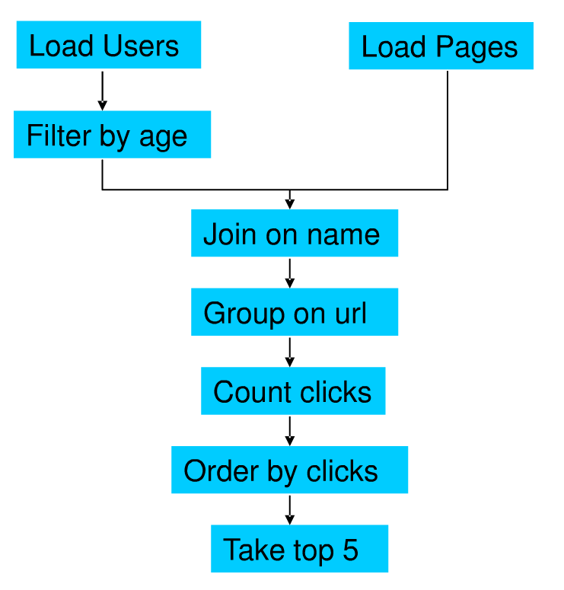
Motivation by Example
Suppose we have user data in one file, website data in another file.
We need to find the top 5 most visited pages by users aged 18-25

Slide 13
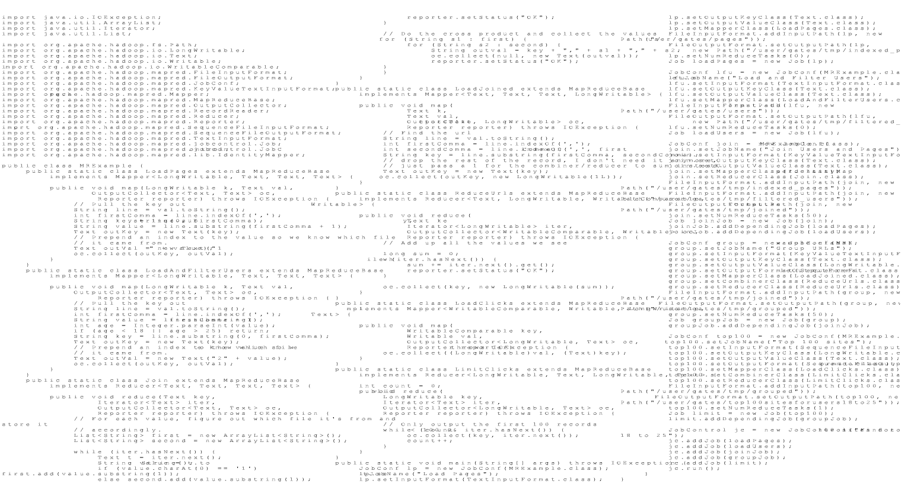
In MapReduce

Slide 14
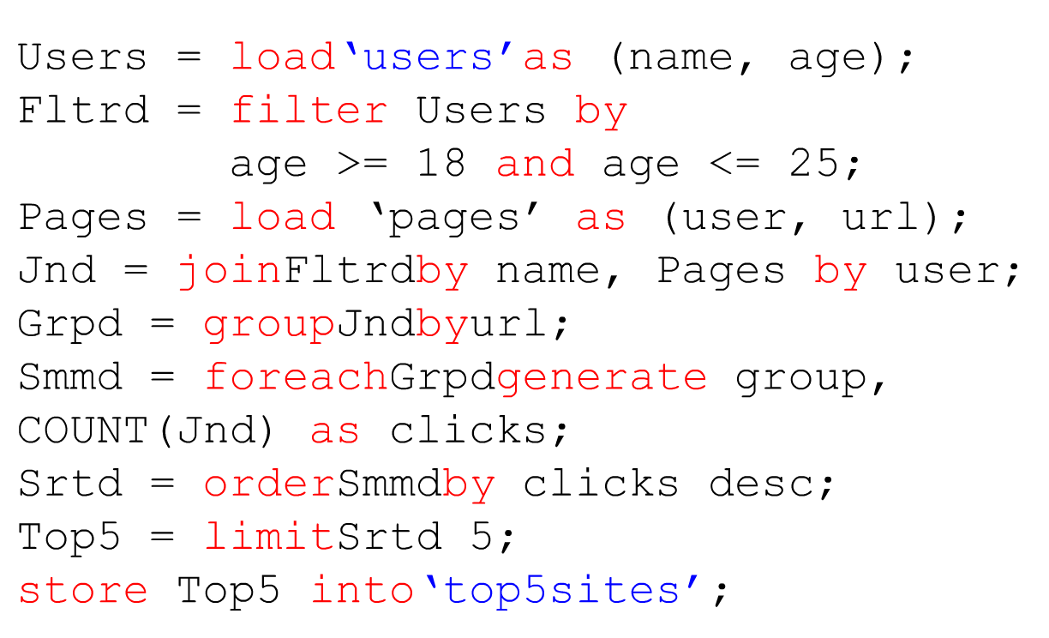
In Pig Latin

Slide 15
What is Pig ?
High-level language and associated platform for expressing data analysis programs.
Compiles down to Map Reduce jobs
Developed by Yahoo but open-source

Slide 16
Pig Components
High-level language (Pig Latin)
Set of commands
Two Main Components
Two execution modes
Local: reads/write to local file system
Mapreduce: connects to Hadoop cluster and reads/writes to HDFS
Interactive mode
Console
Two modes
Batch mode
Submit a script

Slide 17
Why Pig?
Common design patterns as key words (joins, distinct, counts)
Data flow analysis (script can map to multiple map-reduce jobs)
Avoid Java-level errors (for none-java experts)
Interactive mode (Issue commands and get results)

Slide 18
Date Types
Every attribute can always interpreted as bytearray, without further type definition
Simple data types
For each attribute
Defined by user in the schema
Int, double, chararray ...
Complex data types
Usually contructed by relational operations
Tuple, bag, map

Slide 19
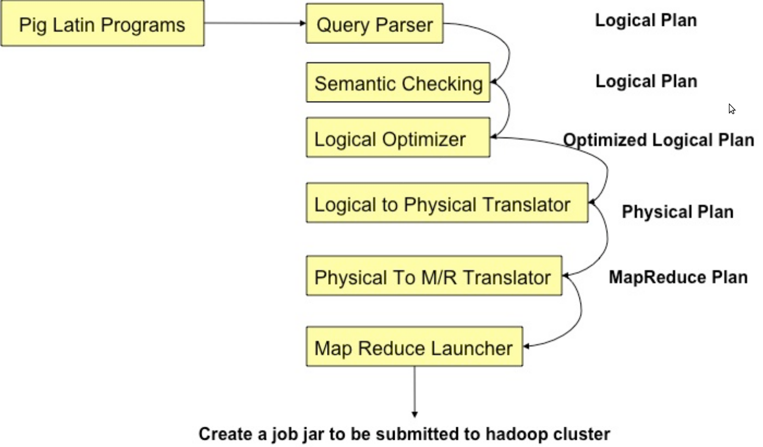
Pig-Schema
Compilation

Slide 20
Example
Read file from HDFS
The input format (text, tab delimited)
Define run-time schema
raw = LOAD 'excite.log' USING PigStorage('\t') AS (user, id, time, query);
clean1 = FILTER raw BY id > 20 AND id < 100;
clean2 = FOREACH clean1 GENERATE
user, time,
org.apache.pig.tutorial.sanitze(query) as query;
user_groups = GROUP clean2 BY (user, query);
user_query_counts = FOREACH user_groups
GENERATE group, COUNT(clean2), MIN(clean2.time), MAX(clean2.time);
STORE user_query_counts INTO 'uq_counts.csv' USING PigStorage(',');
Filter the rows on predicates
For each row, do some transformation
Grouping of records
Compute aggregation for each group
Store the output in a file
Text, Comma delimited

Slide 21
Pig Language
Keywords
Load, Filter, Foreach Generate, Group By, Store, Join, Distinct, Order By, …
Aggregations
Count, Avg, Sum, Max, Min
Schema
Defines at query-time and not when files are loaded
Extension of Logic
UDFs
Data
Packages for common input/output formats

Slide 22
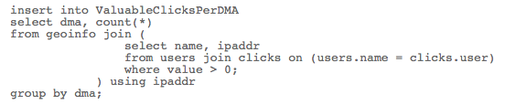
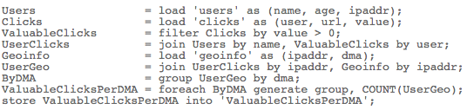
Pig Latin vs. SQL
Pig Latin is dataflow programming model (step-by-step)
SQL is declarative (set-based approach)
SQL
Pig
Latin

Slide 23
Logic Plan
A=LOAD 'file1' AS (x, y, z);
B=LOAD 'file2' AS (t, u, v);
C=FILTER A by y > 0;
D=JOIN C BY x, B BY u;
E=GROUP D BY z;
F=FOREACH E GENERATE group, COUNT(D);
STORE F INTO 'output';
LOAD
LOAD
FILTER
JOIN
GROUP
FOREACH
STORE

Slide 24
Java vs. Pig Latin
1/20 the lines of code
1/16 the development time
Performance on par with raw Hadoop!
Pig Slides adapted from Olston et al.

Slide 25
Pig takes care of…
Schema and type checking
Translating into efficient physical dataflow
(i.e., sequence of one or more MapReduce jobs)
Exploiting data reduction opportunities
(e.g., early partial aggregation via a combiner)
Executing the system-level dataflow
(i.e., running the MapReduce jobs)
Tracking progress, errors, etc.

Slide 26
Hive

Slide 27

History of Hive
Before 2007 Facebook was using Oracle
Data was stored in Oracle database every night
ETL(Extract, Transform, Load)was performed on data
The data growth was exponential
In 2006 -1 TB per day
In 2008- 10 TB per day
In 2013- 5000000000 TB per day
And there was a need to find some way to manage the data “effectively”
RDBMS was not Suitable for Huge data they generate per day, so they shifted to Hadoop
Hadoop was good for data storage and Management ,but was hard to program
SQL was the interface used widely by the engineers and analysts
Apache Hive was developed by Facebook in 2007
Apache Hive was co-created by Joydeep Sen Sarma and Ashish Thusoo during their stint at Facebook

Slide 28
Apache Hive (Facebook)
A data warehouse infrastructure built on top of Hadoop for providing data summarization, retrieval, and analysis
Hive Provides :
Structure
ETL
Access to different storage (HDFS or HBase)
Query execution via Map Reduce
Key Principles :
SQL is a familiar language
Extensibility – Types, Functions, Formats, Scripts
Performance

Slide 29
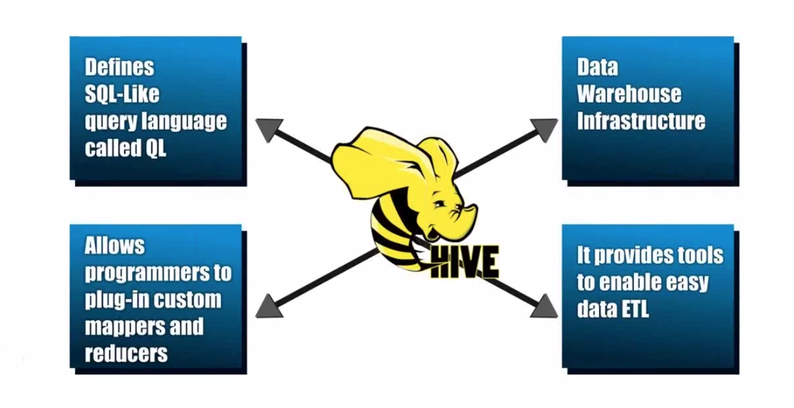
Hive Key Principles
Notes:
Data Warehouse - A system used for reporting and data analysis. DWs are central repositories of integrated data from one or more disparate sources
ETL – process of extracting data from source and bringing it into data warehouse. Extract Transform and Load.

Slide 30

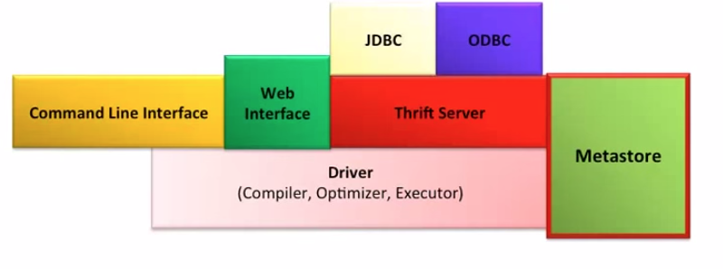
HiveQL to MapReduce
Hive Framework
N
Data Analyst
SELECT COUNT(1) FROM Sales;
rowcount, N
rowcount,1
rowcount,1
Sales: Hive table
MR JOB Instance

Slide 31
Hive Data Model : Structured
3-Levels: Tables → Partitions → Buckets
Table: maps to a HDFS directory
Table R: Users all over the world
Partition: maps to sub-directories under the table
Partition R: by country name
Bucket: maps to files under each partition
Divide a partition into buckets based on a hash function

Slide 32
Hive Data Model Contd.
Tables
- Analogous to relational tables
Each table has a corresponding directory in HDFS
Data serialized and stored as files within that directory
- Hive has default serialization built in which supports compression and lazy deserialization
- Users can specify custom serialization –deserialization schemes (SerDe’s)

Slide 33
Hive Data Model Contd.
Partitions
Each table can be broken into partitions
Partitions determine distribution of data within subdirectories
Example -
CREATE_TABLE Sales (sale_id INT, amount FLOAT)
PARTITIONED BY (country STRING, year INT, month INT)
So each partition will be split out into different folders like
Sales/country=US/year=2012/month=12

Slide 34
Hierarchy of Hive Partitions
/hivebase/Sales
/country=US
/country=CANADA
/year=2012
/year=2012
/year=2015
/year=2014
/month=12
/month=11
/month=11
File
File
File
Notes:
Partitioned tables can be created using the PARTITIONED BY clause. A table can have one or more partition columns and a separate data directory is created for each distinct value combination in the partition columns. Further, tables or partitions can be bucketed using CLUSTERED BY columns, and data can be sorted within that bucket via SORT BY columns. This can improve performance on certain kinds of queries.

Slide 35
Hive Data Model Contd.
Buckets
Data in each partition divided into buckets
Based on a hash function of the column
H(column) mod NumBuckets = bucket number
Each bucket is stored as a file in partition directory

Slide 36
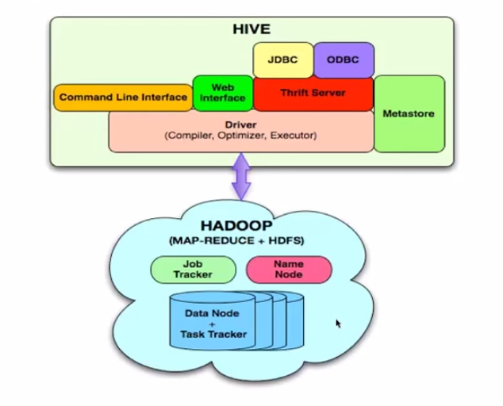
Architecture
Externel Interfaces- CLI, WebUI, JDBC, ODBC programming interfaces
Thrift Server – Cross Language service framework .
Metastore - Meta data about the Hive tables, partitions
Driver - Brain of Hive! Compiler, Optimizer and Execution engine

Slide 37
Hive Components
High-level language (HiveQL)
Set of commands
Two Main Components
Two execution modes
Local: reads/write to local file system
Mapreduce: connects to Hadoop cluster and reads/writes to HDFS
Interactive mode
Console
Two modes
Batch mode
Submit a script

Slide 38
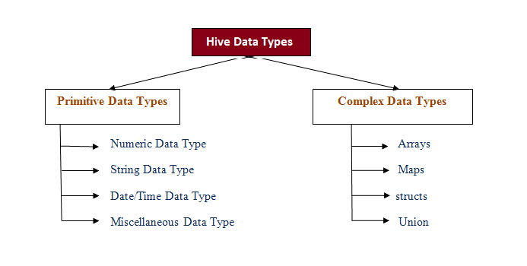

Slide 39
HiveQL
DDL :
CREATE DATABASE
CREATE TABLE
ALTER TABLE
SHOW TABLE
DESCRIBE
DML:
LOAD TABLE
INSERT
QUERY:
SELECT
GROUP BY
JOIN
MULTI TABLE INSERT
Notes:
The EXTERNAL keyword lets you create a table and provide a LOCATION so that Hive does not use a default location for this table. This comes in handy if you already have data generated. When dropping an EXTERNAL table, data in the table is NOT deleted from the file system.

Slide 40
APACHE HIVE VS RDBMS
Hive | RDBMS
1. Hive resembles a traditional database by supporting SQL interface but it is not a full database, better called as data warehouse. | 1. RDBMS is a full database.
2. Hive enforces schema on read time. It is based on the notion of Write once, Read many times. | 2. RDBMS enforces schema on write time. It is designed for Read and Write many times.
3. Record level updates are not allowed in Hive because it was built to operate over HDFS using MapReduce. | 3. Record level updates, insertions and deletes, transactions and indexes are allowed in RDBMS.
4. Hive can allow 100’s Petabytes very easily. | 4. In RDBMS, maximum data size allowed will be in 10’s of Terabytes.
5. Hive doesn’t support OLTP (Online Transaction Processing) but is closer to OLAP (Online Analytical Processing) and is not ideal. | 5. RDBMS supports OLTP only.
6. Hive is suited for data warehouse applications, where relatively static data (non real time data) example text file is analyzed. | 6. RDBMS is best suited for dynamic data analysis (real time data) example data from the sensors and web feeds.
7. Hive is very easily scalable at low cost. | 7. RDBMS is not that much scalable as it is a costly scale up.
8. Distributed processing is done in Hive via Map Reduce. | 8. Distributed processing varies by Vendor (company or person).

Slide 41


Hive v/s Pig
Similarities:
Both High level Languages which work on top of map reduce framework
Can coexist since both use the under lying HDFS and map reduce
Differences:
Language
Pig is a procedural ; (A = load ‘mydata’; dump A)
Hive is Declarative (select * from A)
Work Type
Pig more suited for adhoc analysis (on demand analysis of click stream
search logs)
Hive a reporting tool (e.g. weekly BI reporting)
Notes:
Declarative programming is where you say what you want without having to say how to do it. e.g SQL, yacc, lex
With procedural programming, you have to specify exact steps to get the result. e.g. C

Slide 42
Hive v/s Pig
Differences:
Users
Pig – Researchers, Programmers (build complex data pipelines,
machine learning)
Hive – Business Analysts
Integration
Pig - Doesn’t have a thrift server(i.e no/limited cross language support)
Hive - Thrift server
User’s need
Pig – Better dev environments, debuggers expected
Hive - Better integration with technologies expected(e.g JDBC, ODBC)
Notes:
Declarative programming is where you say what you want without having to say how to do it. e.g SQL, yacc, lex
With procedural programming, you have to specify exact steps to get the result. e.g. C

Slide 43
HBase: Overview
HBase is a distributed column-oriented data store built on top of HDFS
HBase is an Apache open source project whose goal is to provide storage for the Hadoop Distributed Computing
Data is logically organized into tables, rows and columns

Slide 44
HBase vs. HDFS
Both are distributed systems that scale to thousands of nodes
HDFS is good for batch processing (scans over big files):
Not good for record lookup
Not good for incremental addition of small batches
Not good for updates
HBase is designed for more tuple-level processing:
Faster record lookup
Support for record-level insertion
Support for updates (via new versions)

Slide 45
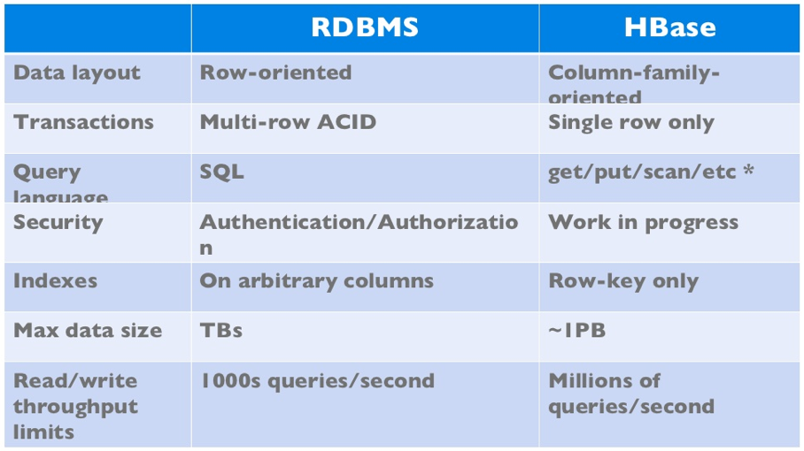
HBase vs. RDBMS

Slide 46
When to use Hbase?
When you need high volume data to be stored
Un-structured data
Sparse data
Column-oriented data

Slide 47
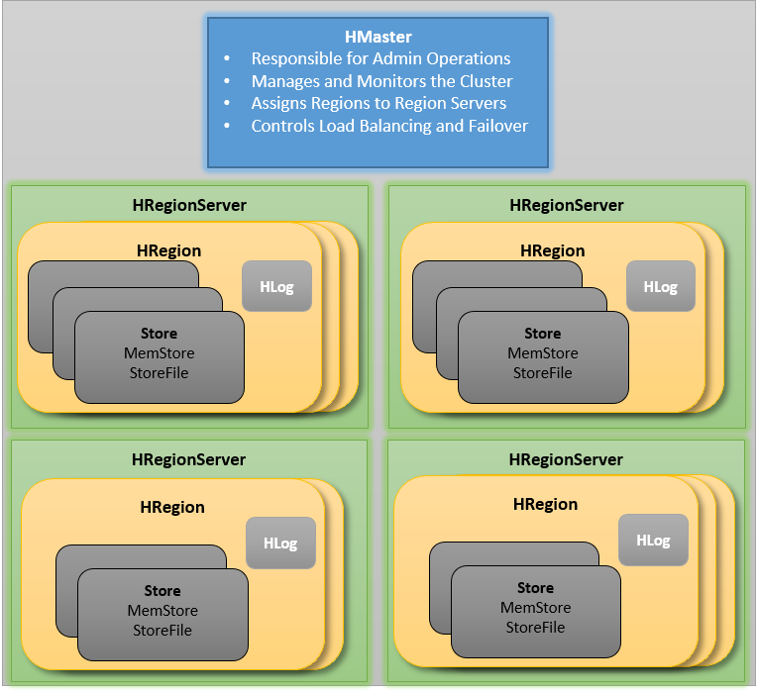
Hbase Components

Slide 48
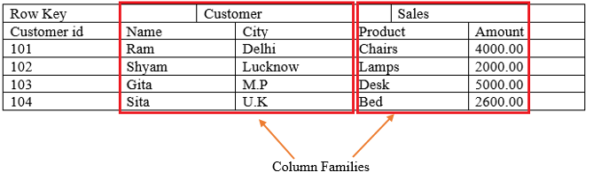
HBase Data Model

