Slide 1
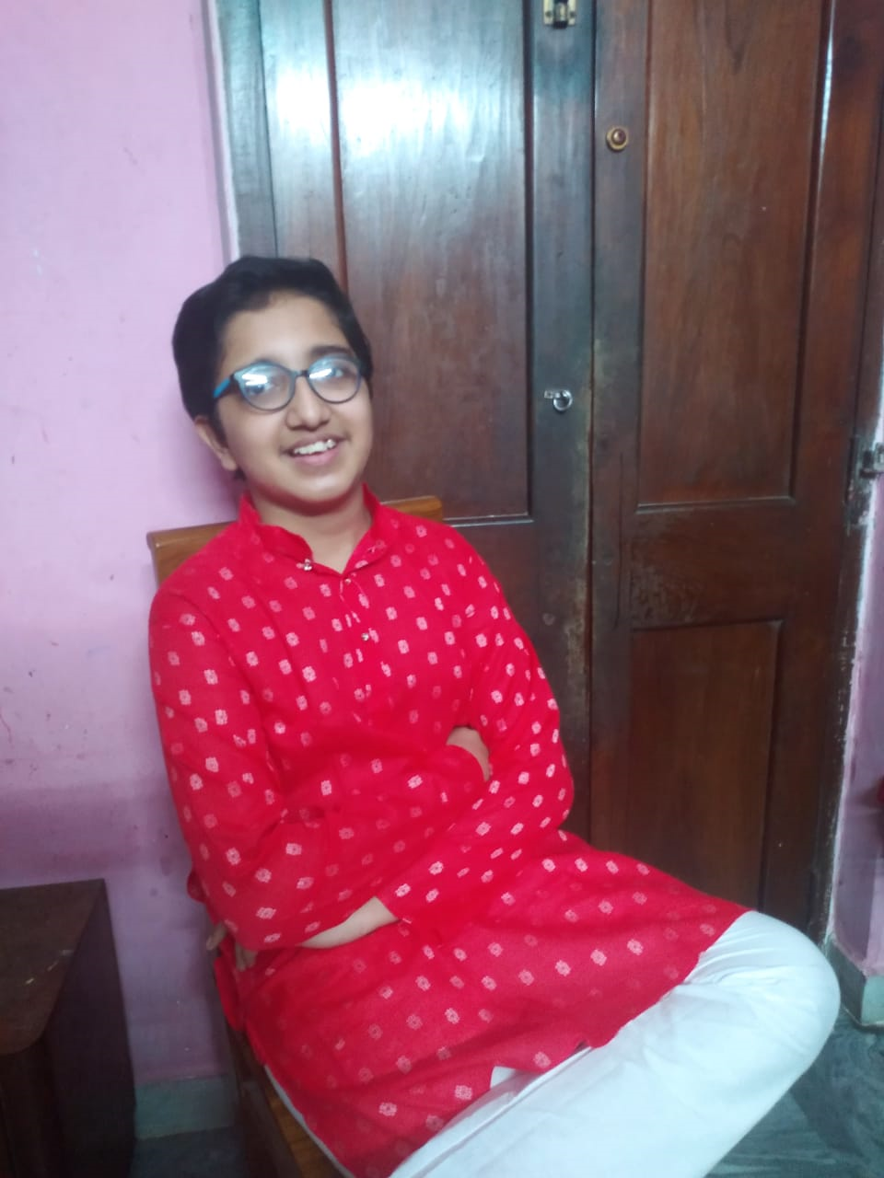
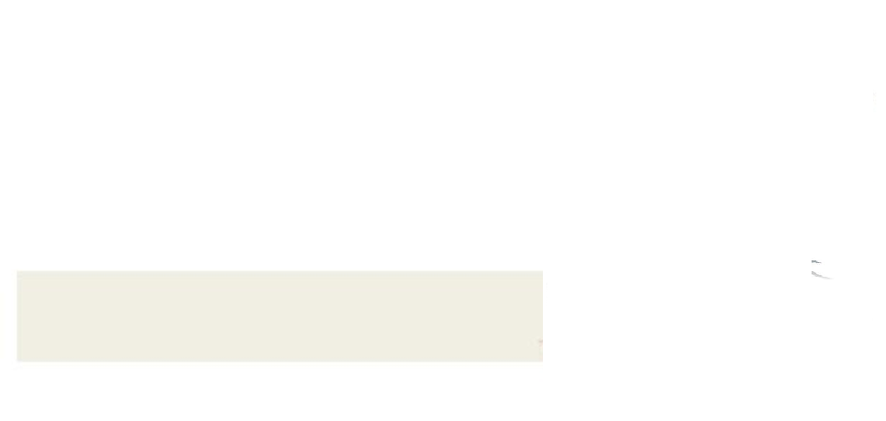
Birthday Snaps…
12th October, 2020
Touch To Start

