Slide 1
Security In Wireless Protocols - A Brief Overview
Magnus Nystrom, RSA Laboratories

Slide 2
Extending e-commerce to wireless applications
Requirements for secure solutions
  Confidentiality
  Authentication (two-way)
  Integrity protection
  Protection against
    Replay attacks
    Denial-of-service attacks
Today’s wireless environment requires
  low bandwidth consumption
  low computational complexity
  low memory consumption
  functional reliability despite unstable connections

Slide 3
Case Study: WAP

Slide 4
The WAP forum
Wireless Application Protocol
  Industry-wide specification for development of “wireless” applications
  Brings interactive applications to handsets such as cellular phones
  Founded by Ericsson, Nokia, Motorola and Phone.com in 1997
    Today, more than 200 members

Slide 5
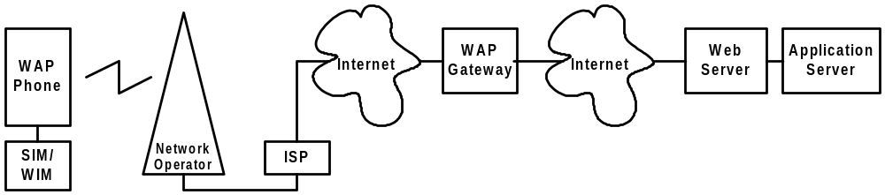
WAP-at-a-glance
The phone calls the modem pool at the ISP
The phone and the ISP does a PPP negotiation
The phone connects to the gateway via UDP/IP over the Internet
The gateway access URLs specified in the phone (either on a local Web server, or via Internet)

Slide 6
WAP’s architecture
WAE
Application environment
WSP
Session layer
WIM
WTP
Transport layer
Identity module
WTLS
Transport security layer
WDP
Datagram/bearer layers

Slide 7
The WAP security model
Four components:
  WTLS - Wireless Transport Layer Security Protocol
    Closely modeled after TLS (Internet protocol)
    Offers confidentiality, integrity and authenticity
  WIM - WAP Identity Module
    Defines both a format for personal credentials and a service interface.
    Provides credential portability, client authentication
  WMLScript CryptoLibrary
    Provides a way for applications to receive signed data from clients.
  WPKI - WAP Public Key Infrastructure
    Acts as “lubricant” - makes components work together

Slide 8
WAP security model, overview
WMLScript
(signText())
W/L
App.
W/L
Client
WIM I/f
WTLS I/f
WIM
WTLS
WTLS
Server
WTLS
Client
WPKI enables verification of signatures etc.

Slide 9
The problems with WAP
WAP V1.x only secures the connection between the handset and the gateway. The gateway *must* be trusted!
If you want to have high security, you have to administer your own WAP Gateway, placed immediately in front of your web server

Slide 10
WIM - WAP Identity Module
Specifies storage of personal credentials (i.e. private keys, certificates) on tokens such as SIM (WIM) cards
Specifies primitives for access of these tokens (service interface)
Enables credential portability
A profile of PKCS #15 from RSA Laboratories

Slide 11
WPKI - foundations
Defines a public-key based authentication framework needed to
  manage security functionality defined in WAP 1.x
PKI Model based on security domains
  Members of domains have certain privileges
  Enrollment into domains either
    automatically (e.g. when subscribing to an operator)
    manually (e.g. explicit request)
Typical domains
  Manufacturer domain
  Network operator domain
  Service provider domain

Slide 12
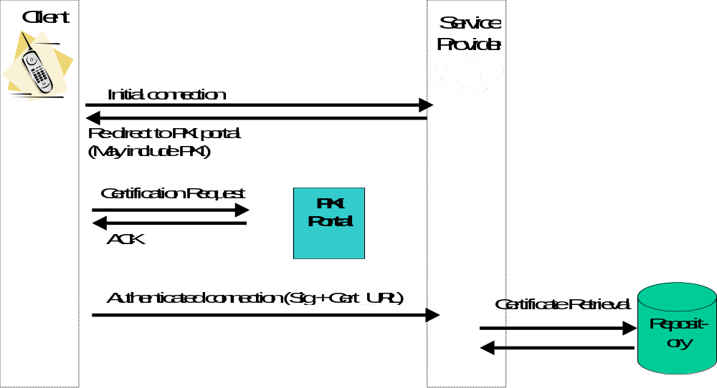
WPKI - client registration

Slide 13
WAP WTLS - wireless transport layer security protocol
Closely modeled after TLS
Provides
  Confidentiality services
  Integrity protection
  Authenticity
Inserts a security layer between application-level protocols and underlying transport protocols

Slide 14
WTLS design
Two layers:
  record layer (or record protocol) potentially providing confidentiality, authenticity and replay protection
  handshake protocol, establishes a cipher context by negotiating the best possible cipher suite (i.e. a triple <authentication method, confidentiality-scheme, integrity-scheme>
Each layer uses services from lower layers and provides functionality to higher ones
This is as in TLS

Slide 15
TLS: Design principles
Record layer: Designed to protect against
  Eavesdropping (but export grade algorithms sometimes necessary
  Active attacks
    Cut & Paste [Bellovin ‘96] (not possible due to strong authentication and context keys)
    Short block attack [Bellovin ‘96] (possible but not likely)
  Replay attacks
    TLS uses sequence numbers
  Impersonation attacks
    Strong authentication methods

Slide 16
TLS: Design principles, II
Handshake layer: Intended to provide best possible protection for the connection
Designed to protect against:
  Cipher-suite rollback attacks
    not possible due to authentication of all key exchange message
    only cipher-suites can be negotiated in TLS

Slide 17
WTLS modifications
Some modifications compared to TLS:
  Connection-less rather than connection-oriented
    But not state-less; just capable of being used on top of a datagram service, e.g. UDP
  Other cipher-, authentication-, and key exchange-algorithms; other IV calculations
    E.g. elliptic-curve algorithms
  More “light-weight” than TLS, e.g.:
    no record fragmentation
    client certificates do not have to be sent over-the-air
    several record layer messages can be combined

Slide 18
Case Study: Bluetooth

Slide 19
What is Bluetooth?
A wireless communication link
Operates at 2,4 GHz
Uses a frequency hopping tranceiver
Allows real-time voice and data communications
Link protocol is based on time slots
Offers authentication and confidentiality

Slide 20
Founder and Market Penetration
Founded in 1998 by Ericsson, Intel, Nokia, IBM and Toshiba. Since then 3COM, Lucent and Microsoft have joined in the leadership.
  Over 1400 members in the Special Interest Group.
It is estimated that by 2005 the Bluetooth wireless technology will be a built-in feature in more than 670 million products according to market researchers (Cahners, ’99)

Slide 21
Application Range
Cable Replacement:
  Bluetooth eliminates the need for numerous, often proprietary cable attachments for connection of practically any kind of communication device.
  The range of each radio is approximately 10 meters, but it can be extended to around 100 meters with an optional amplifier.

Slide 22
Application Range
Data and Voice capabilities:
  Bluetooth facilitates
    real-time voice 64 kb/s synchronously in both directions
    data transmissions up to 723.2 kb/s and 57.6 kb/s in return direction, or 433.9 kb/s symmetric.
  You can surf the Internet and send e-mails on your portable PC or notebook wirelessly through a mobile phone or through a wire-bound connection (e.g., ISDN, LAN).

Slide 23
Link Controller
H
o
s
t
2.4 GHz
radio
Link
Controller
Link
Manager
& IO
Link Controller: Carries out all baseband protocols
(including authentication and encryption) and
other low level routines.
Link Manager: Link Setup and IO ctrl.

Slide 24
Piconets and Scatternets
master
slave
Piconet: Units sharing a channel.
Scatternet: Two or more piconets in same area.
a) b) c)
Point-to-point as well as point-to-multipoint

Slide 25
Time Division Duplex
Master
Slave
Slave
.625 ms
27 bit clock, resolution equals one time slot.
Master transmits in even, and slaves in odd time slots.
Packets may extend over 1, 3 or 5 time slots.
Frequency hop, among 79 channels, after each slot.

Slide 26
Bluetooth Security
Bluetooth security:
Authentication between BT devices.
Encryption of payload on air interface.
Parameters:
BD_ADDR 48 bit address public
Authentication key 128 bits secret
Encryption key 1-16 bytes secret
RAND 128 bit random number

Slide 27
Algorithms
Bluetooth makes use of the following algorithms:
E0 (encryption): Slight modification of Massey&Rueppels
summation stream cipher generator. Consists of 4 LFSR:s
with primitive feedback polynomials, and a summation
combiner. Total length of the shift registers is 128 bits.
E1 (authentication): Construction using SAFER+ twice.
E2 (key generation): Construction using modified
version of SAFER+.

Slide 28
Link keys (authentication keys)
Four types of link keys:
Combination key K_AB
Unit key K_A
Temporary key K_master
Initialization key K_init
B
K_AB
A
K_C
C

Slide 29
Initialization Procedure
Generation of K_init from PIN
Authentication
Generation of Link Key (unit or comb. at init.)
Link Key Exchange
Generation of Encryption Key

Slide 30
Generation of K_init
A verifier B claimant
IN_RAND_A
PIN
BD_ADDR_B
IN_RAND_A
E2
E2
PIN
BD_ADDR_B
IN_RAND_A
K_init
K_init
Lengths of variables:
PIN: 1-16 octets IN_RAND_A: 128 bits
BD_ADDR: 48 bits K_init: 128 bits

Slide 31
Authentication
A verifier B claimant
AU_RAND_A
AU_RAND_A
BD_ADDR_B
Link Key
E1
E1
AU_RAND_A
BD_ADDR_B
Link Key
96 32
ACO
SRES
ACO
SRES’
SRES
B is authenticated if SRES’ = SRES.
Note that “Link Key” is K_init at initialization.
Lengths of variables:
AU_RAND_A: 128 bits BD_ADDR: 48 bits
Link Key: 128 bits SRES: 32 bits

Slide 32
Generation of Unit Key
(Occurs the first time the unit is in operation)
Bluetooth device A
BD_ADDR_A
RAND_A
48
E2
128
128
K_A
The built-in RNG generates RAND_A, which is
used as key in E2. As plaintext, BD_ADDR_A
circularly expanded to 16 bytes, is used.
If K_A shall be used as link key between A and B,
then A sends XOR(K_A, K_init) to B.
B saves K_A as K_BA.

Slide 33
Generation of Combination Key
(on the link AB)
The BT unit A performs the following:
A
BD_ADDR_A
LK_RAND_A
E2
LK_RAND_A
K
A transmits this to B
LK_K
A
K is the current link key, i.e. K_init during initialization.
B performs the analogous operations as A above.
Then both parties can calculate the other parties
contribution to the combination key.
As combination key they use
K_AB = XOR(LK_K , LK_K ) = K_BA
Note. The comb. key is stored, but only after a successful
mutual authentication with the newly derived K_AB.
A
B

Slide 34
Derivation of Encryption Key
128
E2
EN_RAND
ACO
K_AB
Recall that ACO was a
side product from the
authentication.
96
128
128
K
C
The master generates a random number EN_RAND,
and transmits this in clear to the slave.
Both parties calculates K_C.
After a keysize negotiation, K_C is reduced accordingly.
The keysize used is the largest one acceptable to both
parties.

Slide 35
Encryption
K_C
BD_ADDR
CLOCK
EN_RAND
E0
master
master
128
Key stream
plain
cipher
Initialization:
The input variables are shifted into the registers of E0.
200 bits are generated, of which the last 128 are fed back
into the shift registers.
E0 is now initialized and ready to produce key bits.
E0 is reinitialized for each packet (p-size max 2.5kbits)

Slide 36
Contact Information
WAP, Bluetooth:
  www.wapforum.org
  www.bluetooth.com
RSA on the web:
  www.rsasecurity.com
RSA Laboratories on the web:
  www.rsasecurity.com/rsalabs/
If you are interested in doing your M.Sc. Thesis at RSA, contact
  mback@rsasecurity.com (Magnus Back)

