Slide 1
The DIN Standard and PKCS#15
Common Usage for Signature Cards?
Gisela Meister
e-mail: GiMei@compuserve.com
Gisela.Meister@gdm.de

Slide 2
How is the situation ?
Standardised Specification for signature cards
  Signature Cards: Cards to perform the algorithm for generation of signature and / or generation of keys in the card
  DIN = German National Institute for Standardisation
DIN Standard for Smart Cards according to SigG/SigV (1998) for Signature cards including
  DIN Standard for Personalisation of Smart cards according to SigG/SigV (End of 1999)
  ITSEC E4 Pre-Evaluation based on the DIN Standard initiated by TeleTrusT Germany (End of 1999)
    TeleTrusT = Organisation of vendors of technology , application groups and federal and scientific institutes to promote trustworthiness in communication techniques

Slide 3
How is the situation combining PKCS #15 ?
Related standardised specification for smart cards which (could) integrate PKCS #15
  DIN Standard for signature cards DINSIG, (Signature generation, ....)
  DIN Personalisation specification , including Key generation inside the card
  Office ID card
    Key encipherment (RSA, DH)
    Client sever Authentication (SSL/TLS) <----------> WIM specification for WAP
File structure, Application Flow Diagram, Access table for DINSIG /Office ID
How to proceed, ?Concept of a Profile for PKCS #15 , Annex x , similar to Annex B ?
Implications on PKCS #11 ?

Slide 4
Contents of the DIN Standards Where are intersections and common points ?
DIN Standard V66391-1: Interface to smart cards with digital signature application/ functionality
  Application Flow diagram, Command set ( PKCS not relevant)
  File Structure----------------PKCS 15 relevant storage of Certificates and Public Keys
  Certificate structure for Authentication services and Authentication protocols -------------not include in PKCS#15
  Digital signature input formats ( PKCS-1, ISO/IEC 9796-2 with random number , pretty secure)
  Public Key format for different algorithms---- PKCS#15
  Access control rules (table) for files----- to be compared with pkcs #15
DIN Personalisation specification with digital signature application / functionality (Draft)
  Execution phases
  Command set

Slide 5
Office ID Card
Based on Standard
additionally Key encipherment
  according to PKCS 1.5 ( New attacks???)
  according to a modification 9796-2 (pretty secure until now)
Client Server Authentication
  PKCS #1 Format

Slide 6
Key Format Algorithms- Details
1. RSA (SIG / ENC / Device-AUT, CL-AUT)
2. DSA, FIPS Publication 186: Digital Signature Standard (DSS), May 1994
3. DSA variants, based on elliptic curves:
· ISO/IEC 14883-3 [4], Annex A.2.2 ("Agnew-Mullin-Vanstone analogue"),
· IEEE Standard P1363 [5], Section 5.3.3 ("Nyberg-Rueppel version"),
· IEEE Standard P1363 [5], Section 5.3.4 ("DSA version").
4. Diffie Hellman Key Exchange based on 2 and 3
  for AUT
  for ENC
  Format supported by PKCS #15 ?

Slide 7
SIG-Algorithm
Hash-
Funktion
SHA-1
RIPEMD-160
RSA
DSA
ELC
Signature-
Algorithm

Slide 8
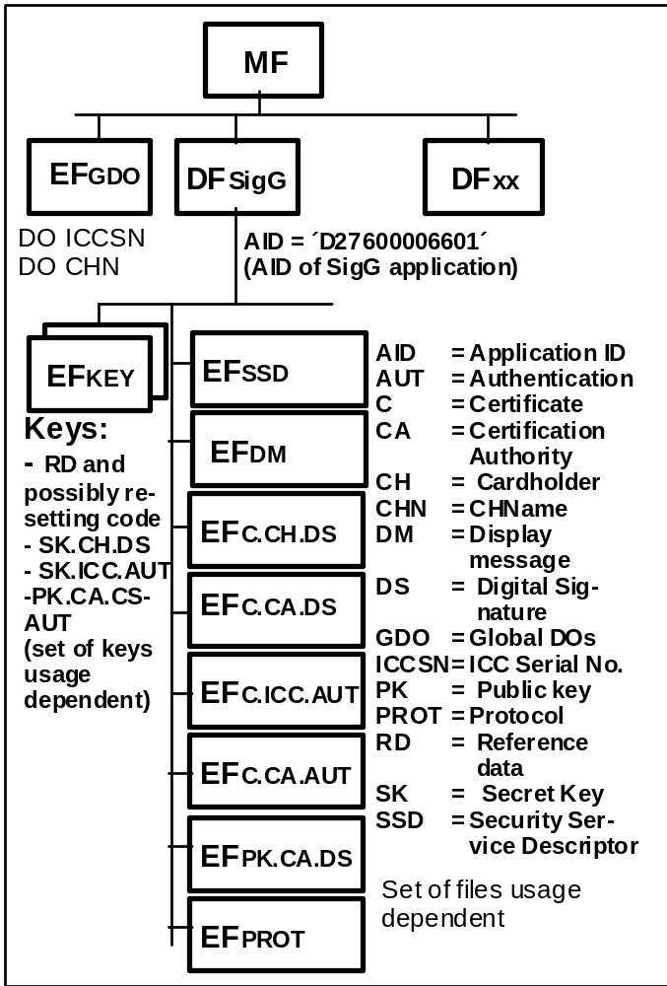
File Structure DINSIG
DFxx = PKCS #15

Slide 9
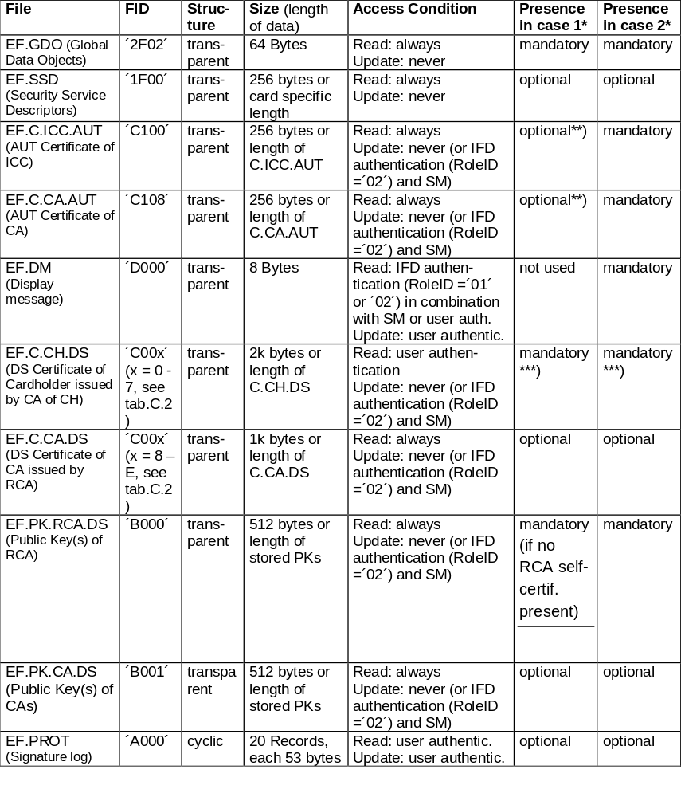
Access Table DINSIG to be included:
SK File ( Generation/ Update for SK)
Certificates with PIN access root Public key trusted

Slide 10
Different Roles for access (Access type ) by Role ID presented in a CV Certificate
CHA Role ID Meaning
´00´ No access right to data
´01´ CHA Role ID for proving the access right of an IFD (Read access to EF.DM)
´02´ CHA Role ID for proving the access right of a CA (e.g. read/write access to certificate files and EF.DM)
´03´ SYS/ Personalisation manager

Slide 11
Management of Access Rights according to 7816-9
Elementary File
Security
Attributes
File
Content
Example:
AM = Read
SC = EXT AUTH (asym) with
CHA = ´x.01´ or ´x.02´ and User AUTH
AM = Update
SC = EXT AUTH (asym) with
CHA = ´x.01´ and SM
X = Prefix denoting the AID or the entity
assigning the role ID
AM = Access Mode
SC = Security Conditions
CHA = Cert. Holder Authorisation
(Prefix, Role ID)
SM = Secure Messaging

Slide 12
German Proposal
Include after Annex B new Annex C
Annex C: A PKCS #15 Profile for Signature Cards
  Signature Cards: Cards to perform the algorithm for generation of signature and / or generation of keys in the card
  Orientation on DIN Standard
    structured as Appendix B ?
    Including ISO Part 9 Access rules (informative)

Slide 13
WWW Addresses
  DIN Standard (English version) http://gmd. darmstadt.de
  SigI /DIN Standard /Pre-Evaluation http://www.bsi.de
  Object Identifier for algorithms / Pre-Evaluation http://teletrust.de

