Slide 1
A PKCS #11 Test Suite
Peter Gutmann
http://www.cs.auckland.ac.nz/~pgut001/cryptlib/

Slide 2
Typical Token Use
Gimme a private key
Generate
Find
Sign this
Decrypt this
Go away
Note: No connection between key fetch and use

Slide 3
Testing Strategy
General initialisation
  Open session
  Log on if necessary
  if not initialised
    Initialise device
    Log on
Low-level tests
  for each algorithm, mode
    Create session object
    Load key
    Encrypt/decrypt or hash
    Actually it currently does the hash in S/W for speed reasons

Slide 4
Testing Strategy (ctd)
Algorithm correctness test
  Compare cryptlib native object with PKCS #11 token object output
    cryptlib self-test checks against standard test vectors
    Encrypt with native object, decrypt with token object

Slide 5
Testing Strategy (ctd)
Key generation test
  if not write-protected
    Create signature key
    Use signature key to sign CA certificate
    Update token with certificate
    Create RSA signature + encryption key
    Use CA key to sign certificate
    Update token with certificate
    Fairly simple to extend this to do DSA if required

Slide 6
Testing Strategy (ctd)
Key read test
  Instantiate public-key (= certificate) object
  Instantiate private-key object
    Uses either previously generated keys (R/W token) or existing keys (R/O token)
High-level test
  Generate S/MIME signed message
  Generate S/MIME encrypted message
    Really a test of cryptlib rather than the token

Slide 7
Configuring cryptlib
Set the driver path
  cryptSetAttributeString( CRYPT_UNUSED, CRYPT_OPTION_DEVICE_PKCS11_DVR01, "c:/winnt/system32/cryptoki.dll" );
  cryptSetAttributeString( CRYPT_UNUSED, CRYPT_OPTION_DEVICE_PKCS11_DVR01, ”/usr/shlib/cryptoki.so" );
Update the config options
  cryptSetAttribute( CRYPT_UNUSED, CRYPT_OPTION_CONFIGCHANGED, TRUE );
Restart cryptlib to load the new driver
  Windows users may want to reboot their machine three or four times as well

Slide 8
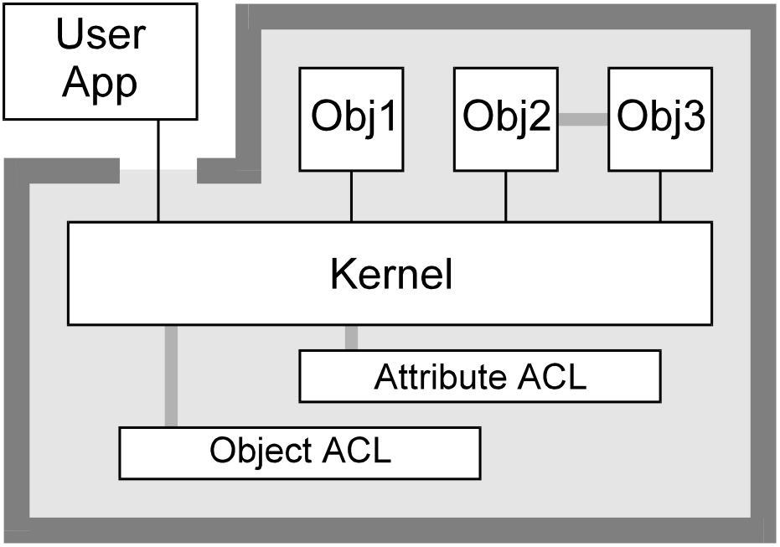
cryptlib Architecture
cryptlib is based on objects and attributes like PKCS #11
Security kernel enforces ACL’s for
  Each object
  Each attribute read/written/deleted for each object

Slide 9
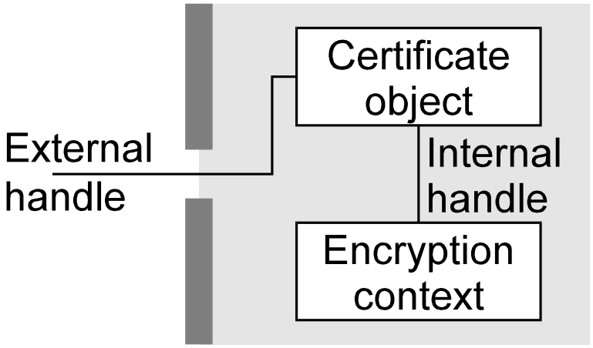
Action Objects
Equivalent to PKCS #11 session objects
Encryption contexts encapsulate the functionality of a security algorithm
  DES object
  RSA object
  SHA-1 object
  HMAC-SHA object
Often associated with another object,
eg public key context with
certificate

Slide 10
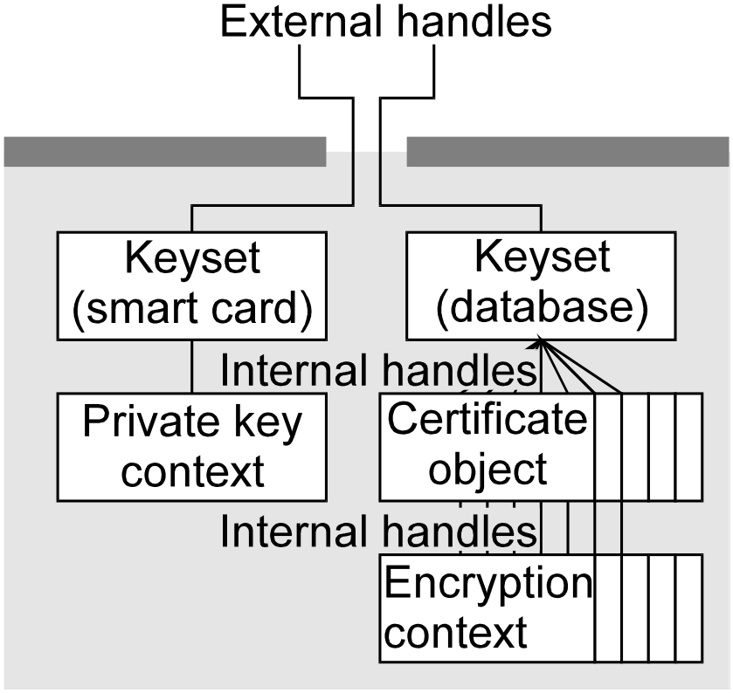
Key and Certificate Containers
Contain one or more token objects (keys, certificates, CRL’s, etc)
  Session objects when written to persistent storage become token objects
  PKCS #11 devices can act as
  container objects
Appear as an (often large)
collection of encryption
contexts or certificate
objects

Slide 11
Object Security
Each objects has an ACL managed by the security kernel
Object attributes have their own ACL’s
Example attribute: Triple DES key
  attribute label = CRYPT_CTXINFO_KEY
  type = octet string
  permissions = write-once
  size = 192 bits min…192 bits max
Kernel checks all data passing in and out of the architecture
Works like PKCS #11 attributes but with strong security checks

Slide 12
Interobject Communications
Objects communicate via message-passing
Example: Load a key
  msg.source: Subject (thread/process/user)
  msg.target: Encryption context object
  msg.type: Write attribute
  msg.data: Attribute, type = Key, value = …
  Kernel checks the target object’s ACL
  Kernel checks the attribute’s ACL
  Kernel forwards message to target object
Messages are sent via krnlSendMessage
  All cryptlib functionality is implemented this way
  Never trace into the send message calls (you’ll end up stepping through the security kernel)

Slide 13
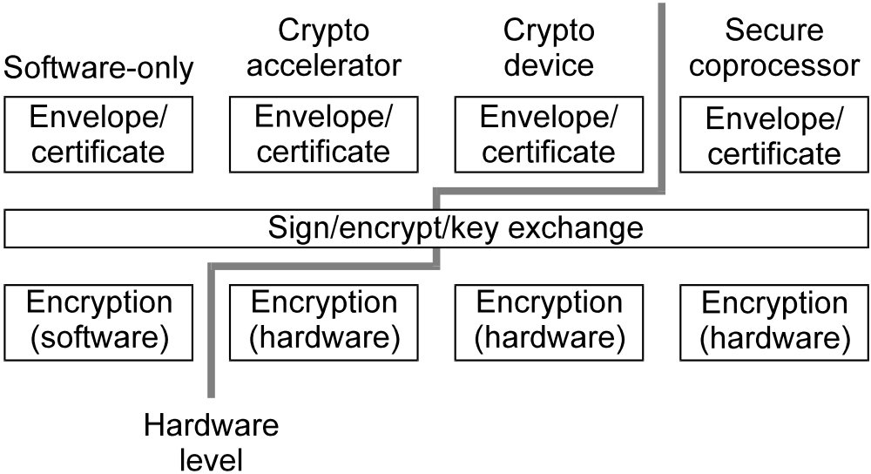
Implementation details
Architecture design allows various levels of functionality to be encapsulated in separate modules and/or hardware
  Crypto accelerator → encryption contexts
  Crypto device (eg PKCS #11) → basic sign/encrypt level
  Secure coprocessor (eg IBM 4758) → certificate/envelope/ session object

Slide 14
Initialisation
Open device by name (“device::token”)
Access slot by name (GetTokenInfo)
OpenSession (first CKF_RW_SESSION, then R/O if that fails)
for each cryptlib capability
  Use GetMechanismInfo to
    Set up key min, max size for non-default values
    Set up function pointers for encrypt, decrypt, sign, verify, keygen

Slide 15
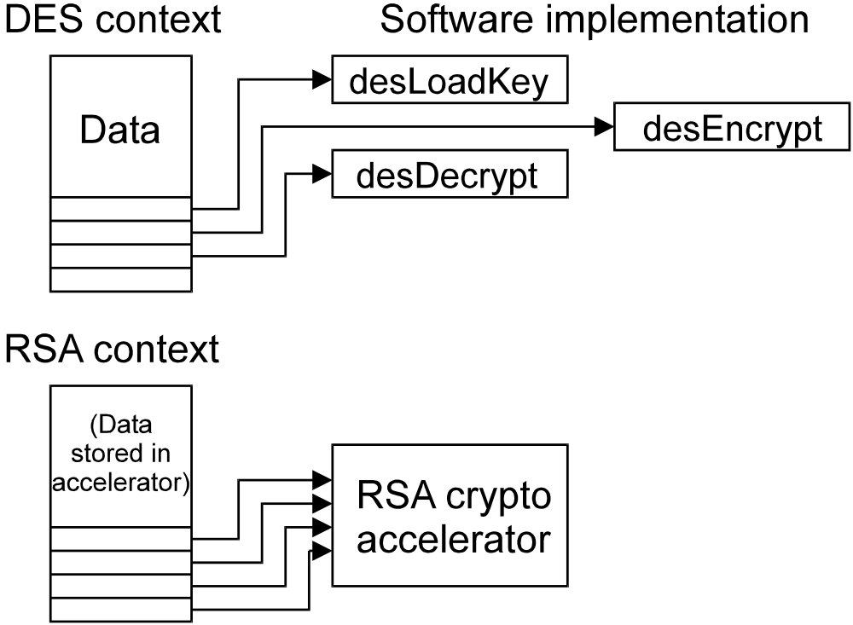
Initialisation (ctd)
Once complete, cryptlib has mappings for all native capabilities to PKCS #11 capabilities
Example:
Software DES
Hardware RSA

Slide 16
Basic Operations
Encryption contexts are created via the token
  cryptCreateContext( &cryptContext, CRYPT_ALGO_DES, CRYPT_MODE_CBC );
  cryptEncrypt( cryptContext, “12345678”, 8 );
  cryptDestroyContext( cryptContext );
  cryptDeviceCreateContext( cryptDevice, &cryptContext, CRYPT_ALGO_DES, CRYPT_MODE_CBC );
  cryptEncrypt( cryptContext, “12345678”, 8 );
  cryptDestroyContext( cryptContext );

Slide 17
Basic Operations (ctd)
Most operations are mapped directly to PKCS #11 functions
  capabilityInfo→initKey ⇒
    CreateObject with pre-set CK_ATTRIBUTE template
  capabilityInfo→generateKey ⇒
    GenerateKey/GenerateKeyPair with pre-set CK_ATTRIBUTE template
    Currently not used for conventional encryption since software is (much) faster
  capabilityInfo→encryptFunction ⇒
    Set up CK_MECHANISM if required
    EncryptInit
    Encrypt

Slide 18
Encryption/Signing Issues
Zero-padding/truncation for PKC operations
Decrypt vs unwrap
  Unwrap key ⇒ generic secret key object
  Read secret key value
  ⇒ Decrypt ≡ unwrap + lateral thinking
By extension, (RSA) signing ≡ unwrap + lateral thinking

Slide 19
Advanced Operations
Device acts as a keyset
  cryptKeysetOpen( &cryptKeyset, CRYPT_KEYSET_MYSQL, “keyserver” );
  cryptGetPublicKey( cryptKeyset, &cryptCert, CRYPT_KEYID_NAME, “My key” );
  cryptKeysetClose( cryptKeyset );
  cryptDeviceOpen( &cryptDevice, CRYPT_DEVICE_PKCS11, “Datakey” );
  cryptGetPublicKey( cryptDevice, &cryptCert, CRYPT_KEYID_NAME, “My key” );
  cryptDeviceClose( cryptDevice );

Slide 20
Advanced Operations (ctd)
Again, operations are mapped to PKCS #11 functions
  deviceInfo→setItem ⇒
    CreateObject with certificate data and attributes
  deviceInfo→getItem ⇒
    Locate object (see later slides)
    if public key or cert
      create cryptlib native object
    if private key
      create device object
    attach certificate to
    private key if necessary

Slide 21
Advanced Operations (ctd)
  deviceInfo→getItem (ctd)
    GetAttributeValue to get key size, usage flags, label, etc
    Set cryptlib attributes and ACL’s based on PKCS #11 attributes (eg decrypt-only, no external access)
  deviceInfo→deleteItem ⇒
    DestroyObject

Slide 22
Finding Keys
Public keys
  Look for a certificate with the given label
  Look for a public key with the given label
  OK, look for any public key
  Look for a private key with the given label, then use the key ID to find the matching certificate

Slide 23
Finding Keys (ctd)
Private keys
  Look for a private key with the given label
  Look for a certificate with the given label, then use the key ID to find the matching private key
  Look for a private key marked as a decryption key
  Look for a private key marked as an unwrap key
    Some implementations mark keys as unwrap-only (no decryption)
    See decryption tricks section
Useful concept: Multiple virtual slots
  Encryption key slot
  Signing key slot
  Nonrepudiation key slot

Slide 24
Key-finding Quirks
  >1 key with a given label
  Mislabelled keys (cert = signature-only, key labelled decrypt-only)
    Works for PKCS #11, not for cryptlib
  No calls allowed between FindObjectsFirst/Find/Final
  FindObjectsFinal is optional, even with v2 drivers

Slide 25
Common Bugs
Length range check is == rather than >=
Space-padded strings are null-terminated
Query functions return garbage values in some fields
  Many variations on this (key sizes, capabilities, etc etc)
  This really screws up cryptlib, which adapts to the driver capabilities based on queries
Fields are set to disallowed values (eg all ones in a bitflag value)
  “This DES mechanism does digital signatures”

Slide 26
Booby Traps
Reading more than one attribute at a time is dangerous
  A single nonpresent attributes can result in no data being returned for any attribute
  Read attributes one at a time
Key generation may be indicated via CKF_GENERATE_KEY_PAIR and/or an xxxGenerateKeyPair mechanism
What does CKF_WRITE_PROTECTED mean anyway?
  Perform various experiments to see what you can get away with
  Astound and amaze the driver developers (“Our driver can do RC4?”)

Slide 27
Where to get it
cryptlib
  http://www.cs.auckland.ac.nz/~pgut001/cryptlib/
Direct link to source code
  ftp://ftp.franken.de/pub/crypt/cryptlib/beta/ cl30beta02.zip
    02 ⇒ 03, 04, 05, ...
Direct link to docs
  ftp://ftp.franken.de/pub/crypt/cryptlib/beta/ manual.pdf
Read the “Installation” section of the docs before using it!

