Slide 1
PKCS #1 : RSA Cryptography Standard
Jessica Staddon
RSA Laboratories
PKCS Workshop
October 7, 1998

Slide 2
Outline
Update on status of v2.0
Overview of v2.0 content
Technical highlights of v2.0
Possibilities for 2.x !

Slide 3
Status of v2.0
v2.0 was posted for 30-day review on 7/14/98
v2.0 was submitted as an Internet-Draft to the IETF on 8/6/98
a few comments were received…and the final document was posted on 9/4

Slide 4
Overview of v2.0
Encryption schemes:
  OAEP-based encryption (Bellare-Rogaway)
  v1.5 encryption, for backward compatibility
v1.5 signature scheme with appendix
ASN.1 syntax
  new OIDs for the OAEP-based scheme

Slide 5
Technical Highlights
Style
RSAES-OAEP
Auxiliary functions
ASN.1

Slide 6
Style and terminology of v2.0 is similar to IEEE P1363:
Primitives
  encryption and decryption
  signature and verification
  data conversion
Encryption and signature schemes
Encoding methods
  for encryption and signatures w/ appendix
Auxiliary functions

Slide 7
Primitives
Basic mathematical operations
Primitives are used in schemes
e.g. RSAEP( (n, e), m):
1. If m is not between 0 and n-1, output “message representative out of range” and stop.
2. Let c = m^{e} mod n.
3. Output c.

Slide 8
Schemes
Combine primitives and other techniques (e.g. encoding methods) to achieve a particular security goal.

Slide 9
RSAES-OAEP (Section 7.1)
Within the random oracle model:
Provably secure
  can tie security to the RSA function
Plaintext-aware
  “can’t” generate valid ciphertext w/o the plaintext
  chosen-ciphertext attacks are ineffective

Slide 10
RSAES-OAEP
Encrypt (public key, M, P):
  EM = EME-OAEP-Encode (M, P)
  C = RSAEP (public key, EM)
Decrypt (private key, C, P):
  EM = RSADP (private key, C)
  M = EME-OAEP-Decode (EM, P)
M, C bounded, P arbitrary length

Slide 11
EME-OAEP-Encode(M, P, emLen) (Section 9.1.1.1)
Options: Hash output length hLen
MGF mask generation function
Input: M length at most emLen-1-2hLen
P encoding parameters
emLen length of output
Output: encoded message, EM (length emLen) or, “message too long”, or “parameter string too long”
RSAES-OAEP-Encrypt calls this with emLen = k -1

Slide 12
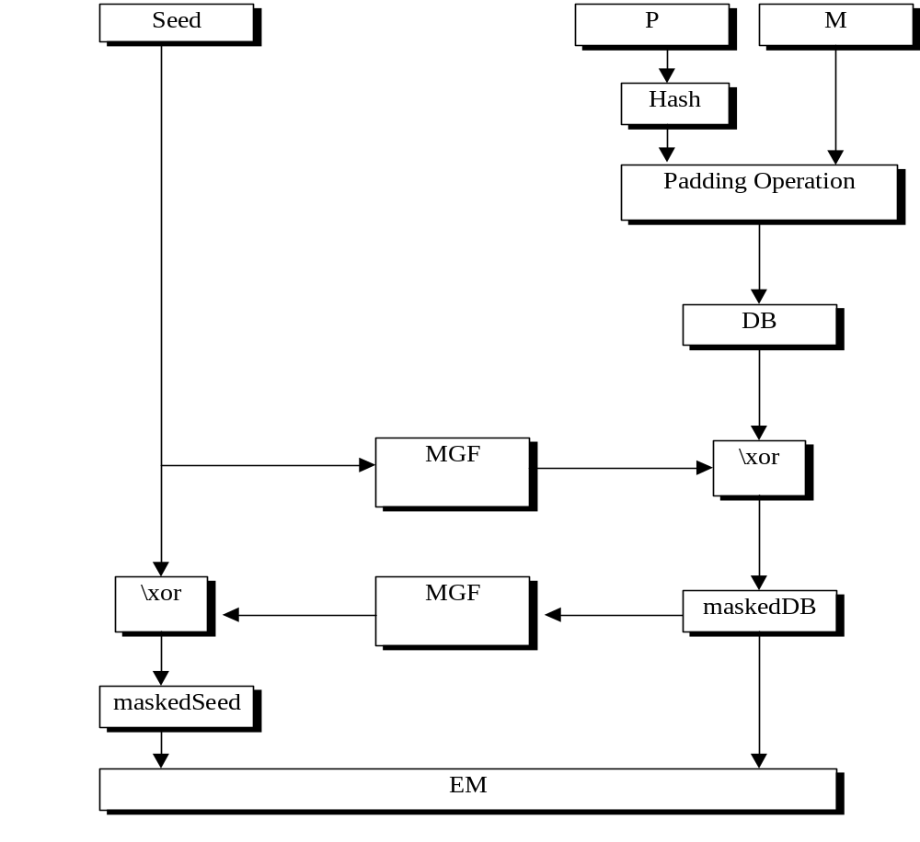
EME-OAEP-Encode

Slide 13
Auxiliary Functions (Section 10)
Hash functions
  deterministic functions, variable length input, fixed length output
  collision resistance important to deter forgery of v1.5 signatures
  SHA-1 is recommended for EME-OAEP
  MD2, MD5 and SHA-1 are recommended for all other encoding methods

Slide 14
Mask generation functions
  deterministic functions
  take variable length input and output string of any predetermined length
  v2.0 defines an MGF based on a hash function, MGF1
  SHA-1 is the recommended hash function for MGF1

Slide 15
MGF1(Z, l)
Z is a seed, l is the length of the mask (the output)
Let T be the empty string
For counter from 0 to ⎡ l / hLen ⎤-1, do the following:
    a. Convert counter to an octet string C of length 4 with the primitive I2OSP:
C = I2OSP (counter, 4)
    b.Concatenate the hash of the seed Z and C to the octet string T:
T = T || Hash (Z || C)
Output the leading l octets of T as the octet string mask.

Slide 16
ASN.1 for RSA-OAEP (Section 11.2.1)
The syntax allows for increased functionality--
other hash functions, other types of MGFs, etc.
OID for the RSAES-OAEP encryption scheme:
id-RSAES-OAEP OBJECT IDENTIFIER ::= {pkcs-1 7}
The parameters field associated with this OID in
an AlgorithmIdentifier shall have type
RSAEP-OAEP-params:

Slide 17
RSAES-OAEP-params ::= SEQUENCE {
hashFunc [0] AlgorithmIdentifier{{oaepDigestAlgorithms}}
DEFAULT sha1Identifier,
maskGenFunc [1] AlgorithmIdentifier{{pkcs1MGFAlgorithms}}
DEFAULT mgf1SHA1Identifier,
pSourceFunc [2]
AlgorithmIdentifier {{pkcs1pSourceAlgorithms}}
DEFAULT pSpecifiedEmptyIdentifier }

Slide 18
In v2.0, P is an octet string that’s
specified explicitly, although the syntax is
more flexible:
pkcs1pSourceAlgorithms ALGORITHM-IDENTIFIER ::= {{OCTET STRING IDENTIFIED BY id-pSpecified}}
(encoding parameters are specified explicitly)
id-pSpecified OBJECT IDENTIFIER ::= {pkcs-1 9}
The parameters field for id-pSpecified shall have type OCTET
STRING, containing the encoding parameters.
pSpecifiedEmptyIdentifier ::=AlgorithmIdentifier {id-pSpecified, OCTET STRING SIZE (0) }

Slide 19
If defaults for all the fields in RSAES-OAEP-params are used then the AlgID has the value:
RSAES-OAEP-Default-Identifier ::= AlgorithmIdentifier {
id-RSAES-OAEP,
{sha1Identifier,
mgf1SHA1Identifier,
pSpecifiedEmptyIdentifier } }

Slide 20
Possibilities for v2.x
Signature schemes
  provable security (PSS)
  message recovery (PSS-R, ISO/IEC 9796)
  other options (X9.31…)
Key generation methods
Key validation methods

Slide 21
ISO/IEC 9796
An international standard for signatures with message recovery
Process involves padding, extending and adding redundancy to messages
Not provably secure

Slide 22
X9.31 rDSA
A hash based encoding method:
M
✵
EM = header || padding || H(M) || trailer
✵
f⁻¹(EM)
(f⁻¹ denotes the signature operation)

Slide 23
Key generation methods
Prime generation methods from ANSI draft X9.79: Prime Number Generation and Validation Methods?
Sieving procedures?
Primality tests (probabilistic/deterministic)?

Slide 24
Key validation methods
Still an area of research…
Some possibilities...
  methods for showing n is product of two primes
  method of Liskov and Silverman for showing that the two factors of n are nearly equal

