Slide 1
PKCS #14: Pseudo-Random Number Generation
Robert W. Baldwin - RSA Engineering
baldwin@rsa.com
James W. Gray, III - RSA Laboratories
jgray@rsa.com
PKCS Workshop ’98
October 7-9, 1998

Slide 2
Outline
Motivation, Purpose and Scope
Criteria and Requirements
Algorithm Families
  Digest, Block-Cipher, Both
  Stream-Cipher, Modular-Exponentiation
Discussion of Criteria & Families

Slide 3
Goals
Rough Consensus on Criteria and Requirements
Start Discussion of Algorithms
Signup Interested Participants For Further Development

Slide 4
Motivation for PKCS #14
Honda-san: Ask why 3 times
1: Increase System Security
2: Users and Developers Feel Safer
3: Lawyers Are Happier :-)
  Generally Accepted Good Business Practice
  Clear Intellectual Property

Slide 5
Possible Non-Purposes for
PKCS #14
Is Not: “Entropy” Gathering Recommendations
Is Not: Ensure Interoperability
  Maybe: state save format

Slide 6
Possible Purposes For PKCS #14
Is: Establish Accepted Practice
Is: Ensure Correctness
  Test Vectors
Is: Ensure Strength
  Cite Literature (Provable Properties)
  Provide Focus for Research

Slide 7
Possible Purposes For PKCS #14
Maybe: Document Evaluation Criteria
Maybe: Evaluate Different Algorithms
Is Not: Repeat RIPE project
Is: Input to Other Standards

Slide 8
Possible Scope For PKCS #14
Just Document the BSAFE Algorithms
Catalog All Known Algorithms
  Unbroken Algorithms
Create the One Ideal PRNG Algorithm
Select a Few Good Algorithms
  One for Each Major Environment
  Need Criteria for Goodness

Slide 9
Current Scope For PKCS #14
Document a Few Good Algorithms
  Including BSAFE Algorithms
By May 1999
Based on Existing Literature
  New Construct OK With Proofs
Cite Preliminary Analysis
  Literature & RSA Bulletins

Slide 10
Outline
Motivation, Purpose and Scope
 Criteria and Requirements
Algorithm Families
  Digest, Block-Cipher, Both
  Stream-Cipher, Modular-Exponentiation
Discussion of Criteria & Families

Slide 11
Meta-Criteria
Any New Algorithm Must Be Better
Than Existing Algorithms
How To Measure Better?
Perhaps Multiple Sets of Criteria

Slide 12
Criteria - Conflicting Sets
Performance
  Cipher-Based PRNG
Export Regulations
  Digest-Based PRNG
Provable Security
  Exponentiation-Based PRNG
Hardware Primitives
  Use Full Digest, Not Hash-Compression

Slide 13
Criteria - Security Checklist
Output Passes Randomness Tests
Large Minimum Cycle Length
Avoid Brute Force State Guessing
Large Output Range
  All 3DES Keys
  All 256-Bit AES Keys
Full Use of Seed Material

Slide 14
Criteria - Security Checklist
Avoid Known Cryptanalytic Attacks
Differential Against Cipher or Digest Input
Timing Attack
Limit Forward and Backward Attacks
Attacker Control of Some Seed Does Not Help Much

Slide 15
Criteria - Conservative Security
Proven Security Properties
Well-Studied Algorithm
Well-Known Primitives
Accepted Properties of Primitives

Slide 16
Criteria - Intellectual Property
Need Well-Defined Ownership
Range Of Ownership:
  No Patents On Any Part
  Patents On Primitives Not Constructs
  Patents On Constructs
  Patents On Whole PRNG
Well-Understood Licensing Terms
  Non-Discriminatory, etc.

Slide 17
Criteria - API
What are the Full Set of Operations for a PRNG?
  Add Initial Seed
  Generate “Random” Bytes
  Add New Seed
  Save and Restore State ?
  Self Test ?
  Test for Needs-More-Seed ?
    How Many Bytes Output Since Last Seed?

Slide 18
Outline
Motivation, Purpose and Scope
Criteria and Requirements
 Algorithm Families
  Introduction
  Digest, Block-Cipher, Both
  Stream-Cipher, Modular-Exponentiation
Discussion of Criteria & Families

Slide 19
Structure of PRNG Algorithms
Reduce Seed Material to State
Loop:
  Generate One Block of Output From State
  Advance State Without New Seed
Update State With New Seed (Maybe)
Save & Restore State (Maybe)

Slide 20
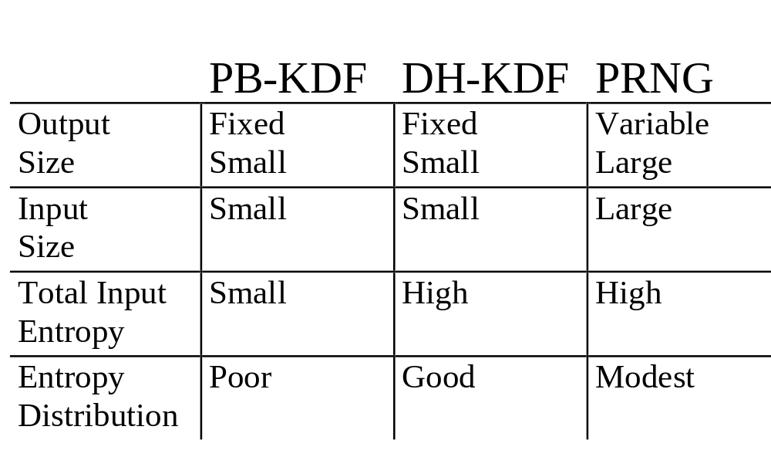
Comparing PRNG & KDFs

Slide 21
Notation
|| = Concatenation
| x | = Bit Size of “x”
+ = Unsigned Integer Addition
* = Unsigned Integer Multiplication
^ = Exponentiation
xor = Exclusive-Or

Slide 22
Notation
S = State
X = X1 .. Xn = Seed blocks
Y= Y1 .. Ym = Output blocks
D(z) = Digest of value z
Enc(k, m) = Encrypt block m with k
CbcRes(k, M) = CBC Residue of message M with key k

Slide 23
Possible Algorithm Families
 Digest
Block-Cipher
Digest and Block-Cipher
Stream-Cipher
Modular Exponentiation

Slide 24
Digest (PRF) Family of PRNG
BSAFE Algorithms
Yarrow
Gutmann
SSL KDF

Slide 25
Digest Family PRNG
Seed Reduction via MD5, SHA1, RIPEMD-160
  128 or 160 Bit Bottleneck
  3DES needs 168-Bit Keys
Generate Output by Digest of State

Slide 26
Digest Family PRNG
Advance State by
  Adding Constant (BSAFE)
  LFSR or LCG
  Iterative Digest (Gutmann, Yarrow)
Update State with New Seed
  Integer Addition of Digested Seed (BSAFE 2)
  Digest (State || Seed) (BSAFE 3)

Slide 27
Proposed Digest-PRNG Algorithm #1
Seed Reduction:
  X = Initial Seed
  S = S1 || S2 = Internal State
  | S | = 256 Bits, | S1 | = | S2 | = 128 Bits
  S1 = D(Pad1 || X) truncated to 128 bits
  S2 = D(Pad2 || X) truncated to 128 bits
  | Pad1 | = | Pad2 | = 512 bits
Extract Up To 256 Bits of Entropy

Slide 28
Proposed Digest-PRNG Algorithm #1
Output Generation
  Yj = HMAC (S, S || j)
    Alternative: Yj = HMAC (S, j)
  Yj = D (S xor Pad1 || D (S xor Pad2 || S|| j))
    Yj = D (S xor Pad1 || D (S xor Pad2 || j))
  | Pad1 | = | Pad2 | = 512 Bits
  | j | = 192 Bits (Room for End Padding)
Advance State is just: j = j + 1

Slide 29
Output Diagram for Digest-PRNG Algorithm #1
- Shows Alternative: Yj = HMAC (S, j)
S
| S | = | j | = 256 Bits
j
Pad2
512 Bits
PRF = SHA1-HC
256 Bits
256 Bits
EndPadding
XOR
512 Bits
256 Bits
IV
PRF
PRF
160 Bits
Pad1
512 Bits
EndPadding
256 Bits
352 Bits
XOR
512 Bits
Yj
IV
PRF
PRF
160 Bits
160 Bits
160 Bits

Slide 30
Proposed Digest-PRNG Algorithm #1
Update State With New Seed, Xk
  S1 = D(S xor Pad1 || Xk) truncated to 128
  S2 = D(S xor Pad2 || Xk) truncated to 128
  | Pad1 | = | Pad2 | = 512 bits
Same as Initial Seeding With S = 0

Slide 31
Benefits of Digest-PRNG
Algorithm #1
Large State Avoids 3DES Key Problem
State Cycle Length of 2^192 Blocks
- Output Cycle Length May Be Same
Benefits From Literature on HMAC
Some Literature (Krawczyk, Bellare, Rogaway)

Slide 32
Drawbacks of Digest-PRNG
Algorithm #1
New Algorithm, No Literature
Does Not Avoid Back-Tracking Attacks
No Proofs of Security for:
  Seed Reduction
  State Update
Slower Than BSAFE’s Algorithm
  2X for Output Generation

Slide 33
Proposed New Digest-PRNG Algorithm #2
Being developed by Jim Gray
“Provable” Security Properties
Based on Hash Compression Function Rather than Full Digest Function
Still Under development

Slide 34
Possible Algorithm Families
Digest
 Block-Cipher
Digest and Block-Cipher
Stream-Cipher
Modular Exponentiation

Slide 35
Block-Cipher Family PRNG
X9.17
Bellare, Rogaway, and others
Related to MAC Literature
  Krawczyk, Davis, Meyer, and others

Slide 36
Block-Cipher Family PRNG
Seed Reduction Often Unspecified
  Cipher-Based Digest (MDC2, Davies-Meyer, etc.)
State = Key and Message-Block
Output by Encrypting Part of State
  Encrypt Single Block Counter
  CBC-Residue of Large Counter (Micro-BSAFE)

Slide 37
Block-Cipher Family PRNG
Advance Message-Block and/or Key by
  Adding Constant (Rogaway)
  LFSR or LCG
  Iterative Encryption (X9.17, Rogaway)
  Append Counter (Rogaway)

Slide 38
Proposed Block-Cipher-PRNG Algorithm #1
Based on Rogaway and others
Uses 64-bit block cipher
With Keys Of At Least 128 bits
  IDEA, RC5, 3DES
Can Generalize to AES Ciphers

Slide 39
Proposed Block-Cipher-PRNG Algorithm #1
Seed Reduction:
  H() = Davies-Meyer One-Way Hash
  K = H(Prefix1 || X) -- 128 Bits
  C = S = S1 || S2 =
  H(Prefix2 || X) -- 128 Bits
  | Prefix1 | = | Prefix2 | = 64 Bits

Slide 40
Proposed Block-Cipher-PRNG Algorithm #1
Output Generation
  Yj = CbcRes (GK, S)
  GK = H(K || j >> d) = Generation Key
  “d” sets key change rate. 0 < d < 20
  CbcRes = 64-bit CBC Residue
    CbcRes (K, S1 || S2)
    = Enc (K, S2 xor Enc (K, S1))
    | S1 | = | S2 | = 64 Bits
  | j >> d | = 64 Bits

Slide 41
Proposed Block-Cipher-PRNG Algorithm #1
Advance S State (LCG)
  S = S + C modulo P
  P is 128-Bit Prime
  Take Care to Avoid Timing Attacks
Advanced CbcRes Key State
  After 2^d Output Blocks
  GK = H(K || j >> d)
  | j >> d | = 64 Bits

Slide 42
Proposed Block-Cipher-PRNG Algorithm #1
Update State With New Seed, Xk
  H() = Davies-Meyer Hash
  K = H(Prefix1 || K || Xk)
  M = H(Prefix2 || M || Xk)

Slide 43
Benefits of Block-Cipher-PRNG Algorithm #1
Large State Avoids 3DES Key Problem
State Cycle Length of P (~2^128) Blocks
  Output Cycle May Be Same
A Bit Faster Than Digest Algorithms
Some Literature (Rogaway, Bellare, Davies)

Slide 44
Drawbacks of Block-Cipher-PRNG Algorithm #1
No Protection Against Back Tracking
New Algorithm, No Direct Literature

Slide 45
Possible Algorithm Families
Digest
Block-Ciphers
 Digest and Block-Cipher
  Overview Only
Stream-Ciphers
Modular Exponentiation

Slide 46
Digest and Block-Cipher PRNG Family
Seed Reduction Using Digest
Output by Encrypting Part of State
  Encrypt Single Block Counter
  CBC-Residue of Large Counter (Micro-BSAFE)

Slide 47
Digest and Block Cipher PRNG Family
Advance State and/or Key by
  Adding Constant (Rogaway)
  LFSR or LCG
  Iterative Encryption (X9.17)
  Iterative Hashing

Slide 48
Possible Algorithm Families
Digest
Block Ciphers
Digest and Block
 Stream Ciphers
  Overview Only
Modular Exponentiation

Slide 49
Stream Cipher PRNG Family
Seed Reduction Using ???
Output Key Stream Cipher
  RC4, PIKE, SEAL, VESTA, A5
Advance State
  Running Stream Cipher

Slide 50
Possible Algorithm Families
Digest
Block Ciphers
Digest and Block
Stream Ciphers
 Modular Exponentiation
  Overview Only

Slide 51
Modular Exponentiation PRNG Family
Seed Reduction Using ???
Output by:
  Output Function of Value
  (Parity, LSB, O(log log n) Bits, etc.)
Advance State
  Iterate Exponentiation
Literature for BBS, ACGS, and BM

Slide 52
Outline
Motivation, Purpose and Scope
Criteria and Requirements
Algorithm Families
  Digest, Block Cipher, Both
  Stream Cipher, Modular-Exponentiation
 Discussion of Criteria & Families

Slide 53
Discussion of Criteria
Is Documenting BSAFE Enough?
Are Cipher-Based PRNGs Needed?
Is Patent-Free Required?
  PRNG Construct and/or Primitive?
Is Re-Seeding Needed?
Can Digest Function Internals Be Used?

