Slide 1
PKCS #1 v2.1:
RSA Cryptography Standard
Burt Kaliski, RSA Laboratories
PKCS Workshop, 30 September 1999

Slide 2
Summary
PKCS #1 v1.5 published in November 1993
Wide deployment, in parallel with increased understanding of security of RSA-based techniques
PKCS #1 v2.0 released in July 1998 with OAEP (Optimal Asymmetric Encryption Padding) for enhanced security of encryption schemes
  OAEP developed by M. Bellare and P. Rogaway, 1994
PKCS #1 v2.1 draft incorporates the companion technique for digital signatures, PSS (Probabilistic Signature Scheme)
  PSS developed by same authors, 1996

Slide 3
Goals of Presentation
Part I: Review the current draft
Part II: Propose a strategy for RSA signature standards
Part III: Discuss several other topics related to the draft

Slide 4
Part I: The Current Draft

Slide 5
Status
PKCS #1 v2.1 adds PSS signature scheme, includes some editorial improvements
Draft 1 released 21 September for 30-day review

Slide 6
Outline
What is PSS?
General Model for Signature Schemes
Draft Specification of PSS
ASN.1 Syntax
Example Applications
PSS Advantages and Alternatives
Patent Issues
Recommended Deployment
A Brief Security Update

Slide 7
What is PSS?
PSS stands for Probabilistic Signature Scheme
Published in 1996 by M. Bellare and P. Rogaway
“Encoding method” for signatures with appendix in the integer factorization (IF) family, including RSA signatures
Provable security in the random oracle model
PSS-R variant provides message recovery

Slide 8
General Model for Signature Schemes
Following IEEE P1363 classification
Primitives are mathematical operations on integers, field elements
Schemes are sets of operations on messages
Schemes are built up from primitives, “encoding methods” mapping between messages, integers
  Note: in PKCS #1 v2.1 encoding methods map to strings, which are then converted to integers; this detail omitted here for simplicity

Slide 9
IF Family
Cryptography based on the difficulty of the integer factorization (IF) problem
Modulus n = pq
Public exponent e, private exponent d
RSA: e odd
Rabin-Williams: e even; conditions on p, q

Slide 10
Notation
M message (string)
m message representative (integer)
s signature (integer)
SP Signature Primitive (m → s)
VP Verification Primitive (s → m)

Slide 11
Encoding Methods
Mappings between message M, integer message representative m
  Encode: M → m
  Check: M, m consistent?
  Decode: m → M
Security goals: one-way, collision-resistant, no mathematical structure

Slide 12
IF Signature and Verification Primitives
RSA case:
  SP: s = m^{d} mod n
  VP: m = s^{e} mod n
Rabin-Williams case:
  SP: s = |t^{d} mod n|
    where t = m or m/2 such that (t/n) = +1
  VP: m = t, 2t, n-t or 2(n-t)
    where t = s^{e} mod n, m has redundancy

Slide 13
IF Signature Scheme with Appendix
Signature operation:
  m = Encode(M)
  s = SP(m)
Verification operation:
  m = VP(s)
  Check(M, m)

Slide 14
IF Signature Scheme with Message Recovery
Signature operation:
  m = Encode(M)
  s = SP(m)
Recovery operation:
  m = VP(s)
  M = Decode(m)
(Size of M is limited)

Slide 15
Draft Specification of PSS
RSASSA-PSS in PKCS #1 v2.1 d1
  “RSA signature scheme with appendix based on PSS”
Following general model, with salt value
  input to encoding operation
  optional output from signature operation and input to verification operation
    for “single-pass processing”
    two cases for verification operation, with and without salt value
Based on RSA primitives, also supports RW
  as noted in Bellare-Rogaway submission to IEEE P1363a

Slide 16
PSS Signature Operation
Input: message M
Output: signature s, salt (opt.)
1. Generate salt
2. Apply encoding operation to message, salt to produce message representative:
  m = Encode(M, salt)
3. Apply signature primitive to produce signature:
  s = SP(m)

Slide 17
PSS Verification Operation w/Salt
Input: message M, signature s, salt
Output: “valid” / “invalid”
1. Apply encoding operation to produce message representative:
  m = Encode(M, salt)
2. Apply verification primitive to recover original message representative:
  m’ = VP(s)
3. Compare:
  m =? m’

Slide 18
PSS Verification Operation w/o Salt
Input: message M, signature s
Output: “valid” / “invalid”
1. Apply verification primitive to recover original message representative:
  m = VP(s)
2. Apply checking operation to determine whether message representative is valid:
  Check(M, m)

Slide 19
PSS Encoding Method
Following general model, with encoding and checking operations
Salt is additional input to encoding operation
  same length as hash function output
Message representative is one byte shorter than modulus
Based on underlying hash function, mask generation function

Slide 20
PSS Encoding Operation
Input: message M, salt
Output: message representative m
1. Hash message and salt:
  H = Hash (salt || M)
2. Add padding to salt to form data block:
  DB = salt || 00 … 00
3. Expand hash and mask data block:
  maskedDB = DB xor MGF(H)
4. Format message representative:
  m = H || maskedDB

Slide 21
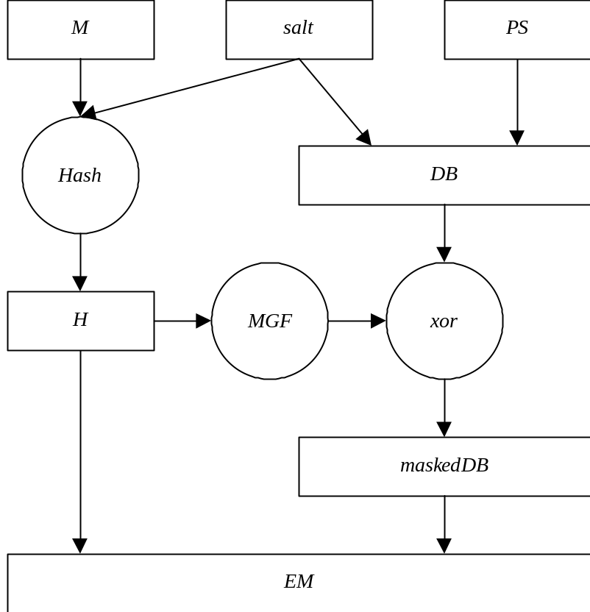
Block Diagram of PSS Encoding Operation

Slide 22
Observations
Message is hashed with random salt
  improves security proof
  reduces reliance on hash function security
Hash value is expanded to full length
  randomizes input to primitive
  removes multiplicative structure
  enables proof
Salt value is xored into expanded hash
  shortens signature overhead
  part of message may also be xored

Slide 23
PSS Checking Operation
Input: message M, message representative m
Output: “consistent” / “inconsistent”
1. Parse message representative:
  H || maskedDB = m
2. Expand hash value and unmask data block:
  DB = maskedDB xor MGF(H)
3. Check and remove padding to recover salt:
  salt || 00 … 00 =? DB
4. Rehash message and salt and compare:
  H =? Hash (salt || M)

Slide 24
PSS Advantages
Provable security under random oracle model
  other methods have “ad hoc” security, not a proof
Reduced reliance on hash function security
  “birthday attack” collisions not useful due to random salt
Natural extension to message recovery

Slide 25
What’s Provable?
Suppose an algorithm A can forge PSS signatures without access to the details of Hash, MGF
  Hash, MGF are effectively “random oracles” that can only be queried
Then an algorithm B can invert RSA in about the same time using algorithm A as a subroutine
⇒ If RSA is hard to invert, then PSS is secure

Slide 26
Proof Method
Inverting algorithm B “builds” Hash, MGF that appear random to forgery algorithm A, but embed an instance to be inverted
When A succeeds at forgery, B succeeds at inverting RSA
Random salt is key to “tight” proof, but even if not random, proof still holds

Slide 27
What about the Random Oracle Model?
Some concerns have been raised about the relevance of proofs in the random oracle model:
  some on theoretical grounds
  others on practicality of “instantiating” a random oracle with a real hash or mask generation function
But although the proof may “overestimate” the properties of Hash and MGF, it underestimates properties of RSA
  e.g., bit security properties are not considered
Thus, in practice, PSS may well provide high security even without the random oracle model

Slide 28
Alternatives to PSS
Current methods
  but not provably secure (“what if?”)
Full Domain Hashing (Bellare-Rogaway 1993)
  but security proof not as tight
  not as flexible
Future research

Slide 29
ASN.1 Syntax for RSASSA-PSS
Generic OID:
  id-RSASSA-PSS ::= pkcs-1.10
Parameters:
  RSASSA-PSS-params ::= SEQUENCE {
  hashFunc [0] AlgorithmIdentifier {{oaepDigestAlgorithms}}
  DEFAULT sha1Identifier,
  maskGenFunc [1] AlgorithmIdentifier {{pkcs1MGFAlgorithms}}
  DEFAULT mgf1SHA1Identifier,
  salt OCTET STRING OPTIONAL }
Note: syntax needs some updating

Slide 30
Some Special Syntax
In some applications, e.g., PKCS #7 and S/MIME CMS, the hash function underlying a signature scheme is identified separately
Generic OID for use in combination with PSS:
  id-salted-hash ::= pkcs-1.11
Parameters:
  Salted-Hash-Params ::= SEQUENCE {
  hashFunc [0] AlgorithmIdentifier,
  salt OCTET STRING OPTIONAL }

Slide 31
Example Application: X.509 Certificates
Signature algorithm identified in two places:
  body of certificate
  adjacent to signature
To save space, both identifiers should specify id-RSASSA-PSS without salt
Salt can be recovered from signature during verification

Slide 32
Example Application: S/MIME Signed Messages
Relevant algorithms are identified in three places:
  underlying hash function before message and in SignerInfo after message
  signature algorithm in SignerInfo
To facilitate single-pass processing, identifier before message should specify id-salted-hash with underlying hash function, salt
Hash function identifier in SignerInfo should specify id-salted-hash without salt
Signature algorithm identifier should specify id-RSASSA-PSS without salt

Slide 33
Patent Issues
University of California has applied for a patent (U.S. only) on PSS and PSS-R
In a letter to IEEE P1363, UC has offered to waive licensing on PSS for signatures with appendix if adopted as an IEEE standard
Reasonable and non-discriminatory licensing for signatures with message recovery

Slide 34
Recommended Deployment
A gradual transition to PSS is recommended in the interest of prudent security
  rollover, along with AES, new hash functions, …
PKCS #1 v1.5 signature scheme is still appropriate for new applications
Different than situation with PKCS #1 v1.5 encryption scheme, where only OAEP is recommended for new applications

Slide 35
A Brief Security Update
At Crypto ’99, J.-S. Coron, D. Naccache and J. Stern give a thorough analysis of security of RSA-based signature schemes against attacks based on factoring message representatives
  stronger versions of Desmedt-Odylzko attack (1985)
PKCS #1 v1.5 fared very well
  attacks are impractical, more expensive than finding hash function collisions (2⁸⁰ operations)
  design considerations by R. Rivest (1991) provide resistance
D. Coppersmith, S. Halevi and C. Jutla extended the attack to break ISO/IEC 9796-1 (Crypto ’99 rump session)

Slide 36
Part II: RSA Standards Strategy

Slide 37
Introduction
Various methods today for digital signatures in the integer factorization / RSA family
Standards, practice, theory differ
How to harmonize?

Slide 38
Major Signature Schemes in the IF Family
Signature schemes with appendix:
  ANSI X9.31
  PKCS #1 v1.5 (also in v2.0, v2.1 draft)
  Bellare-Rogaway FDH and PSS
Signature schemes with message recovery:
  ISO/IEC 9796-1
  Bellare-Rogaway PSS-R
This discussion focuses on the first set

Slide 39
ANSI X9.31
Encode(M) =
6b bb … bb ba || Hash(M) || 3x cc
  where x = 3 for SHA-1, 1 for RIPEMD-160
Ad hoc design
Widely standardized
  IEEE P1363, ISO/IEC 14888-3
  US NIST FIPS 186-1
ANSI X9.31 requires “strong primes”

Slide 40
PKCS #1 v1.5
Encode(M) =
00 01 ff … ff || HashAlgID || Hash(M)
Ad hoc design
Widely deployed
  SSL certificates
  S/MIME
To be included in IEEE P1363a

Slide 41
Bellare-Rogaway FDH
(Full Domain Hashing, ACM CCCS ’93)
Encode(M) =
00 || Full-Length-Hash(m)
Provably secure design
To be included in IEEE P1363a

Slide 42
PSS vs. FDH: Technical Comparison
PSS is probabilistic, FDH is deterministic
Both provably secure
  same paradigm as Optimal Asymmetric Encryption Padding (OAEP)
PSS has tighter security proof, is less dependent on security of hash function
PSS-R variant supports message recovery, partial message recovery
PSS is patent pending (but generously licensed)

Slide 43
ANSI X9.31 vs. PKCS #1 v1.5: Technical Comparison
Both are deterministic
Both include a hash function identifier
Both are ad hoc designs
  both resist Coron-Naccache-Stern / Coppersmith-Halevi-Jutla attacks on ISO/IEC 9796-1,-2
Both support RSA and RW primitives
  see IEEE P1363a contribution on PKCS #1 signatures for discussion
No patents have been reported to IEEE P1363 or ANSI X9.31 for these encoding methods

Slide 44
Standards vs. Theory vs. Practice
ANSI X9.31 is widely standardized
PSS is widely considered secure
PKCS #1 v1.5 is widely deployed
How to harmonize?

Slide 45
Challenges
Infrastructure changes take time
  particularly on the user side
ANSI X9.31 is more than just another encoding method, also specifies “strong primes”
  a controversial topic
Many communities involved
  formal standards bodies, IETF, browser vendors, certificate authorities

Slide 46
Prudent Security
What if a weakness were found in ANSI X9.31 or PKCS #1 v1.5 signatures?
  no proof of security, though designs are well motivated, supported by analysis
  would be surprising — but so were vulnerabilities in ISO/IEC 9796-1,-2
PSS embodies “best practices,” prudent to improve over time

Slide 47
Proposed Strategy
Short term (1-2 years): Support both PKCS #1 v1.5 and ANSI X9.31 signatures for interoperability
  e.g., in IETF profiles, FIPS validation
    NIST is in the process of adding PKCS #1 v1.5 to FIPS 186-2 for an 18-month transition period
Long term (2-5 years): Move toward PSS signatures
  not necessarily, but perhaps optionally with “strong primes”
  upgrade in due course — e.g., with AES algorithm, new hash functions

Slide 48
Standards Work
IEEE P1363a will include PSS
  also FDH, PKCS #1 v1.5 signatures
PKCS #1 v2.1 d1 includes it
To be proposed to ANSI X9F1
Other relevant standards bodies include ISO/IEC, US NIST, IETF

Slide 49
Part III: Some Discussion Topics

Slide 50
Outline
PSS-R
ANSI X9.31 encoding method
Composite hash functions
New mask generation functions
Rabin-Williams support

Slide 51
PSS-R
Should PKCS #1 v2.1 include the PSS-R encoding method?
ISO/IEC 9796-1, -2 may be updated with new and potentially different signature scheme with message recovery
PSS-R to be included in IEEE P1363a

Slide 52
ANSI X9.31 Encoding Method
Should PKCS #1 v2.1 include the ANSI X9.31 encoding method?
ANSI X9.31 is a banking standard
FIPS 186-1 includes it

Slide 53
Composite Hash Functions
Should PKCS #1 v2.1 specify “composite” hash functions?
  raised by Tom Gindin, IBM
Example:
  SHA-1-MD5(M) = SHA-1(M) || MD5(M)
A simple method to increase security in a modular fashion
Could be combined with PKCS #1 v1.5 encoding method, or PSS

Slide 54
New Mask Generation Functions
Should PKCS #1 v2.1 define new mask generation functions?
Example:
  MGF2(Z) = HMAC(Z,0) || HMAC(Z,1) || …
Current method lacks HMAC’s security proof:
  MGF1(Z) = Hash(0 || Z) || Hash(1 || Z) || …

Slide 55
Rabin-Williams Support
Should PKCS #1 v2.1 include the RW primitives for even exponents?
Would be consistent with ANSI X9.31, X9.44 draft, IEEE P1363
PKCS #1 v1.5, PSS versions require slightly different primitives than currently specified
  cf. relevant submissions to IEEE P1363a

Slide 56
Conclusions
A new draft of PKCS #1 nearing completion
Standards strategy for RSA signatures emerging
  PSS a prudent choice for long-term security, harmonization of standards
For future work?
  PKCS #1 usage guidelines
  key generation and validation specifications

