Slide 1
The RC6 Block Cipher:
A simple fast secure
AES proposal
Ronald L. Rivest MIT
Matt Robshaw RSA Labs
Ray Sidney RSA Labs
Yiqun Lisa Yin RSA Labs
(August 21, 1998)

Slide 2
Outline
Design Philosophy
Description of RC6
Implementation Results
Security
Conclusion

Slide 3
Design Philosophy
Leverage our experience with RC5: use data-dependent rotations to achieve a high level of security.
Adapt RC5 to meet AES requirements
Take advantage of a new primitive for increased security and efficiency: 32x32 multiplication, which executes quickly on modern processors, to compute rotation amounts.

Slide 4
Description of RC6

Slide 5
Description of RC6
RC6-w/r/b parameters:
  Word size in bits: w ( 32 )( lg(w) = 5 )
  Number of rounds: r ( 20 )
  Number of key bytes: b ( 16, 24, or 32 )
Key Expansion:
  Produces array S[ 0 … 2r + 3 ] of w-bit round keys.
Encryption and Decryption:
  Input/Output in 32-bit registers A,B,C,D

Slide 6
RC6 Primitive Operations
A + B Addition modulo 2^{w}
A - B Subtraction modulo 2^{w}
A ⊕ B Exclusive-Or
A <<< B Rotate A left by amount in
low-order lg(w ) bits of B
A >>> B Rotate A right, similarly
(A,B,C,D) = (B,C,D,A) Parallel assignment
A x B Multiplication modulo 2^{w}
RC5

Slide 7
RC6 Encryption (Generic)
B = B + S[ 0 ]
D = D + S[ 1 ]
for i = 1 to r do
{
t = ( B x ( 2B + 1 ) ) <<< lg( w )
u = ( D x ( 2D + 1 ) ) <<< lg( w )
A = ( ( A ⊕ t ) <<< u ) + S[ 2i ]
C = ( ( C ⊕ u ) <<< t ) + S[ 2i + 1 ]
(A, B, C, D) = (B, C, D, A)
}
A = A + S[ 2r + 2 ]
C = C + S[ 2r + 3 ]

Slide 8
RC6 Encryption (for AES)
B = B + S[ 0 ]
D = D + S[ 1 ]
for i = 1 to 20 do
{
t = ( B x ( 2B + 1 ) ) <<< 5
u = ( D x ( 2D + 1 ) ) <<< 5
A = ( ( A ⊕ t ) <<< u ) + S[ 2i ]
C = ( ( C ⊕ u ) <<< t ) + S[ 2i + 1 ]
(A, B, C, D) = (B, C, D, A)
}
A = A + S[ 42 ]
C = C + S[ 43 ]

Slide 9
RC6 Decryption (for AES)
C = C - S[ 43 ]
A = A - S[ 42 ]
for i = 20 downto 1 do
{
(A, B, C, D) = (D, A, B, C)
u = ( D x ( 2D + 1 ) ) <<< 5
t = ( B x ( 2B + 1 ) ) <<< 5
C = ( ( C - S[ 2i + 1 ] ) >>> t ) ⊕ u
A = ( ( A - S[ 2i ] ) >>> u ) ⊕ t
}
D = D - S[ 1 ]
B = B - S[ 0 ]

Slide 10
Key Expansion (Same as RC5’s)
Input: array L[ 0 … c-1 ] of input key words
Output: array S[ 0 … 43 ] of round key words
Procedure:
S[ 0 ] = 0xB7E15163
for i = 1 to 43 do S[i] = S[i-1] + 0x9E3779B9
A = B = i = j = 0
for s = 1 to 132 do
{ A = S[ i ] = ( S[ i ] + A + B ) <<< 3
B = L[ j ] = ( L[ j ] + A + B ) <<< ( A + B )
i = ( i + 1 ) mod 44
j = ( j + 1 ) mod c }

Slide 11
From RC5 to RC6 in seven easy steps

Slide 12
(1) Start with RC5
RC5 encryption inner loop:
for i = 1 to r do
{
A = ( ( A ⊕ B ) <<< B ) + S[ i ]
( A, B ) = ( B, A )
}
Can RC5 be strengthened by having rotation amounts depend on all the bits of B?

Slide 13
Better rotation amounts?
Modulo function?
Use low-order bits of ( B mod d )
Too slow!
Linear function?
Use high-order bits of ( c x B )
Hard to pick c well!
Quadratic function?
Use high-order bits of ( B x (2B+1) )
Just right!

Slide 14
B x (2B+1) is one-to-one mod 2^{w}
Proof: By contradiction. If B ≠ C but B x (2B + 1) = C x (2C + 1) (mod 2^{w})
then
(B - C) x (2B+2C+1) = 0 (mod 2^{w})
But (B-C) is nonzero and (2B+2C+1) is odd; their product can’t be zero! □
Corollary:
B uniform → B x (2B+1) uniform
(and high-order bits are uniform too!)

Slide 15
High-order bits of B x (2B+1)
The high-order bits of
f(B) = B x ( 2B + 1 ) = 2B² + B
depend on all the bits of B .
Let B = B₃₁B₃₀B₂₉ … B₁B₀ in binary.
Flipping bit i of input B
  Leaves bits 0 … i-1 of f(B) unchanged,
  Flips bit i of f(B) with probability one,
  Flips bit j of f(B) , for j > i , with probability approximately 1/2 (1/4…1),
  is likely to change some high-order bit.

Slide 16
(2) Quadratic Rotation Amounts
for i = 1 to r do
{
t = ( B x ( 2B + 1 ) ) <<< 5
A = ( ( A ⊕ B ) <<< t ) + S[ i ]
( A, B ) = ( B, A )
}
But now much of the output of this nice multiplication is being wasted...

Slide 17
(3) Use t, not B, as xor input
for i = 1 to r do
{
t = ( B x ( 2B + 1 ) ) <<< 5
A = ( ( A ⊕ t ) <<< t ) + S[ i ]
( A, B ) = ( B, A )
}
Now AES requires 128-bit blocks.
We could use two 64-bit registers, but
64-bit operations are poorly supported with typical C compilers...

Slide 18
(4) Do two RC5’s in parallel
Use four 32-bit regs (A,B,C,D), and do
RC5 on (C,D) in parallel with RC5 on (A,B):
for i = 1 to r do
{
t = ( B x ( 2B + 1 ) ) <<< 5
A = ( ( A ⊕ t ) <<< t ) + S[ 2i ]
( A, B ) = ( B, A )
u = ( D x ( 2D + 1 ) ) <<< 5
C = ( ( C ⊕ u ) <<< u ) + S[ 2i + 1 ]
( C, D ) = ( D, C )
}

Slide 19
(5) Mix up data between copies
Switch rotation amounts between copies, and cyclically permute registers instead of swapping:
for i = 1 to r do
{
t = ( B x ( 2B + 1 ) ) <<< 5
u = ( D x ( 2D + 1 ) ) <<< 5
A = ( ( A ⊕ t ) <<< u ) + S[ 2i ]
C = ( ( C ⊕ u ) <<< t ) + S[ 2i + 1 ]
(A, B, C, D) = (B, C, D, A)
}

Slide 20
One Round of RC6
A
B
C
D
t
u
<<<
f
<<<
f
5
5
<<<
<<<
S[2i]
S[2i+1]
A
B
C
D

Slide 21
(6) Add Pre- and Post-Whitening
B = B + S[ 0 ]
D = D + S[ 1 ]
for i = 1 to r do
{
t = ( B x ( 2B + 1 ) ) <<< 5
u = ( D x ( 2D + 1 ) ) <<< 5
A = ( ( A ⊕ t ) <<< u ) + S[ 2i ]
C = ( ( C ⊕ u ) <<< t ) + S[ 2i + 1 ]
(A, B, C, D) = (B, C, D, A)
}
A = A + S[ 2r + 2 ]
C = C + S[ 2r + 3 ]

Slide 22
(7) Set r = 20 for high security
(based on analysis)
B = B + S[ 0 ]
D = D + S[ 1 ]
for i = 1 to 20 do
{
t = ( B x ( 2B + 1 ) ) <<< 5
u = ( D x ( 2D + 1 ) ) <<< 5
A = ( ( A ⊕ t ) <<< u ) + S[ 2i ]
C = ( ( C ⊕ u ) <<< t ) + S[ 2i + 1 ]
(A, B, C, D) = (B, C, D, A)
}
A = A + S[ 42 ]
C = C + S[ 43 ]
Final RC6

Slide 23
RC6 Implementation Results

Slide 24
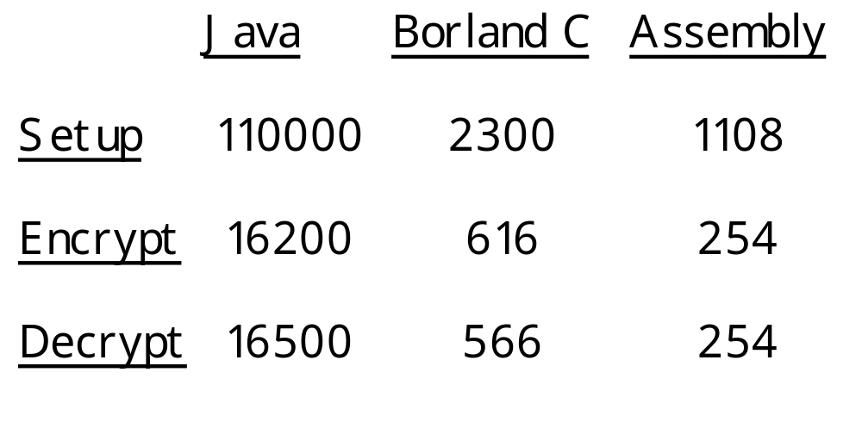
CPU Cycles / Operation
Less than two clocks per bit of plaintext !

Slide 25
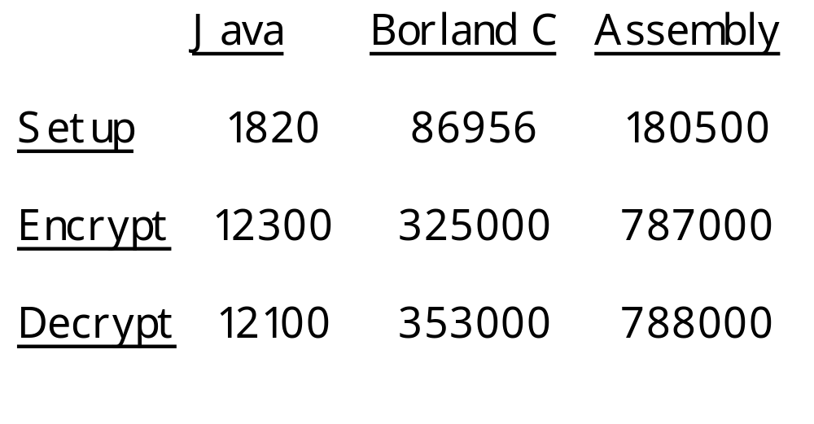
Operations/Second (200MHz)

Slide 26
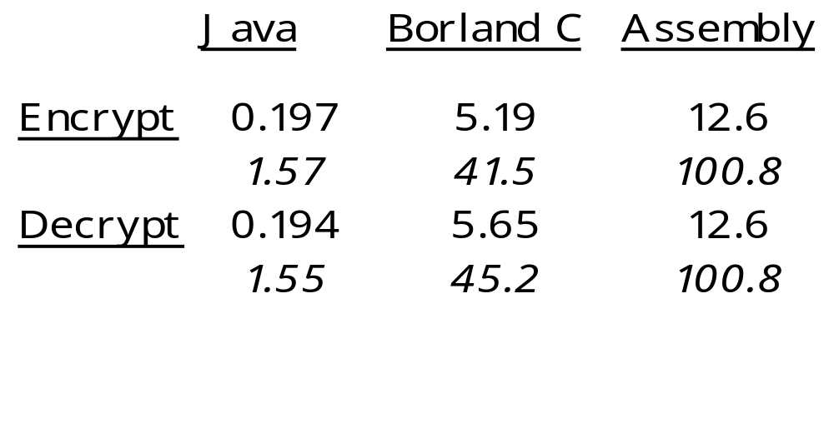
Encryption Rate (200MHz)
MegaBytes / second
MegaBits / second
Over 100 Megabits / second !

Slide 27
On an 8-bit processor
On an Intel MCS51 ( 1 Mhz clock )
Encrypt/decrypt at 9.2 Kbits/second
(13535 cycles/block;
from actual implementation)
Key setup in 27 milliseconds
Only 176 bytes needed for table of round keys.
Fits on smart card (< 256 bytes RAM).

Slide 28
Custom RC6 IC
0.25 micron CMOS process
One round/clock at 200 MHz
Conventional multiplier designs
0.05 mm² of silicon
21 milliwatts of power
Encrypt/decrypt at 1.3 Gbits/second
With pipelining, can go faster, at cost of more area and power

Slide 29
RC6 Security Analysis

Slide 30
Analysis procedures
Intensive analysis, based on most effective known attacks (e.g. linear and differential cryptanalysis)
Analyze not only RC6, but also several “simplified” forms (e.g. with no quadratic function, no fixed rotation by 5 bits, etc…)

Slide 31
Linear analysis
Find approximations for r-2 rounds.
Two ways to approximate A = B <<< C
  with one bit each of A, B, C (type I)
  with one bit each of A, B only (type II)
  each have bias 1/64; type I more useful
Non-zero bias across f(B) only when input bit = output bit. (Best for lsb.)
Also include effects of multiple linear approximations and linear hulls.

Slide 32
Security against linear attacks
Estimate of number of plaintext/ciphertext pairs required to mount a linear attack.
(Only 2¹²⁸ such pairs are available.)
Rounds Pairs
8 2⁴⁷
12 2⁸³
16 2¹¹⁹
20 RC6 2¹⁵⁵
24 2¹⁹¹
Infeasible

Slide 33
Differential analysis
Considers use of (iterative and non-iterative) (r-2)-round differentials as well as (r-2)-round characteristics.
Considers two notions of “difference”:
  exclusive-or
  subtraction (better!)
Combination of quadratic function and fixed rotation by 5 bits very good at thwarting differential attacks.

Slide 34
An iterative RC6 differential
A B C D
1<<16 1<<11 0 0
1<<11 0 0 0
0 0 0 1<<s
0 1<<26 1<<s 0
1<<26 1<<21 0 1<<v
1<<21 1<<16 1<<v 0
1<<16 1<<11 0 0
Probability = 2⁻⁹¹

Slide 35
Security against differential attacks
Estimate of number of plaintext pairs required to mount a differential attack.
(Only 2¹²⁸ such pairs are available.)
Rounds Pairs
8 2⁵⁶
12 2¹¹⁷
16 2¹⁹⁰
20 RC6 2²³⁸
24 2²⁹⁹
Infeasible

Slide 36
Security of Key Expansion
Key expansion is identical to that of RC5; no known weaknesses.
No known weak keys.
No known related-key attacks.
Round keys appear to be a “random” function of the supplied key.
Bonus: key expansion is quite “one-way”---difficult to infer supplied key from round keys.

Slide 37
Conclusion
RC6 more than meets the requirements for the AES; it is
  simple,
  fast, and
  secure.
For more information, including copy of these slides, copy of RC6 description, and security analysis, see
www.rsa.com/rsalabs/aes

Slide 38
(The End)

