Slide 1

Crypto 301: Practical Implementations of Cryptography
Tim Matthews,
Director, Product Marketing

Slide 2
Problem #1
Clear understanding of the need for security…
...But no security architecture

Slide 3
Problem #2
Rough security architecture design...
…No detailed implementation path

Slide 4
Task List
0) Get a grip on security
1) Home Banking Application
2) Secure Messaging Client

Slide 5
ÂrÒÞú/{N`_x0006__x0007_vÝ Q’¥á_x0005_Šqª8_x001f_¤_x0017_ _x001e_á_x0007_ìÃù_x0019_Bñƒ~§_x0016_‘²y_x001f_û{Oáÿ¤P×DÉ_x001f_%iâ4_x0013_ùù
{/_x001e_Œú‡&_x001d__x001c_BC+\_x0008__x001e_Ì™¼Òk±áŸ±5|_x001f__x0003_Ð D: ÚN¢ˆ_x0006_2šI”"@_x001c_¨ÓÎ_x0002_ÀxÕ`­‚
#K]_x0015_r·G¥ì•ûÈÉ©¡d5þfÌë0‡:„_x0002_®G_x0017_Bi8_x0013_ïû( ¤DG¹Ü±–yQéÂ_x0006__x001d_Aš:K…E»E(L²
Y`°_x0018_÷_x001c_÷_PÌ#A{fØ˜Ì—´DêC3S´= _x0004_Šê)e
_x0006_î…‚ Zwø„Ûá¥×>³¬&—Ú«A_x0011_Â_x0006_ÄuÍª“
ÖüTOµƒ‘A[tiBçw±ð_x0013_ÇõkfxCUF½qx2t¸¬_•(4s/_x0002_|9öÍ_x0017_ù_x001c_7¯)Šù_x000f_«™Çóà÷’)&Ó5
4 _x001e_>„Èêô¥ÈGP¾_x001b__x001a_šn¿yk¹tq /õx¡Ô»Öüf_p¥ê'A®À¤‹Ü4Œ D’z_x001a_¡Ôn§Õ5øëÿ]TW
9>ªÄa&_x0012_}”x_x0016_Gó¹âÄÐ_x0005_f©ß\›á„½_x001b_]_x0018_0ôÂ9mb_x0006_×u4'­Œ_x0018_0G_x000f_Ýj
WA¿«7•_x001f_²~Æ¯¯;yMö_x0015_ÉmR,’I?ª*IùëFðÔ1å…­ý=&¥_x001a__Ö§^ l²d¥Ôì+ ‡»ë_x0005_þ£Hì«±k‰8_x000c_;ëry
r¿’sØÔ‡°hŒÃß6ˆ_x001b_£d‚í_x001d_»_x000f_™N¯_x0002__x0015_é)šÉ·h1þe_x0004__x0005_A_x000c_•$‚ _x0010_R«l\jÔ°ÏÏ__x0002_3±_x0012_4_x0002_7©PÓ2gæ›·Ê
l_x0006_â‚½+N Çþ«]¬’£s=_x0011_f‡4ÜÂrÒÞú/{N`_x0006__x0007_vÝ Q’¥á_x0005_Šqª8_x001f_¤_x0017_ _x001e_á_x0007_ìÃù_x0019_Bñƒ~§_x0016_‘²y_x001f_û{Oáÿ¤P×DÉ_x001f_%iâ4_x0013_ùù
{/_x001e_Œú‡&_x001d__x001c_BC+\_x0008__x001e_Ì™¼Òk±áŸ±5|_x001f__x0003_Ð D: ÚN¢ˆ_x0006_2šI”"@_x001c_¨ÓÎ_x0002_ÀxÕ`­‚
#K]_x0015_r·G¥ì•ûÈÉ©¡d5þfÌë0‡:„_x0002_®G_x0017_Bi8_x0013_ïû( ¤DG¹Ü±–yQéÂ_x0006__x001d_Aš:K…E»E(L²
Y`°_x0018_÷_x001c_÷_PÌ#A{fØ˜Ì—´DêC3S´= _x0004_Šê)e
_x0006_î…‚ Zwø„Ûá¥×>³¬&—Ú«A_x0011_Â_x0006_ÄuÍª“
ÖüTOµƒ‘A[tiBçw±ð_x0013_ÇõkfxCUF½qx2t¸¬_•(4s/_x0002_|9öÍ_x0017_ù_x001c_7¯)Šù_x000f_«™Çóà÷’)&Ó5
4 _x001e_>„Èêô¥ÈGP¾_x001b__x001a_šn¿yk¹tq /õx¡Ô»Öüf_p¥ê'A®À¤‹Ü4Œ D’z_x001a_¡Ôn§Õ5øëÿ]TW
9>ªÄa&_x0012_}”x_x0016_Gó¹âÄÐ_x0005_f©ß\›á„½_x001b_]_x0018_0ôÂ9mb_x0006_×u4'­Œ_x0018_0G_x000f_Ýj WA¿«7•_x001f_²~
,Æ¯¯;yMö_x0015_ÉmR,’I?ª*IùëFðÔ1å…­ý=&¥_x001a__Ö§^ l²d¥Ôì+ ‡»ë_x0005_þ£Hì«±k‰8_x000c_;ëry
r¿’sØÔ‡°hŒÃß6ˆ_x001b_£d‚í_x001d_»_x000f_™N¯_x0002__x0015_é)šÉ·h1þe_x0004__x0005_A_x000c_•$‚ _x0010_R«l\jÔ°ÏÏ__x0002_3±_x0012_4
_x0002_7©PÓ2gæ›·Ê
l_x0006_â‚½+N Çþ«]¬’£s=_x0011_f‡4Ü

Slide 6
Competitive Strategy/ Cryptography
What is Cryptography?
Cryptographer’s View
Privacy
Data Integrity
Authentication
Non-Repudiation
Business View
Trust/Comfort
Fraud Protection
Assent/Authentication
Guarantee/Recourse

Slide 7
Competitive Strategy/ Cryptography
Mapping Concepts to Practices - Cryptographic Analogs
Cryptographic Construct
Digital Envelope
Digital Signature
Digital Certificate
Result
Privacy, Protection
Assent, Authorization, Integrity
Identity

Slide 8
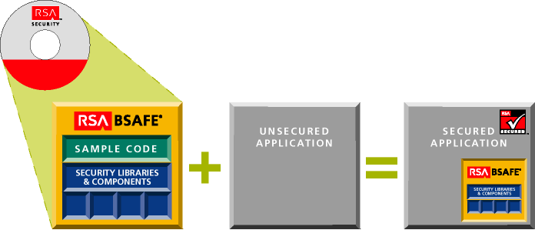
Building in Security

Slide 9
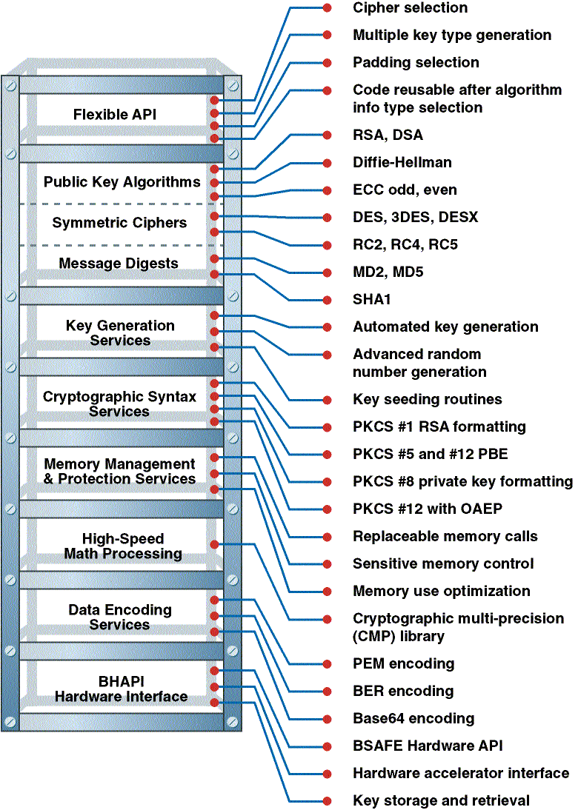
Inside a Crypto Stack

Slide 10
CDSA
Applications in C++
Applications in C
Applications in Native Java
System
Layered Services
Method Wrapper
Language Interface Adapter
Security Services
Tools
CSSM Security API
EM-API
Common
Security Services
Integrity Services
Security Contexts
Elective
Module Mgr.
Manager
SPI
TPI
CLI
DLI
EMI
Crypto
Service
Provider
Trust Model
Library
Certificate
Library
Data Store
Library
New
Service
e.g. Key
Recovery
Security Add-in
Modules
Data store

Slide 11
The Java Security Model
Java Security API
java.security, java.security.Interfaces)
Engine Classes
.MessageDigest, .Signature, .KeyPair Generator
JCE Classes/Interfaces
AsymmetricCipher,SymmetricCipher,
FeedbackCipher, SecretKey, Padding
Providers (Signatures, No Encryption)
SUN, Others
Crypto Providers (Signatures and Encryption)
BSAFE Crypto-J, Others

Slide 12
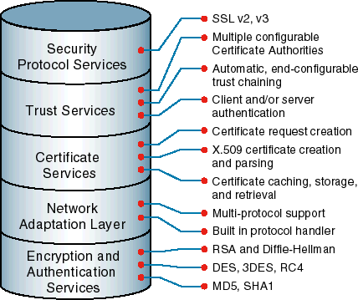
Functional Layers for SSL

Slide 13
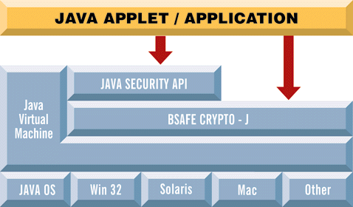
A Crypto Provider Example

Slide 14
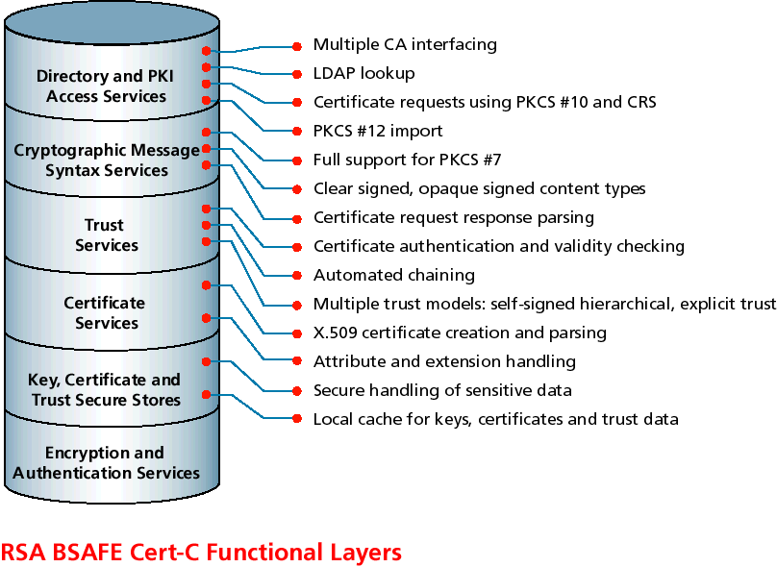
Functional Layers for PKI-Enabling

Slide 15
ÂrÒÞú/{N`_x0006__x0007_vÝ Q’¥á_x0005_Šqª8_x001f_¤_x0017_ _x001e_á_x0007_ìÃù_x0019_Bñƒ~§_x0016_‘²y_x001f_û{Oáÿ¤P×DÉ_x001f_%iâ4_x0013_ùù
{/_x001e_Œú‡&_x001d__x001c_BC+\_x0008__x001e_Ì™¼Òk±áŸ±5|_x001f__x0003_Ð D: ÚN¢ˆ_x0006_2šI”"@_x001c_¨ÓÎ_x0002_ÀxÕ`­‚
#K]_x0015_r·G¥ì•ûÈÉ©¡d5þfÌë0‡:„_x0002_®G_x0017_Bi8_x0013_ïû( ¤DG¹Ü±–yQéÂ_x0006__x001d_Aš:K…E»E(L²
Y`°_x0018_÷_x001c_÷_PÌ#A{fØ˜Ì—´DêC3S´= _x0004_Šê)e
_x0006_î…‚ Zwø„Ûá¥×>³¬&—Ú«A_x0011_Â_x0006_ÄuÍª“
ÖüTOµƒ‘A[tiBçw±ð_x0013_ÇõkfxCUF½qx2t¸¬_•(4s/_x0002_|9öÍ_x0017_ù_x001c_7¯)Šù_x000f_«™Çóà÷’)&Ó5
4 _x001e_>„Èêô¥ÈGP¾_x001b__x001a_šn¿yk¹tq /õx¡Ô»Öüf_p¥ê'A®À¤‹Ü4Œ D’z_x001a_¡Ôn§Õ5øëÿ]TW
9>ªÄa&_x0012_}”x_x0016_Gó¹âÄÐ_x0005_f©ß\›á„½_x001b_]_x0018_0ôÂ9mb_x0006_×u4'­Œ_x0018_0G_x000f_Ýj
WA¿«7•_x001f_²~Æ¯¯;yMö_x0015_ÉmR,’I?ª*IùëFðÔ1å…­ý=&¥_x001a__Ö§^ l²d¥Ôì+ ‡»ë_x0005_þ£Hì«±k‰8_x000c_;ëry
r¿’sØÔ‡°hŒÃß6ˆ_x001b_£d‚í_x001d_»_x000f_™N¯_x0002__x0015_é)šÉ·h1þe_x0004__x0005_A_x000c_•$‚ _x0010_R«l\jÔ°ÏÏ__x0002_3±_x0012_4_x0002_7©PÓ2gæ›·Ê
l_x0006_â‚½+N Çþ«]¬’£s=_x0011_f‡4ÜÂrÒÞú/{N`_x0006__x0007_vÝ Q’¥á_x0005_Šqª8_x001f_¤_x0017_ _x001e_á_x0007_ìÃù_x0019_Bñƒ~§_x0016_‘²y_x001f_û{Oáÿ¤P×DÉ_x001f_%iâ4_x0013_ùù
{/_x001e_Œú‡&_x001d__x001c_BC+\_x0008__x001e_Ì™¼Òk±áŸ±5|_x001f__x0003_Ð D: ÚN¢ˆ_x0006_2šI”"@_x001c_¨ÓÎ_x0002_ÀxÕ`­‚
#K]_x0015_r·G¥ì•ûÈÉ©¡d5þfÌë0‡:„_x0002_®G_x0017_Bi8_x0013_ïû( ¤DG¹Ü±–yQéÂ_x0006__x001d_Aš:K…E»E(L²
Y`°_x0018_÷_x001c_÷_PÌ#A{fØ˜Ì—´DêC3S´= _x0004_Šê)e
_x0006_î…‚ Zwø„Ûá¥×>³¬&—Ú«A_x0011_Â_x0006_ÄuÍª“
ÖüTOµƒ‘A[tiBçw±ð_x0013_ÇõkfxCUF½qx2t¸¬_•(4s/_x0002_|9öÍ_x0017_ù_x001c_7¯)Šù_x000f_«™Çóà÷’)&Ó5
4 _x001e_>„Èêô¥ÈGP¾_x001b__x001a_šn¿yk¹tq /õx¡Ô»Öüf_p¥ê'A®À¤‹Ü4Œ D’z_x001a_¡Ôn§Õ5øëÿ]TW
9>ªÄa&_x0012_}”x_x0016_Gó¹âÄÐ_x0005_f©ß\›á„½_x001b_]_x0018_0ôÂ9mb_x0006_×u4'­Œ_x0018_0G_x000f_Ýj WA¿«7•_x001f_²~
,Æ¯¯;yMö_x0015_ÉmR,’I?ª*IùëFðÔ1å…­ý=&¥_x001a__Ö§^ l²d¥Ôì+ ‡»ë_x0005_þ£Hì«±k‰8_x000c_;ëry
r¿’sØÔ‡°hŒÃß6ˆ_x001b_£d‚í_x001d_»_x000f_™N¯_x0002__x0015_é)šÉ·h1þe_x0004__x0005_A_x000c_•$‚ _x0010_R«l\jÔ°ÏÏ__x0002_3±_x0012_4
_x0002_7©PÓ2gæ›·Ê
l_x0006_â‚½+N Çþ«]¬’£s=_x0011_f‡4Ü

Slide 16




Task #1:
Home Banking Client/Server
Bank of the
Net
Internet
Bank Customer

Slide 17
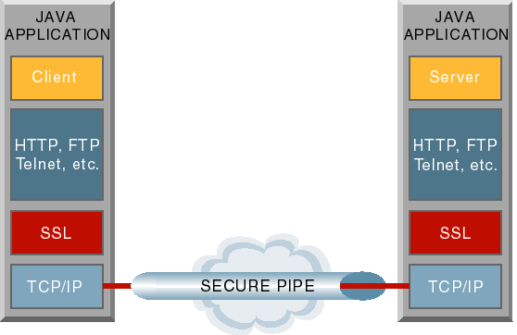
SSL in Java

Slide 18
Electronic Banking Application: Needs
Link Security
Authentication Based on Account #’s
Message Integrity
Moderate Amount of Traffic

Slide 19
Electronic Banking Application: Constructs
Key Exchange Diffie-Hellman
Symmetric Encryption Triple-DES
Message Digest SHA-1

Slide 20
BSAFE SSL-J API Calls
SSLParams.setCipherSuites (new DH_With_3DES_EDE_CBC_SHA());
SSLSocket.getCipherSuite();
SSLParams.setCertificateAndKey();
SSLSocket.getPeerCertificateChain();
To initiate an SSL session, use
getInputStream()
To encrypt and decrypt, use write() and read()

Slide 21
Other Applications
Groupware
Web Browser
Internet Firewall
Medical Record Security
_____________________
_____________________

Slide 22
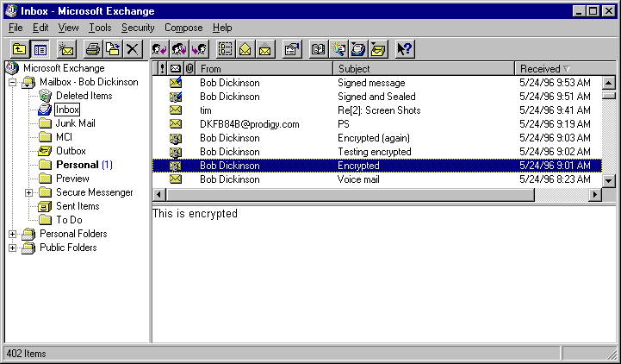
Task #2: Secure E-Mail Client

Slide 23
S/MIME E-Mail Client

Slide 24
S/MIME E-Mail Environment
Message Content
MIME formatting
Mail Engine
Address Info
(Name, certificate,
public keys)
S/MIME-C Engine
User Database
ed@rsa.com
5h2d1fa54
bc732a3df...
Message out
(Transport decisions
are independent of
SDK)
MIME tagging
Secure Mail Message

Slide 25
S/MIME E-mail Client: Needs
Digital Envelopes
Digital Signatures
Certificate Chaining
Certificate Requests
Export

Slide 26
S/MIME E-mail Client: Constructs
Message Format PKCS #7
Certificates X.509 v3
Algorithms RSA, SHA-1, RC2, Triple-DES

Slide 27
BSAFE S/MIME-C API Calls
SmtMsg_EncryptAndSign
SmtMsg_DecryptAndVerify
Also
  SmtCert_EnumCerts
  SmtAddress_AttachCertificate

Slide 28
Other Applications
EDI Over Internet
Downloading Secure Objects
Executable Signing
_____________________
_____________________

Slide 29
Links
This Presentation
  www.rsaconference.com/presentations/RSA00-Crypto301.ppt
Developing Secure Applications
  http://www.rsasecurity.com/developers/
Tim Matthews
  tim@rsasecurity.com

