Slide 1
Welcome to
RSA Conference 2000
Jim Bidzos
RSA Conference Chairman and Greek Guy
Notes:
Welcome to RSA Conference 2000!
This year’s conference honors the contributions of the ancient Greeks to the history of cryptography. We all know the Greeks made major contributions to the development of philosophy and mathematics, and it’s only natural that they had an important role in the history of cryptography.
In fact, the Greeks are responsible for the terminology that we still use today:
Cryptography = kriptos (hidden) + grafia (writing)
Steganography = steganos (covered) + grafia (writing)
In addition to the story by Herodotus that you’ve all read in the conference materials that were mailed to you prior to the conference, the Greeks’ involvement with cryptography is extensive. In the famous Greek drama the 'Iliad', cryptography was used when Bellerophon was sent to the king with a secret tablet which told the king to have him put to death. The king tried to kill him by having him fight several mythical creatures, but he won every battle.
The Spartans used a system called the 'skytale' cipher, which was used in the 5th century B.C. to send secret messages between Greek warriors. This system relied on a thin sheet of papyrus wrapped around a staff of a precise diameter. Messages were written down the length of the staff, and the papyrus was unwrapped. In order to read the message, the papyrus had to be wrapped around another staff of exactly equal diameter.. Without the right-diameter staff, it would be difficult to decode the message using the techniques available at that time.
The Greek Polybius developed an encryption system now called the "Polybius Square". The letters of the alphabet would be laid out in a five by five square with rows and columns numbered 1 to 5 so that each letter has a corresponding (row,column) pair. These pairs could easily be signaled by torches or hand signals. Decryption was performed by mapping the digit pairs back into their corresponding characters.

Slide 2
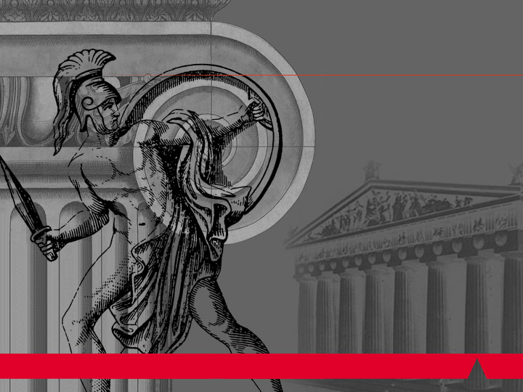
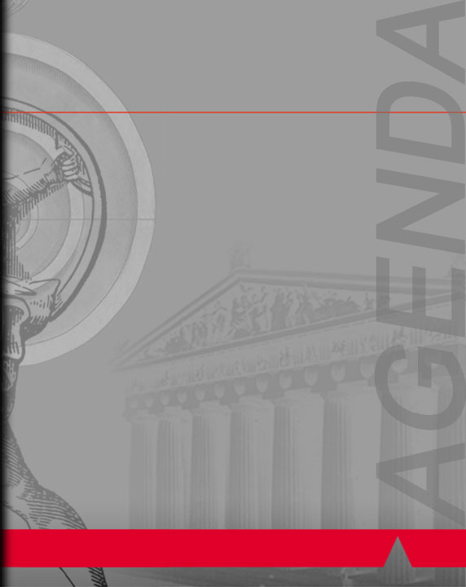
Agenda
1999: The Year in Review
Announcing RSA Press
RSA Security Awards
Notes:
Agenda:
1999 in review
Announcing RSA Press
The third annual RSA Security awards

Slide 3
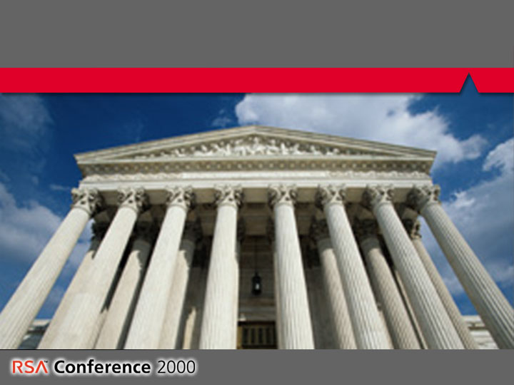
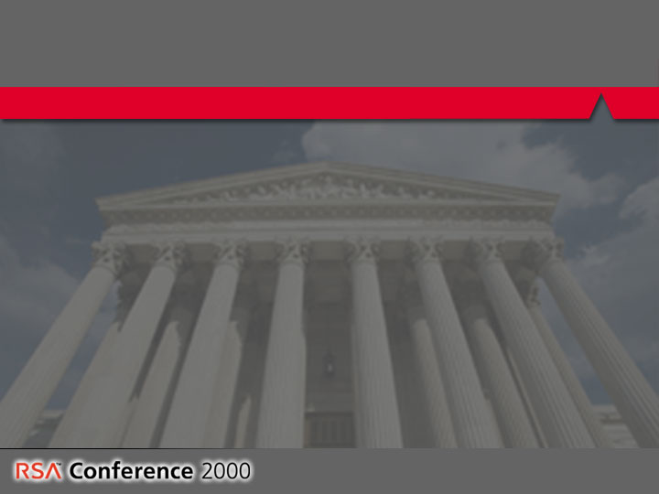
The Year in Review
Government news
  Federal legislative and judicial events
  Endorsement of PKI
  Selection of AES finalists
  Recognition of digital signatures
Notes:
According to IDC, the market for Internet security software grew from $2 billion in 1997 to an estimated $3.1 billion in 1998. The market is expected to reach $4.2 billion worldwide in 1999, and to grow to $7.4 billion in 2002. (Survey based on 300 companies with more than $100 million in annual revenues). Reflecting this financial growth in the security market, the government paid more attention than ever to security in 1999. The Clinton Administration announced that it was changing export control rules for crypto products. The proposed legislation – the Cyberspace Electronic Security Act (CESA) contains provisions for key escrow, requires third parties to disclose keys to government agents with a court order; also allows government to refuse to disclose in court the methods used to recover plaintext. “Retail” encryption hardware and software of unlimited strength could be exported without a license after a “technical review”; “Custom” products would have restrictions on sales to foreign governments and known terrorist/criminal organizations. Products less than 64 bits would be decontrolled. The Security and Freedom through Encryption (SAFE) Act is gaining support with more than 250 members of congress supporting it. The bill allows for export of off-the-shelf crypto devices if a comparable product is available, and it bans mandatory key escrow. In the Senate, John McCain (R-Ariz) reversed his previous position opposing cryptography and introduced S 798, the Promote Reliable OnLine Transactions to Encourage Commerce and Trade (PROTECT) Act of 1999. Bill allows free export of products of 64 bits or less. Stronger encryption can be exported to online merchants, major corporations that are publicly traded companies, government regulated organizations, subsidiaries or affiliates of U.S. corporations and governments in NAT, OECD and ASEAN.
In the courts, the federal Ninth Circuit Court of Appeals agreed with a lower court ruling that export laws constitute prior restraint and are unconstitutional. The court agreed that source code can be (though isn’t always) “expressive” and thus qualifies as speech for the purpose of the First Amendment. Thus, the Export Administration Regulations (EAR) are a prior restraint on free speech.
The head of the federal government's public-key infrastructure initiative said the benefits of PKI far outweigh difficulties in implementation. Richard Guida, chairman of the federal PKI steering committee, called PKI the best method for meeting the government's high security needs. He outlined plans to deploy PKI in agencies including the Dept. of Defense, and to use PKI to let the public securely interact with government over e-mail and the Internet.
NIST chose five finalists for the Advanced Encryption Standard: Mars, RC6, Rijndael, Serpent and Two-fish. Final selection will come in the summer of 2001.
Digital Signatures. The Senate in November gave a boost to Internet commerce by passing a bill to set standards for electronic signatures and protect consumers who buy things on line. The Millennium Digital Commerce Bill would ensure that contracts will not be denied legal effect that they would otherwise would have under state law solely because they are in electronic form or because they were signed electronically. It also seeks to protect consumers against companies that try to confuse them with electronic disclosures or compel them, into waiving their rights to paper records (Patrick Leahy D-VT) and Spencer Abraham (R-MICH). House passed legislation in November that would give electronic signatures and records the same legal validity as written contracts. HR 1714 has been called “the most important pro-technology vote that Congress will take,” said chief sponsor Tom Bliley (R-VA), who is the Commerce Committee Chairman. A bill signed in 1999 by California Gov. Gray Davis allows unique electronic codes to serve like pen and ink signatures, making it possible to enter into legally binding contracts over the Internet. The law, which took effect Jan. 1, 2000 applies to accounts with California-based brokerages opened by people who live anywhere in the United States. Charles Schwab and E*Trade Group, the two biggest Internet brokerages, will be able to open accounts online without waiting for signed paper contracts by mail under this new law.

Slide 4
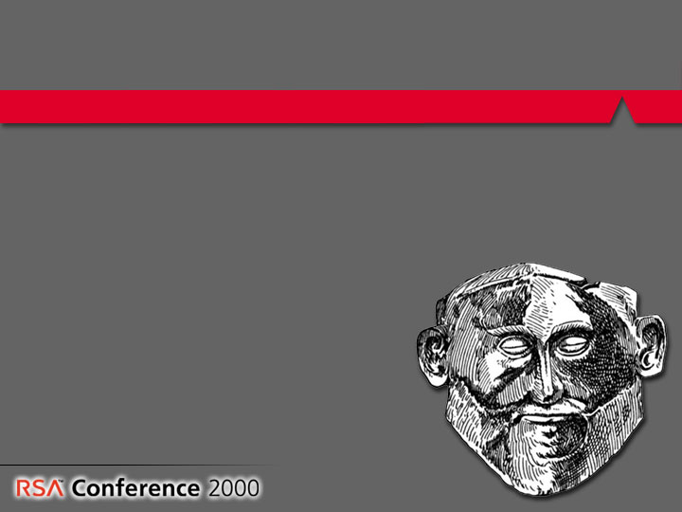
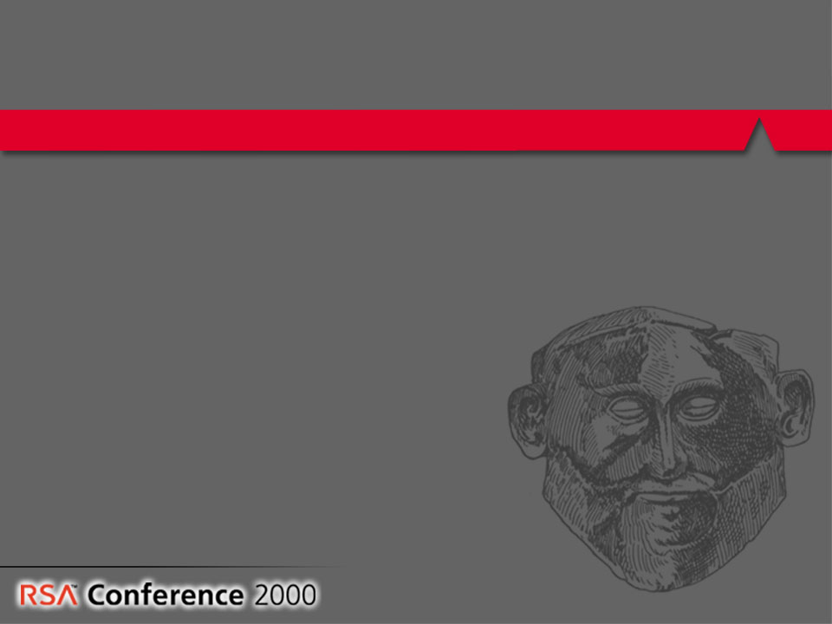
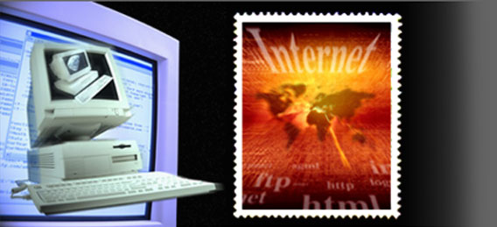
The Year in Review
New developments in cryptography
  Hardware crypto
    Intel RNG, IBM encryption chip
  Digital postage
Notes:
Crypto-on-a-Chip
Intel announced that it is putting a hardware random-number generator in its processor chips, Pentium III and later. Random numbers are required for almost all crypto protocols and bad random number generators are one of the easiest ways to break the security of a system.
IBM in September launched an all-in-one encryption chip designed to protect documents stored on desktop PCs and servers. The chip, as yet unnamed, will be initially installed in IBM's 300PL PC, but will soon be built into the company's full line of desktop systems. Actually, the 300PL may not feature the new chip since it's based on Intel's i820 chipset and the i820's release has been delayed indefinitely. IBM said users will pay no more for a hardware encryption-enabled PC than they will for a machine without the chip. In addition to handling key encryption -- the technology most usually associated with document protection -- the chip will also generate and verify digital signatures.
Digital Stamps
Now you can print stamps from the Internet onto envelopes and mailing labels from your own printer. Advances in security allow digital postage to proliferate without fear of counterfitting.

Slide 5
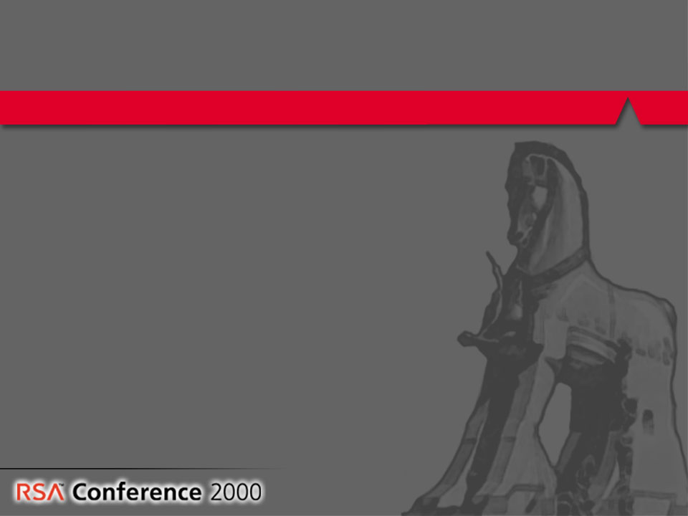
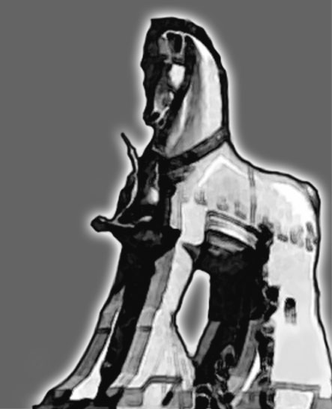
The Year in Review
New hacks and attacks
  Advances in attack methods
  Hacking and infowar
  Death sentence for hackers
  High-profile viruses
Notes:
Advances in attack methods
A group of cryptographers led by Herman J.J. te Riele of CWI in Amsterdam, factored a 465-bit (140-digit number). Same group also factored a 512-bit number using about 300 SGI workstations and Intel Pentium PCs. This demonstrates that factoring 512-bits is possible and practical, and it is reasonable to expect 768 bits to be factored within a number of years. We should be moving to 1028 and even 2048-but keys
Adi Shamir described a special-purpose electro-optical computer called TWINKLE that could increase factoring speeds by a factor of 1,000. The entire effort was about 50 times easier that breaking DES.
Hacking
Hacking as weapon in information warfare. Chinese and Taiwanese hackers attacked each others’ government sites, as did Serbian and Kosavar hackers.
Two hackers in China were sentenced to death for electronically siphoning the equivalent of $87,000 from a bank and transferring to their accounts.
Malicious Viruses caused considerable damage:
Melissa
PaPa macro virus
Chernonbyl Virus
BackDoorG
Explore.Zip worm
The creator of the Melissa virus, David L. Smith, was identified and convicted for the estimated $80 million worth of damage caused by the virus. It’s hoped that this successful prosecution will make other virus authors consider the consequences of unleashing their creations.

Slide 6
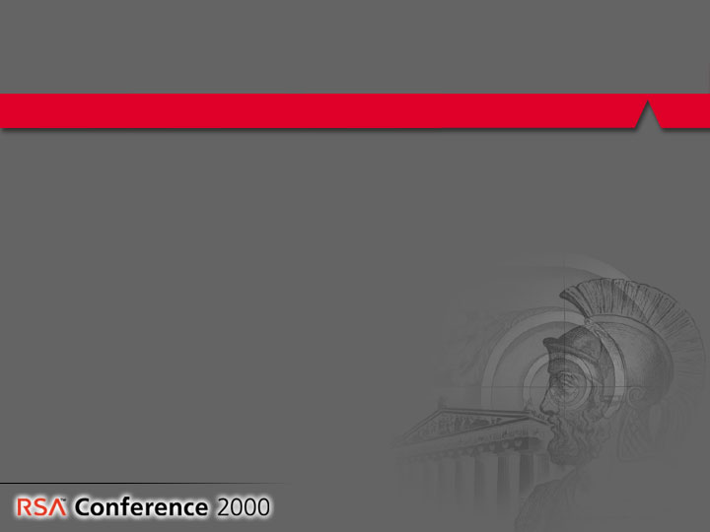
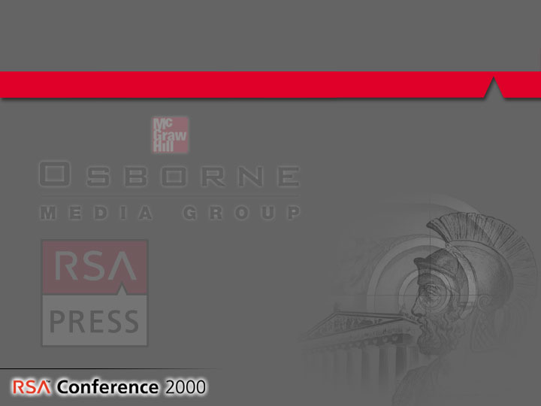

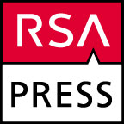
Announcing RSA Press
Publishing partnership with McGraw-Hill
Authoritative source for e-security analysis and information
Covering a broad range of e-security topics for a broad audience of readers
RSA Press books will be available in major retail book outlets like Barnes & Noble and Amazon.com, plus important independent stores
Notes:
Announcing RSA Press!
Our vision is to make RSA Press the leading source for all e-security information. This includes cryptographic politics and policy, public key infrastructure, practical implementation of trusted security, cryptographic theory and new advances, reference guides on e-security issues and terminology.
RSA Press will offer books for all e-security audiences: IT/IS professionals, executives, end users.
The publishing partnership with Computing McGraw-Hill provides RSA Press with unmatched editorial quality, publishing innovation and global leadership. Working together, we will provide top authors and high-quality productions. Add in expert knowledge from the most trusted name in e-security for the strongest security-related publishing combination around.

Slide 7
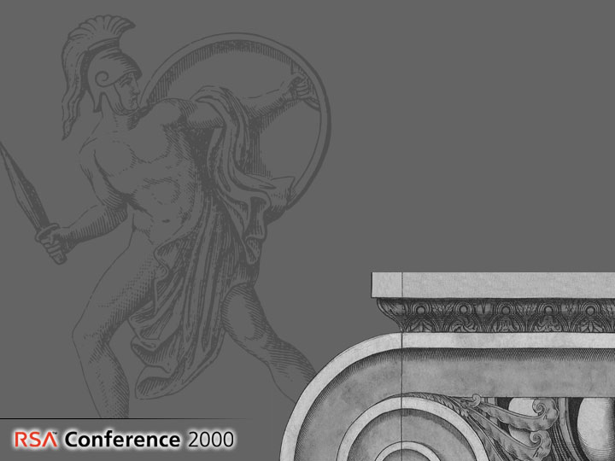
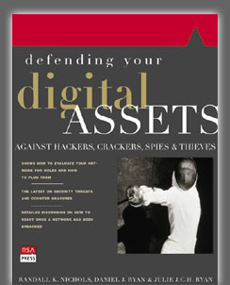
Introducing…
Defending Your Digital Assets
  by Randall Nichols, Daniel Ryan and Julie Ryan
Notes:
Visit the RSA Conference 2000 bookstore on the main concourse from Monday-Wednesday to purchase Defending Your Digital Assets, the first book fromRSA Press.
Look for RSA Press books to answer all your e-security questions. We expect to publish several additional titles during 2000. RSA Press books will be available in major retail book outlets, like Barnes & Noble and Amazon.com, plus important independent stores.
Titles will be internationally available via McGraw-Hill’s strong worldwide distribution network.

Slide 8
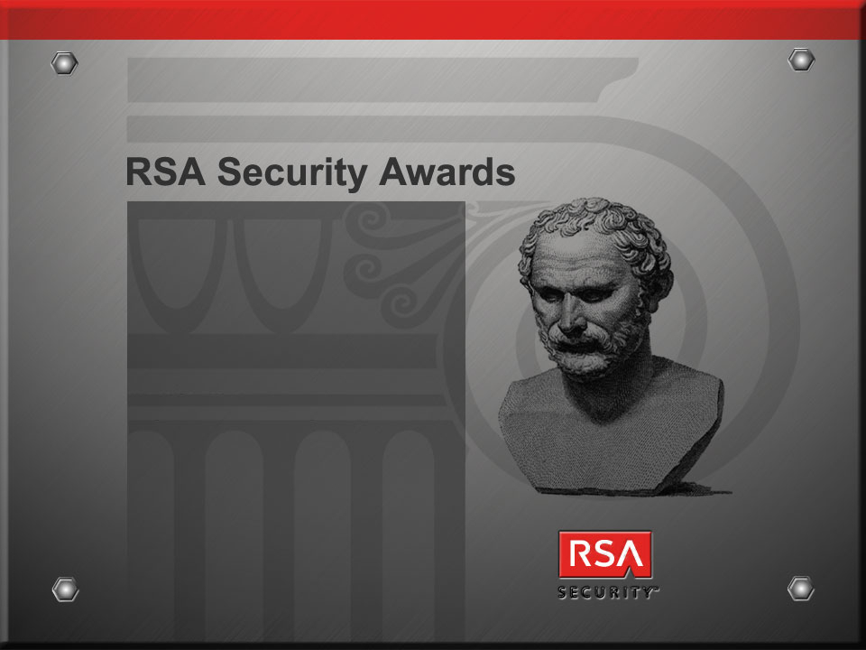
The 3rd annual RSA Security Awards, honoring achievement in three categories:
  Mathematics
  Industry
  Public Policy
Notes:
Presenting the third annual RSA Security Awards!
This is a community effort and we base RSA Security award nominations on input from the cryptographic community in nominations. Winners were chosen jointly by RSA Security staff and a panel of award winners from previous years. The goal is to honor those who have advanced the state of crytography in theory and practice, and whose acheivements might otherwise go unnoticed.
RSA Security awards honor achievement in three categories:
Mathematics
Industry
Public Policy

Slide 9
RSA Security Award for Mathematics, recognizing innovation and ongoing contributions to the field of cryptography
And the winner is…
Ralph Merkle
Notes:
Mathematics
Ralph Merkle
Xerox PARC
Ralph Merkle is the co-inventor of public key cryptography. His failed algorithms have advanced the state of the art more than any successful one (knapsack, Snefru, etc).

Slide 10
RSA Security Award for Industry, recognizing outstanding contributions in commercial applications of cryptography
And the winner is…
Check Point
Software Technologies
Notes:
Accepting the award on behalf of Check Point, is Mr. Jerry Ungerman, Executive Vice President.
Check Point is the company that has really taken security out of the backrooms and into the mainstream.
Check Point has grown dramatically, in part due to its aggressive partnering efforts with other companies, and has shown that best-of-breed wins. (CP's top-line growth is at 50%+ and VPN growth is at 100%. Source: Goldman Sachs, 11/4/99)
Check Point has made VPN technology approachable, and to date has installed over 27,000 VPNs, an increase from approximately 10,000 at the beginning of the year. (Source: Morgan Stanley, 11/2/99)

Slide 11
RSA Security Award for Public Policy, recognizing significant contributions and leadership in the national cryptography policy discussion during 1999
And the winners are…
Ed Gillespie & Jack Quinn
Americans for Computer Privacy
Notes:
Policy
Ed Gillespie/Jack Quinn
Americans for Computer Privacy
As Executive Director and Counsel of Americans for Computer Privacy, a coalition of over 40 Associations, 100 companies and over 6,000 individual members, Ed Gillespie and Jack Quinn have provided the strategic backbone on Capitol Hill and in the Administration which lead to the most sweeping policy announcement to date providing relief for the export of encryption products.
As Executive Director and Counsel the two coalition leaders were responsible for changing the public policy debate on encryption educating members of Congress, the Administration, and the American public about the importance of strong encryption for all Americans and around the globe. Their leadership directly affected public policy decisions that will provide for greater security as we make the transition from the industrial to the information age.

Slide 12
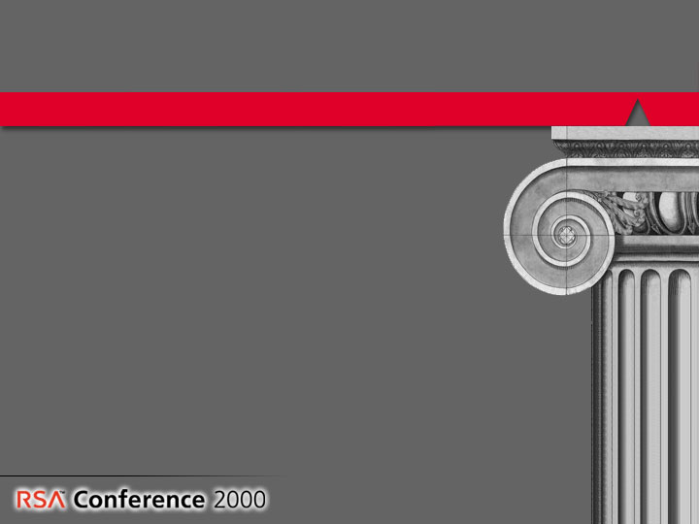
RSA Conference 2000
RSA Conference 2000
The Conference continues to grow
The information you need is here:
  Eight class tracks, including a NIST Tracklet
  Over 120 talks
  NSA cryptography exhibits
  Including Dennis Miller
Notes:
As always, this year’s conference is bigger and better than the previous year. Whatever your interests in security, the information you need is here:
Eight class tracks, over 120 talks, NIST Tracklet, NSA exhibits on cryptography
We expect 8-10,000 people to attend this year’s conference -- all of them interested in learning more about security, whether they are relative newcomers or seasoned crypto veterans.
The RSA Conference is also expanding to Europe this year -- visit us on April 10-13 in Munich, Germany.
And, again as always, we have plenty of entertainment for you
Tonight’s Expo reception, 6-9pm
IBM Cryptographers’ Gala, Wednesday evening 7-11pm
Special Friday closing session with Dennis Miller, not to be missed

Slide 13
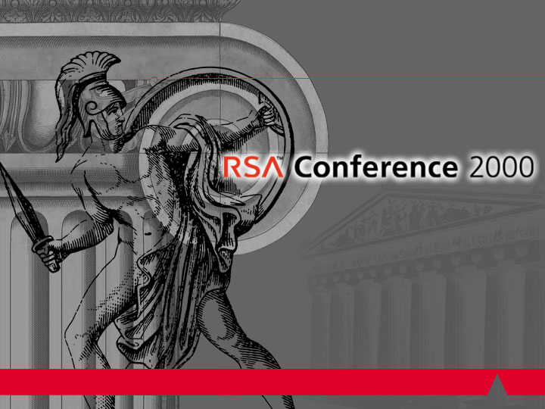

Slide 14
Welcome to
RSA Conference 2000
Michael Dertouzos
Director, MIT Laboratory for Computer Science
Notes:
Welcome to RSA Conference 2000!
This year’s conference honors the contributions of the ancient Greeks to the history of cryptography. We all know the Greeks made major contributions to the development of philosophy and mathematics, and it’s only natural that they had an important role in the history of cryptography.
In fact, the Greeks are responsible for the terminology that we still use today:
Cryptography = kriptos (hidden) + grafia (writing)
Steganography = steganos (covered) + grafia (writing)
In addition to the story by Herodotus that you’ve all read in the conference materials that were mailed to you prior to the conference, the Greeks’ involvement with cryptography is extensive. In the famous Greek drama the 'Iliad', cryptography was used when Bellerophon was sent to the king with a secret tablet which told the king to have him put to death. The king tried to kill him by having him fight several mythical creatures, but he won every battle.
The Spartans used a system called the 'skytale' cipher, which was used in the 5th century B.C. to send secret messages between Greek warriors. This system relied on a thin sheet of papyrus wrapped around a staff of a precise diameter. Messages were written down the length of the staff, and the papyrus was unwrapped. In order to read the message, the papyrus had to be wrapped around another staff of exactly equal diameter.. Without the right-diameter staff, it would be difficult to decode the message using the techniques available at that time.
The Greek Polybius developed an encryption system now called the "Polybius Square". The letters of the alphabet would be laid out in a five by five square with rows and columns numbered 1 to 5 so that each letter has a corresponding (row,column) pair. These pairs could easily be signaled by torches or hand signals. Decryption was performed by mapping the digit pairs back into their corresponding characters.

Slide 15
