Slide 1
21st Century Internet Trends
Vint Cerf
MCI WorldCom
January 2000

Slide 2
Life Lesson #113
Friends may come and go,
but enemies accumulate.

Slide 3
Famous Last Words
"The wireless music box has no imaginable commercial value. Who would pay for a message sent to nobody in particular?"
--David Sarnoff's associates in
response to his urgings for investment
in the radio in the 1920s.

Slide 4
Famous Last Words
"640K ought to be enough for anybody."
-- Bill Gates, 1981

Slide 5
Famous Last Words
“32 bits should be enough address space for Internet”
-- Vint Cerf, 1977

Slide 6
What is the Internet?
The largest network
of networks in the world.
Uses TCP/IP protocols and packet switching .
Runs on any communi-
cations substrate.

Slide 7
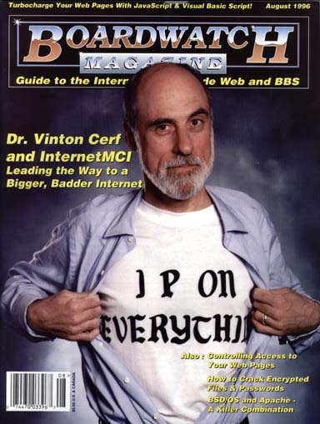

Slide 8
Some philosophical analogies
Electrical Power and fractional horsepower motors - doing work for us 24 hours/day.
Internet and computers (processing power) doing work for us - distributing and processing information, performing logical tasks 24 hours/day

Slide 9

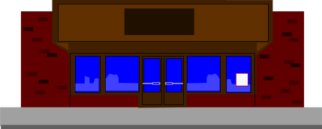







INTERNET “GOLDRUSH”
[California: 1848. It was gold.
150 years later…it’s Internet and the stock market]
SUPPLY STORE
WESTERN INN
Notes:
2
2

Slide 10
Internet - Recent Statistics
6 M Level 2 Domains (NSI Nov 1999)
75 Million Hosts (VC est. Jan 2000)
212/246 IP countries (NW June 1999)
201 Million Users (NUA Nov 1999)
(950 Million Telephone Terminations)
Notes:
4

Slide 11
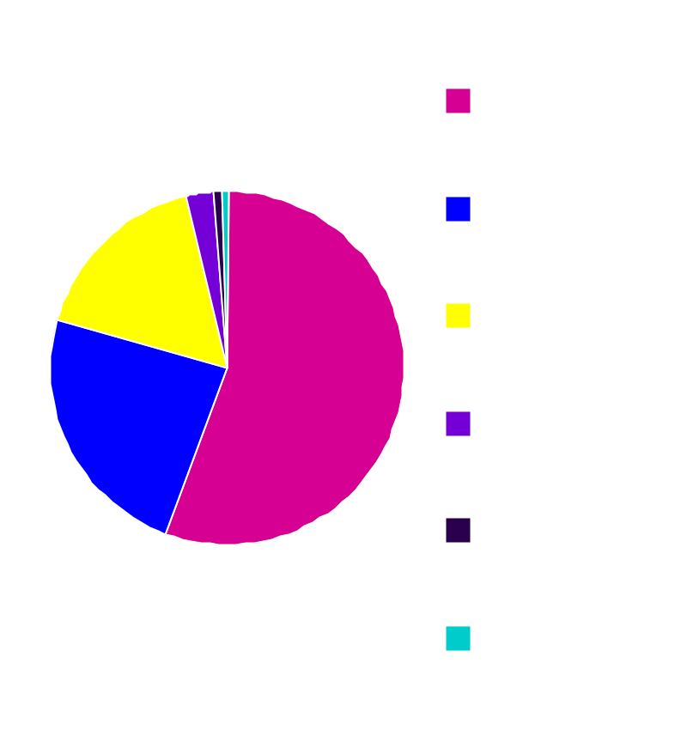
Users on the Internet - Nov 1999
CAN/US - 112.4M
Europe - 47.15M
Asia/Pac - 33.61M
Latin Am - 5.29M
Africa - 1.72M
Mid-east - 0.88 M
---------------------------
Total - 201.05M

Slide 12
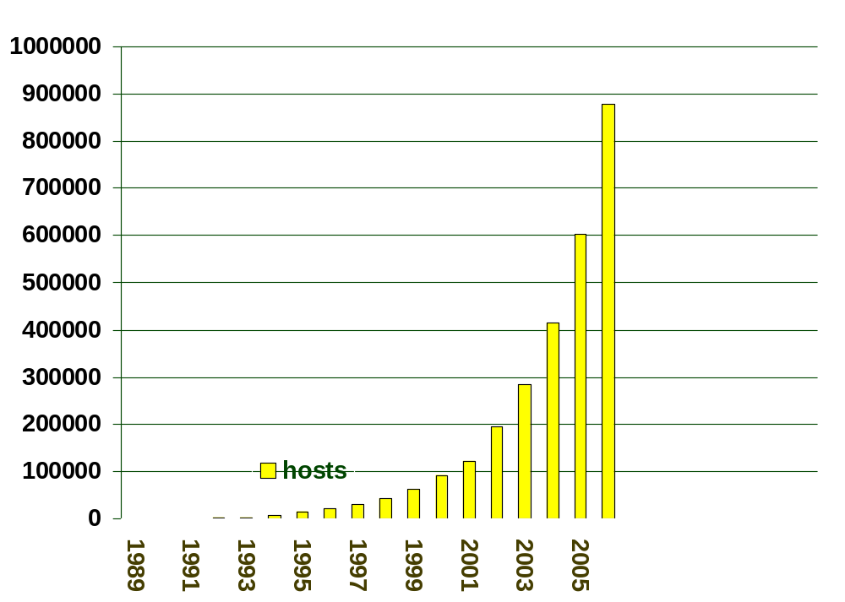
Internet Hosts (000s) 1989-2006
300 Million users
Notes:
5

Slide 13
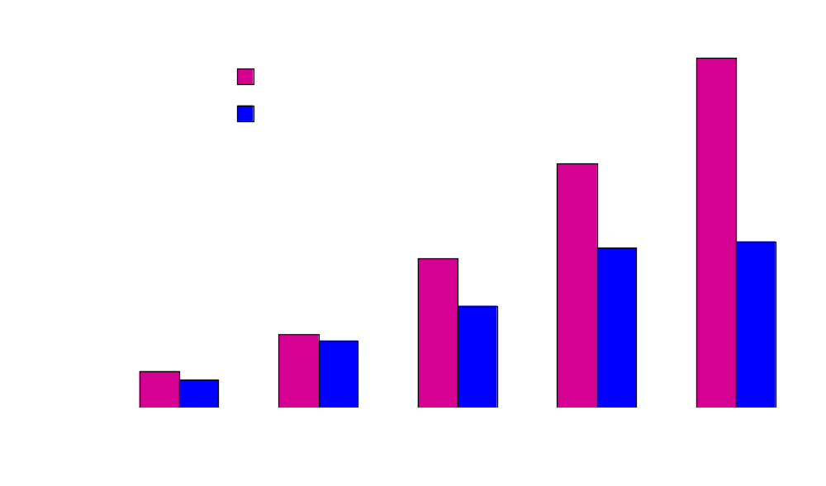
Intranet/Internet Market
Source:Zona Research

Slide 14
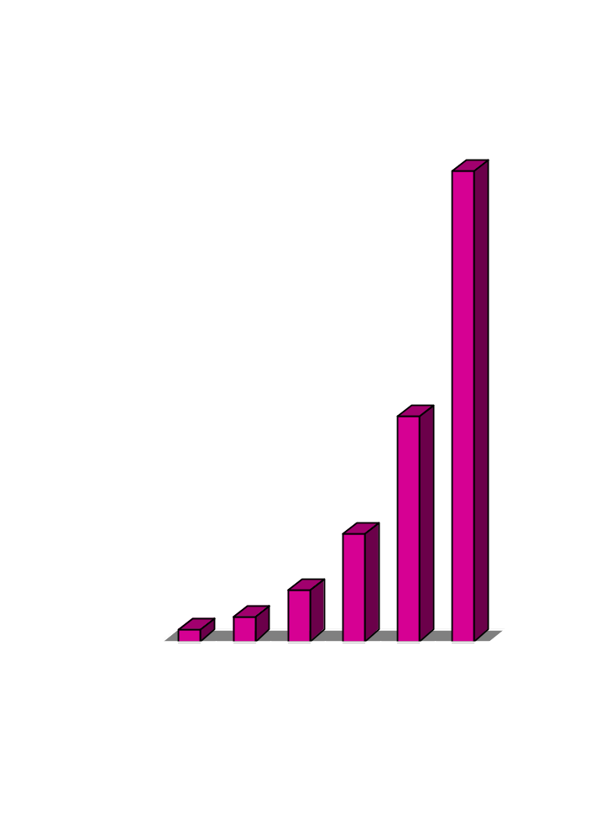
Internet Transactions ($Billions)
Goods and services traded between companies from $8 billion this year to $327 billion in 2002
Source: Forrester Research

Slide 15
iCommerce in 2003
Commerce sales will be between $1.8 trillion and $3.2 trillion in 2003.
Estimates include business-to-business and business-to-consumer sales and EDI orders placed on the Internet, but exclude the value of financial transactions.

Slide 16
Internet and MultiMedia
Internet multicast “video”, telephony and “radio”
Transport of Internet traffic on cable, direct broadcast satellite, radio and broadcast TV
Real-time quality of service support, VOIP e.g. MCI WorldCom’s “Click ‘n Connect”
Notes:
20

Slide 17
High Performance Networking
DWDM Backbone - Electro-optical or all-optical switching (lamdas now, packets maybe)
Core BFRs (Juniper M160, Cisco 12000, Avici, Lucent, …) w/MPLS traffic engineering
Edge-derived QOS

Slide 18
Internet Backbone Architectures
Router (IP layer)
ATM/Frame Relay (traffic engineering)
SONET
WDM (DWDM, Solitons), Radio, Satellite
ATM/FR and SONET may be eliminated

Slide 19
Newer Service Features
Multicast
Encryption
Authentication
IPv6
Classes of Service
Roaming, Dynamic DNS?

Slide 20
Higher Performance Last Hop
Digital Subscriber Loops: 0.5 -25 Mb/s
Cable Modems: 0.5 -10 Mb/s
Fixed Radio links (blimps?, ground link)
IR or Radio LANs: 0.2 - 10 Mb/s

Slide 21
Wireless Internet
e.g.Internet cell phones, cameras
“always on” networking
  increasing demand for IP address space
“Bluetooth”, Wireless LANs, LMDS and MMDS, Digital Broadcast Satellite
Mobile Radio -
  Ricochet (128 kb/s), 3G cellular (2 Mb/s)

Slide 22
Internet-enabled Devices
Information appliances
  1997 - 3 M, 1998 - 6 M, 2002 - 56 M (IDC)
WebTV, Palm-Pilot, Nokia 9000,Sony, Nintendo, Sega games (video conf)
Refrigerator (and the bathroom scales)
Automobiles, household appliances (turning a box of soap into a service)
“Reading” glasses
Web-server on a chip (see next slide)

Slide 23
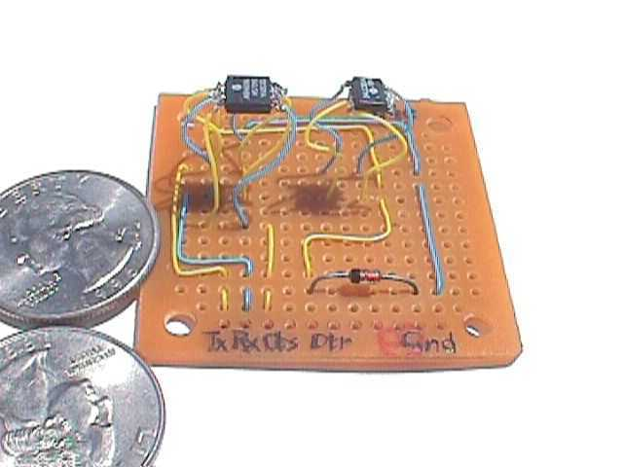
UMASS Web server on a chip born 10 AM, 14 July 1999
TCP/IP code itself fits in about 256 bytes (12-bit)
PIC 12C509A, running at 4MHz
24LC256 i2c EEPROM
HTTP 1.0 and RFC 1122 compliant
eternity.cs.umass.edu:
9080/index0.html

Slide 24
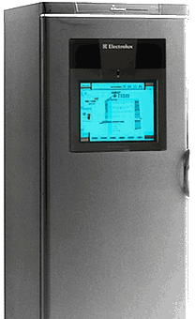
Internet-enabled
Refrigerator
News, Radio
Email
Video Messages
Recipes
Shopping Lists

Slide 25
Security
Public Network infrastructure
Corporate networks
Laptop to remote VPN communication
Servers (public, corporate)
Downloadable software

Slide 26
Protective Measures
Active Monitoring (patterns of attack, rule-based traffic analysis)
Strong authentication for command and control infrastructure, network management, information integrity
Paranoid applet hotels (“just because I am paranoid doesn’t mean they aren’t out to get me…”)

Slide 27
Protective Measures (2)
Network infrastructure
  Digital Signatures on control traffic
End Application Systems
  Firewalls are not sufficient
  The enemy within: inside attacks likely
  MAC registration w/DHCP
End user to server: encrypted tunnels allow users on foreign LANS to gain safe access (Guest Ports)

Slide 28
Protective Measures (3)
DARPA-sponsored R&D at Lincoln Labs (Communications Department) -
  false alarm filters
  critical Operating System state transition analysis - not just pattern recognition
Constant probing of internal systems for known weaknesses
Firewall configuration consistency checking

Slide 29
Scenes in 5+ years
IPv6 well established w/IPSEC
NAT boxes still around
More flexible firewalls (they are not enough)
end/end security measures
  SSL/IPSEC
  Application level
network level security

Slide 30
Some Security and Authentication Scenarios
The Smart Card Scenario starting with ATM smart cards
The appliance scenario
The wireless scenario (home, mobile, international roaming…satellite?)

Slide 31
Policy Issues
Cryptography and export
Digital Signatures/Certificate issuance
Taxation
Trademarks and Copyright
Liability and Dispute Resolution
Convergence (TV, Radio, Telephony)
Regulatory Framework
Censorship/Voluntary Filtering

Slide 32
.
.
Future look

Slide 33
Space: the final frontier
Our 25 year mission: to go where
no network has gone before!

Slide 34
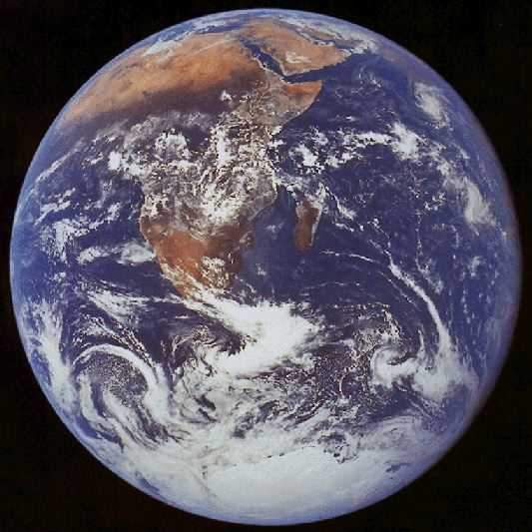

Slide 35
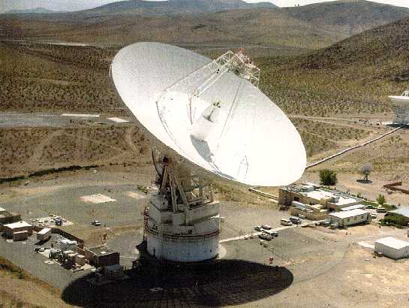

Slide 36
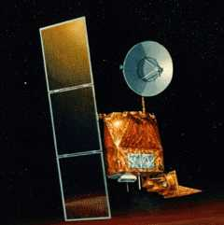

Slide 37
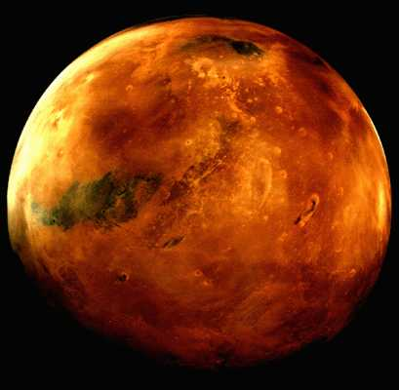

Slide 38
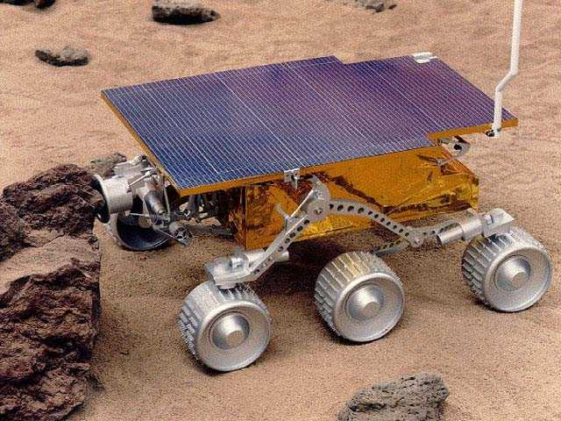

Slide 39
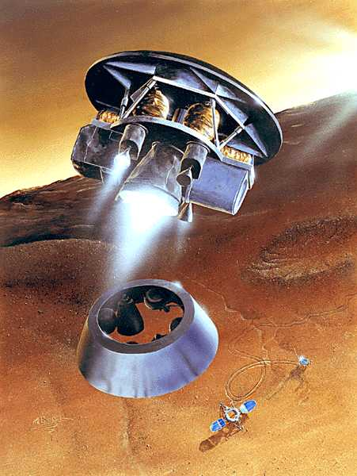

Slide 40
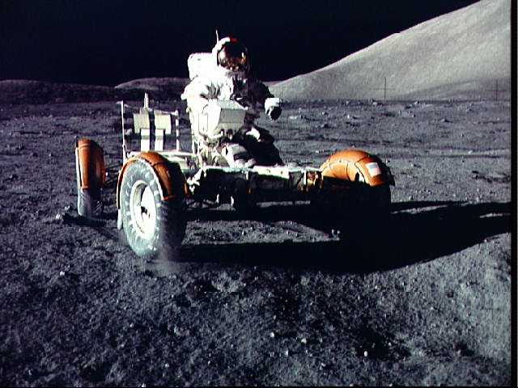

Slide 41
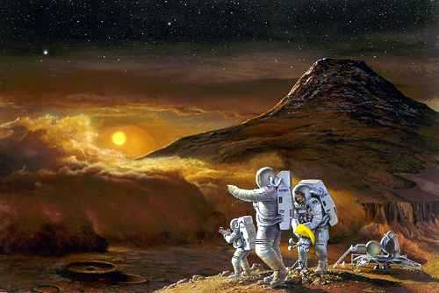

Slide 42
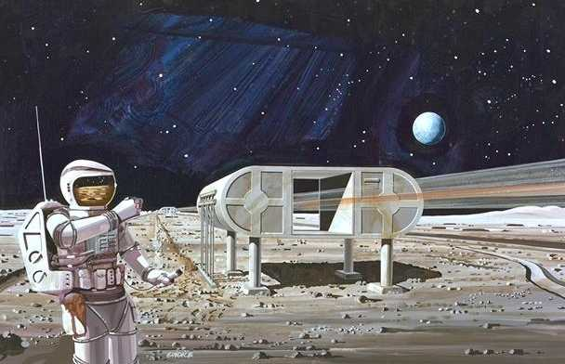

Slide 43
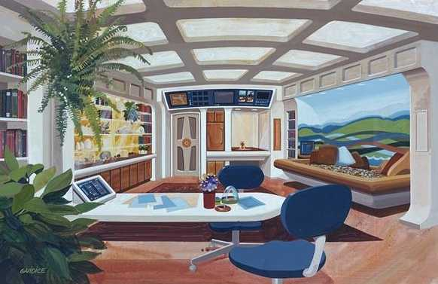

Slide 44
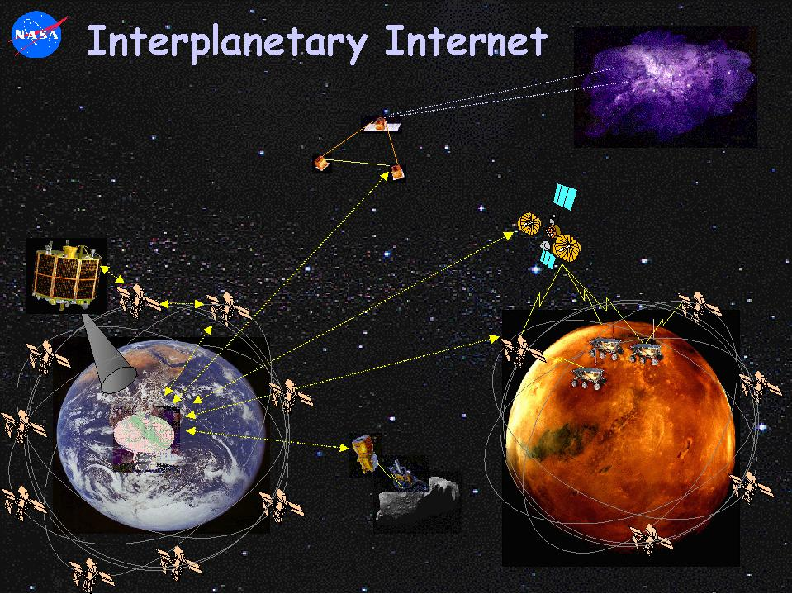
End-to-end information flow across the solar system
Layered architecture for evolvability and interoperability
IP-like protocol suite tailored to operate over long round trip light times
Integrated communications and navigation services

Slide 45
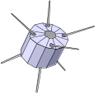
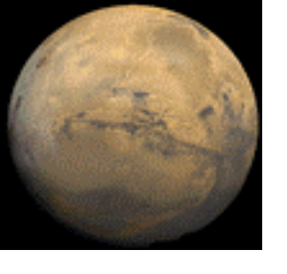






Components of the Interplanetary Internet
Proximity communications via in-situ relay and positioning networks
Earth’s Internet
Long-haul Interplanetary
communications
Remote
Internet
Interplanetary
Internet Gateways

Slide 46
Interplanetary Internet Status
Part of the Mars Mission Plan
Low Mars Orbit and Areosynchronous satellites by 2008
Access control & confidentiality!
Mars Outposts by 2010
Possible Manned Mars station 2030??
Stable Interplanetary backbone 2040?

Slide 47
Cerf’s Slides and other information are found at:
www.wcom.com/cerfsup
www.isoc.org/internet
Also see:
www.gip.org
www.nua.org
www.idc.com/telb/projectatlas.html

