Slide 1
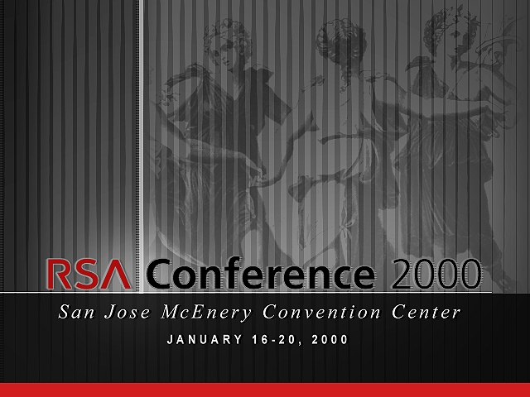

Slide 2






Slide 3



Slide 4
New World Catalysts & Security Challenges

Slide 5
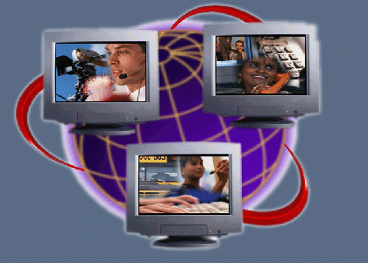
The Internet Is
Changing Everything…
Work
Learn
From
Wires &
Protocols
To Users & Information Services through Ubiquitous
Connectivity
Live and Play

Slide 6
New World Catalysts
Convergence
The Internet Business
Mobility
Entering the Home
Notes:
Leave the current outline as it was:
convergence
mobility
entering the home
increasing integration of newtork with business process
4 things that are driving the business:
increasing integration of network with business process
covnergence
mobility
entering the home
unnderlying all of these is the network intelligence
take intelligence out of the catalyst and put it in technology enablers
the catalyst is increasing integration of network with business processes
non technology challenges should be at the very end.

Slide 7
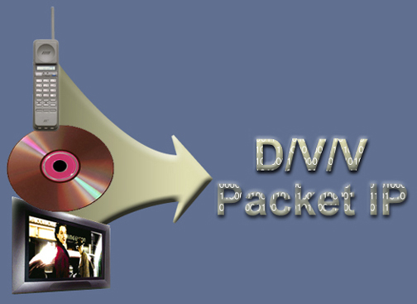
Data/Voice/Video Convergence
Telecom and Datacom
(Enterprise WAN, Networked PBX
Service Providers
of All Types)
Voice
Circuit Phone
Data
Packet
Video
Circuit TV
Entertainment and
Information
Notes:
Cisco has been focused on the first two convergence technologies. But video delivery through internet will be critical in the next 2-5 years.
Video delivery will have a huge impact on bandwidth requirements to the home and for access.
Moving video to the home will require significantly more bandwidth than available today. HDTV requires 20MB of bandwidth.
In addition, the network will require an awareness of applications as more and more applications and services are offered over the Internet

Slide 8
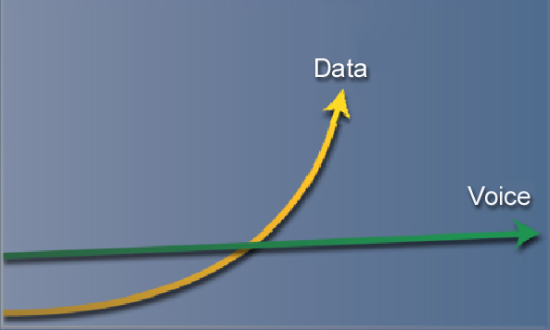
Explosion In Data Traffic
Traffic
Volume
Notes:
Data traffic has exploded over the Internet and will continue to grow tremendous rate.
This is due to the addition of more and more services and applications on the internet. Hosted applications, video, customized content, interactive gaming etc will increase the bandwidth needs on the internet as well as increase the traffic.
In contrast, voice as an application will have little impact on the bandwidth changes in the net. Voice requires only 64K of bandwidth in 8K packets. In addition there is compression and silence that occurs in voice traffic. This compared to MB size applications for data, will allow voice to cost very little in terms of overall bandwidth on the Internet.
This means that data networks will continue to grow in mission criticality as well as complexity.

Slide 9
New World Architecture
Distributed vs Centralized
Open vs Proprietary
Scalability
High Availability/Reliability

Slide 10

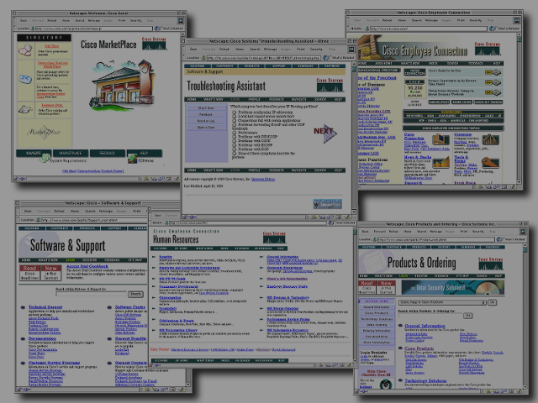
Internet Advantage
Changing the Way Companies Do Business
$825 Million
in financial impact
$10 Billion
Run rate
20% Increase
in productivity
© 1999, Cisco Systems, Inc.

Slide 11
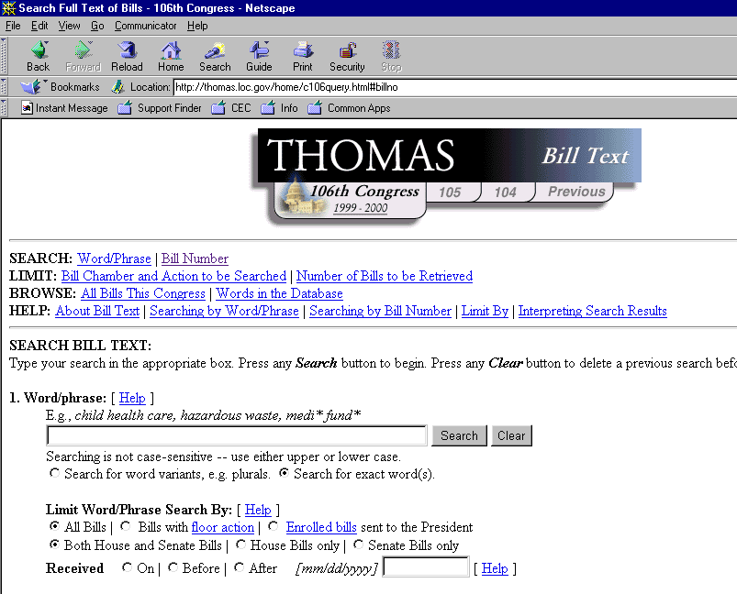
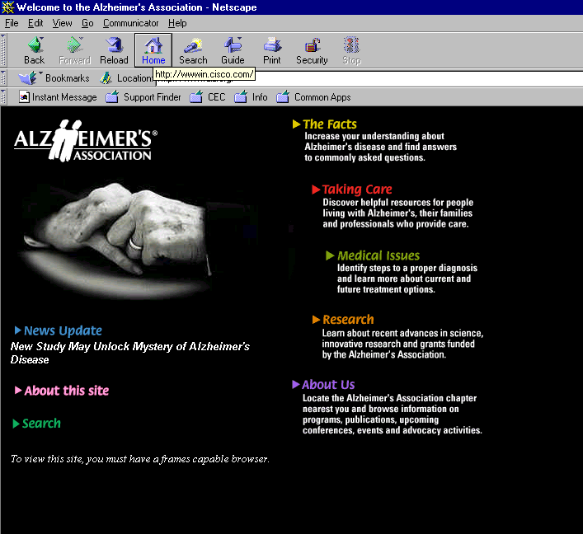
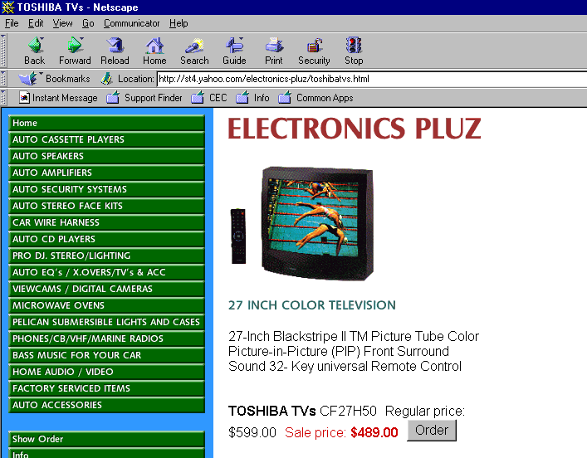
Internet Tomorrow
Reaching Out to the Consumer
Commerce
Content
Community
Control

Slide 12
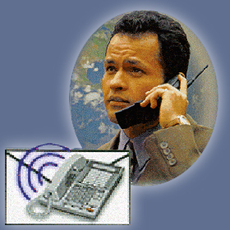
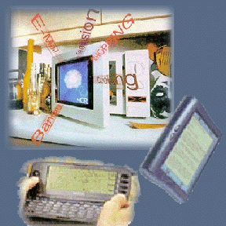


The Mobile User
Removing Location Dependency
Anytime/
Anywhere
Internet
Access
Internet-Enabled
Devices
Networking
within the Home
On Campus Mobility

Slide 13
Wireless Market View
Residential/
Campus
Fixed
Mobile
Satellite
Broadband
Data/Voice/Video
Services
2G
Cellular
3G
Cellular
Multiservice
Applications
IP Based
Services
Data
Services
Packet
Data/Voice
LMDS
MMDS
UNII
Aironet/
Cisco
GPRS
Mobile IP
IMT- 2000
Spectrapoint/Cisco
Cisco Wireless
Motorola/Cisco

Slide 14
Mobility Is More Than
Just Wireless
Mobile IP = persistent IP address
Persistent IP vs. persistent services
Special user interface requirements
  Network appliances
  Lower bandwidth

Slide 15
Entering The Home
Pervasive Computing
Smart Devices
Multi Client Architecture
Ubiquitous
Communications
Globally Accessible Internet
Availability vs. Security
Portals
Services, Content
Personalization

Slide 16

Network Appliances
Dedicated computer appliances bring the necessary ease of use
  Set top boxes
  Downloadable Audio (MP3)
  Electronic Books
  Intelligent phones
  Browser appliance
  “5 IP devices per body”
Connected to the Internet and to each other!

Slide 17
Consumer Networking Challenges
Ease of use
Scalable deployment
Entertainment quality video
Privacy issues
“Micronets”

Slide 18
Enabling the New World
Intelligent Network Services
End to End VPN
Policy Based Security

Slide 19



New Applications Require Higher Level of Services
Diverse Range
of Clients
Hosted Applications
Intelligent Network Services

Slide 20

What Is Required Of Intelligent Network Services?
User Awareness
Application & Content Awareness
And Operational Automation
(Provisioning and Management)

Slide 21
Intelligent Network Services Architecture
Availability
Cisco IP Fabric
Scalability
Internet Application Technologies
Network
Services
QoS
Security
Voice
Video
Multicast
VPN
SNA Evolution
Load Balancing
Caching
. . .
. . .
Management
Directory
Address Mgmt.
Policy
Reliability
Platforms
Price/Performance
Investment Protection
Connectivity

Slide 22
Security Services
Security is a fundamental element of networking
Security enables customers to gain competitive advantage through the Internet Economy
Security services are integral to new application implementations and new infrastructures
Notes:
Why is security important to Cisco? For two reasons:
1. The first reason is altruistic: security is a fundamental element of networking. A secure network empowers our customers to take advantage of new applications and technologies and allows them to gain competitive advantage in their markets.
2. The second reason security solutions are important to Cisco is a selfish one. The number one reason cited by customers for reluctance to embrace Internet technologies, is privacy and security. By developing new and important security tools, Cisco can make its customers more comfortable with Internet technology and cause them to grow their Internet infrastructures. When our customers increase their Internet infrastructures, Cisco’s share of the Internet marketplace grows as does Internet technology in general.

Slide 23





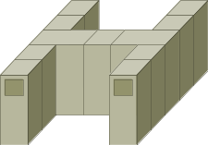





The Value of Security in the Network
Touches all components
Already the focus of management efforts
Effective place
to enforce
security policy
Greatest scalability
Leverage investment in infrastructure
Notes:
This slide addresses Cisco’s fundamental philosophy about the value of security in the network.
Network security does NOT replace other forms of security. All well-run organizations need to look at security not only from a network perspective, but also need to consider the physical security of their facilities, the operating systems in use, the hosts and applications, etc. They need to look at security from a user perspective.
And because the network touches so many components of an organization, it is an important place to focus security efforts. The network infrastructure is also the focus of a tremendous amount of time, effort and energy and thus a natural place to focus security efforts from a management perspective.
If we can enable the network infrastructure with incremental security tools and technologies, that network becomes an effective place to enforce security policy. Security solutions scale effectively and are generally more cost effective than individual, point security application products.

Slide 24
The Future of Network Security
Integrated
Identity
Security Monitoring
Policy Management
Privacy / VPN
Perimeter Security
Ubiquitous
Transparent
Notes:
Cisco Secure solutions incorporate five elements that Cisco believes is critical to effective network security:
Identity-
Identity is the accurate and positive identification of network users, hosts, applications, services, and resources. Standard technologies that enable
identification include authentication protocols such as RADIUS and TACACS+, Kerberos, and one-time password tools. New technologies such as digital
certificates, smart cards, and directory services are beginning to play increasingly important roles in identity solutions.
Perimeter Security -
This element provides the means to control access to critical network applications, data, and services so that only legitimate users and information can pass
through the network. Routers and switches with access control lists and stateful firewalling, as well as dedicated firewall appliances, provide this control.
Complementary tools, including virus scanners and content filters, also help control network perimeters.
Data Privacy -
When information must be protected from eavesdropping or tampering, the ability to provide authenticated, confidential communication on demand is
crucial. Sometimes, data separation using tunneling technologies, such as generic routing encapsulation (GRE) or Layer 2 Tunneling Protocol (L2TP),
provides effective data privacy. Often, however, additional privacy requirements call for the use of digital encryption technology and protocols such as
IPSec. This added protection is especially important when implementing VPNs.
Security Monitoring-
To ensure that a network remains secure, it's important to regularly test and monitor the state of security preparation. Network vulnerability scanners can
proactively identify areas of weakness, and intrusion detection systems can monitor and reactively respond to security events as they occur. Using security
monitoring solutions, organizations can obtain unprecedented visibility into both the network data stream and the security posture of the network.
Policy Management
As networks grow in size and complexity, the requirement for centralized policy management tools that leverage directory services grows as well.
Sophisticated tools, ones that can define, distribute, enforce, and audit the state of security policy through browser-based user interfaces, enhance the
usability and effectiveness of network security solutions.

Slide 25




Applied Security Services:
The “P” in VPN
Separate Data
Increase Protection
Prevent Tampering
Tunneling
Encryption
Integrity
GRE
IPSec
L2TP
DES, 3 DES
TCP Checksum
AH in IPSec
MPLS
MPPE
Identify Source
Authentication
RSA
RSA
PKI
Notes:
Date privacy services: (slide build) The ability to separate data as it moves through the network is one function of a VPN. Layer 2 and 3 technologies that allow this are “generic routing encapsulation” protocol, “Layer 2 Tunneling Protocol,” and VPN solutions based upon “multi-protocol label switching” standards in the IATF. Tunneling protocols provide separate data streams for the protection of data moving through the network. The protection and privacy of information can be increased through the use of encryption technologies such as the IPSec version of digital encryption using DES and 3DES.
If you’re using “Microsoft point-to-point encryption” (slide build), to prevent tampering, integrity services such as the Checksum in the TCP protocol and the authentication header in the IPSec standards implementations can be used to ensure that information has not been modified in transit and actually originates from where/from whom you think.
(slide build) Digital certificates, through a public key infrastructure and a certificate authority, are a strong method of providing a means to identify source and destination.

Slide 26













VPNs Enable the Internet Economy
Customers
Very Remote Sites
Partners
Virtual Office
VPNs
Multiservice / Voice
Networked Applications
Notes:
Most importantly, VPNs are fundamental
With our solutions suite we will enable our customers to reply with a decisive yes when they are asked: Are you Ready?

Slide 27
Major VPN Challenges
Mobility
Streaming services
  Voice, video, audio require IPSec
  SSL doesn’t secure UDP traffic
Scalable deployment
Policy management
Notes:
Mobility -
- Users must carry security credential to allow them to be access the network from a variety of locations and devices
Streaming services must be secured -
- This requires IPSec for TCP + UDP vs. the SSL TCP only model
- Stream cyphers are cryptographic algorithms that have the promise to offer optimal communications privacy for these data types
Scalability -
- Public Key Infrastructure must scale and become easier to deploy and manage.
- The Xtranet e-commerce people need to work with the Intranet (Internal IT org)
to rationalize security requirements - allowing a single digital certificate. Note that today each application and VPN require a separate certificate - users hate this
Policy Management -
Most importantly, it is important to remember that Security must be melded with QoS to be truly
successful. We do not have to take two steps back and one step forward to make security a useful service if the industry is thoughtful was we moce forward.

Slide 28








Security Policy
Management
Intranet Network
policy
translation
DMZ
Security
Policy Server
Define
Policy
Internet
Policy
Security
Policy Manager
Policy
New York
Policy
Policy
Boston
Frame Relay
Chicago

Slide 29
Cisco’s Security Focus
  Deliver leading-edge products in key network security markets
  Achieve interoperability and accelerate implementation of secure IP Networks
  Collaborate through standards bodies and industrial organizations
  Develop reference technology to speed market acceptance
Notes:
We are changing everything securely

Slide 30
The Goal: Intelligent
Self-Defending Networks
Comprehensive Network Security
System Approach to Operation
Dynamic Reconfiguration of Devices
Centralized Policy Management
Leverages Customer Infrastructure Investment
Notes:
Ultimately, Cisco endeavors to deliver the “Intelligent, Self-Defending Network”:
Network operaters require a solution with comprehensive Security -
The system itself will be secure - we will employ an IPSec encryption approach and authentication mechanisms
Systematic Approach -
Perimeter Devices (Maganot Line analogy) and simple secure tunneling
will giveaway to intelligent network delivery systems. Intellegent networks offer a collection of services; data privacy, intrusion detection monotiring
Dynamic Reconfig -
Devices must a recognize threats/faults, self-heal and correspond with other elements to isolate the offender, shore up defense and report the incident to enable the business to better manage risk.
Centralized Policy Management -
Must be sophistcated enough to meld Security and QoS to individuals
identity and role
Infrastucture
Must be an overlay solution , not a forklift upgrade
And we will leverage the significant installed base of Cisco infrastructure through embedded security technology

Slide 31

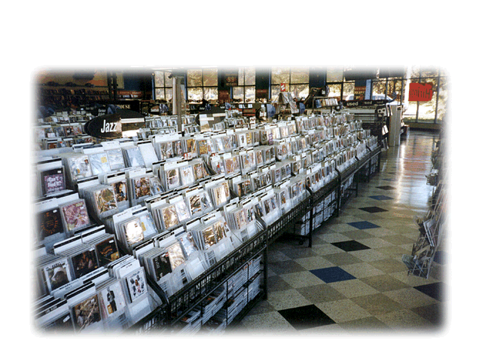


Non-Technology Challenges
Role of
Regulation
Intellectual Property Rights
Conflicting
National
Policies
Local Standards
and Practices
Digital
Divide
Globalization of Language & Culture
Privacy

