Slide 1


Slide 2
RSA Security
Strategy and Announcements
Scott Schnell
Sr. Vice President, RSA Security Inc.

Slide 3


Agenda
RSA Security’s wireless roadmap
Raising the bar in PKI
New industry partnerships
Initiatives toward industry expansion
Notes:
Agenda:
1999 in review
Announcing RSA Press
The third annual RSA Security awards

Slide 4

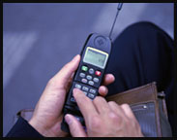


Wireless e-Business
User authentication
Signed e-Business transactions
Secure information access

Slide 5



RSA Security Product Strategy
Optimized for Wireless
Protocols and encryption engines for handheld and cellular devices
Embedded authentication solutions and management systems for handheld and cellular devices
Issuance and management of wireless and wired certificates for the enterprise

Slide 6
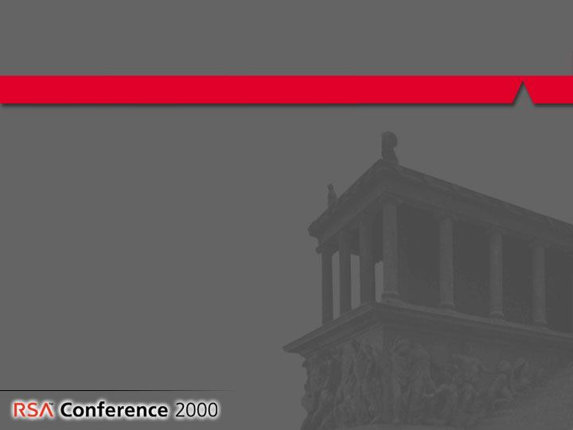
RSA Security
Pioneering Wireless e-Security
Standards
Business partnerships
WAP / WTLS
WTLS certificates
PKCS #15 Crypto information storage
Bluetooth security layer
  Phone.com
  Symbian
  Nokia
  Ericsson

Slide 7
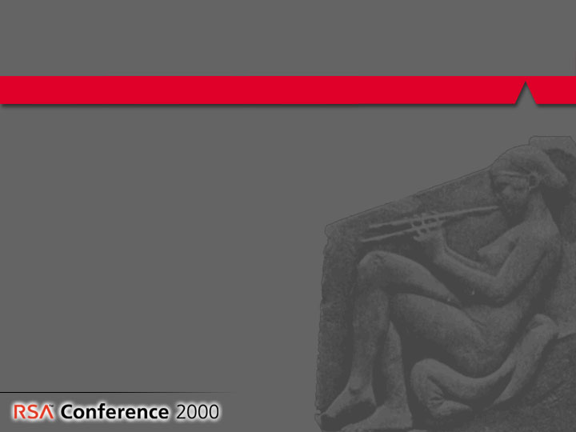
Pioneering Wireless e-Security
RSA Wireless Announcements
New wireless protocol software and tools
  RSA BSAFE SSL-C 1.1
  RSA BSAFE WTLS
RSA Security teams with…
  VeriSign on wireless tools and managed
  certificate services
  Ericsson to secure wireless communications

Slide 8
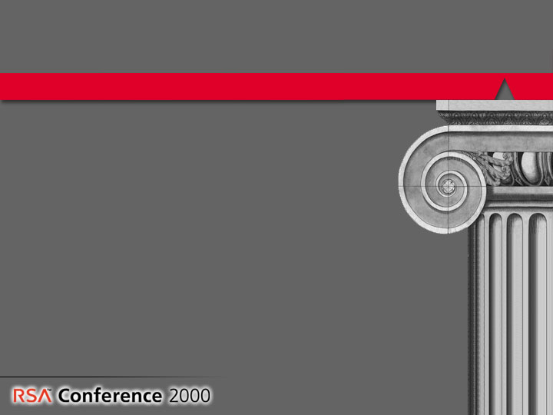
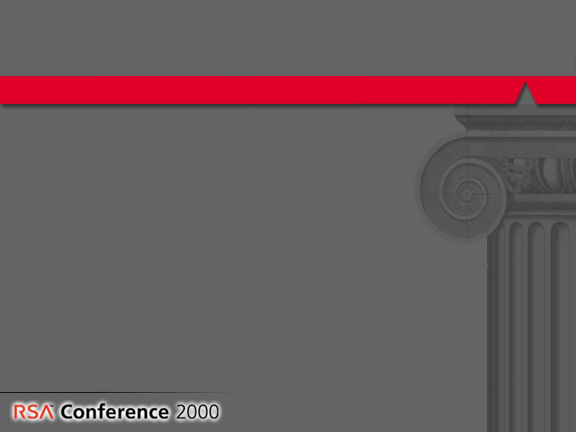
RSA Security
Raising the Bar in PKI
Accelerating PKI deployment for
today’s e-business
Removing the roadblocks to deployment,
real-world use, and management
Delivering PKI with strong security
Driving interoperability between Keon, applications, and other infrastructure products
Providing the tools to build the next
generation of e-business applications

Slide 9
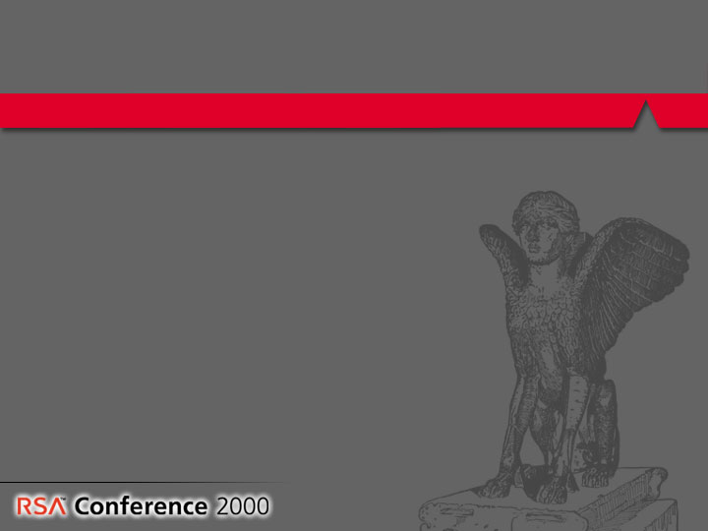
RSA Security
Raising the Bar in PKI
RSA PKI Announcements
RSA Keon Certificate Server 5.5 – secure, automated certificate registration with OneStep
RSA Keon Standalone Desktop turns PCs into secure “Digital Vaults”
RSA BSAFE Cert-C allows developers to build secure PKI applications
RSA and ValiCert team on OCSP initiatives

Slide 10
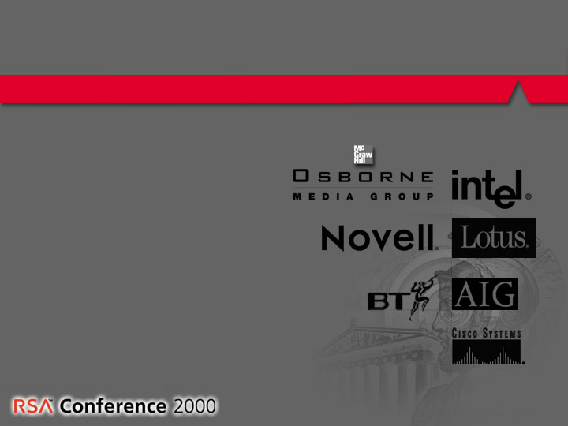
RSA Partnerships that Define the e-Security Landscape
RSA teams with Intel, Microsoft, Cisco, Novell and Lotus to strengthen e-Security
integration
RSA and BT sign global
Keon reseller agreement
RSA and AIG Roll-out
e-Business insurance alliance
RSA Capital accelerates growth
of e-Business
RSA and McGraw-Hill launch
RSA Press

Slide 11
E-Business in the New Millennium
Ira Flatow
Host & Executive Producer
Science Friday - NPR
Frank Campagnoni
Chief Technology Officer
GE Information Services
Paul Denniger
Chairman & CEO
Broadview Associates
Art Coviello
President and CEO
RSA Security
Notes:
Agenda:
1999 in review
Announcing RSA Press
The third annual RSA Security awards

Slide 12
