Slide 1
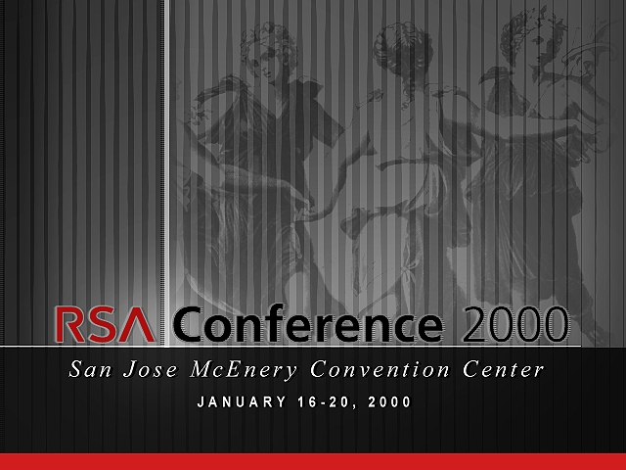

Slide 2
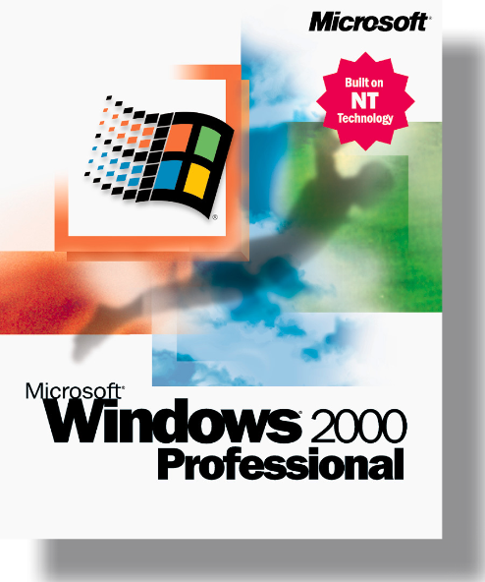
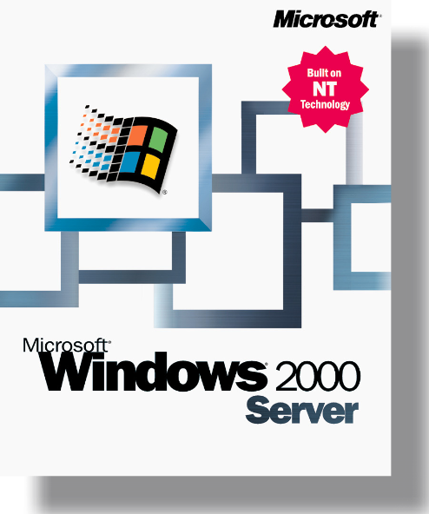
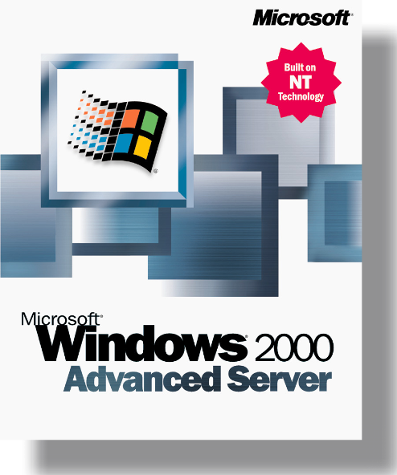
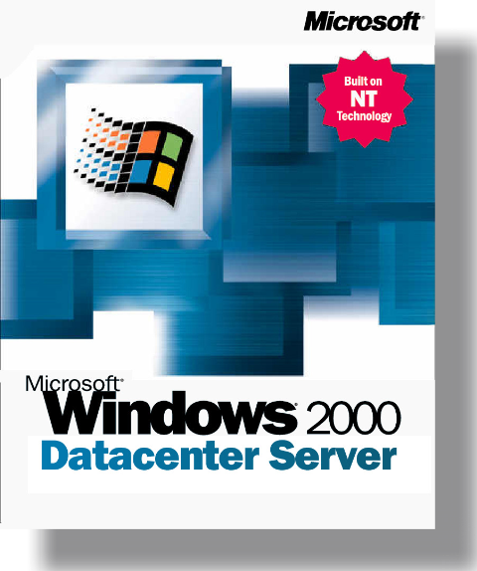
Meeting the Security Challenge
Brian Valentine
Senior Vice President, Windows Division
Microsoft Corporation

Slide 3
just because you’re paranoid…
doesn’t mean
they aren’t out to get you

Slide 4
s e c u r i t y u s e d t o b e a m a i n f r a m e i s s u e
The goal used to be getting users connected
With the Internet, security becomes
everyone’s concern
  More users, more “unsophisticated” users
  Broader computer use, more exposure of personal data
  More software products, more products to secure
We’re facing a greater overall threat
  More opportunity for “glory”
The industry needs leadership
Notes:
Not too long ago, the IT administrator's greatest worry was how to get his users connected to the corporate network. Now, they worry about how to keep people out.

Slide 5
i n f o r m a t i o n s e c u r i t y
what is Microsoft doing?
Protecting the integrity and privacy of our
customers’ data
Building products with security as a primary design consideration
Creating usable, secure solutions for customers
Engaging in public forums to address security issues

Slide 6
creating secure products
Windows 2000: roadmap to a secure development process

Slide 7
c r e a t i n g s e c u r e p r o d u c t s
Microsoft Windows 2000
  The most secure product Microsoft has ever shipped
  Demonstrates our commitment to security
Windows 2000 as a case study
  Galvanizes the security initiatives of Microsoft and its partners
  Demonstrates how we build secure products
Notes:
Re: “Galvanizes” The security in Windows 2000 provides a base for enhanced security for Microsoft and partner products. As Windows 2000 is launched, you will see new offerings from Microsoft and its partners – some announced at this conference - that exploit the Windows 2000 security architecture. Examples – product and architecture partnerships from ValiCERT, Entrust, Cisco, nCipher
We believe that Windows 2000 is one of the most secure general purpose operating systems anyone has ever shipped.

Slide 8
c o m m i t m e n t t o s e c u r i t y
the internal development process
Design for security from the ground up
  Windows 2000 is based on Windows NT®
Review specifications and architecture internally
Review code internally
Engage independent internal security test team
Security is a showstopper issue
Notes:
Windows NT 4.0
Completed C2 evaluation for Window NT 4.0
Completed ITSEC evaluation of Windows NT 4.0

Slide 9

c o m m i t m e n t t o s e c u r i t y
standards: Windows 2000 supports the industry
FIPS 140-1
IPSec
ITU X.509
PC/SC
S/MIME V3
RSA PKCS
C2, CC
IETF
  PKIX
  SSL/TLS
  S/MIME
  GSSAPI
  Kerberos
Fortezza
TrustE
World Wide Web Consortium (W3C)
    Online Privacy Alliance
    P3P Working Group
Notes:
Brian: This is a quicky slide…

Slide 10
c o m m i t m e n t t o s e c u r i t y
open and external review
Extensive Beta
  Most tested software product we’ve released
  Security test site (windows2000test.com)
FIPS 140-1 evaluation of Cryptographic Service Provider (CSP) - Completed
NAI Labs review of the IPSec implementation - Completed
Common Criteria evaluation against
Controlled Access Protection Profile (CAPP)
for operating systems (replaces C2) – In Preparation
Source code licensed to over 80 universities, labs,
and government agencies
Notes:
<<steve>>
We need a list of the top 5 universities to which we have licensed our source code.
MIT
Stanford
Cambridge (UK)
Cornell
Georgia Tech
We need to verify the number of academic sites (universities and any others) licensed to review our source code.
Actual number is 85 including universities, gov’t research labs, nonprofits etc
Regarding Open Source vs “Closed Source Perception”
Microsoft absolutely supports the open review of our code and we have provided that code to large number of academic and commercial security experts. But we protect our intellectual property for our shareholders by controlling who has access to full source.

Slide 11
c o m m i t m e n t t o s e c u r i t y
investment for the future
Research
  TCPA
  Fundamental research in cryptography (reported at this conference)
Participating in standards forums
  PKIX
  IETF
  PCSC
  PKI Forum founding member
Funding academic and nonprofit research organizations
  University California - Davis
  University of Virginia
  Carnegie Mellon
  …others to come
Notes:
<<steve>>
Brian needs to know what Microsoft is doing in each of the organizations. For example “Microsoft is participating in the IETF by submitting Internet Drafts on the first Mickey Mouse Silly Cipher”
PKIX is the working group on public key infrastructure including certificate profiles, cryptographic message syntax (CMS)
PCSC is the PC Smart Card standards group
IETF we participate in working groups including S/MIME, PKIX, XML signature. TLS (Transport Layer Security). In each case we participated actively by implementing draft standards and providing our feedback to the standards group
PKI forum is an industry group that is focused on interoperability of PKIs across vendors
College research efforts are a new effort so no results yet.
At UC Davis, researching Windows 2000 resistance to denial of service attacks
At U Virginia, researching critical information systems survivability issues using networks of NT/Win2K servers and workstations
At CMU, building a wireless handheld notification/communication network based on Windows 2000, Windows CE and Kerberos authentication

Slide 12
creating usable secure solutions for customers
making security tangible and simple

Slide 13
b u i l d i n g s e c u r e p r o d u c t s i s o n l y t h e b e g i n n i n g
what did our customers ask for?
Microsoft’s promise to protect their data
More and better lines of communication
  Information that fits their needs (IT Pros vs. Consumers)
  Full and appropriate disclosure of security issues
Simple methods to secure their data
  Guidelines for IT Pros and for Consumers
  Easy to implement security configurations
Assistance from Microsoft
  Rapid response to security issues
  Help from experts

Slide 14
b u i l d i n g s e c u r e p r o d u c t s i s o n l y t h e b e g i n n i n g
how is Microsoft responding?
Providing a written commitment that takes customer security to a new level
  Microsoft products protect privacy and security of customers’ data
  Microsoft customers are in control of their information
Relaunching Security Response Center
Providing simple security configuration steps
Committing to ensure customers’ access to help when they need it
Notes:
<<steve>>
Need good talking points on the written commitment. We don’t have a slide on it, so Brian will have to talk to it here. Even if just to say “the following constitutes the whole of our written commitment.
Commitment
- Our customers expect us to build products that can protect the confidentiality, integrity, and availability of their information.
- We’ll document the security functions the products should be expected to perform and the threats they are expected to resist.
- We will build and test the products to meet those documented requirements
- We will tell our customers how to use them securely
- If the products don’t resist the threats, the customer can invoke our response process to correct the problems as a high priority issue, and we’ll tell our customers about it so they can protect themselves.
Brian: This slide is an overview. There will be a slide on each of these points following. You can read this slide word for word, then move on and do the details later.

Slide 15
s e c u r i t y r e s p o n s e c e n t e r
secure@microsoft.com
Works within framework of Microsoft Security Commitment
  Responds to every report within 24 hours, 7 days a week
  Works with internal product groups when issue requires
  Provides bulletin and web posting of patches or workarounds
Integrates with WindowsUpdate and OfficeUpdate sites
  Key priority is getting patches to more customers
Notes:
The Security Response Center is intended to be, and is, a model in the industry for open acknowledgement and responsiveness

Slide 16
s e c u r i t y r e s p o n s e c e n t e r
expanding the information for our customers
For IT Professionals:
Relaunching http://www.microsoft.com/security
  Focused on the needs of IT Professionals
  Provides expanded information on using systems securely
For Consumers:
New Consumer Privacy/Security Website
  Contains practical guidance for implementing security
  Focuses on guiding the consumer user rather than the IT Pro
  Focuses on security methods to protect personal privacy
  Focuses on simplicity of implementation
Notes:
You can say we’ll continue to publish the security response/security patch information and information about product security features in addition to expanded best practices info

Slide 17
s e c u r e s i m p l e s o l u t i o n s
provide guidance on use of security features
Checklists for securely deploying Microsoft products
  IIS
  C2 security; domain controller; member server; workstation; under development
  Win 9x, Exchange, SQL Server to follow
Security templates for Windows 2000
  Preconfigured security configurations
  Used with Security Configuration Editor and Group Policy
Office Resource Kit for Office 2000
Windows 2000 logo security requirements
  Ensures applications are designed to be secure
Notes:
<<Steve>>
Can you please add a couple of talking points on the checklists (ie. What kinds of info do they include)
How to set up accounts, file protection, registry settings, and other parameters so that the system can expect the threats that can be expected in its environment.
Can you please add a couple of talking points on the logo security requirements?
How products should install and protect files and directories
How products should use and protect the registry
How products should require (or not require) privilege for normal use – so that a user who runs the product does not need to have access to the entire system.
Security templates:
Windows 2000 ships with several preconfigured Security Configuration Editor templates:
Can be modified if desired
Can be applied to one or multiple computers to configure multiple security settings at once
Can be imported into a Group Policy Object to effect the computers/users that the GPO applies to
Examples of the templates provided:
Basic DC
Secure DC
High Security DC
Basic, Secure, High Security Server and Workstation

Slide 18
s e c u r i t y a s s i s t a n c e
providing support for security issues
Microsoft support and consulting services
Third-party consulting partners
  Over forty partners provide consulting services in security design, deployment, and recovery
  Example: Antivirus vendors during Y2K preparations
Support design, installation, and recovery
Notes:
“We and our partners provide support to customers as they plan and design the security of their systems by providing consulting services based on the specific environment and application.
We and our partners help them as they deploy and operate their systems by providing “hands on” support and a source of advice when security issues are expected
We and our partners are available to help recover from breakins and other incidents.
Need some examples of solutions provided by consulting partners. At least one or two for Brian to mention even if we don’t put them on the slide.
MCS and partners provide PKI design, smart card deployment planning,
3rd Party consulting partners:
ISS is a partner that provides network security scanning and configuration review.
Price Waterhouse Coopers performs a variety of planning and assessment services; we worked with Price Waterhouse Coopers to help a customer recover from a suspected incident.

Slide 19
driving security issues
commitment to the community

Slide 20
s e c u r i t y i s a n i n d u s t r y i s s u e
Microsoft Security Advisory Council
  Chartered to improve customers information security
  Consist of sample of the IT security community
    Customers and Academics
    Opinion Leaders, Fans, and Critics
Corporate Information Security Officer’s Council
  Members are corporate IT Security Directors
  Chartered to represent needs of enterprise customers
Industry Security/Privacy Summit – Summer/Fall 2000
  Invite government, academics, customers, public interest groups, competitors
  Focused on identifying and solving industry issues
  Conference to include privacy leaders and issues
Notes:
Advisory Council
Help us review our requirements and technology directions to ensure that we are doing the best job that we (Microsoft) can for our customers
Information Security Officers
Specific to the needs and priorities of Information Security Officers of large enterprises. Being organized by Howard Schmidt, Microsoft CISO and president of ISSA
Summit
Industry wide issues such as vulnerability disclosure policy, future directions for standards work, etc

Slide 21
c h a n g i n g t h e d i a l o g u e
security and privacy go hand-in-hand
Trusted relationship with consumers is good business
Microsoft is putting consumers in control of their information
Privacy is a priority from technical and policy standpoint
  TRUSTe privacy seal on all Microsoft web sites
  Working on industry privacy standard P3P
  Founding sponsor of GetNetWise for Children’s Online Safety
Notes:
<<steve>>
How is Microsoft putting customers in control of their information?
We are committed to having and living by a privacy policy for every web site that Microsoft operates.
TRUSTe
Microsoft is a premier sponsor of TRUSTe and a member of the TRUSTe privacy program. TRUSTe is an independent, non-profit initiative whose mission is to build users' trust and confidence in the Internet by promoting TRUSTe's principles of fair information practices.
TRUSTe is an independent organization whose mission is to build users' trust and confidence on the Internet. Businesses that display the TRUSTe logo have agreed to privacy principles developed by TRUSTe and to periodic reviews to make sure that the businesses' privacy practices are in keeping with the policies. In the event TRUSTe learns of serious violations of a businesses' privacy practices, TRUSTe takes steps to insure compliance. Microsoft strongly believes in the TRUSTe mission and is a premier sponsor of the organization.
World Wide Web Consortium (W3C)’s Platform for Privacy Preference’s Project (P3P)
The Platform for Privacy Preferences Project (P3P) enables Web sites to express their privacy practices in a standard format that can be retrieved automatically and interpreted easily by user agents. P3P user agents will allow users to be informed of site practices (in both machine- and human-readable formats) and to automate decision-making based on these practices when appropriate. Thus users need not read the privacy policies at every site they visit.
GetNetWise
GetNetWise is a public service brought to you by a wide range of Internet industry corporations and public interest organizations. The GetNetWise coalition wants Internet users to be only "one click away" from the resources they need to make informed decisions about their family's use of the Internet.

Slide 22
s e c u r i t y i s a p u b l i c p o l i c y i s s u e
our industry has a critical role
Partnership for Critical Infrastructure Security
FTC’s Online Access and Security Advisory Committee
Windows 2000 will ship worldwide with
integrated strong (128 bit) encryption
  First general purpose operating system to do so
  Result of cooperation with Government to create new crypto regulations
  Big win for customers and industry partners
Notes:
<<steve>> Need talking points for the first two bullets.
We’re working actively with the administration to develop effective measures that will help protect the information infrastructure of the United States from potential terrorist threats. We are committed to the view that this can only be done by government-industry cooperation and are an active participant in efforts to develop workable solutions to this issue.
We’re participating in an FTC advisory panel looking at whether there’s a need for new regulation for privacy of information collected by web site operators.
128 bit Crypto talking points:
Strong crypto protection available worldwide in a simple, integrated solution
Partners need not adapt to, or workaround, variants by geography and user set
No need for International customers to deal with delays and restrictions associated with individual export licenses
No need to buy additional software to “add-on” higher encryption

Slide 23
c o n t i n u o u s s e c u r i t y r e q u i r e s c o n t i n u o u s i n n o v a t i o n
Contributions from innovators
  Windows 2000 Research Symposium- April 2000
    Invitational symposium on research applications of Windows 2000
    Will introduce Windows 2000 technology to academic and research organizations
  Funding academic research grants for security
Research contributions to the community
  Microsoft presentations at technical sessions
Notes:
<<steve>> will need some talking points on each of these. A single example per bullet is perfect.
Research symposium
Invite research organizations – especially those with source license – to an in-depth walk through of the security guts of Windows 2000. Aim is to help them use it as a research vehicle and base for experimentation in computer and network security.
Academic research grants include those mentioned
U California Davis, U Virginia, CMU, and others now in process. We expect this to be a growing area of our research funding.
Microsoft presentations
fundamental work on cryptography by Peter Montgomery, Dan Simon

Slide 24
a security expert’s work is never done…
Security is a journey, not a destination.
We are embarked on a new and positive journey to improved security with our customers and the rest of the industry.

Slide 25

Notes:
They made me take the mustache off…security folks have no sense of humor ☺

Slide 27
- Presentation Overview -
Speaker:
Brian Valentine
Content Manager:
Ryan Calafato
Date of presentation:
January 18, 2000
Title of presentation:
Meeting the Security Challenge
Length of presentation
:60
Name of Event:
RSA Conference 2000
Location of Event:
Audience:
Security Professionals
Product:
Microsoft Products: Windows 2000 Platform
Industry:
IT Security
Key objective(s):
Announce our 2000 security initiatives

Slide 28
Doh!
This slide got hacked
Notes:
Don’t let this be you…
Too much?

