Slide 1
RSA Conference Europe 2000
Welcome to RSA Conference Europe 2000
Jim Bidzos
RSA Conference Chairman

Slide 2

Agenda
Perspective
  Hacks and attacks
  Export
  Market trends
  Technology
  Standards
About RSA Conference

Slide 3
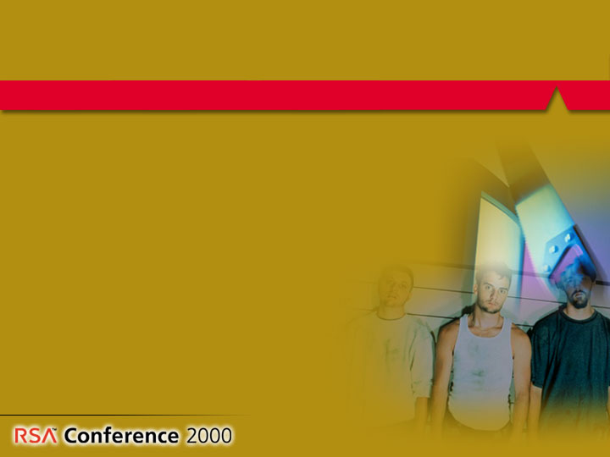
The Year in Review – Hacks and Attacks
Teens arrested for global multi-million
dollar Internet fraud
Microsoft free hotmail hacked,
40 million users impacted
Hacker from Hanover convicted
for publishing TFN program used
in Denial-of-Service attacks
Russian news agency’s website
defaced

Slide 4
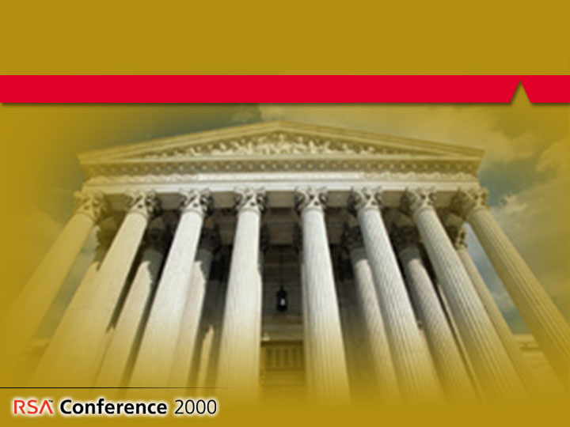
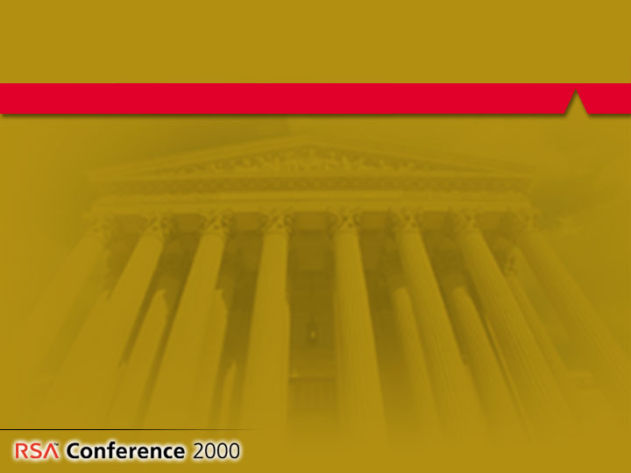
The Year in Review – Export
French law on encryption liberalized
Germany reduces constraints on mass market cryptography
Irish paper affirms commitment to relax cryptography exports

Slide 5
The Year in Review - Export
US relaxes strong crypto export policy
UK Commons Committee stage
Swedish law allows for export of up to 128 bit symmetric crypto

Slide 6
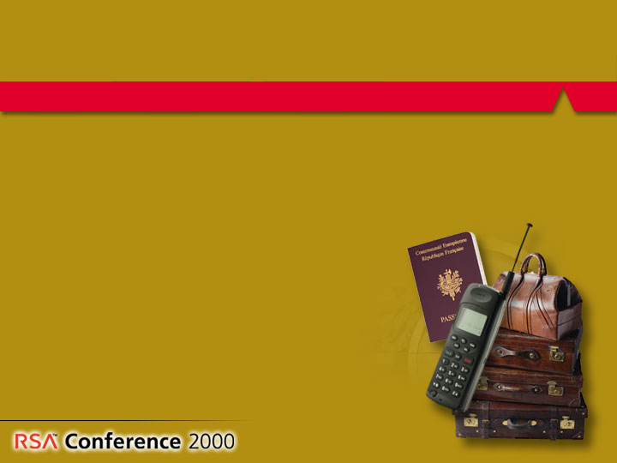
The Year in Review – Market Trends
Wireless Internet Takes off
One third of all Europeans will use the Net through mobile phones in 2004
Nine out of 10 Internet leaders in Europe plan to launch mobile Internet sites
Firms are building sites now
Source: Forrester Research, Dec 99

Slide 7
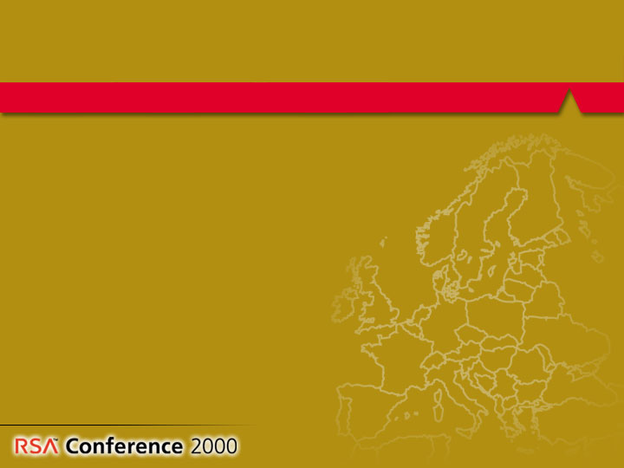
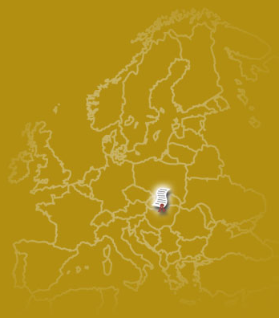
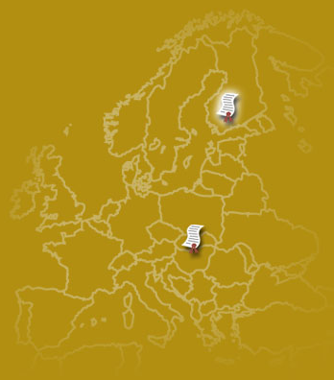
The Year in Review – Market Trends
Digital certificates broadly adopted
Digital certificates broadly adopted
Digital certificates broadly adopted
EU Commission uses legal framework to guarantee security of electronic signatures
EU Commission uses legal framework to guarantee security of electronic signatures
EU Commission uses legal framework to guarantee security of electronic signatures
Austria First Chamber of Parliament
passed digital signature act
Austria First Chamber of Parliament
passed digital signature act
Finland bill on electronic personal identification cards

Slide 8
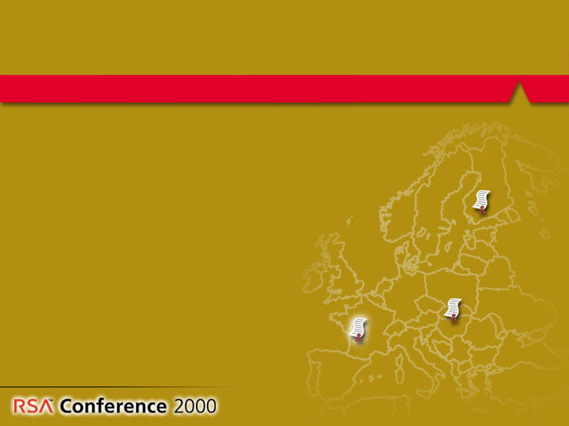
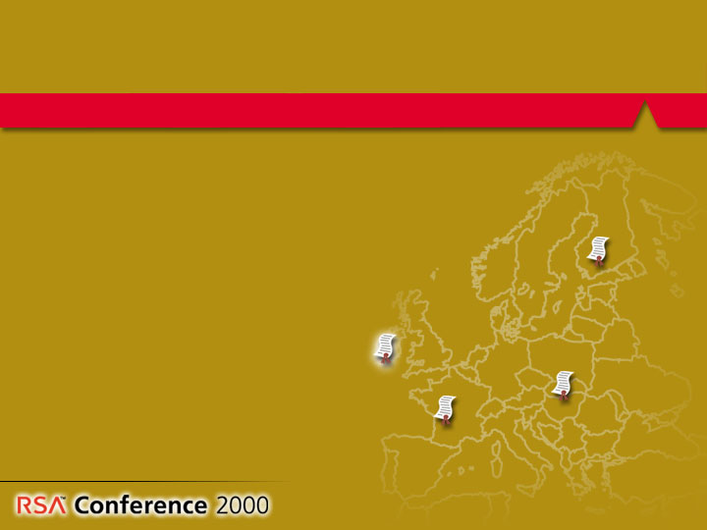
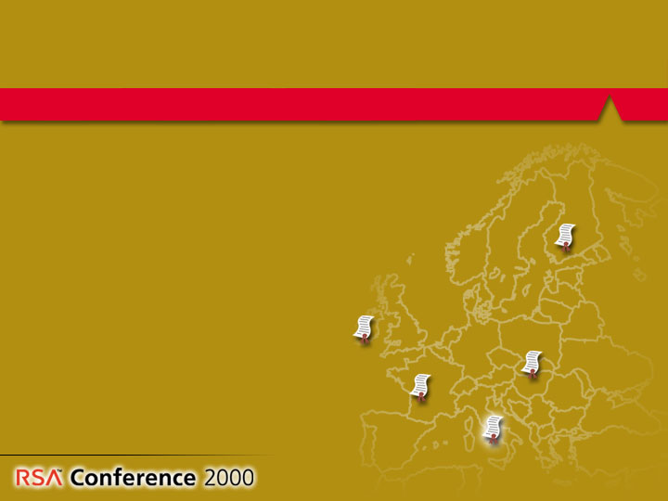
The Year in Review – Market Trends
Digital certificates broadly adopted
French cabinet approved draft law on electronic signatures
Digital certificates broadly adopted
French cabinet approved draft law on electronic signatures
Irish government outlined legislative proposals on electronic signatures, electronic contracts, certification service provision
Digital certificates broadly adopted
French cabinet approved draft law on electronic signatures
Irish government outlined legislative proposals on electronic signatures, electronic contracts, certification service provision
Italian technical rules for digital signatures published

Slide 9
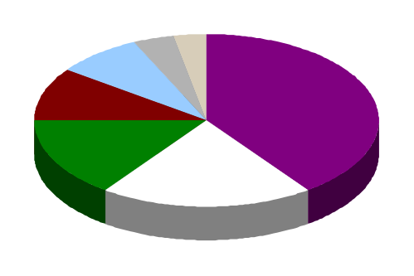
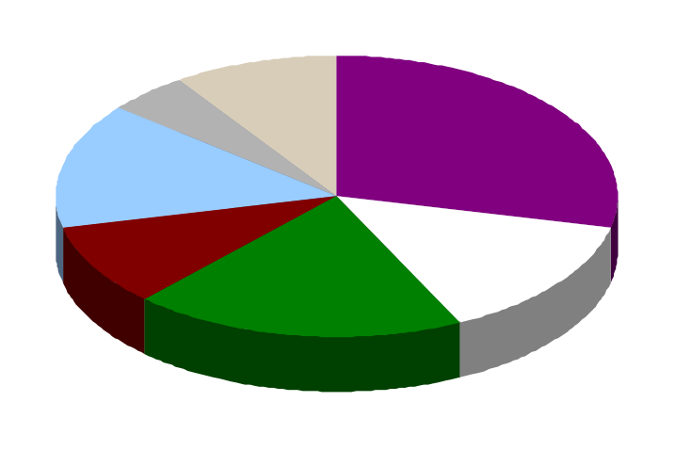
Digital Certificate and PKI Adoption
1999
Antivirus
Firewall
PKI
Security management
VPN
Authentication
2003
Encryption
Source: Datamonitor

Slide 10
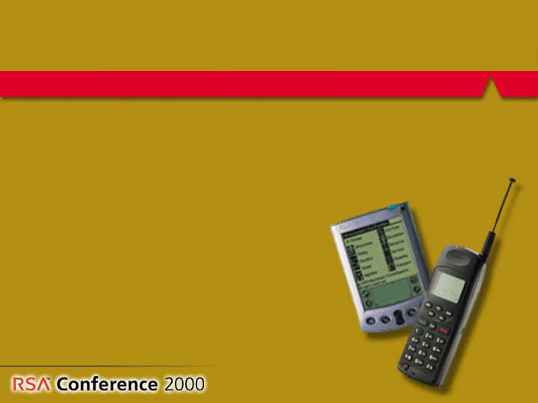
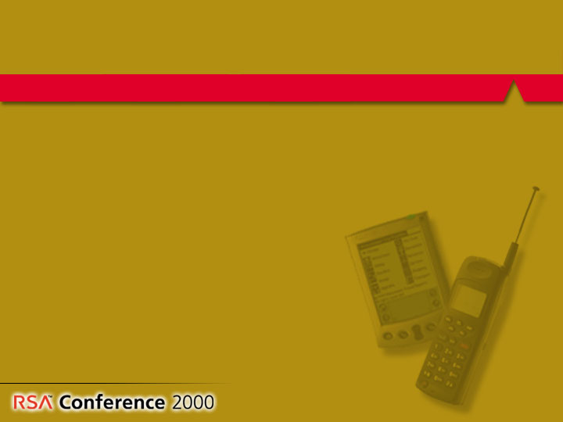
The Year in Review - Technology
Cryptography has been optimized to fit into smaller environments
  Techniques for using RSA
  algorithm in small devices
  Creation of new certificate
  formats by RSA Labs

Slide 11
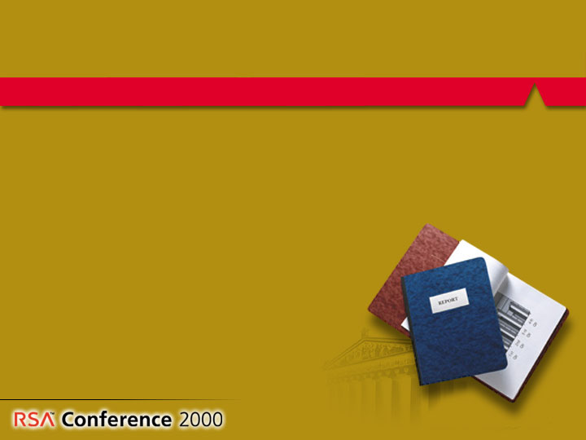
The Year in Review - Standards
PKCS #15 for Smart Cards published
WAP specifies RSA RC5 as only mandatory symmetric cipher for clients and servers
Selection of AES finalists

Slide 12
Summary
Export laws relaxed
Digital certificates gaining momentum
Wireless Internet takes off
Standards and technology progressing

Slide 13
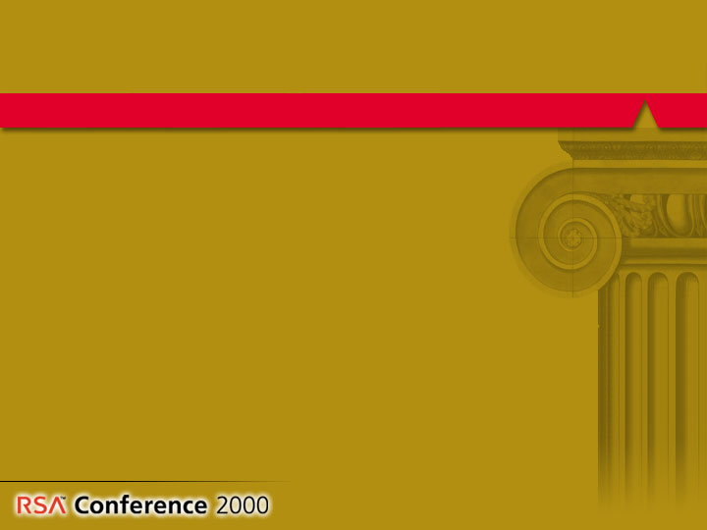
RSA Conference Europe 2000
Five class tracks
More than 60 talks
30+ exhibits
10 sponsors
Expect more than 750 attendees

Slide 14
Thank You!

