Slide 1
Scott Schnell
Senior Vice President, Marketing
RSA Security Inc.

Slide 2
Welcome to a Wireless World
Wireless…does reality justify the hype?
Wireless e-business
RSA Security and wireless
Where we go from here

Slide 3
Wireless — It’s Everywhere, Anywhere...
Wireless phones to reach 1 billion by 2003
Web-ready phones will outnumber PCs by 2002
50 million wireless phones with Internet
access by year end
40% of B2C commerce on wireless devices by 2004
One out of three Europeans to tap the
mobile Internet by 2004

Slide 4
…Does Reality Justify the Hype?
98% of wireless traffic
is voice communication
Competing standards
Constrained visual interfaces
It’s expensive
It’s slow, slow, slow
Answer:
Yes - Absolutely.

Slide 5
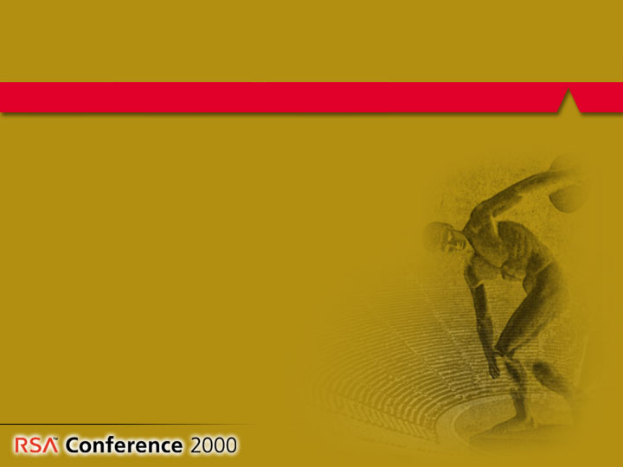
Wireless, It’s Only the Beginning...
End-user pricing is falling
Killer apps are around the corner
Operator costs held in check
New devices hitting the market
Connectivity and capacity increasing
Security is improving
Consumer demand on the rise

Slide 6
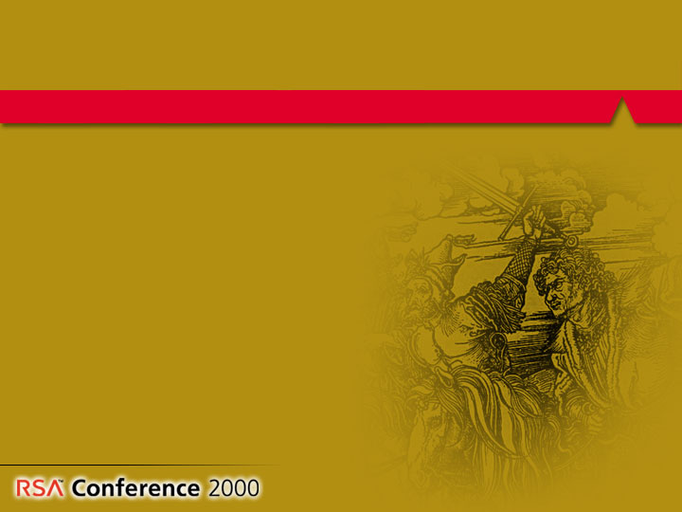
…And Europe is Leading
World leader in wireless
  Universal GSM standard drives adoption
  Consistently high quality of service
  Advanced billing models
Significant penetration for GSM phones
Operators aggressively promoting
WAP, SMS and other data services
Market consolidation and partnering

Slide 7
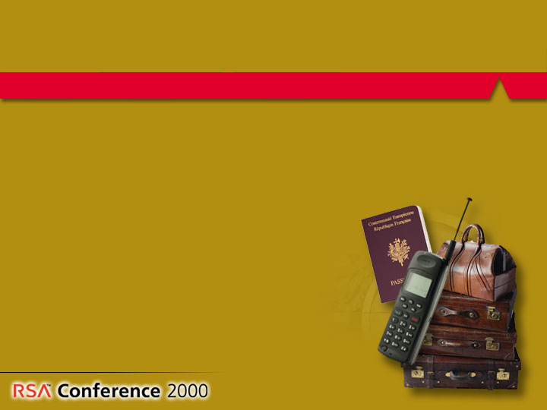
The Impact of Wireless on e-Business
Business anytime, anywhere
Real applications, real business
Universal device for
authentication,
communications,
transaction signing
and storage

Slide 8
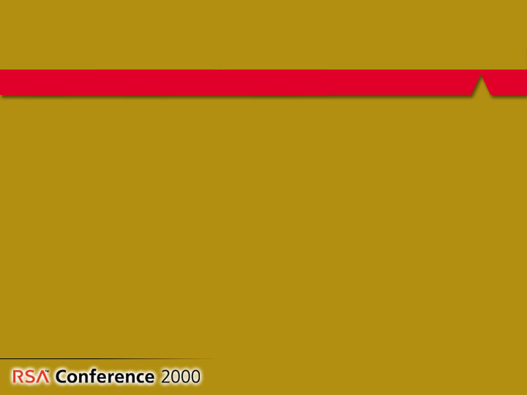
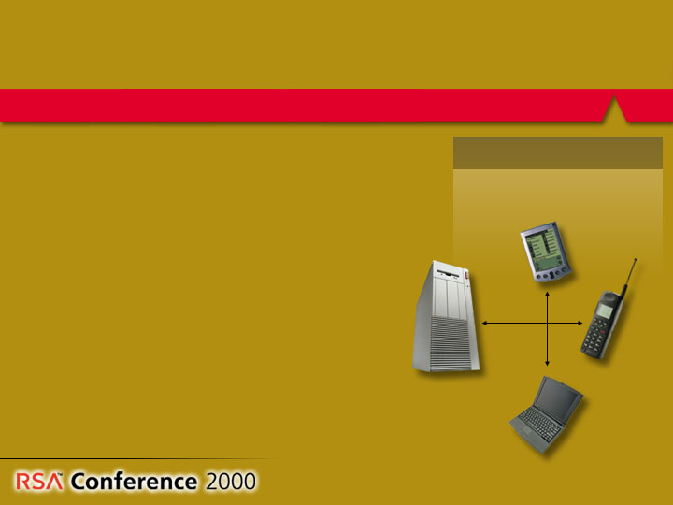
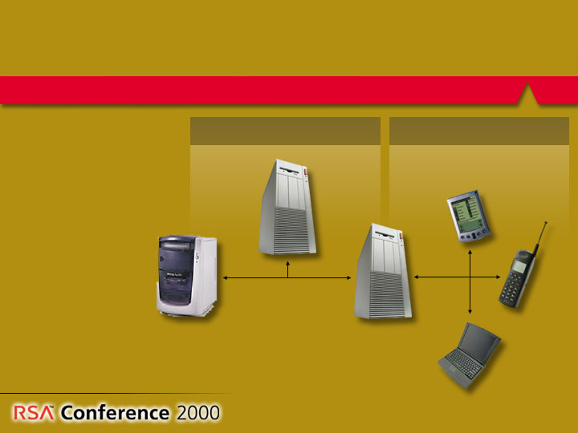
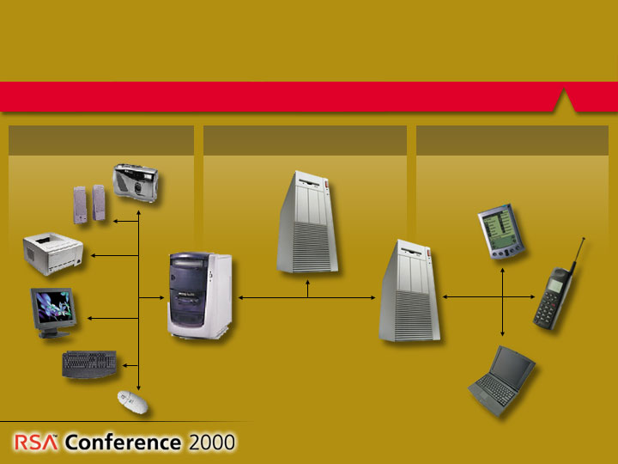
Wireless in the Enterprise
Bluetooth
Wireless LAN
Wireless LAN
CDMA, GSM, etc.
CDMA, GSM, etc.
CDMA, GSM, etc.
Enterprise Server
Enterprise Server
WAP Server
WAP Server
WAP Server
Wireless security in the enterprise is essentially an authentication, authorization, and privacy problem.

Slide 9
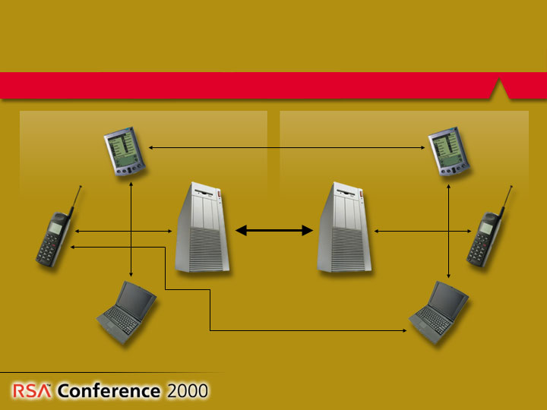
Wireless in B2B Exchanges
In Business-to-Business exchanges, integrity and non-repudiation become additional security concerns.

Slide 10
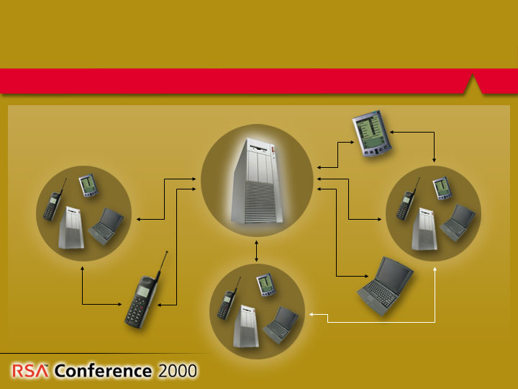
Wireless in Multi-Party Exchanges
Exchange
Exchange
may not
always be involved.
In multi-party exchanges, the exchange becomes the keystone of trust and interoperability becomes necessary.

Slide 11
e-Security is a Critical Enabler
Identify parties to prevent fraud
Encrypt traffic, browsing and
transactions for privacy
Prove authorship and integrity
for enforceability
Provide seamless compatibility
with wired e-business

Slide 12
RSA Security and Wireless
RSA Wireless Development Center
RSA Products
Partners
Standards

Slide 13
Announcing: RSA Wireless Development Center
Driving corporate, product and partner development in wireless security
Defining extensions to RSA Security’s wireless product lines
Directed by John Adams, CTO,
with managers for Labs, R&D
and corporate development
Based in Stockholm
RSA
Wireless
Development
Center

Slide 14
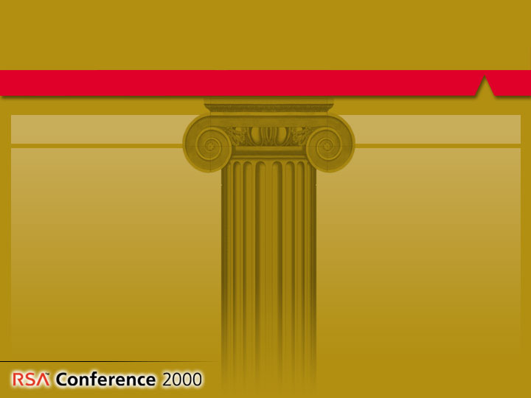
RSA Security
Pioneering Wireless e-Security
Standards
Business partnerships
WAP / WTLS
WTLS certificate standards
PKCS #15 Crypto information storage standard
Bluetooth security layer
  Phone.com
  Symbian
  Nokia
  Ericsson
  TanTau
  Diversinet

Slide 15



RSA Security Products
Optimized for Wireless
embedded in handsets; authorization management services for operators and carriers
Authentication
wireless security software and embedded encryption engines for wireless devices and infrastructure
Privacy
certification and policy management systems for
extended enterprise security
Trust

Slide 16
Announcing: MultiPrime™
New Cryptography for Wireless
RSA Security and Compaq unveil MultiPrime, advanced cryptography for wireless & embedded
Over 2X performance of regular RSA algorithm in wireless handheld signing operations
Over 6X acceleration for wireless servers
Full strength security
Complete compatibility
Available in forthcoming BSAFE products
  incl. BSAFE WTLS-C in June 2000
Available in Compaq accelerators June 2000

Slide 17

Challenges Before Us – Beyond Technology, Standards & Competition
Privacy
Device Control
System Reliability

Slide 18
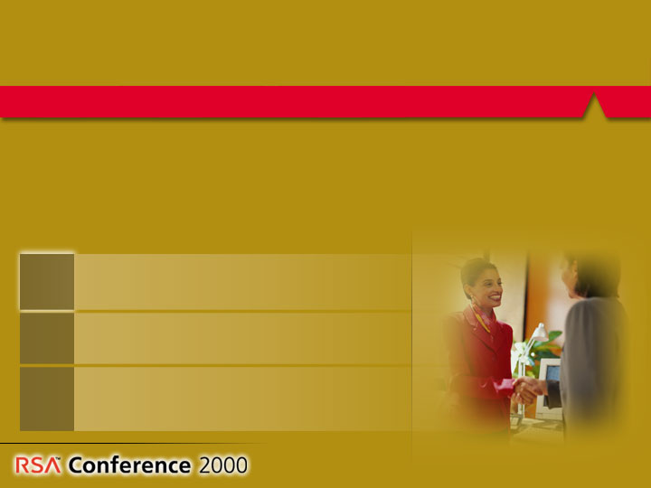
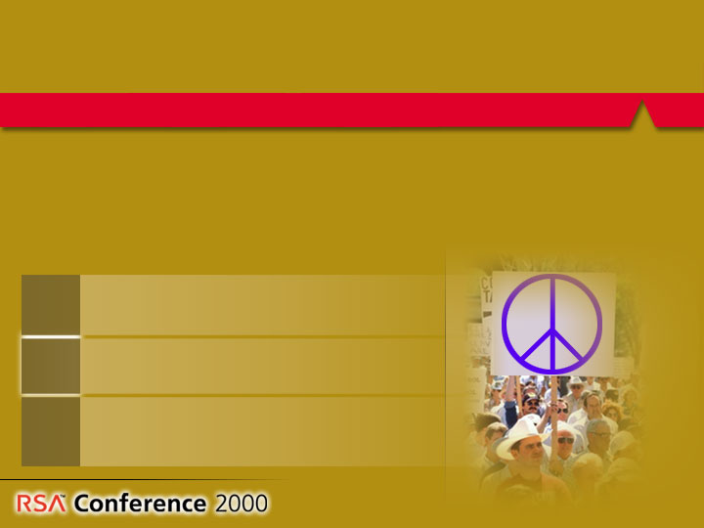
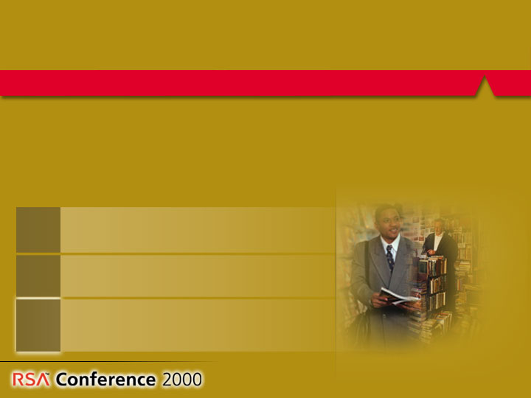
Privacy Concerns
Wireless devices will be able to track an individual’s location.
Wireless devices will be able to track an individual’s location.
Wireless devices will be able to track an individual’s location.
Who has access to this information?
Who has access to this information?
Who has access to this information?
Who controls the access to this information?
Who controls the access to this information?
Who controls the access to this information?
The Enterprise?
The Government?
The Operator?
The Enterprise?
The Government?
The Operator?
The Enterprise?
The Government?
The Operator?

Slide 19
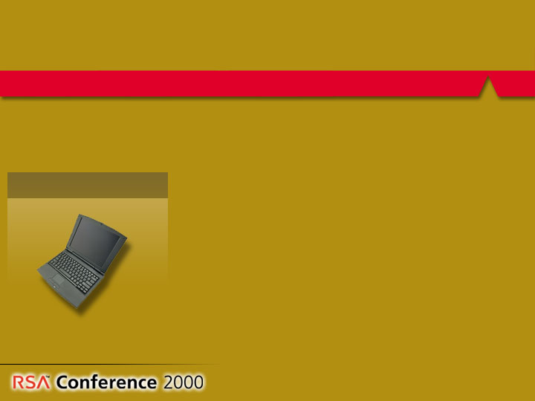
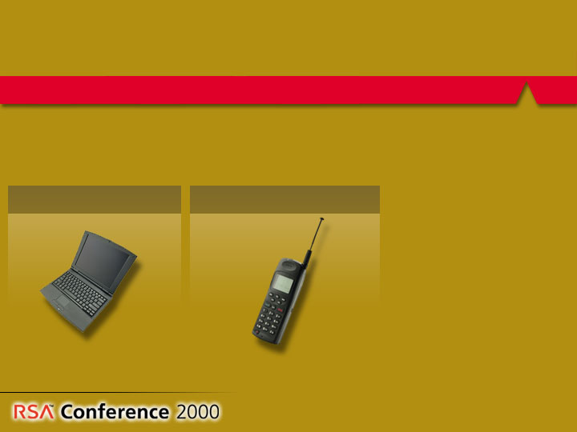
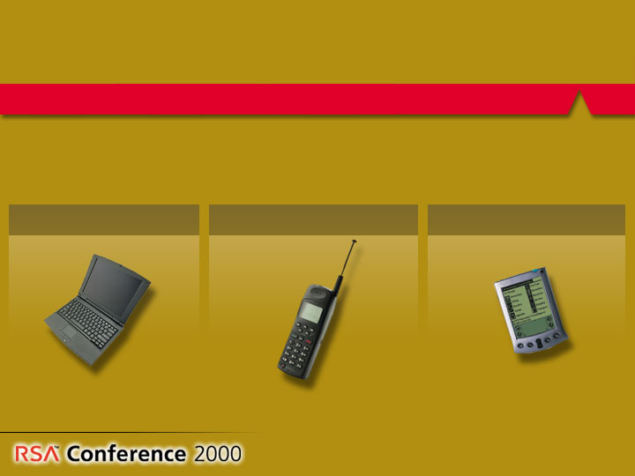
Control of Devices
In today’s devices, different parties control the access to,
content on, and policy management of each device.
Enterprise
Enterprise
Enterprise
Operator
Operator
Individual
Who controls this if and when the devices merge?

Slide 20
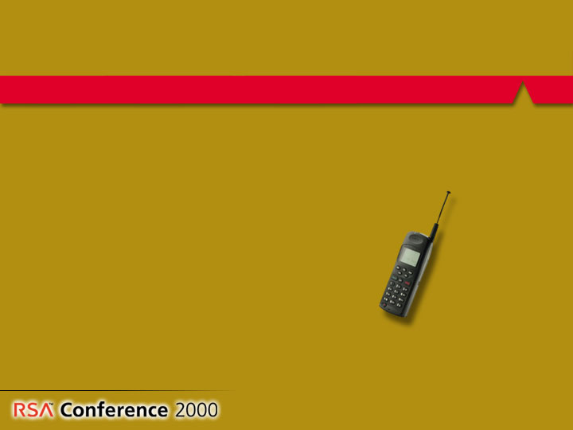
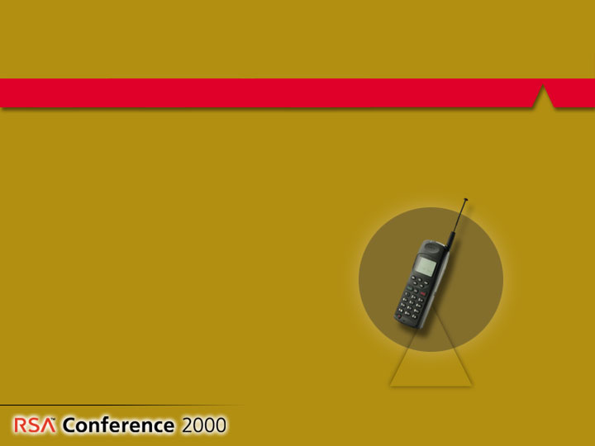

Device Reliability
Who will certify which applications can work on which phones with various operating systems and different operators?
Will the phone reboot to accept new applications?
How do we prevent introduction of viruses?
How do you recover when an application crashes a phone – and who pays?
Applications
Upgrades
Operator
Operator
Operator
Operating System
Operating System

Slide 21
Conclusion
The Internet just got bigger – with a whole new set of wireless users, applications, and infrastructure players
Wireless technologies to ensure security, performance and interoperability are here today
Our challenge now is to define policy and management to ensure privacy, reliability, and system security

Slide 22

The Most Trusted Name in e-SecurityTM
www.rsasecurity.com
Notes:
Thank you very much for your time today, and, at this point, I would like to answer any questions that you may have.

