Slide 1





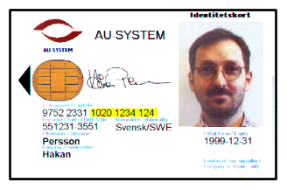


One EID card, many applications
e-banking e-commerce at work health care betting
private
private
private
User Authentication
Digital signatures, e.g. for non-repudiation
Confidentiality through encryption

Slide 2
Why smart cards?
Security
  safe storage for private keys
  no duplication of private keys
  implements ”know” and ”possess” criteria
Mobility
  easy to carry complex keys
Understandable for the user

Slide 3

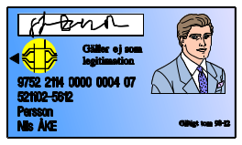

Visual ID
Electronic ID
ID card
Certificate
Securing the information
ID information
Issuer
Quality assurance
Unique properties
Authenticating
the subject
Secure printing
Name, SSN, (Country)
Card issuer
ISO or nat.stand.body
Photo, signature
Face + ability to
write correct signature
Digital signature
Name, SSN, (Country)
CA
Certificate policy
Public key
Access to
correct private key(s)
Physical characteristics
Electronic ID card

Slide 4
The SEIS Specifications
S1: The Electronic ID Card
  card file structure and contents
S3: EID Certificate Contents
  similar to PKIX-1 and S/MIME certificate specifications
S4: EID Implementation profile
  specifies number of keys, key lengths etc

