Slide 1
RSA Laboratories’ PKCS Series - a Tutorial
PKCS #1
Magnus Nyström,
October, 1999

Slide 2
RSA Cryptography Standard
Specifies RSA encryption, decryption, signature and verification primitives
Specifies RSA encryption and signature schemes
Specifies encoding methods for these schemes
Specifies ASN.1 syntax for
  public RSA keys
  private RSA keys
  above mentioned schemes (object identifiers for defined schemes and associated parameters)

Slide 3
Definitions, I
Primitives
  Basic mathematical operations on which cryptographic schemes can be built.
  Intended for implementation in hardware or as software modules
  Not intended to provide security apart from a scheme
  Defined in PKCS #1:
    Encryption/Decryption
    Signature/Verification

Slide 4
Definitions, II
Schemes
  Combines cryptographic primitives and other techniques to achieve a particular security goal.
  Two types of scheme are specified in this document:
    encryption schemes
    signature schemes with appendix

Slide 5
Definitions, III
Encoding Methods
  Operations that map between octet string messages and integer message representatives.
  Two types defined in PKCS #1:
    encoding methods for encryption
    encoding methods for signatures with appendix

Slide 6
Primitives
RSA Encryption (RSAEP)
RSA Decryption (RSADP)
  “Ordinary” RSA en/decryption
RSA Signature (RSASP1)
RSA Verification (RSAVP1)
  “Ordinary” RSA signatures and verification

Slide 7
Encryption Schemes
RSAES-OAEP
  Optimal asymmetric encryption (Bellare-Rogaway, ‘94)
    plaintext-aware encryption (stops chosen ciphertext attacks)
RSAES-PKCS1-v1_5
  Classical PKCS #1 encryption/decryption
    possible to generate valid ciphertexts without knowing the corresponding plaintexts, with a reasonable probability of success (Bleichenbacher, ‘98)

Slide 8
Signature Schemes
Currently only “Signature schemes with an appendix” in PKCS #1
RSASSA-PKCS1-v1_5
  “Classical” PKCS #1 signatures
Support for the “Probabilistic Signature Scheme” (PSS) is being added (RSASSA-PSS)
  Provable security under certain assumptions
  Allows for a signature scheme with message recovery as well

Slide 9
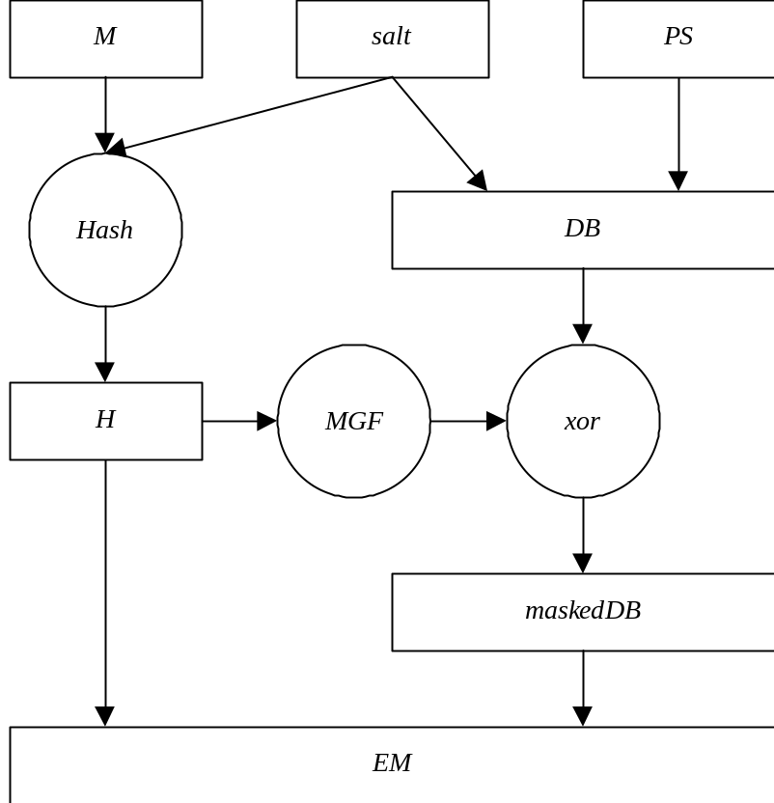
Block Diagram of PSS Encoding Operation

Slide 10
Some Observations
Message is hashed with random salt
  improves security proof
  reduces reliance on hash function security
Hash value is expanded to full length
  randomizes input to primitive
  removes multiplicative structure
  enables proof
Salt value is xored into expanded hash
  shortens signature overhead
  part of message may also be xored

Slide 11
PSS Advantages
Provable security under certain assumptions (random oracle model)
  other methods have “ad hoc” security, not a proof
Reduced reliance on hash function security
  “birthday attack” collisions not useful due to random salt
Natural extension to message recovery

Slide 12
Encoding methods
Used to define how a message is transformed and encoded when being transformed by one of the schemes
Encoding methods for en/decryption:
  EME-OAEP
  EME-PKCS1-v1_5
Encoding methods for signatures with appendix:
  EMSA-PKCS1-v1_5
  (EMSA-PSS)

Slide 13
Standards Strategy
Several RSA standards:
  PKCS
  ANSI X9.31
  ISO 9798
ANSI X9.31 is widely standardized
PSS is widely considered secure
PKCS #1 is widely deployed
How harmonize?

Slide 14
Standards Strategy, II
Short term (1-2 years): Support both PKCS #1 v1.5 and ANSI X9.31 signatures for interoperability
  e.g., in IETF profiles, FIPS validation
    NIST is in the process of adding PKCS #1 v1.5 to FIPS 186-2 for an 18-month transition period
Long term (2-5 years): Move toward PSS signatures
  upgrade in due course — e.g., with new hash functions

Slide 15
More information
PKCS #1 v2.0 (and the v2.1 draft) is available from
http://www.rsasecurity.com/rsalabs/pkcs

