Slide 1
RSA Laboratories’ PKCS Series - a Tutorial
PKCS #11
Magnus Nyström
October, 1999

Slide 2
Cryptographic Token Interface Standard
Different from other PKCS documents in that it defines an application programming interface (API)
Shields applications from details of cryptographic tokens such as smart cards
Concentrates on cryptographic matters
The API is written for ANSI C
Also known as “Cryptoki”

Slide 3
Cryptographic Token Interface Standard, II
Widely used in many token-aware products, e.g. Netscape Communicator
Simplified user model: Just one user and a security officer (SO)

Slide 4
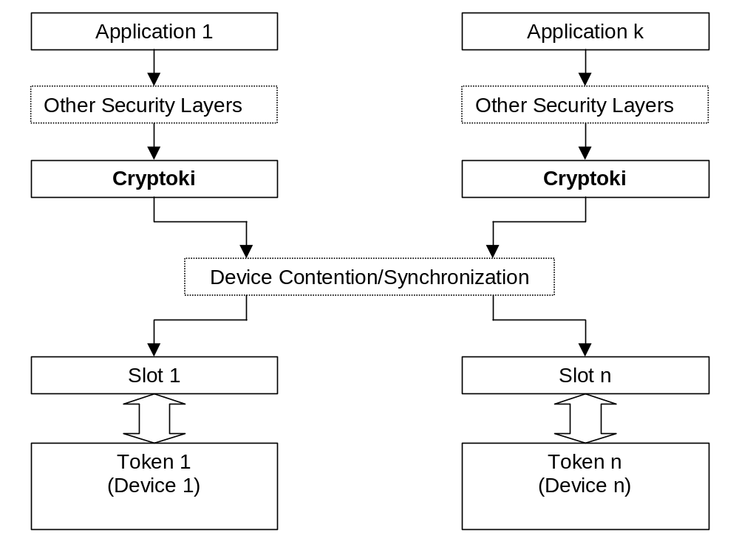
General model

Slide 5
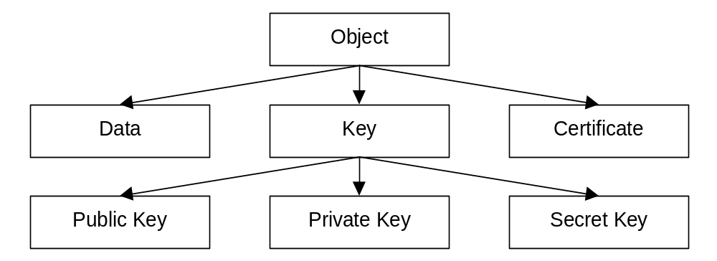
PKCS #11’s object model
Objects may be created, read, updated and deleted
All access is governed by security states

Slide 6
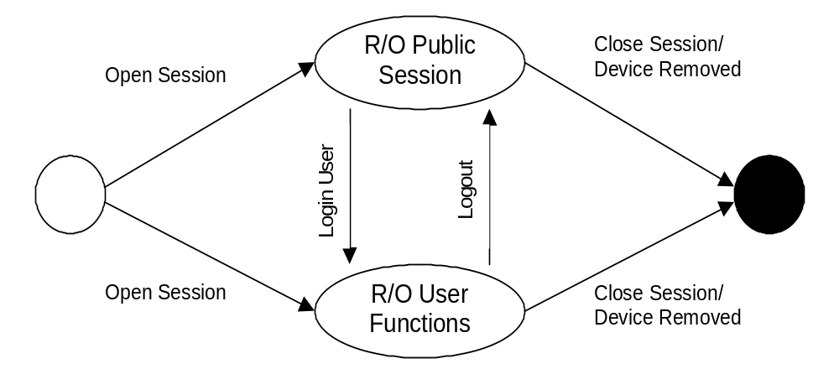
PKCS #11 states (or sessions)

Slide 7
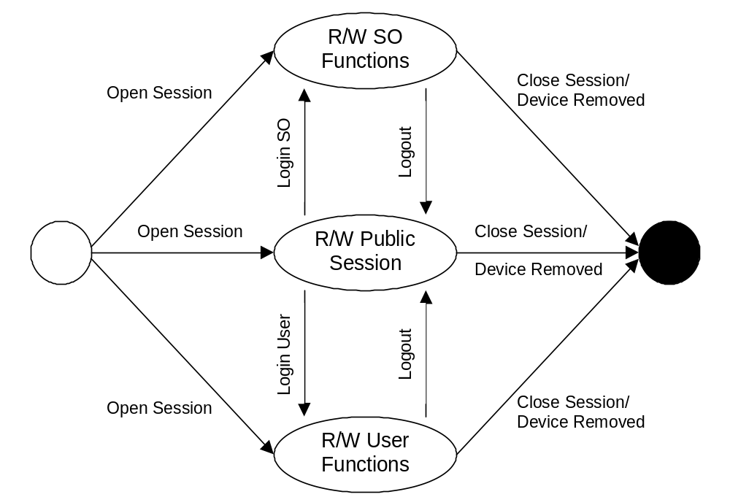
PKCS #11 Read-write sessions

Slide 8
Functional overview
General purpose functions
  Initialize, cleanup, information about the library itself
Slot and token management
  GetSlotInfo, GetTokenInfo,…
Session management
  OpenSession, CloseSession…
Object management
  Create, Destroy, Copy

Slide 9
Functional overview, II
Encryption functions
Decryption functions
Digest functions
Signing functions
MAC functions
Key management (e.g. generate a key pair)
Callbacks (e.g. error handling)

Slide 10
Future enhancements
Support for new types of certificates (e.g. attribute certificates)
Support for multiple PINs
More fine-grained access control
Support for “signature-only” keys
Time plan: v2.1 in Q4’99
v3.0 perhaps Q3’00

Slide 11
More information
As usual:
  http://www.rsasecurity.com/rsalabs/pkcs

