Slide 1
German Digital Signature Card and
Office Identity Card and
PKCS #15
Bruno Struif
GMD
German National Research Center for Information Technology
Darmstadt

Slide 2
General Configuration
PC
Different cards
with PKCS#15
ICC1
Application
Card
Terminal
Smartcards
providing the
same service,
but possibly
in a different way.
PKCS#11
Interface
ICC2
ICC3
- If a PC application knows to deal with a card application, no directory files are necessary
- If a PC application does not know how to deal with a card application, it needs information

Slide 3
Is PKCS#15 powerful enough?
Some challenges:
- cards may have a hash function or not
- cards may support different signature algorithms
- cards may support a different set of Digital Signature Input formats
- a card may be configurated in such a way that it allows
- either after PIN presentation an unlimited number of DS
- or requires PIN presentation before each DS
- a card may support ETSI PIN management commands instead of
ISO-commands
- a card may support a proprietary command for a certain
security service

Slide 4
Card File Structure (1)
MF
DF(PKCS#15)
EF(DIR)
Other
DFs/EFs...

Slide 5
Card File Structure (2)
DF(PKCS#15)
EF(ODF)
EF(PrKDF)
EF(CDF)
EF(AODF)
EF(TokenInfo)
EF(ODF) - Object Directoty File - points to
- EF (PrKDFs) - Private Key Directory Files
- EF (PuKDFs) - Public Key Directory Files
- EF (SKDFs) - Secret Key Directory Files
- EF (CDFs) - Certificate Directory Files
- EF (DODFs) - Data Object Directory Files

Slide 6
Cross-References
EF(PuKDF)
PuKDF pointer
PrKDF pointer
CDF pointer
AODF pointer
DODF pointer
EF(PrKDF)
EF(CDF)
EF(ODF)
EF(AODF)
EF(DODF)

Slide 7
Card File Structure (3)
MF
DF(PKCS#15)
EF(DIR)
Other
DFs/EFs...
EF(ODF)
EF(PrKDF)
EF(CDF)
EF(AODF)
EF(TokenInfo)
Real objects

Slide 8
Card File Structure (4)
MF
DF(PKCS#15)
EF(DIR)
DF1
DF2
EF(ODF)
EF(PrKDF)
EF(CDF)
EF(AODF)
EF(TokenInfo)
Real objects
Real objects

Slide 9
Card File Structure (5)
MF
DF(PKCS#15)
EF(DIR)
DF1
DF2
EF(ODF)
EF(TokenInfo)
EF(PrKDF)
EF(CDF)
EF(AODF)
EF(PrKDF)
EF(CDF)
EF(AODF)

Slide 10
User Authentication
PKCS15 describes PINs and passwords, but no
biometric user authentication
The German Digital Signature law allows biometric user authentication
It is technically already feasible to implement
biometric feature matching algorithms in cards
ISO/IEC will add an amendment to 7816-4 with
respect to biometric user authentication

Slide 11
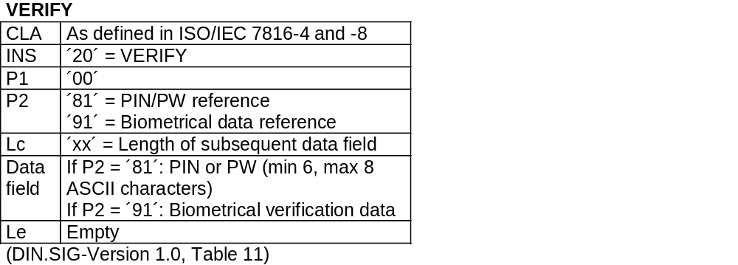
VERIFY Command
- If a digital signature is made on a private PC,
then the PIN is presented as plain value
- If a digital signature is made on a public customer service terminal,
then the PIN shall be presented as cryptogram
followed by a cryptographic checksum

Slide 12
Proposal for integration of bio objects (1)
PKCS15Authentication ::= CHOICE {
pin PKCS15AuthenticationObject { PKCSPinAttributes },
bio PKCS15AuthenticationObject { PKCSBioAttributes },
}
PKCS15BioAttributes ::= SEQUENCE {
bioFlags PKCS15BioFlags,
bioSubject PKCS15BioSubject,
bioType PKCS15BioType,
bioReference [0] PKCSReference DEFAULT 0,
lastBioChange GeneralizedTime OPTIONAL,
path PKCS15Path OPTIONAL,
... -- For future extensions }

Slide 13
Proposal for integration of bio objects (2)
PKCS15BioFlags ::= BIT STRING {
reserved (0),
local (1),
change-disabled (2),
unblock-disabled (3),
initialized (4),
reserved (5),
reserved (6),
reserved (7),
disable-allowed (8),
authentic (9),
enciphered (10),
}

Slide 14
Proposal for integration of bio objects (3)
PKCSBioSubject ::= CHOICE {
fingerPrint [0] FingerPrint,
voicePrint [1] VoicePrint,
irisPrint [2] IrisPrint,
facePrint [3] FacePrint,
retinaPrint [4] RetinaPrint,
handGeometry [5] HandGeometry,
writeDynamics [6] WriteDynamics,
keystrokeDynamics [7] KeystrokeDynamics,
lipDynamics [8] LipDynamics,
... -- For future extensions
}

Slide 15
Proposal for integration of bio objects (4)
FingerPrint ::= SEQUENCE {
handID HandID,
fingerID FingerID
}
HandID ::= ENUMERATED {righthand (0), lefthand (1) }
FingerID ::= ENUMRATED { thumb(0), pointer finger (1),
middle finger (2), ring finger (3), little finger (4) }

Slide 16
Access to objects
Access is free
Public Object
Authentication
Object has to be
presented
(PIN, password,
biometrics)
Private Object
Authentication
procedure
has to be performed
„Entity Object“

Slide 17
Management of Access Rights
Elementary File
Security
Attributes
File
Content
Example:
AM = Read
SC = EXT AUTH (asym) with
CHA = ´x.01´ or ´x.02´ and User AUTH
AM = Update
SC = EXT AUTH (asym) with
CHA = ´x.01´ and SM
X = Prefix denoting the AID or the entity
assigning the role ID
AM = Access Mode
SC = Security Conditions
CHA = Cert. Holder Authorisation
(Prefix, Role ID)
SM = Secure Messaging

Slide 18
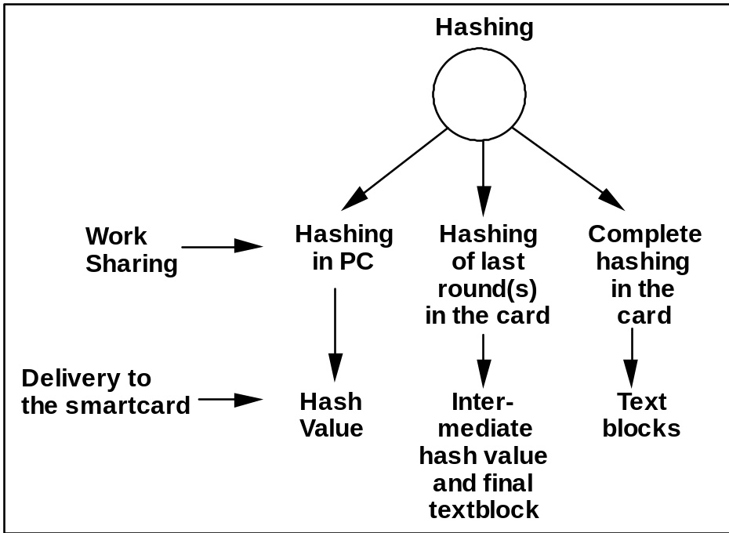
Hashing

Slide 19
Certificates
PKCS15 distinguishes
- x509Certificates
- x509Attribute Certificates
- spkiCertificates
- pgpCertificates
- wtlsCertificates
- x9-68Certificates
but no cvCertificates!!

Slide 20
Card Verifiable Certificates
CPI CAR CHR CHA OID PK SIG.CA
- CPI = Certificate Profile Identifier
- CAR = Certification Authority Reference (Authority Key Identifier)
- CHR = Certificate Holder Reference (Subject Key Identifier)
- CHA = Certificate Holder Authorisation (Authority || Role Identifier)
- OID = Object Identifier of PK Algorithm
- PK = Public Key of Certificate Holder
- SIG.CA = Signature of Certificate Issuing CA

Slide 21
Security Service Descriptor
- Template tags for all security services
(e.g. user authentication service, digital signature service,
entity authentication service, key cipherment service)
- DO Instruction set mapping ISM (regular command)
- DO Command to perform (if command is different form that in ISM)
- DO Object Id of the algorithm
- DO Algorithm reference (as used by the card)
- DO Key reference (as used by the card)
- DO Key file id (some cards select the key file containing the key to be used)
- DO Certificate file id (if present then the file contains the certificate )
- DO Certificate reference (used e.g. if the certificate is not stored in the card)
- DO Certificate qualifier (e.g. X.509 certificate, ICC certificate)
- DO PIN usage policy (present if the security service is PIN protected)

Slide 22
Security Service Descriptors
Indication of supported algorithms, DSI schemas, hash functions
Indication of user authentication method
Indication where to find certificates
Indication of implementation variants
Support of migration

Slide 23
SSD construction (1)
- For each security service provided by the card exists one or more SSD templates
- Inside an SSS template is one DO mandatory: the DO „command to perform“
- Use e.g. for VERIFY:
- command class is present
- PIN reference is present
- PIN length is present possibly with padding
- presentation form is present: plain value or with SM
- Use e.g. for CHANGE RD:
- command class is present
- PIN reference is present
- usage option is present, e.g. old PIN required/not required in the command
- PIN length is present possibly with padding
- presentation form is present: plain value or with SM

Slide 24
SSD construction (2)
- Use e.g. for digital signature function:
- the MANAGE SECURITY ENVIRONMENT
to perform is presented
- the HASH command, if needed, is presented
- The PERFORM SECURITY OPERATION command
is presented for the digital signature compuation
- Different methods for Dig. Sig. Input constructions
can be denoted by the DO OID or the DO AlgID
E.g. PKCS#1 or ISO 9796-2 rnd
- The FIDs of related certificate files are given

Slide 25
Working with PKCS#15 (1)
The usage of PKCS#15 requires
- selection of DF(PKCS15)
- selection of EF(ODF) for getting the pointer information
- reading EF(ODF)
- selection of EF(AODF) for getting the PIN information
- reading EF(AODF)
- selection of EF (PrKDF) for getting the signature key information
- reading EF(PrKDF)
- selection of EF(CDF) for getting the certificate information
- reading EF(CDF)
- selection of EF(PuKDF) for getting the root CA PuK information
- reading EF(PuKDF)

Slide 26
Working with PKCS#15 (2)
To do this all is not very efficient. Therefor:
- Read the information once from the card and
store it under a card reference, e.g. the ICC Serial Number ICCSN
or
- keep the information outside the card and store in the card the
card profile identifier pointing to the outside information
Open problem: there is no indication whether the PKCS15 files are
- reocrd-oriented or
- transparent.

Slide 27
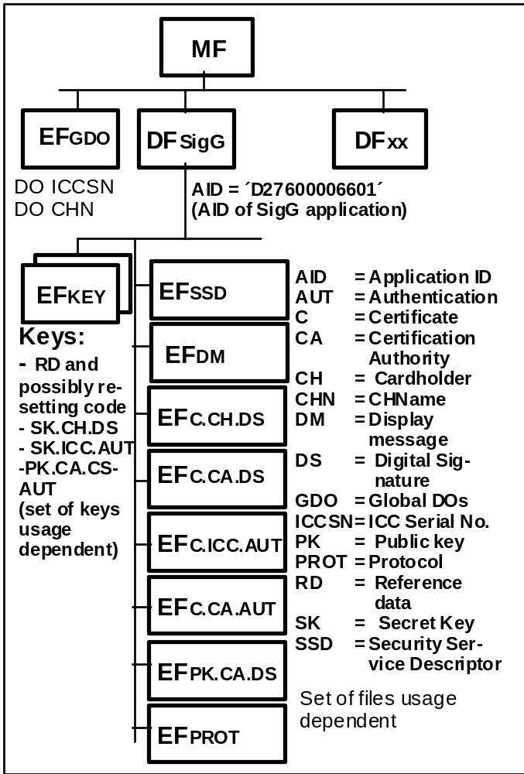
File Structure of DF.SIG

