Slide 1
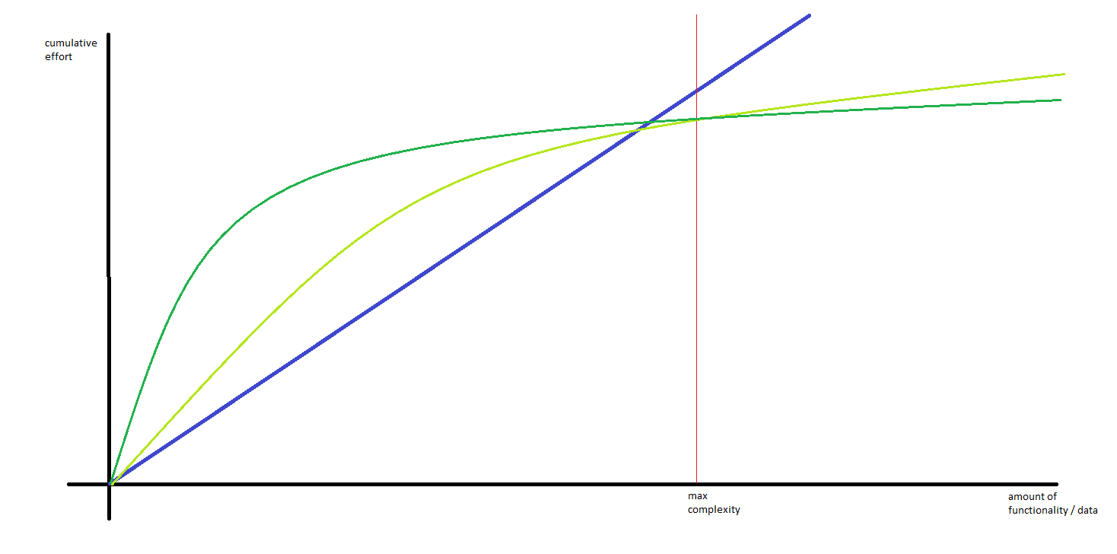
Data warehouse automation Microsoft versus SAS
DWA
Data warehouse architecture
Tooling
Infra as code
Cloud / on premise
- manual
dwa method 1
dwa method 2

Slide 2
Contents
The goal of this presentation:
Learn about DWA using Microsoft Azure *
Learn about DWA using SAS
Learn from differences
Discuss best DWA method tool independently
* For Microsoft we will demonstrate DWA by using an open source framework called betl. (https://github.com/basvdberg/BETL)

Slide 3
Example data warehouse architecture
BI
Analytics / data science
frontend
datamarts
backend
Integrated data warehouse
raw data warehouse
presentation
staging
source
adventureWorks

Slide 4

Steps
Ingest source object tree
Define objects to be transferred
Drop create staging tables
Copy staging object from source to staging
staging

Slide 5
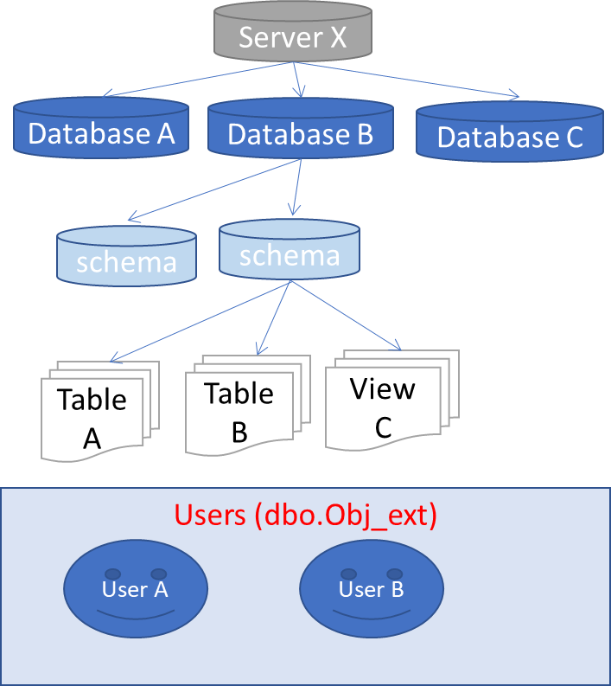
Steps
Ingest source object tree
Define objects to be transferred
Drop create staging tables
Copy staging object from source to staging
Source database
BETL
object tree query
stored procedure ingest object tree
object tree
select
null src_obj_id
, isnull(o.object_id, db.database_id) external_obj_id
, dbo.server_type() server_type
, @@SERVERNAME server_name
, …..
from
sys.databases db
full outer join sys.schemas s on db.database_id = db_id()
left join sys.objects o on o.schema_id = s.schema_id
and o.type in ( 'U','V') -- only tables and views
….

Slide 6
Steps
Ingest source object tree
Define objects to be transferred
Drop create staging tables
Copy staging object from source to staging
-- lets take the entire aw database
exec setp 'include_staging', 1, '[sqldb-aw]’
-- but exclude some tables that we don't need.
exec setp 'include_staging', 0, '[sqldb-aw].[SalesLT].[Address]'
exec setp 'include_staging', 0, '[sqldb-aw].[dbo].[BuildVersion]';

Slide 7
Steps
Ingest source object tree
Define objects to be transferred
Drop create staging tables
Copy staging object from source to staging
@{concat(
'IF EXISTS (SELECT * FROM sys.objects WHERE object_id = OBJECT_ID(N''['
,variables('target_schema_name')
,'].'
, item().target_table_name
, ''') AND type in (N''U'')) DROP TABLE ['
,variables('target_schema_name')
,'].['
, item().target_table_name
, '] select 1 result '
)}

Slide 8
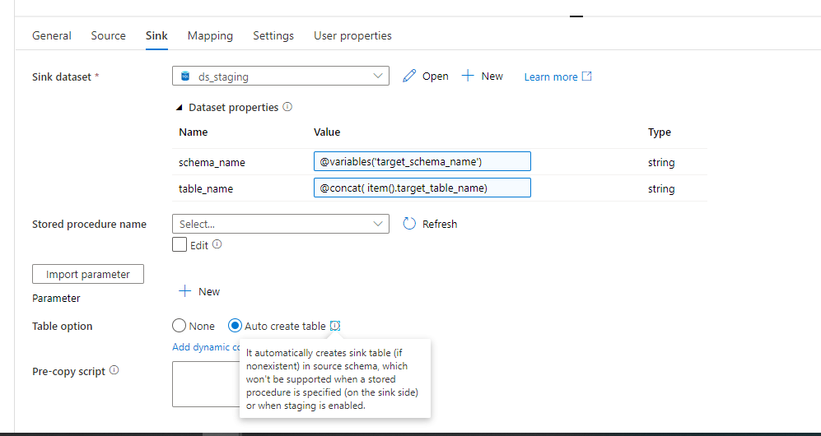
Steps
Ingest source object tree
Define objects to be transferred
Drop create staging tables
Copy staging object from source to staging

Slide 9

Steps
Ingest source object tree
Define objects to be transferred
Drop create staging tables
Copy staging object from source to staging
staging

Slide 10
Steps
Ingest staging object tree
Define rdw object tree
Drop create rdw tables
Insert rdw contents using change data capture
raw data warehouse
staging
adventureWorks

Slide 11
Steps
Ingest staging object tree
Define rdw object tree definition
Drop create rdw tables
Insert rdw contents using change data capture

Slide 12

Wat is Data warehouse automation?
Templates
ETL Tool
Code generator
ETL
DDL
Orchestration
Meta data

Slide 13
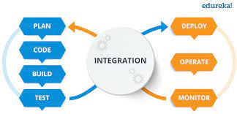
Design time versus runtime DWA
Templates
ETL Tool
Code generator
ETL
DDL
Orchestration
Meta data

Slide 14



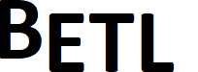
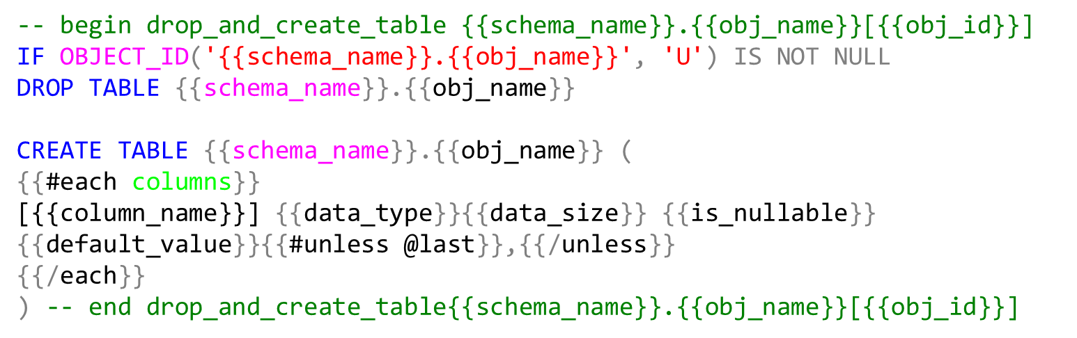
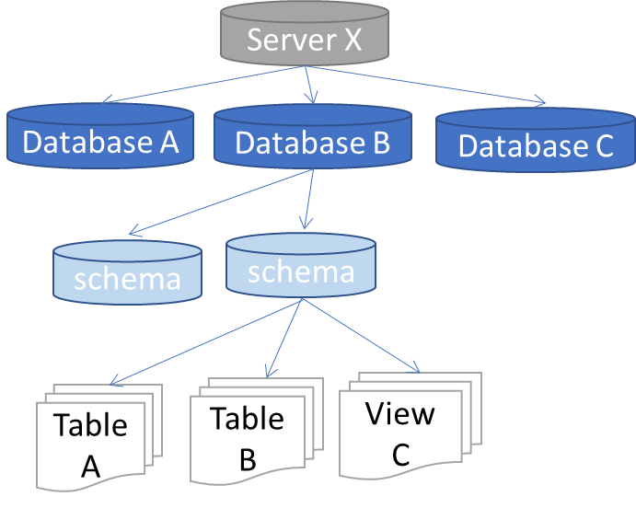
Data warehouse automation
Templates
ETL Tool
Code generator
ETL
DDL
Orchestration
Meta data
Object tree
Mapping
Business rules
Properties

Slide 15
Object tree (dbo.Obj_ext)
Server X
Database A
Database B
Database C
schema
schema
Table A
Table B
View C
Users (dbo.Obj_ext)
User A
User B

Slide 16
Object tree (dbo.Obj_ext)
Properties (static.Property)
Server X
target_schema_id
Database A
Database B
Database C
template_name_create_table
schema
schema
log_level
View C
delete_detection
Table A
Table B
etc…
Users (dbo.Obj_ext)
User A
User B
exec info select * from obj_ext select * from col_ext
exec set_p <property>,<value>,<obj_name>
exec get_p <property>,<value>,<obj_name>
select * from prop_ext

Slide 17
-- begin drop_and_create_table {{schema_name}}.{{obj_name}}[{{obj_id}}]
IF OBJECT_ID('{{schema_name}}.{{obj_name}}', 'U') IS NOT NULL
DROP TABLE {{schema_name}}.{{obj_name}}
CREATE TABLE {{schema_name}}.{{obj_name}} (
{{#each columns}}
[{{column_name}}] {{data_type}}{{data_size}} {{is_nullable}} {{default_value}}{{#unless @last}},{{/unless}}
{{/each}}
) -- end drop_and_create_table{{schema_name}}.{{obj_name}}[{{obj_id}}]

Slide 18
Source database
BETL
object tree query
stored procedure ingest object tree
object tree
select
null src_obj_id
, isnull(o.object_id, db.database_id) external_obj_id
, dbo.server_type() server_type
, @@SERVERNAME server_name
, …..
from
sys.databases db
full outer join sys.schemas s on db.database_id = db_id()
left join sys.objects o on o.schema_id = s.schema_id
and o.type in ( 'U','V') -- only tables and views
….

Slide 19
ETL Tool
1
3
Obj tree source
Obj tree target
Tables
2
Tables
source
target

Slide 20
ETL Tool
1
2
Obj tree source
Obj tree target
Tables
3
Tables
source
target

Slide 21
Meta data
Object tree
Mapping
Business rules
Properties

Slide 22

Data warehouse automation Microsoft versus SAS
Not the car, but the driver

