Slide 1

Data warehouse automation
Notes:
Marcel.
- Introductie Bas

Slide 2
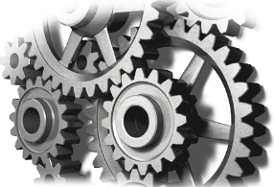
What is Data warehouse automation?
Data warehouse automation (DWA) refers to the process of accelerating and automating the data warehouse development cycles, while assuring quality and consistency.
[source: wikipedia]
Generic DWA model
Templates
ETL Tool
Code generator
ETL
DDL
Orchestration
Meta data
Notes:
Bas.
Wat is DWA. (Veel ervaring bij DWH nieuwbouwprojecten. Met SSIS. Begonnen met veel handmatig bouwen van DWH en steeds meer gaan automatiseren op basis van meta data). Uiteindelijk eigen open source tool gebouwd ter ondersteuning van mijn werkzaamheden., Momenteel veel met Azure bezig.

Slide 3
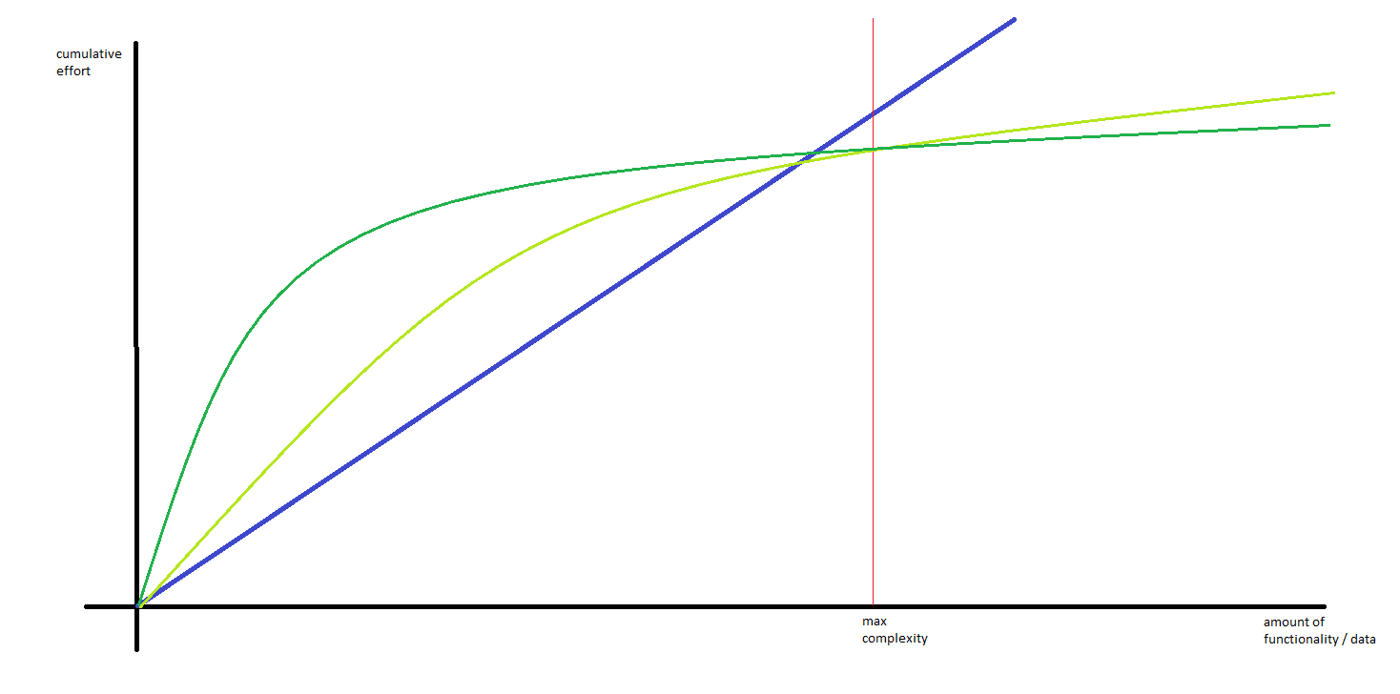
Why data warehouse automation ?
DWA helps to:
improve productivity
improve overall quality
reduce cost
- manual
dwa method 1
dwa method 2
https://www.c2h.nl/
Notes:
Bas. Vroeger was ik blauw. Nu groen.
Handmatig voor kleine dwh projecten. De manier waarop je DWA doet maakt nogal uit. ( slecht voorbeeld met BIML bijv. ).
Anekdote over klant die niet wilde dat ik een betere fabriek ging neerzetten maar waarde voor de business moest opleveren.
Naast efficientie ook:
Uitbreidbaarheid ( zie max complexity verticale as)
Kwaliteit ( minder (menselijke) fouten, generieker en meer modulair werken). Voorbeeld met synoniemen afhandeling. Of performance cdc, of logging.

Slide 4
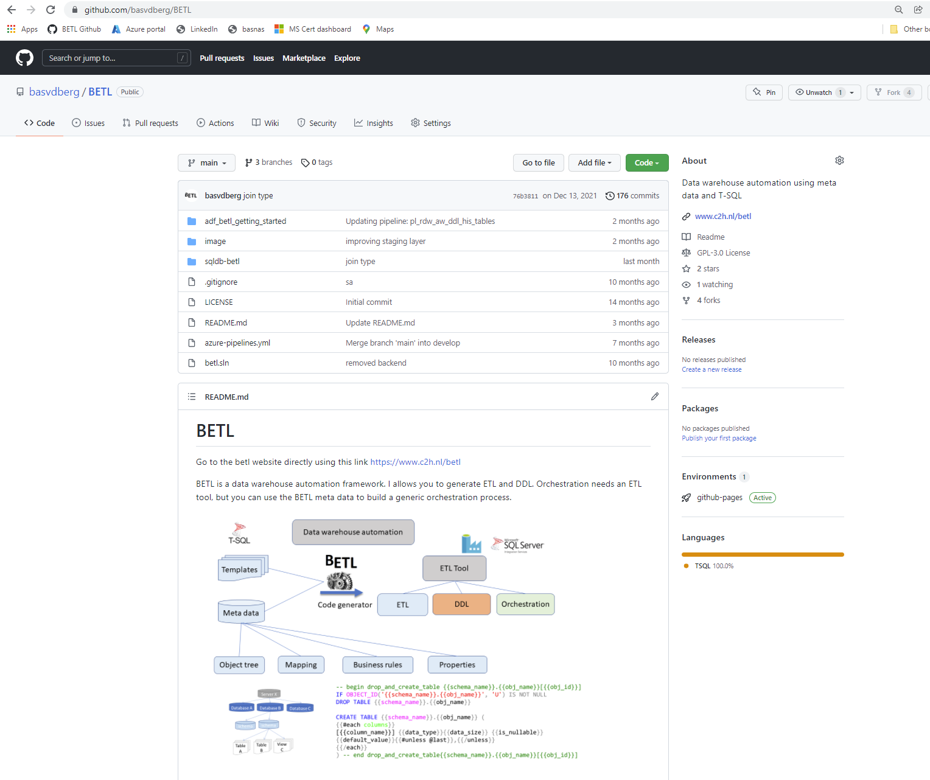
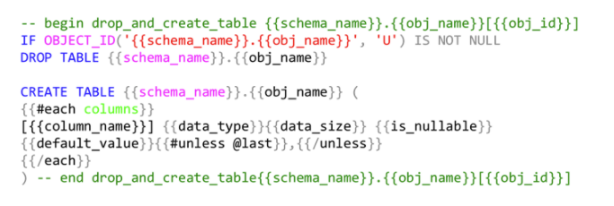
Betl
Open source
- kennisdeling / samenwerken
https://github.com/basvdberg/BETL
100 % T-SQL
- stored procedures, functions
- meta data
Azure of on premise MS SQL
Handle bars template taal:

Slide 5
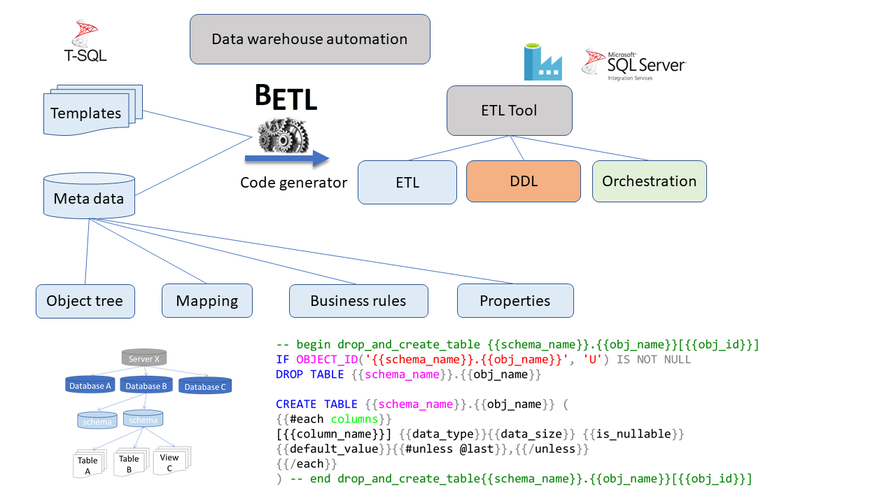
Betl architecture

Slide 6
Getting started with Betl in Azure
Example data warehouse architecture
presentation
Analytics / data science
frontend
datamarts
backend
Integrated data warehouse
raw data warehouse
Scope of getting started
staging
source
adventureWorks

Slide 7


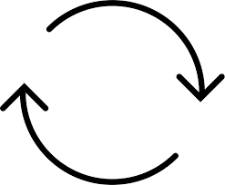
betl
betl
2.define staging
7.define RDW
T-SQL DDL
3.materialize staging
6.observe
T-SQL DDL
8.materialize RDW
1.observe
4.observe
9.observe
Adventure
Works
MyDWH Staging
MyDWH RDW
⊳
5.staging etl
⊳
10.rdw etl

Slide 8
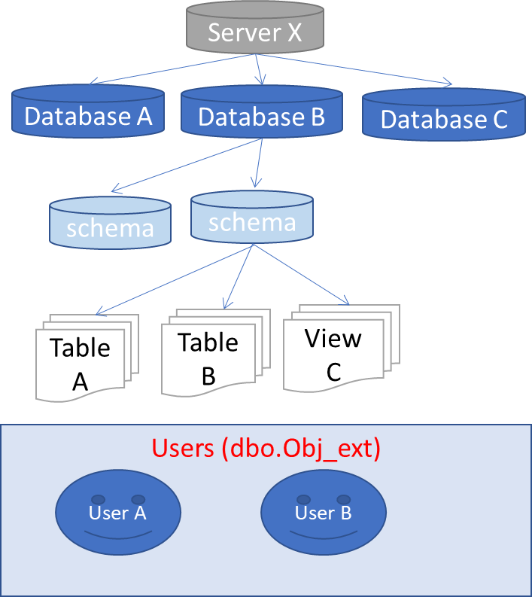
Steps
Ingest source object tree ( import structure of source data)
Define objects to be transferred
Define staging objects
Drop create staging tables
Copy staging object from source to staging
Source database
BETL
object tree query
stored procedure ingest object tree
object tree
select
null src_obj_id
, isnull(o.object_id, db.database_id) external_obj_id
, dbo.server_type() server_type
, @@SERVERNAME server_name
, …..
from
sys.databases db
full outer join sys.schemas s on db.database_id = db_id()
left join sys.objects o on o.schema_id = s.schema_id
and o.type in ( 'U','V') -- only tables and views
….

Slide 9
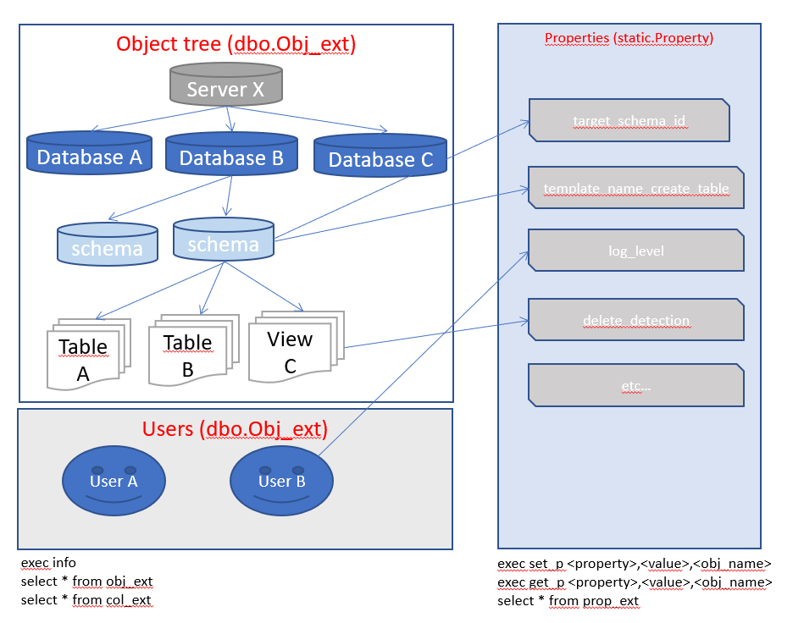
Steps
Ingest source object tree
Define objects to be transferred
Define staging objects
Drop create staging tables
Copy staging object from source to staging
-- lets take the entire aw database
exec setp 'include_staging', 1, '[sqldb-aw]’
-- but exclude some tables that we don't need.
exec setp 'include_staging', 0, '[sqldb-aw].[SalesLT].[Address]'
exec setp 'include_staging', 0, '[sqldb-aw].[dbo].[BuildVersion]';

Slide 10
Steps
Ingest source object tree
Define objects to be transferred
Define staging objects
Drop create staging tables
Copy staging object from source to staging
SELECT
null external_obj_id -- this is an object id outside betl for this object.
, server_type_id
, 'sqls-betl-dev' server_name
, 'sqldb-rdw' db_name
, 'staging_aw' schema_name
, case when schema_name <> 'dbo' then schema_name +'_' else '' end + [obj_name] [obj_name]
,10 [obj_type_id] -- table
,c.ordinal_position -- stays the same
,c.column_name
,c.column_type_id
,c.is_nullable
,c.data_type
,c.max_len
,c.numeric_precision
,c.numeric_scale
,c.primary_key_sorting
,null default_value -- just copy contents. Do not use source system defaults.
,'aw' _source
, o.[obj_id] src_obj_id -- this is the betl internal reference to the main object/table that acted as a source for this object
, null obj_def_id
--select *
from prop_ext pe
inner join dbo.obj_ext o on pe.obj_id = o.obj_id
inner join dbo.col c on c.obj_id= o.obj_id
where property = 'include_staging' and inherited_value = 1
and pe.obj_type = 'table'
and o._source = '@{variables('source')}'

Slide 11
Steps
Ingest source object tree
Define objects to be transferred
Define staging objects
Drop create staging tables
Copy staging object from source to staging
@{concat(
'IF EXISTS (SELECT * FROM sys.objects WHERE object_id = OBJECT_ID(N''['
,variables('target_schema_name')
,'].'
, item().target_table_name
, ''') AND type in (N''U'')) DROP TABLE ['
,variables('target_schema_name')
,'].['
, item().target_table_name
, '] select 1 result '
)}

Slide 12
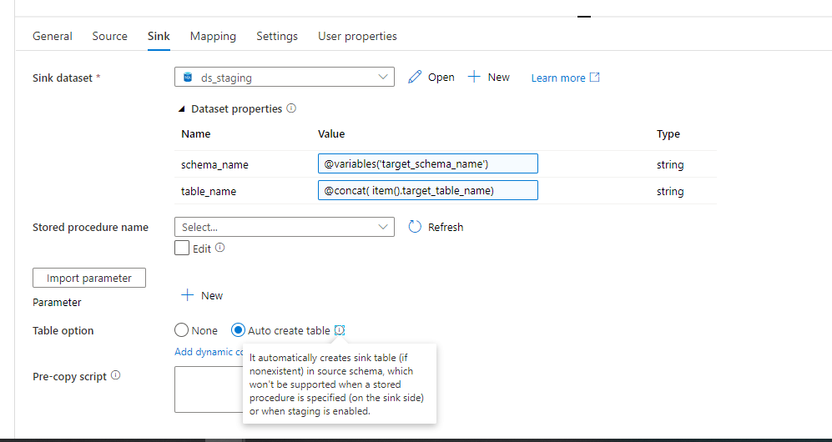
Steps
Ingest source object tree
Define objects to be transferred
Define staging objects
Drop create staging tables
Copy staging objects from source to staging

Slide 13

Steps
Ingest staging object tree
Define rdw object tree
Drop create rdw tables
Insert rdw contents using change data capture
raw data warehouse
staging
adventureWorks

Slide 14
Steps
Ingest staging object tree
Define rdw object tree definition
Drop create rdw tables
Insert rdw contents using change data capture

Slide 15
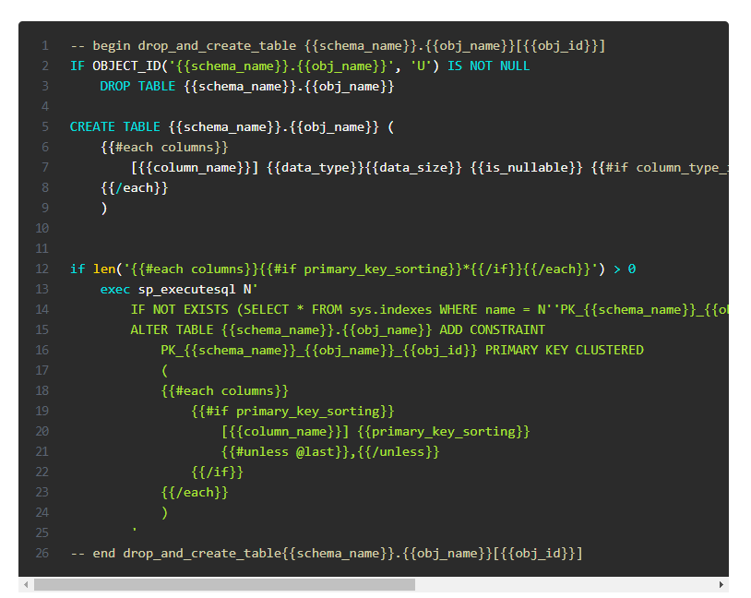

Drop create object tables
SQL Code generation using handlebars templates.
Functionality compares to SAS macro language scripting and parametrization.

Slide 16
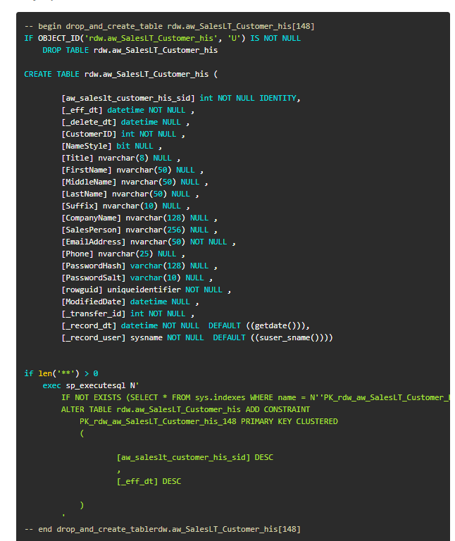
result

Slide 17
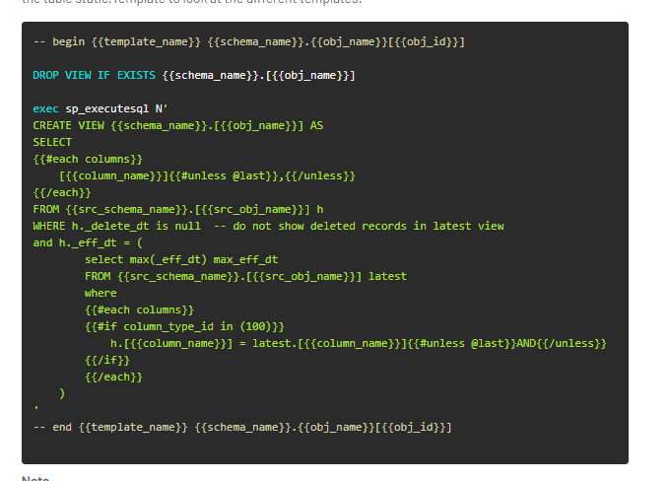
Latest views

Slide 18
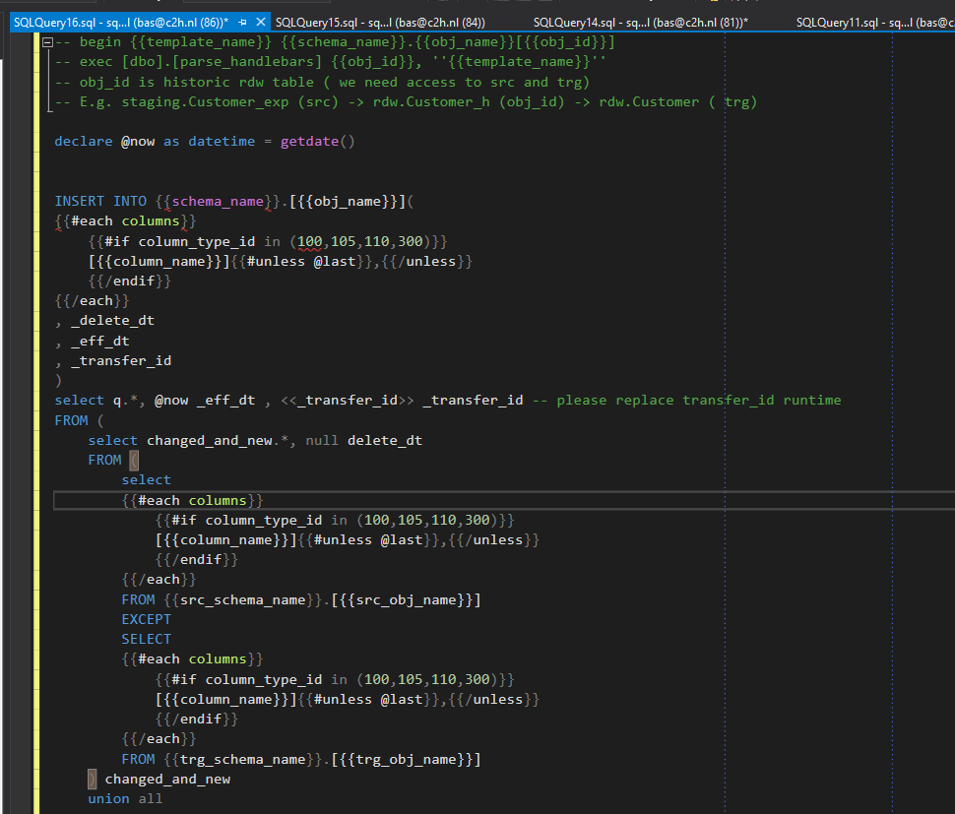
RDW ETL

Slide 19
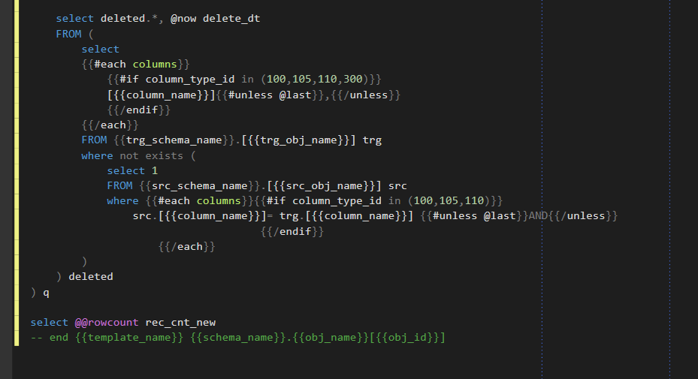

Slide 20
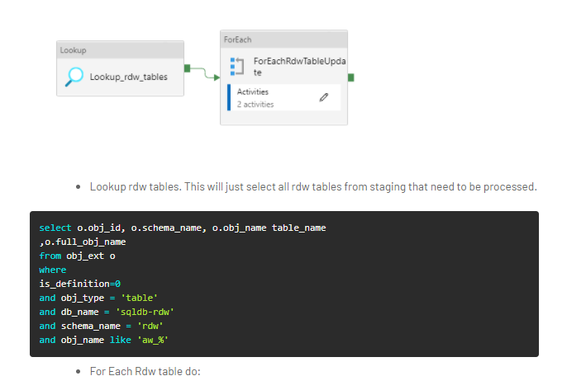
Which rdw tables to load

Slide 21
Assertions
DWA principles are tool independent
DWA methods and best practices are poorly documented
Many developers invent their own DWA implementation
There is little re-use of DWA best practices
There is little re-use of DWA implementations

Slide 22
Questions
What DWA do you use in your current assignments ?
Have you come across other DWA tools ?
TimeXtender
Wherescape
BIML
Quipu
… ?
Do you think it’s likely that you will change you DWA toolset in the coming years ?

Slide 23
One step further
datamarts
Integrated data warehouse
Next time ?
Business rules
Complex transformations
raw data warehouse
This presentation
staging
adventureWorks

Slide 24
Extra sheets

Slide 25
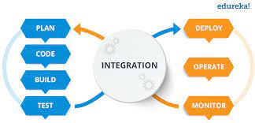
Design time versus runtime DWA
Templates
ETL Tool
Code generator
ETL
DDL
Orchestration
Meta data

