Slide 1





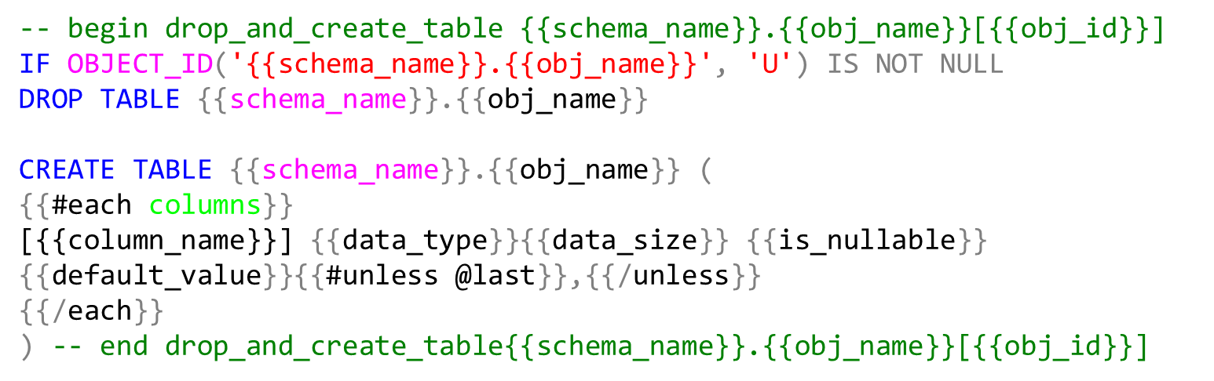
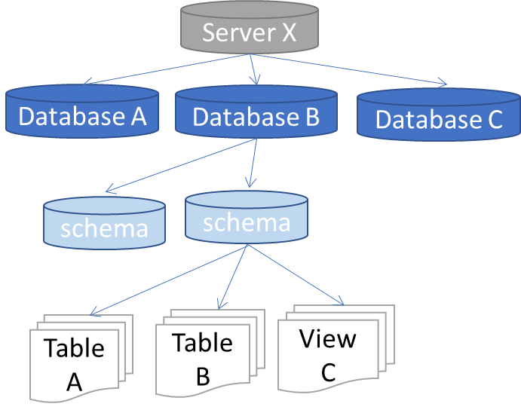
Data warehouse automation
ETL Tool
Meta data
Templates
Code generator
ETL
DDL
Orchestration
Object tree
Mapping
Business rules
Properties

Slide 2
Object tree (dbo.Obj_ext)
Server X
Database A
Database B
Database C
schema
schema
Table A
Table B
View C
Users (dbo.Obj_ext)
User A
User B

Slide 3
Server X
Database A
Database B
Database C
schema
schema
Table A
Table B
View C
Users (dbo.Obj_ext)
User A
User B

Slide 4
-- begin drop_and_create_table {{schema_name}}.{{obj_name}}[{{obj_id}}]
IF OBJECT_ID('{{schema_name}}.{{obj_name}}', 'U') IS NOT NULL
DROP TABLE {{schema_name}}.{{obj_name}}
CREATE TABLE {{schema_name}}.{{obj_name}} (
{{#each columns}}
[{{column_name}}] {{data_type}}{{data_size}} {{is_nullable}} {{default_value}}{{#unless @last}},{{/unless}}
{{/each}}
) -- end drop_and_create_table{{schema_name}}.{{obj_name}}[{{obj_id}}]

