Slide 1

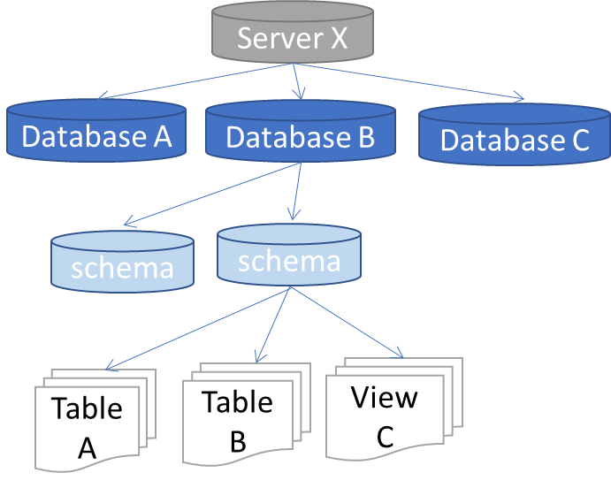
Data warehouse automation
ETL Tool
Meta data
Templates
Code generator
ETL
DDL
Orchestration
Object tree
Mapping
Business rules
Properties

Slide 2
Object tree (dbo.Obj_ext)
Server X
Database A
Database B
Database C
schema
schema
Table A
Table B
View C
Users (dbo.Obj_ext)
User A
User B

Slide 3
Server X
Database A
Database B
Database C
schema
schema
Table A
Table B
View C
Users (dbo.Obj_ext)
User A
User B

