Slide 1

Data warehouse automation Microsoft versus SAS
Notes:
Marcel.
- Introductie Bas

Slide 2
Data warehouse automation Microsoft versus SAS
The goal of this presentation:
Discuss best (tool independent) DWA principles
Learn about DWA using Microsoft Azure (Bas ) *
Learn from comparison. Handlebars to extend your toolset. (Marcel)
* For Microsoft we will demonstrate DWA by using an open source framework called betl. (https://github.com/basvdberg/BETL)
Notes:
Marcel
Waarom is versus doorgestreept-> gaat niet om toolvergelijking, maar om overstijgende DWA principes

Slide 3
Out of scope related subjects
Data warehouse architecture
Tooling
Infra as code
Cloud / on premise
Notes:
Marcel

Slide 4
Contents
What is DWA ?
Why DWA ?
Learn about DWA using Microsoft Azure
Conclusion
Discussion
Notes:
Marcel

Slide 5

What is Data warehouse automation?
Data warehouse automation (DWA) refers to the process of accelerating and automating the data warehouse development cycles, while assuring quality and consistency.
[source: wikipedia]
Generic DWA model
Templates
ETL Tool
Code generator
ETL
DDL
Orchestration
Meta data
Notes:
Bas.
Wat is DWA. (Veel ervaring bij DWH nieuwbouwprojecten. Met SSIS. Begonnen met veel handmatig bouwen van DWH en steeds meer gaan automatiseren op basis van meta data). Uiteindelijk eigen open source tool gebouwd ter ondersteuning van mijn werkzaamheden., Momenteel veel met Azure bezig.

Slide 6
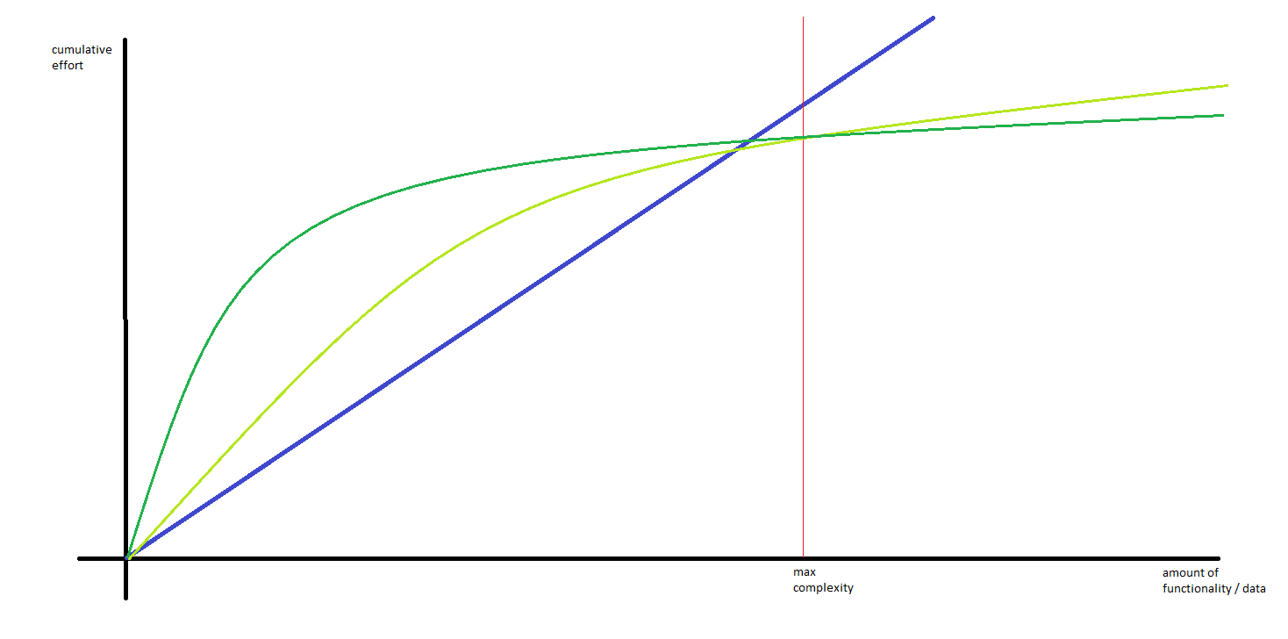
Why data warehouse automation ?
DWA helps to:
improve productivity
reduce cost
improve overall quality
- manual
dwa method 1
dwa method 2
https://www.c2h.nl/
Notes:
Bas. Vroeger was ik blauw. Nu groen.
Handmatig voor kleine dwh projecten. De manier waarop je DWA doet maakt nogal uit. ( slecht voorbeeld met BIML bijv. ).
Anekdote over klant die niet wilde dat ik een betere fabriek ging neerzetten maar waarde voor de business moest opleveren.
Naast efficientie ook:
Uitbreidbaarheid ( zie max complexity verticale as)
Kwaliteit ( minder (menselijke) fouten, generieker en meer modulair werken). Voorbeeld met synoniemen afhandeling. Of performance cdc, of logging.

Slide 7

Data warehouse automation Microsoft versus SAS
Not the car, but the driver
DWA can be implemented in different ways using different tools. The efficiency of your DWA is mainly dependable on the DWA principles that you follow (the driver) and not the tool (the car).

Slide 8
Learn about DWA using Microsoft Azure
Example data warehouse architecture
BI
Analytics / data science
frontend
datamarts
backend
Integrated data warehouse
raw data warehouse
presentation
staging
source
adventureWorks

Slide 9



DWA process
for each
for every layer
perform the following steps
datamarts
observe
Integrated data warehouse
dataset
observe source dataset structure
raw data warehouse
describe
staging
describe what needs to be done
structure change (ddl)
data loading and transforming (etl)
orchestration
execute
for each
generate code
ddl
etl
orchestration
execute code
dataset object

Slide 10

Steps
Ingest source object tree ( meta data)
Define objects to be transferred (selection)
Drop and create staging tables (ddl)
Copy staging object from source to staging (etl)
https://adf.azure.com/en-us/
staging
Notes:
- Start Staging pipeline ( ADF)

Slide 11
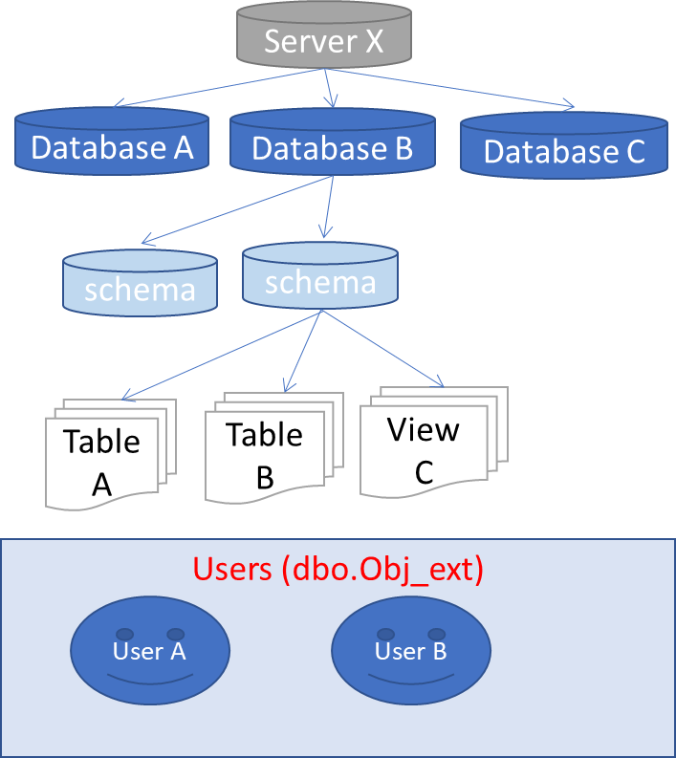
Steps
Ingest source object tree ( import structure of source data)
Define objects to be transferred
Drop create staging tables
Copy staging object from source to staging
Source database
BETL
object tree query
stored procedure ingest object tree
object tree
select
null src_obj_id
, isnull(o.object_id, db.database_id) external_obj_id
, dbo.server_type() server_type
, @@SERVERNAME server_name
, …..
from
sys.databases db
full outer join sys.schemas s on db.database_id = db_id()
left join sys.objects o on o.schema_id = s.schema_id
and o.type in ( 'U','V') -- only tables and views
….
Sidestep:
- Resembles SAS engine connection to source system. Relatively simple operation.

Slide 12
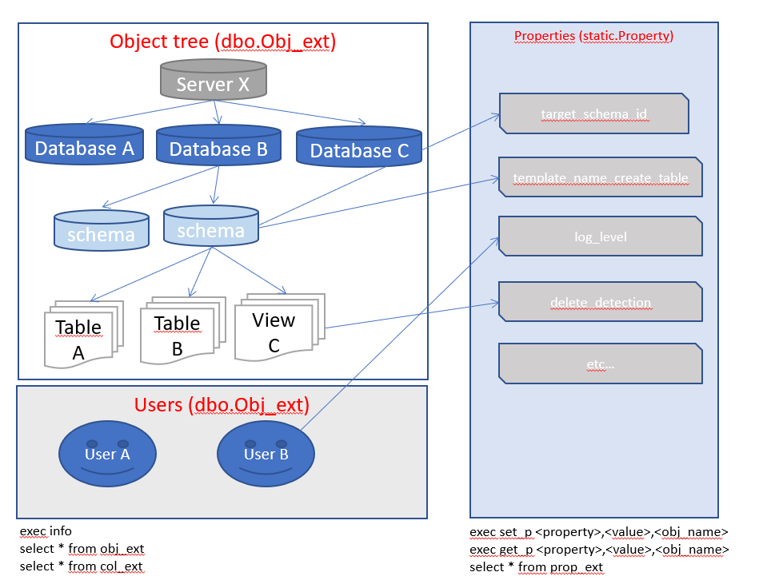
Steps
Ingest source object tree
Define objects to be transferred
Drop create staging tables
Copy staging object from source to staging
-- lets take the entire aw database
exec setp 'include_staging', 1, '[sqldb-aw]’
-- but exclude some tables that we don't need.
exec setp 'include_staging', 0, '[sqldb-aw].[SalesLT].[Address]'
exec setp 'include_staging', 0, '[sqldb-aw].[dbo].[BuildVersion]';

Slide 13
Steps
Ingest source object tree
Define objects to be transferred
Drop create staging tables
Copy staging object from source to staging
@{concat(
'IF EXISTS (SELECT * FROM sys.objects WHERE object_id = OBJECT_ID(N''['
,variables('target_schema_name')
,'].'
, item().target_table_name
, ''') AND type in (N''U'')) DROP TABLE ['
,variables('target_schema_name')
,'].['
, item().target_table_name
, '] select 1 result '
)}

Slide 14
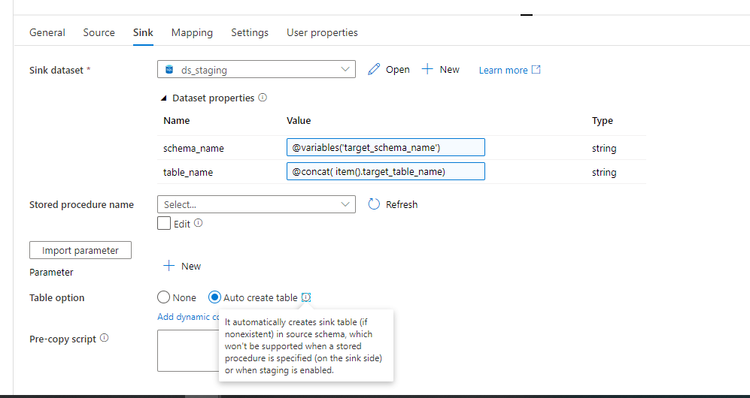
Steps
Ingest source object tree
Define objects to be transferred
Drop create staging tables
Copy staging object from source to staging

Slide 15
Steps
Ingest staging object tree
Define rdw object tree
Drop create rdw tables
Insert rdw contents using change data capture
raw data warehouse
staging
adventureWorks

Slide 16
Steps
Ingest staging object tree
Define rdw object tree definition
Drop create rdw tables
Insert rdw contents using change data capture

Slide 17
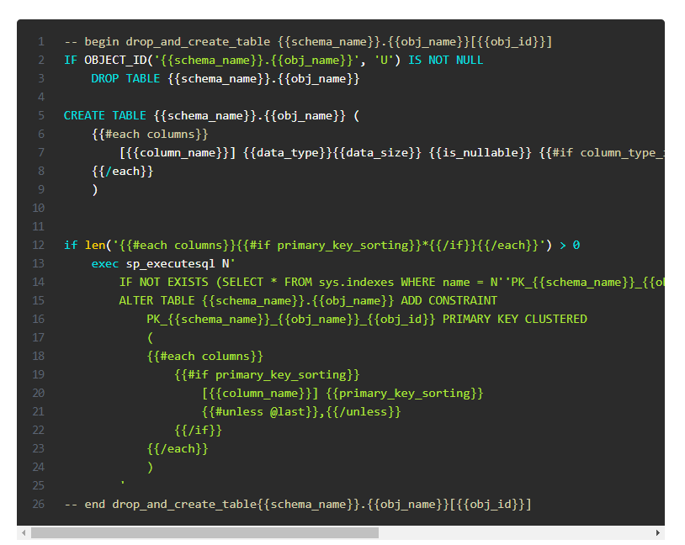

Drop create object tables
SQL Code generation using handlebars templates.
Functionality compares to SAS macro language scripting and parametrization.

Slide 18
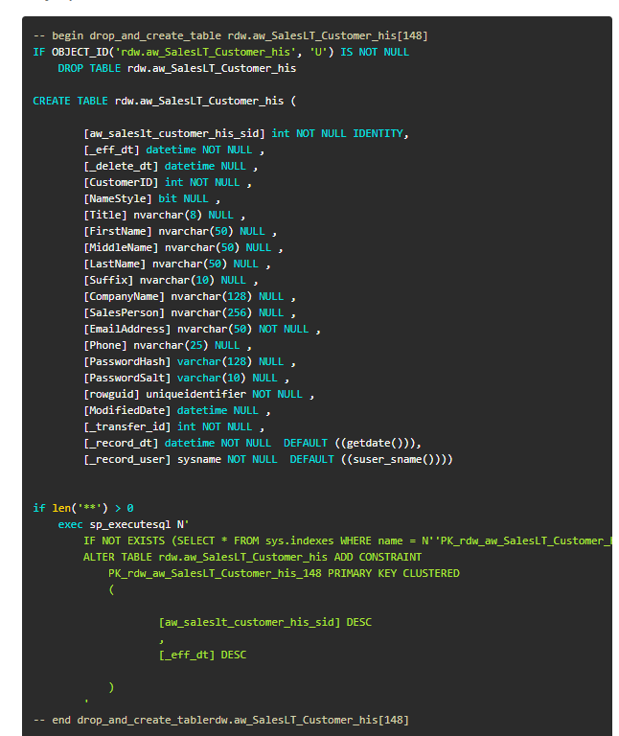
result

Slide 19
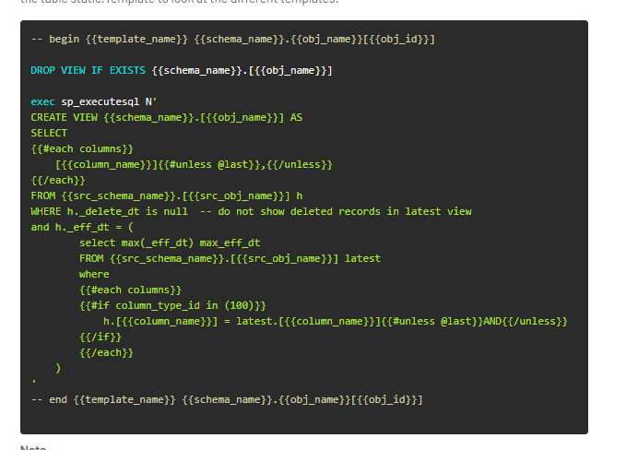
Latest views

Slide 20
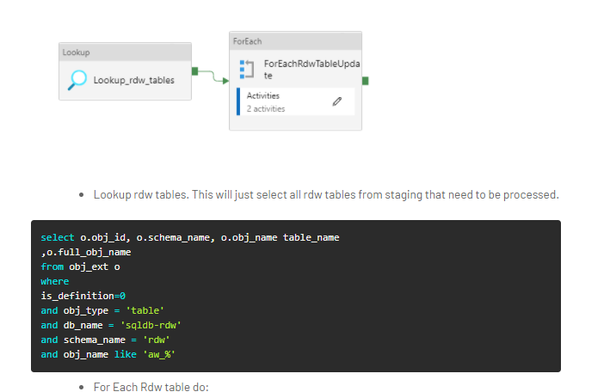
Which rdw tables to load

Slide 21
Conclusion
We have shown you
What and why of DWA
How to use DWA in Azure using an open source framework
Comparisons DWA Microsoft ADF vs SAS
Learn from comparison. Handlebars to extend your toolset.
Next: discussion

Slide 22
Assertions
DWA principles are tool independent
DWA methods and best practices are poorly documented
Many developers invent their own DWA implementation
There is little re-use of DWA best practices
There is little re-use of DWA implementations

Slide 23
Questions
Can all of the functionality as shown in the Azure demo with the open source BETL framework also be implemented using SAS ?
How can we combine the best of SAS and Microsoft (Azure) ?
What DWA do you use in your current assignments ?
Have you come across other DWA tools ?
Do you think it’s likely that you will change you DWA toolset in the coming years ?

Slide 24
One step further
datamarts
Integrated data warehouse
Next time ?
Business rules
Complex transformations
raw data warehouse
This presentation
staging
adventureWorks

