Slide 1
Discord Demo DWA 9 juli 2021
Wie ben ik
Wat is DWA
Design time versus runtime DWA
BETL demo
Discussie

Slide 2

Wat is Data warehouse automation?
Templates
ETL Tool
Code generator
ETL
DDL
Orchestration
Meta data

Slide 3
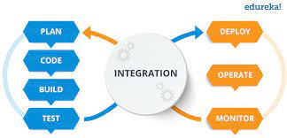
Design time versus runtime DWA
Templates
ETL Tool
Code generator
ETL
DDL
Orchestration
Meta data

Slide 4




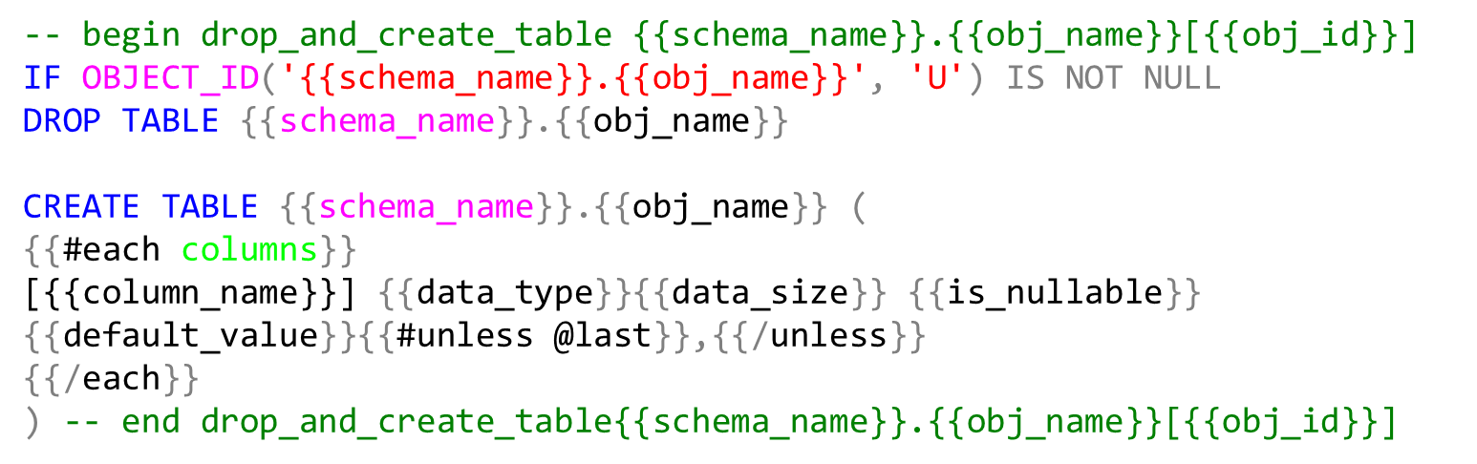
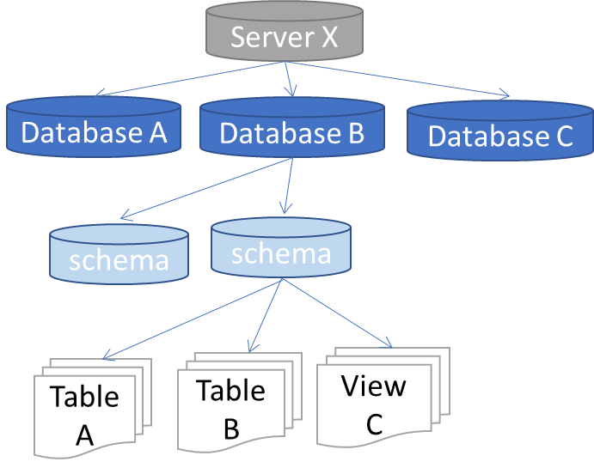
Data warehouse automation
Templates
ETL Tool
Code generator
ETL
DDL
Orchestration
Meta data
Object tree
Mapping
Business rules
Properties

Slide 5
Object tree (dbo.Obj_ext)
Server X
Database A
Database B
Database C
schema
schema
Table A
Table B
View C
Users (dbo.Obj_ext)
User A
User B

Slide 6
Object tree (dbo.Obj_ext)
Properties (static.Property)
Server X
target_schema_id
Database A
Database B
Database C
template_name_create_table
schema
schema
log_level
View C
delete_detection
Table A
Table B
etc…
Users (dbo.Obj_ext)
User A
User B
exec info select * from obj_ext select * from col_ext
exec set_p <property>,<value>,<obj_name>
exec get_p <property>,<value>,<obj_name>
select * from prop_ext

Slide 7
-- begin drop_and_create_table {{schema_name}}.{{obj_name}}[{{obj_id}}]
IF OBJECT_ID('{{schema_name}}.{{obj_name}}', 'U') IS NOT NULL
DROP TABLE {{schema_name}}.{{obj_name}}
CREATE TABLE {{schema_name}}.{{obj_name}} (
{{#each columns}}
[{{column_name}}] {{data_type}}{{data_size}} {{is_nullable}} {{default_value}}{{#unless @last}},{{/unless}}
{{/each}}
) -- end drop_and_create_table{{schema_name}}.{{obj_name}}[{{obj_id}}]

Slide 8
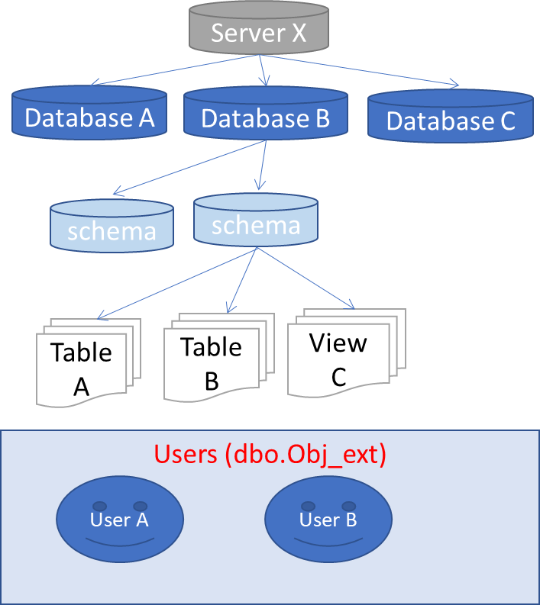
Source database
BETL
object tree query
stored procedure ingest object tree
object tree
select
null src_obj_id
, isnull(o.object_id, db.database_id) external_obj_id
, dbo.server_type() server_type
, @@SERVERNAME server_name
, …..
from
sys.databases db
full outer join sys.schemas s on db.database_id = db_id()
left join sys.objects o on o.schema_id = s.schema_id
and o.type in ( 'U','V') -- only tables and views
….

Slide 9
ETL Tool
1
3
Obj tree source
Obj tree target
Tables
2
Tables
source
target

Slide 10
ETL Tool
1
2
Obj tree source
Obj tree target
Tables
3
Tables
source
target

Slide 11
datamarts
Integrated data warehouse
raw data warehouse
staging

Slide 12
Meta data
Object tree
Mapping
Business rules
Properties

